Slide 1


Educational Web-app
Edu-Mantra
Team Persevarance / Hack-36
Theme: Education
Team Members-
-Anurag Gupta
-Prakhar Jain

Slide 2


PROBLEM STATEMENT
:
Edu Manta is an online tutoring webapp aimed at providing a platform to hone your learning experience
In the hard times of pandemic, E-education is the need of the hour. This webapp provides a User Friendly and interactive platform for budding learners to come together and learn in an effective way..
Features:
Precise Content over a vast number of topics
Test yourself with our quizzes and asssessments
Have a doubt? Clarify with a mentor or just chat right away!

Slide 3

Edu-Mantra
Landing Page of our website

Slide 4
Implementation
The whole website is made using Django Framework and some other Python Libraries namely :
Django-crispy-forms: For creating better looking forms
Channels: To implement Asynchronous Web socket for live chatting
Frontend is made using Bootstrap4 and some stock images are used for better UI of website.

Slide 5
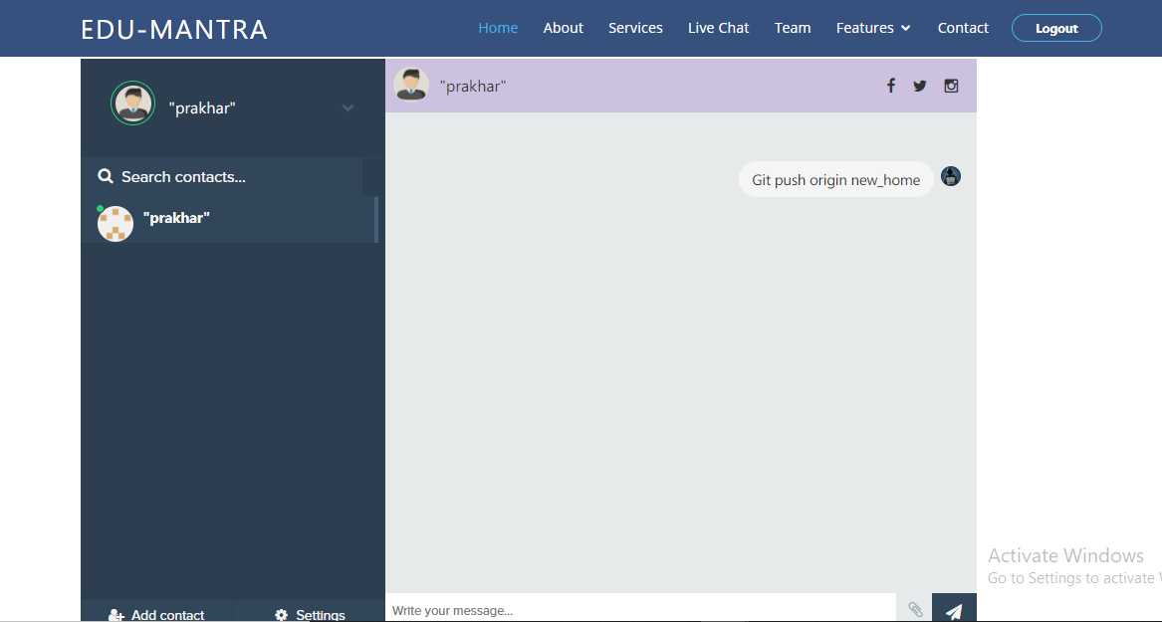
FUNCTIONALITIES
Website contains Live Chatting feature that uses Web Sockets and Asynchronous Request to send messages between students and teachers

Slide 6
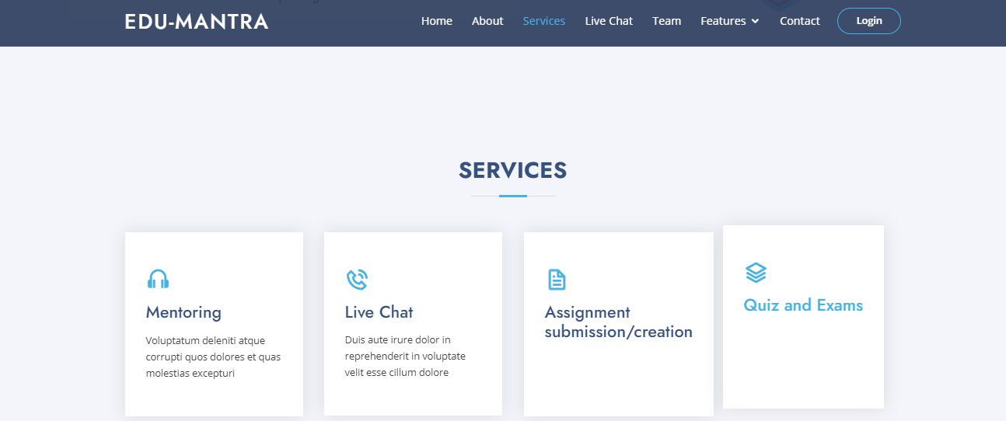
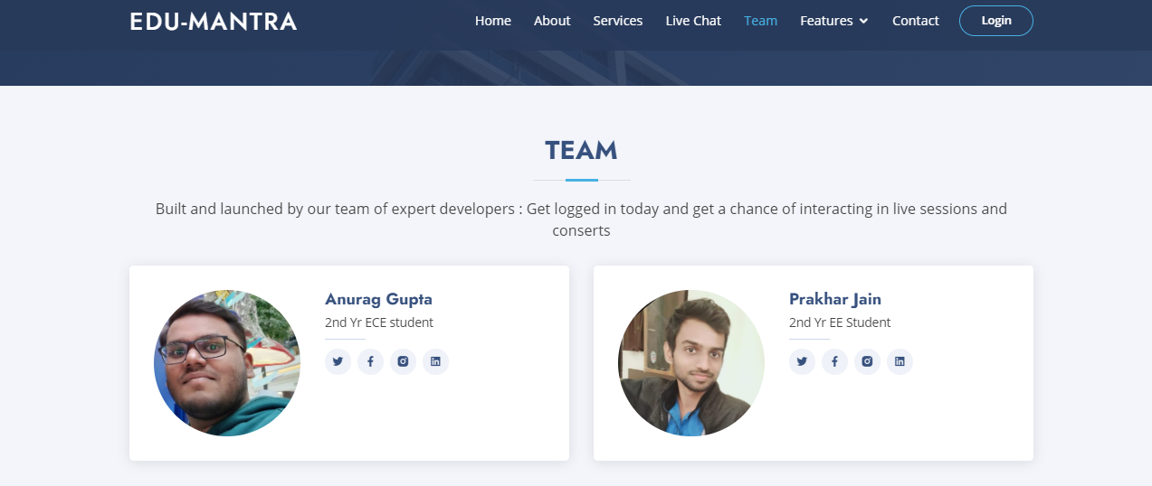
More to it!

Slide 7
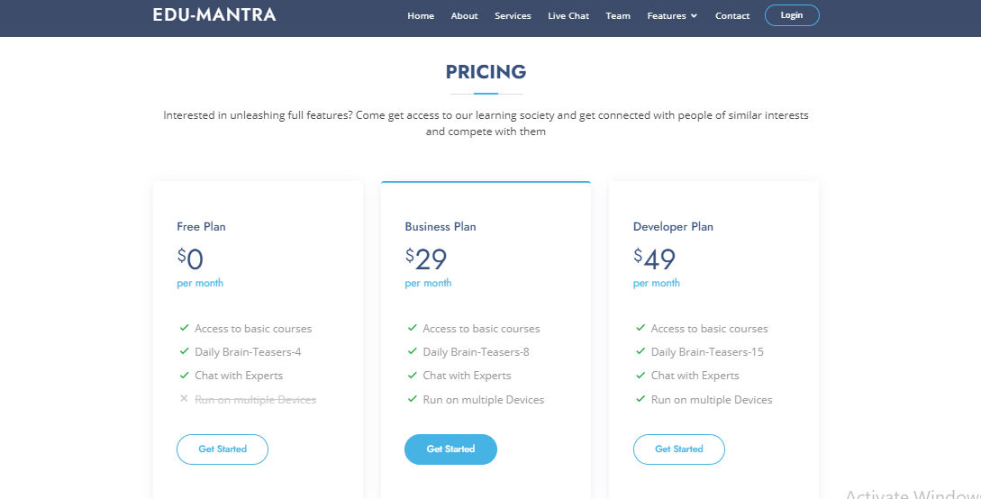
FUTURE Scope

Slide 8

That’s it !

