Slide 1
Cloud Intro / AWS Overview
Franky Romero and Mark Zhao

Slide 2
announcements
- Sign up on Google Form for paper presentations
- Need group for next Monday
- OH for paper projects (by appt?)

Slide 3
Review: What is the cloud?
“On-demand delivery of [IT resources] … via the internet with pay-as-you-go pricing.”
On-demand
Stop guessing capacity, right-size for demand
Agility to adopt new resources/advancements
Via the internet
Avoid direct datacenter costs
Global deployment
Pay-as-you-go pricing
Fixed expense -> variable expense
Economies of scale

Slide 4
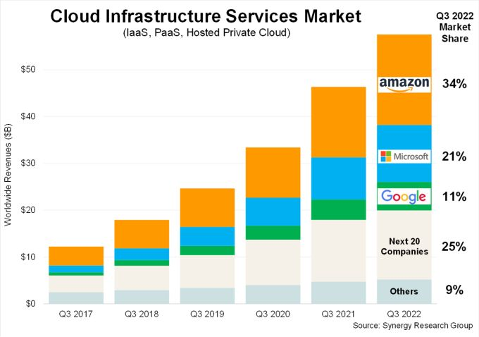
Cloud Service Providers
Who’s used a cloud service before? What are some similarities and differences across providers?

Slide 5
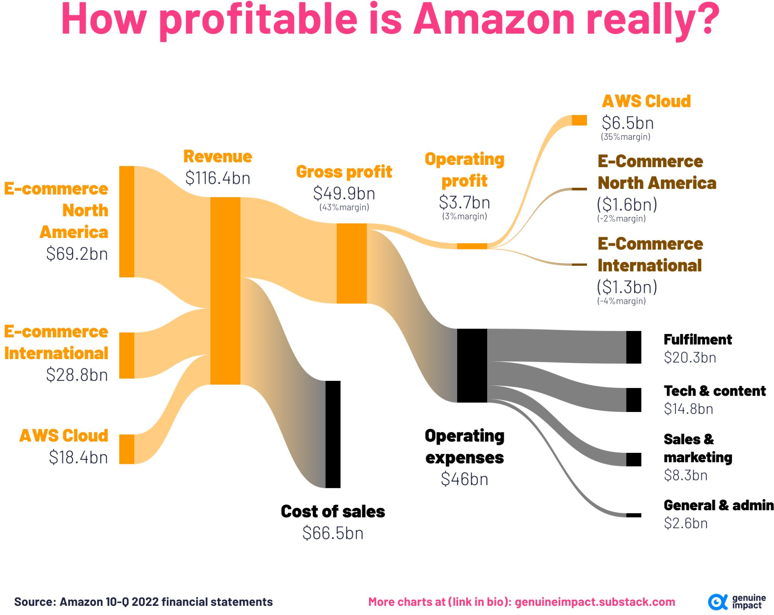
What is AWS?
- Provides suite of cloud services (200+)
Question: What is a service?

Slide 6
Review: Cloud Service Types
Cloud computing models: IaaS, PaaS, SaaS
Infrastructure as a Service
Basic infrastructure building blocks (VMs, networking, storage)
AWS Example: EC2
Platform as a Service
Automatically manages underlying infrastructure (capacity, load balancing, auto-scaling)
AWS Example: Elastic Beanstalk
Software as a Service
Complete product managed by the service provider
AWS Example: Rekognition
Question: What does Serverless fall under?

Slide 7
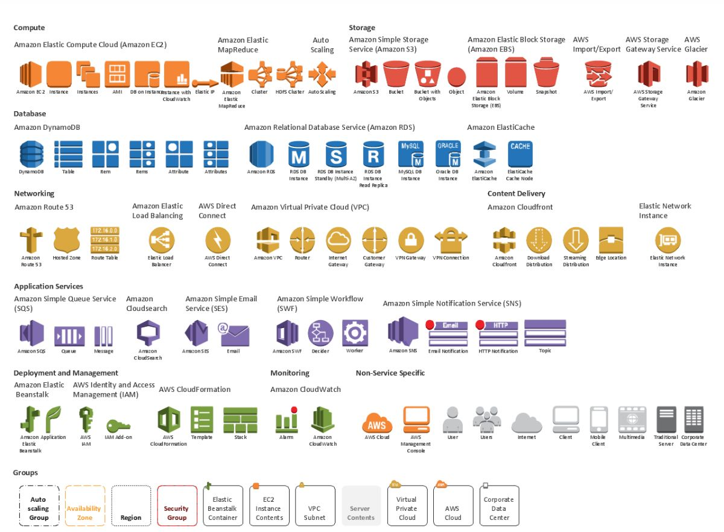
AWS Services
Question: What do you think the most important AWS services are?

Slide 8
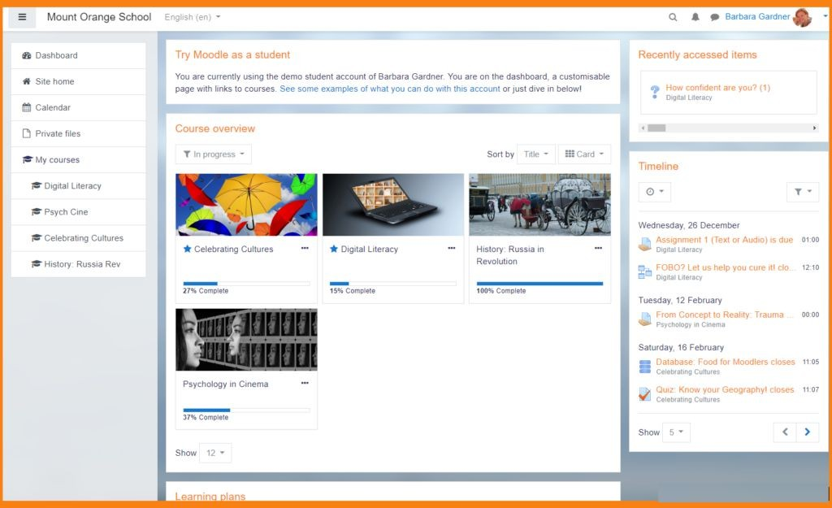
Let’s build Moodle

Slide 9
Let’s build Moodle with AWS
User types “myschool.edu/myclass” and logs into course page to watch latest lecture
DNS resolution: Amazon Route 53
Load balancer: Amazon Application Load Balancer
Secure communication (SSL): AWS Certificate Manager
Web Server: Amazon EC2
Content Distribution Network: Amazon CloudFront
User uploads a discussion post
Storage system: Amazon EFS or S3
Session/application cache: Amazon ElastiCache
Database: Amazon Aurora or DynamoDB
Developer updates website
CodeCommit->CodeBuild->CodeDeploy->CodePipeline

Slide 10
https://aws.amazon.com/architecture/reference-architecture-diagrams

Slide 11
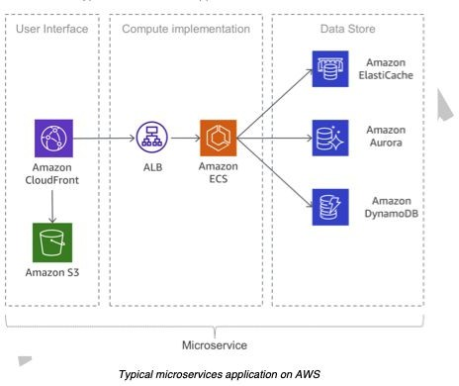
Microservices Architecture
- What is a monolithic vs microservice architecture?
- Microservice: Application composed of small, independently-scalable services that communicate over well-defined APIs
Question: What are the benefits of microservice architectures?

Slide 12
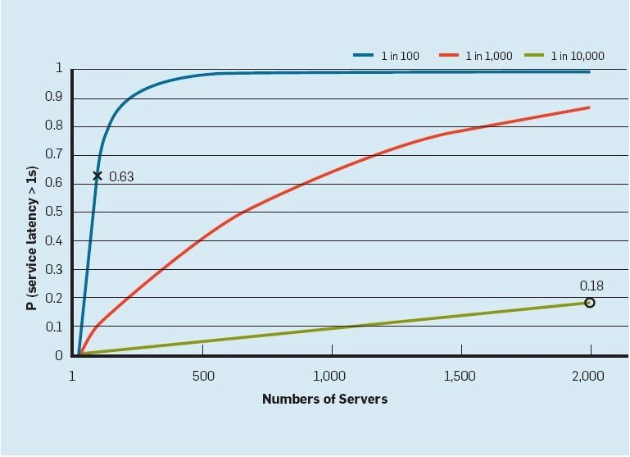
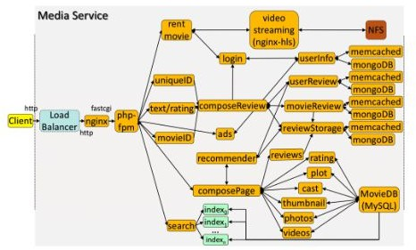
Quality-of-service in microservice architectures
What are some drawbacks?
Each service has multiple dependencies (high fan-out)
Why do we care about tail latency?

Slide 13
Quality of Service Metrics
How do we measure the “success” of a service?
SLOs:
Latency
Uptime (9s)
Recovery point/recovery time
- …
- …

Slide 14
How do we build a “Well-Architected” system on AWS?
Centered around six pillars
Operational excellence
Security
Reliability
Performance efficiency
Cost optimization
Sustainability

Slide 15
Operational Excellence
Perform operations as code
commit/review config files
Make frequent, small, reversible changes
small, reviewable commits
Refine operations procedures frequently
Anticipate failure
“storms” or “game days”, pre-mortems
Learn from all operational failures
post-mortems - any interesting ones?

Slide 16
Security
Implement a strong identity foundation
principle of least privilege
Enable traceability
monitor/alerting
Apply security at all layers
Automate security best practices
Protect data in transit and at rest
Keep people away from data
Prepare for security events

Slide 17
Reliability
Automatically recover from failure
Test recovery procedures
Scale horizontality to increase aggregate workload availability
Stop guessing capacity
Manage change in automation
Questions:
What are some other design patterns to help with service reliability?

Slide 18
Performance Efficiency
Democratize advanced technologies
Go global in minutes
Why do we need to distribute workloads across global regions?
Use serverless architectures
Q: When is serverless *not* more efficient/performant?
Experiment more often
Consider mechanical sympathy

Slide 19
Cost Optimization
Implement cloud financial management
Adopt a consumption model
Measure overall efficiency
Stop spending money on undifferentiated heavy lifting
Analyze and attribute expenditure

Slide 20
Sustainability
Understand your impact
Establish sustainability goals
Maximize utilization
Anticipate and adopt new, more efficient hardware and software offerings
Use managed services
Reduce the downstream impact of your cloud workloads
- Energy-proportionality?
- Embodied vs Operational carbon footprint?
- Benefits of PUE?
What are some other methods to improve sustainability of cloud workloads?

Slide 21
Discussion Questions
What are some surprising services offered by AWS? Were there any that you think should/shouldn’t be offered?
What are some pros/cons of building systems on top of IaaS vs PaaS vs SaaS solutions?
e.g., deploying an ML app on top of SageMaker vs EC2 vs Lamba?
How does cost factor into this?
What are some of the pros/cons of using all of a provider’s services versus building some of it yourself? How do you decide this?
From the well-architected documentation, we see that logging and monitoring are important across all facets of one’s system. What sorts of logging should we be doing, and what are the challenges with providing infrastructure for this?

