Slide 1
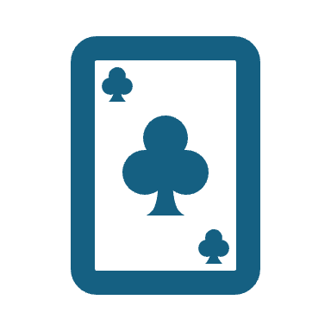
Deal Steelers
Simplify Gift Card

Slide 2
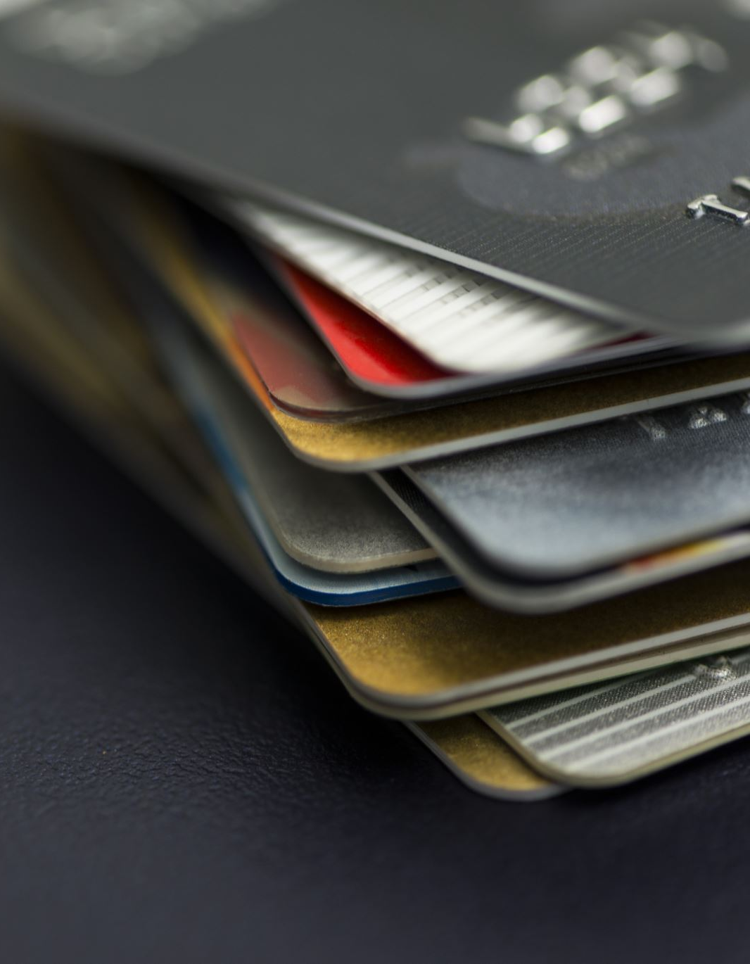
Introduction
Gift cards often go unused due to forgetfulness.
Our project aims to solve this problem by serving as a reminder to users when they're near a store within a certain radius.
This feature ensures that users never miss out on using their gift cards

Slide 3
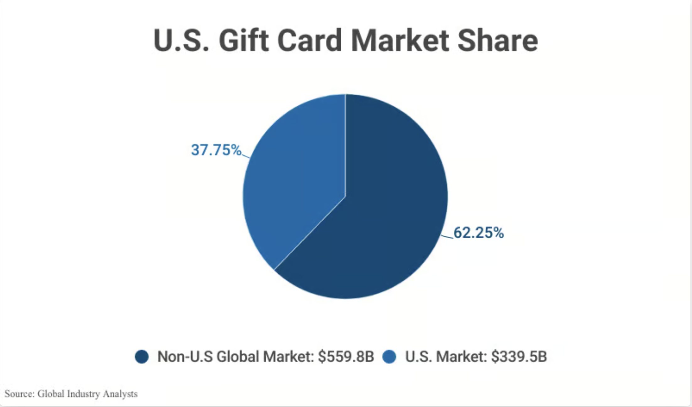
Gift Card Statistics
The global gift card market is valued at $899.3 billion and is expected to reach $2.3 trillion by 2030.
47% of American adults have unused gift cards, and the total value of these unspent funds in the U.S. is around $23 billion.

Slide 4
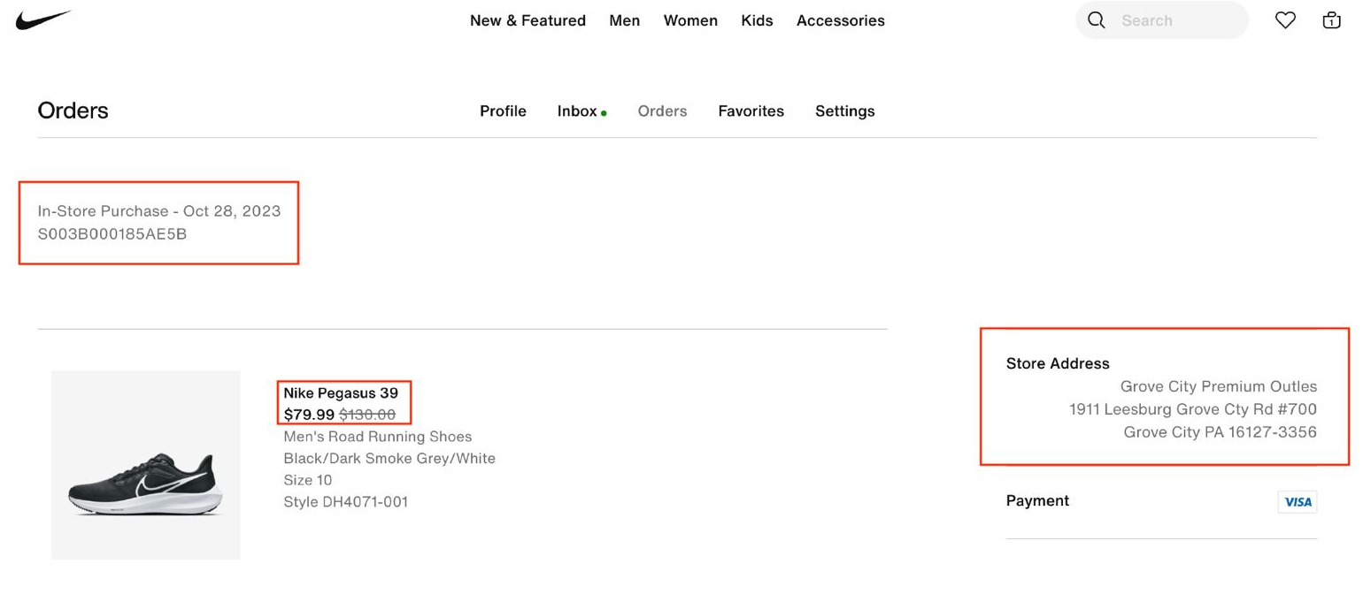
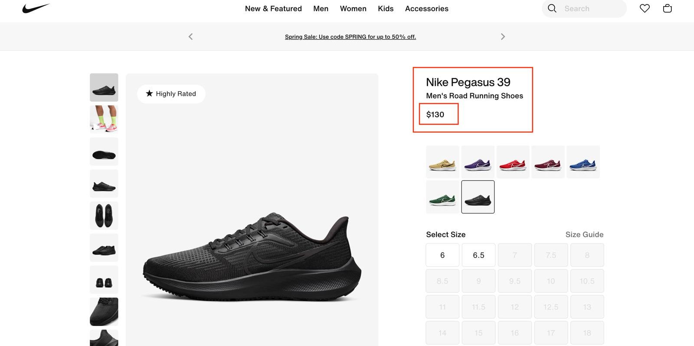
Price Difference (In-Store Vs Online Store)

Slide 5

Solution: Enabling User to Remember Gift Cards
Gift Card Organization
Keep track of all your gift cards in one convenient application .
Easily categorize and sort cards for quick access.
A Seamless Solution for Utilizing and Managing Gift Cards

Slide 6
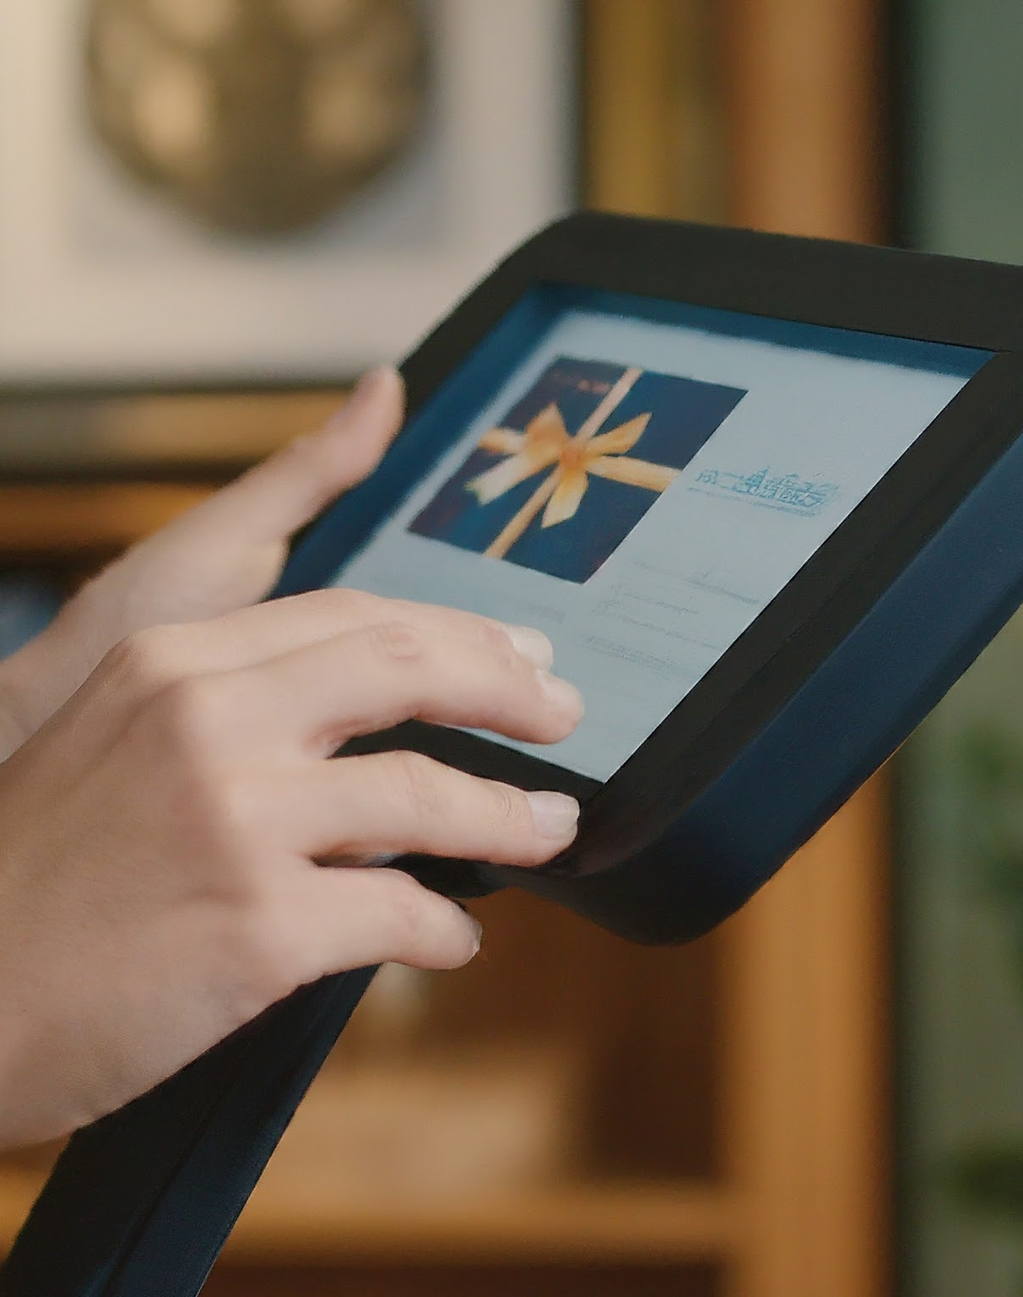
Automatic Gift Card Loading
YOLOV8 is an advanced object detection algorithm known for its real-time capabilities and high accuracy.
Brand images: 11
Training Set Size: 1090 images
Training Time: 3 hours
Epochs: 50
Accuracy: 78%

Slide 7
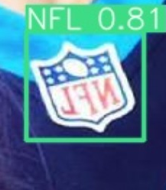
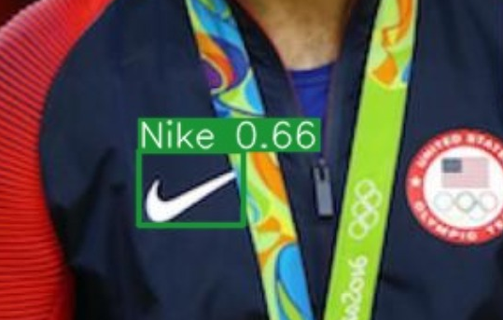
Model Accuracy in Testing Data

Slide 8
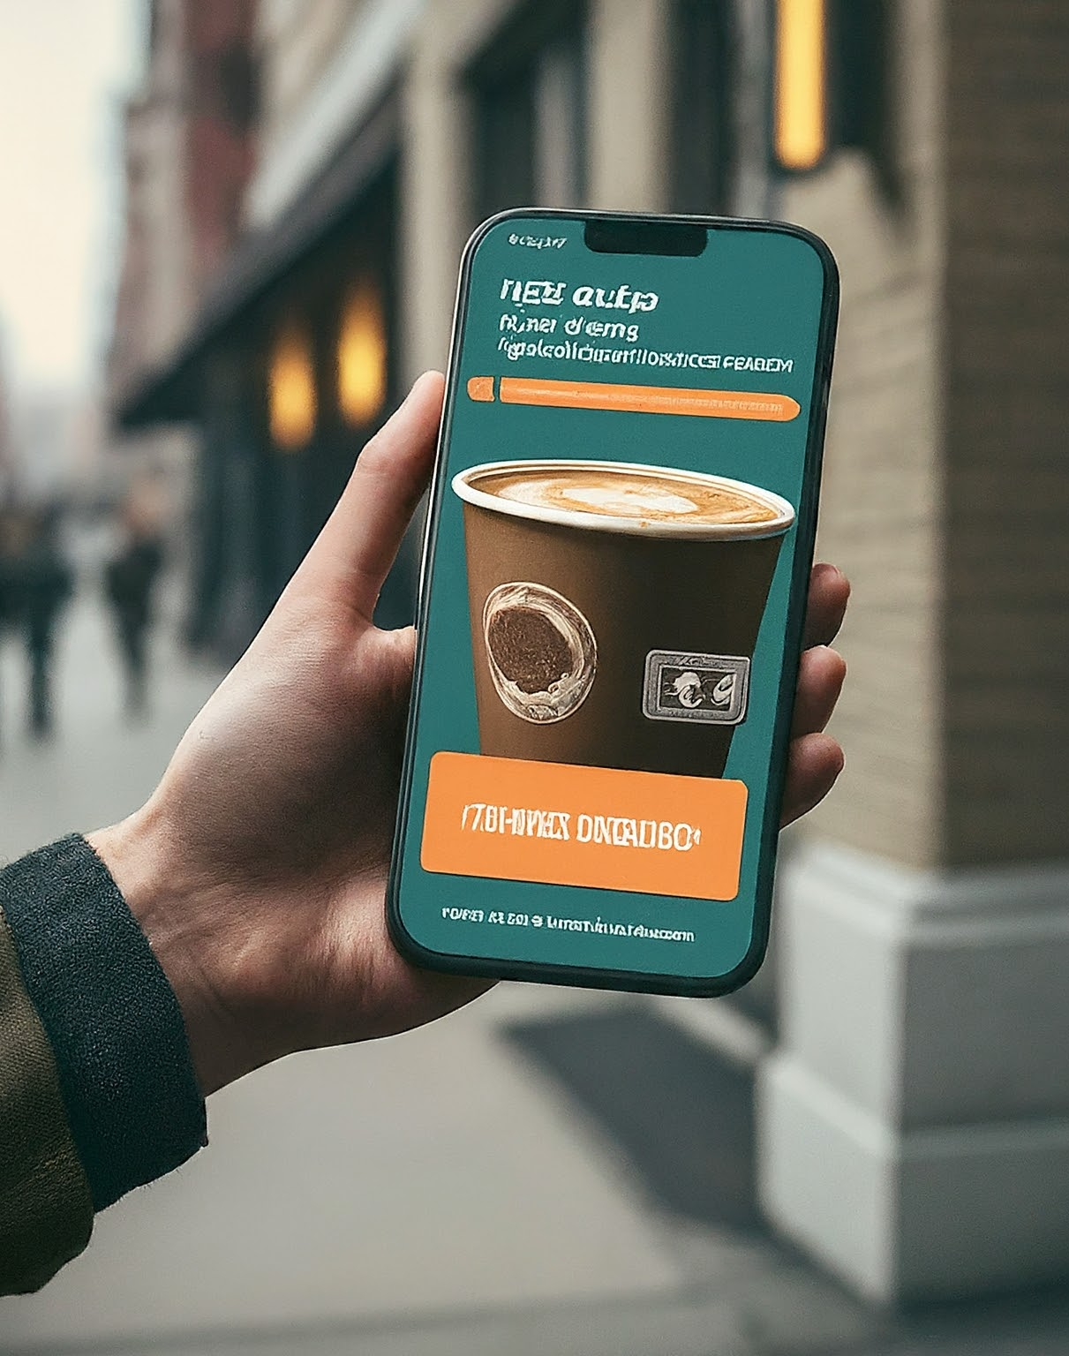
Proximity-Based Notifications
Google Maps API - Brand info, includes Location(Latitude, Longitude), ratings .
Geolocation API
Desktop Notifications

Slide 9
Features to Add
Expiration Alerts
Fraud Protection
Holiday Gifting Idea.
Generational Insights:
Gift card preferences.
Tailored gift card.

Slide 10
Further Development Ideas
Store Offers Integration
User-Generated Content
Brand Collaboration
Proximity-Based Marketing

Slide 11

Boosting In-Store Sales
As online product orders rise, in-store sales are declining. To incentivize in-person purchases, the application collects in-store offers from various stores available nearby.
These offers are sourced from the stores websites and enable users to receive notifications when they are within a certain proximity range.

Slide 12
Introduction
The application assists users in utilizing specific store gift cards stored within it. It provides notifications when users are within a certain radius of a relevant store.
The application automatically loads gift cards by recognizing the brand names, eliminating the need for manual entry and making the process seamless for users.

