Slide 1
IMAGE CLASSIFICATION
Instructor: Sharad Shandilya
Presented by Anurag Kuche and Aarthika Reddy Karumudi
Group 6

Slide 2
INTRODUCTION
Given the current state, there is immense pressure on the healthcare industry as there are millions of Covid-19 cases every week. So, we would like to automate the process and relieve some pressure on the current healthcare industry.
We predict if a person has pneumonia given his x-ray image of their chest.
This is a classic image classification problem which could be solved in number of ways like SVM, decision trees and Neural Networks.
We would be using TensorFlow to build Neural Networks more specifically CNN architecture.

Slide 3
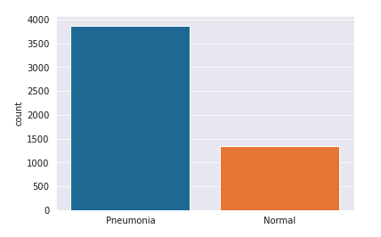
DATA DESCRIPTION
We are given over 6000 X-ray images. Out of which 1350 are normal and 3850 have Pneumonia and the remaining the test data.
We would be using Neural networks to solve this classification problem.
We would be using the convoluted neural networks as they are wildly used in image classification.
In addition to the above-mentioned techniques, we would be using batch normalization, optimizing strides, padding, pooling, and also dropouts.

Slide 4
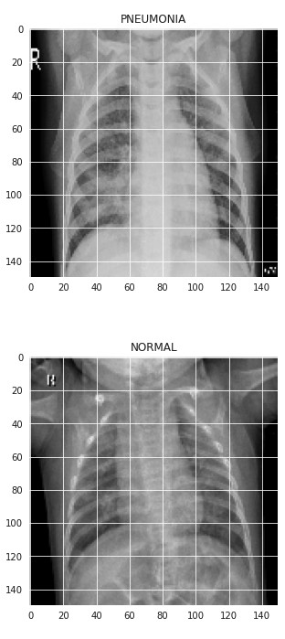
DATA DESCRIPTION
In the right we can see x-ray images of each classes that is normal and pneumonia. In general doctors examine images like these to know if a person is affected or not.
There could be many factors that could cause some errors in this process and so we would like to automate this process. Which would only be beneficial to the healthcare industry. This should only be used as an additional decision-making step but not to replace the doctor's decision in this process.

Slide 5
NEURAL NETWORKS
Neural network is nothing but a combination of neurons, which basically outputs a number between 0 and 1. just list like a logistic regression or logit function(sigmoid).
If a Neural Network has many more of neurons with more than one hidden layer, then it’s called a Deep Neural Network.

Slide 6
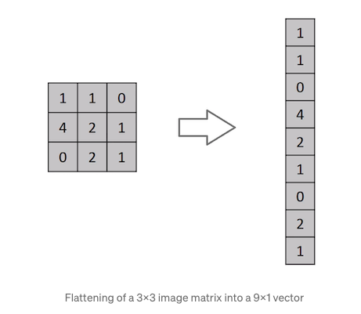
Feed Forward NEURAL NETWORK
Prior to CNN , A Feed forward neural network was used to work with images, where all the pixels in the input image would have to go through neural networks that would make the whole process slow. And this method would not preserve the special data of the image because it would take the pixel values sequentially.
A ConvNet can successfully capture the Spatial and Temporal dependencies in an image through the application of relevant filters. This causes due to the reduction in the number of parameters involved and reusability of weights.

Slide 7
FUNCTIONALITY of CNN
A Convolutional Neural Network (ConvNet/CNN) is a Deep Learning architecture which is commonly used for image classification and image segmentation.
They are by far more efficient than a feed forward method, can help us with the special data as well.
Notes:
So what are CNN’s?
Computer doent interpret things like humans. It can only take in numbers and output numbers.

Slide 8

DATA Pre-Processing
Data pre-processing are a combination of various steps that should be followed so that we could use our data with the corresponding model in an effective way.
Luckily for CNN’s there isn’t much pre-processing required except for normalization and reshaping of input data.
Firstly, we would normalize the data that is shrink the greyscale values in the range of 0-1. for better accuracy as well as faster computation
Then we would we would reshape the data so that we could successfully input the data to CNN’s
Notes:
Some of the other data preprocessing steps include checking for null values, outliers, data inconsistencies, encoding issues and so on.

Slide 9
CNN Hyper-Parameters
Kernel or Filter
Stride
Pooling
Notes:
While building a CNN model there are 3 things to keep in mind, they are kernel, stride and pooling. Here we are dealing with a greyscale image so we would have only one filter if we were dealing with color, they would have required 3 different filters.

Slide 10
STRIDE
The number of pixels the kernel moves to the right in each step.
Notes:
While talking about stride its important that we talk about padding as well. Padding is nothing but adding zeros to the border of the images so that the information in the edges would. Not be lost. There are two popular options for padding they are valid and same. We use same in this project.

Slide 11
POOLING
Pooling is a technique which is used to shrink the image with out loosing much information. This is usually done with the help of boosting the highlights
There are 2 types of pooling . They are max pooling and average pooling.
In this project we have used max pooling to boost the details.

Slide 12
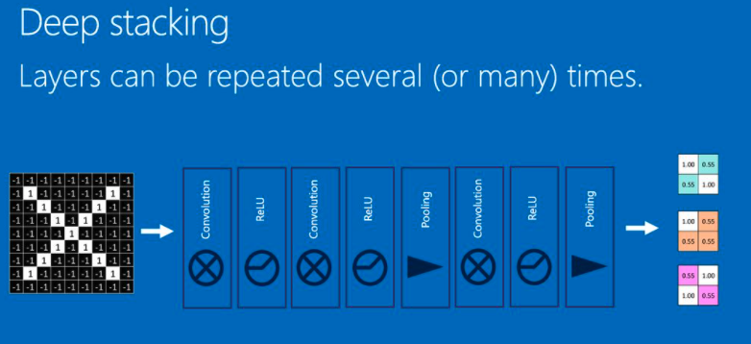
Putting Everything Together

Slide 13

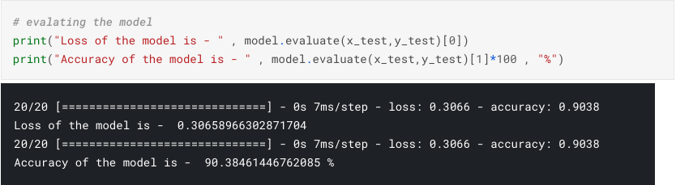
MODEL METRICS
We obtained a test accuracy of over 90%.
The model has falsely classified 10 pneumonia images as normal. And misclassified 50 normal images as pneumonia images.

Slide 14
CONCLUSION
Convolutional neural networks are the best fit for image classification models. By using CNN, we could obtain 90% accuracy our image classification model.
By changing the value of various hyper- parameters, we were able to increase the accuracy from 75% to 90%.

Slide 15
THANK YOU

