Slide 1

Ore Body AI
Drillholes to Ultimate Pit Limit
An AI-assisted open-pit resource and mine design system
Four drillhole tables in. One interactive engineering report out.
Presented By
[ Your name ]
Prepared for
Ecomine

Slide 2
The Problem With Resource Estimation Today
A fragmented workflow, measured in weeks
A resource estimate passes through five disconnected tools and several specialists
Every step is manual: desurvey, composite, cap, digitise, estimate, optimise
Turnaround is days to weeks, so a new drill result cannot be tested quickly
Assumptions get buried — cutoff grade and pit economics are rarely stated on the page
Results are hard to audit: numbers arrive without the method that produced them
Where the real risk sits
The ore / waste cutoff grade
The variogram and estimator choice
The pit economics
Three judgement calls decide the answer — and they are the three least likely to be written down.
Logging
Desurvey
Compositing
Wireframing
Block model
Pit design
Each handover is a chance for an assumption to go unrecorded

Slide 3
What Ore Body AI Does
The whole Surpac open-pit workflow, end to end, in one run
Collar
where each hole starts
Survey
where it points, by depth
Assay
what each sample contained
Geology
what rock was logged
One self-contained HTML report
Opens in any browser · no network, no licence, no install
CSV · Excel · WAMEX / GSWA statutory .txt
What comes out
Desurveyed holes and composited, top-cut assays
A validated, watertight 3D orebody wireframe
A kriged block model with an uncertainty per block
The true optimal ultimate pit, by maximum closure
A bench-by-bench mining schedule
An orbitable 3D scene with every layer toggleable
Grade-tonnage, variogram and price-sensitivity charts
Every economic assumption labelled at its source

Slide 4
System Architecture
Fifteen stages, one orchestrator, five deterministic compute packages
1
Ingest &
validate
2
Desurvey
holes
3
Composite
& top cut
4
Variography
5
Cutoff &
domaining
6
Orebody
solid
7
Block grid
& kriging
8
Tonnage
9
Cross-
validation
10
GemPy
implicit
11
Preliminary
pit
12
Economics
& narrative
13
Ultimate
pit
14
Scene &
charts
15
Render
report
Amber = the two judgement calls Green = deterministic arithmetic Teal = independent second model Purple = reporting
Built as five layers
Entry points — a command-line tool and a FastAPI service, sharing one orchestrator
Orchestration — the single file that knows the order of the workflow
Deterministic compute — ingest, geology, solid, block model, pit (stateless functions)
Reporting — 3D scene, charts, tables, one self-contained HTML file
Cross-cutting — configuration, errors, logging; imported by everything, importing nothing

Slide 5
The Design Principle That Makes It Trustworthy
Exactly two AI calls per run — everything else is arithmetic
AI decides (2 calls)
Call 1 — the ore/waste cutoff, which rock codes are mineralised, the ore boundary on each section, the variogram and the estimator
Call 2 — pit economics and the written engineering narrative
Judgement over ambiguous, conflicting evidence — where two competent geologists can disagree and both be defensible.
Code computes (everything else)
Minimum-curvature desurvey · length-weighted compositing · top cut · convex-hull enveloping · polar-resampled lofting · mesh validation · variogram fitting · ordinary kriging · ray-cast point-in-solid · tonnage · maximum-closure pit · bench scheduling
Every one has a known formula. Routing them through a model would cost money and add a hallucination risk where none is needed.
Three guarantees this buys you
No fabricated figures
The model writes prose and picks parameters. Every number in a table, chart or 3D layer is supplied by the pipeline, so no figure in the report can be invented.
Every answer is range-checked
A cutoff outside the observed grade range, an unknown rock code or a negative sill is replaced with the coded value, and the substitution is reported.
It still runs with no AI at all
With no model reachable the run completes on coded convention — and the report says so in a banner, rather than passing a default off as a decision.

Slide 6
Stage 1 — Data Ingestion That Does Not Guess
Real exploration data is messy; the loader is built for that
Any format, any mix. CSV, Excel or WAMEX / GSWA statutory .txt, detected by content rather than extension. All four tables may sit in one workbook.
Column names resolve themselves. A synonym dictionary covers Surpac, Datamine, Micromine and Vulcan conventions — BHID, HoleID and hole_id all map to the same field.
Censored lab values are handled. <0.5 becomes half the detection limit and >2000 becomes the limit — the standard convention — and both counts are reported.
It refuses to guess the grade element. A multi-element assay file raises and lists what is available, rather than silently binding Cu as the grade on a uranium project.
Eleven validation checks
Missing or duplicate collars
Orphan hole IDs across tables
Azimuth wrapped, dip clipped
All-positive dips detected and negated
Intervals where to ≤ from
Overlapping downhole intervals
Negative or missing grades
Why this matters commercially
Most of the effort in a resource estimate is spent getting data into the tool, not estimating. The pipeline takes the files as they arrive from the lab and the logger. A data problem raises a flag carried to a banner at the top of the report; only three conditions stop the run altogether.

Slide 7
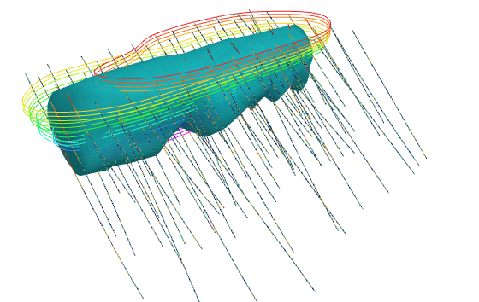
Stages 2–6 — Building the Orebody Solid
Desurvey · composite · cap · domain · wireframe
Minimum-curvature desurvey places every sample in 3D from the standard ratio-factor formula.
Length-weighted compositing puts ragged samples on a common support — 16,506 raw samples became 16,866 composites at 1.00 m.
A 99th-percentile top cut caps outliers and reports how much contained metal the cap removed.
Sections are lofted into a closed solid, resampled in polar coordinates so the loft cannot twist.
All six wireframe checks passed
Validation check | Result
Watertight (closed) | pass
No non-manifold edges | pass
Single connected surface | pass
No duplicates / zero-area | pass
Consistent outward winding | pass
No self-intersection | pass
66 drillholes coloured by grade, the lofted orebody solid and the ultimate pit shell — this view turns by itself through the whole slide
▶ Open the live 3D model
Volume 6,007,755 m³ · surface 235,719 m² · 290 vertices, 576 triangles

Slide 8
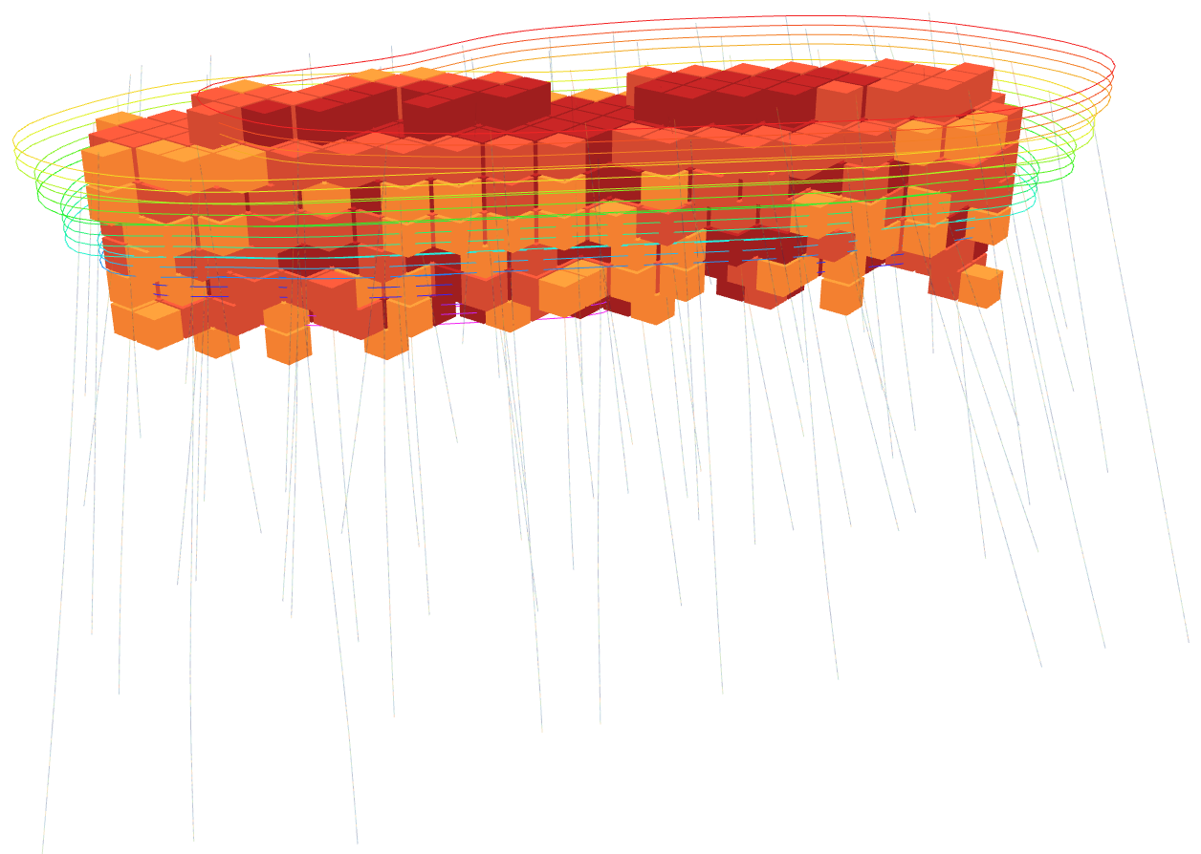
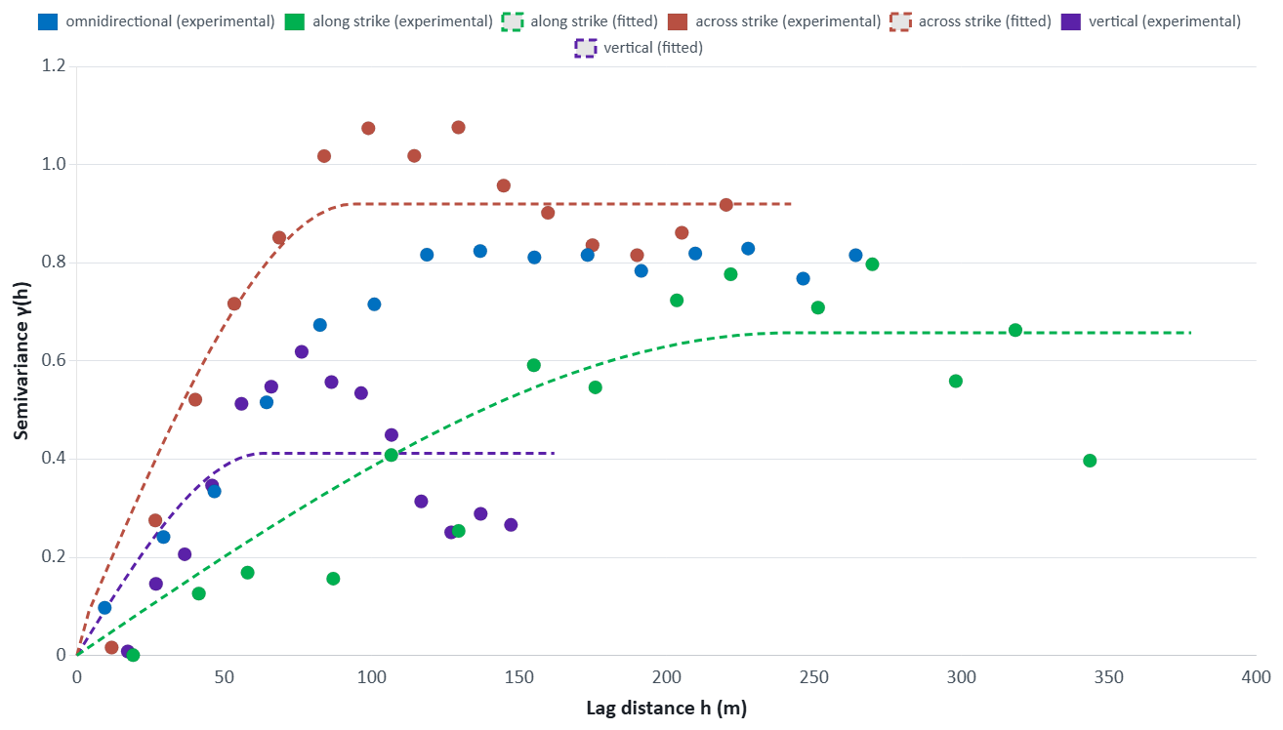
Stages 7–8 — Grade Estimation
Ordinary kriging with a moving search neighbourhood
668 ore blocks of 20 × 20 × 20 m coloured by estimated grade, inside the pit shell
Experimental variograms with fitted models — along strike, across strike and vertically
The variogram model, its parameters and the choice between kriging and inverse-distance weighting are decided once, then executed in code. Blocks with too few neighbours are left unestimated rather than extrapolated.
139 m
variogram range
0%
nugget effect
5,760
blocks estimated

Slide 9
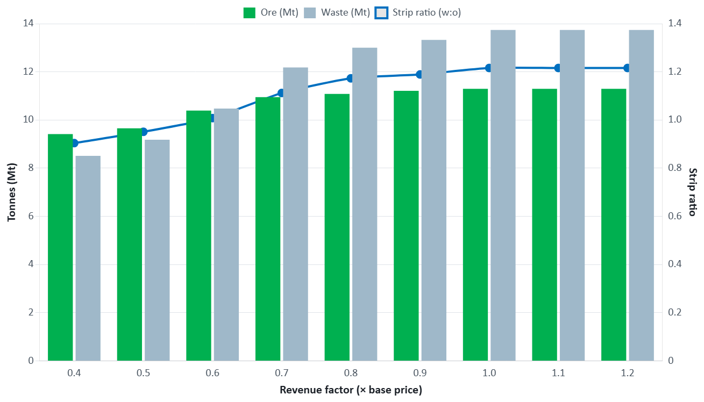
Stages 11–13 — The Ultimate Pit Limit
The true optimum, not a heuristic
The pit is a maximum-weight closure. The best set of blocks to mine, subject to the rule that you cannot reach a block without removing everything above it.
Solved exactly by minimum cut. Lerchs and Grossmann solved this in 1965; Picard showed in 1976 the same closure comes from a min-cut. That is what runs here — the same optimum, computed with a fast C solver.
Checked against brute force. The test suite enumerates every subset on small grids and confirms the optimizer finds the true maximum, and that the result is a valid closure.
Slope angles are reported honestly. A requested angle is quantized by the block size; the report states the angle actually achieved beside the one requested.
Nested pit shells — ore, waste and strip ratio across a sweep of revenue factors, showing how the pit responds to price
One constraint that prevents a wrong answer
A block outside the wireframe is waste, whatever the estimator interpolated into it. Without that rule the optimizer sells grade smeared into the padding around the orebody and reports more ore in the pit than the deposit contains.

Slide 10
Pit and Bench Design
An economic shell sliced into a real, bench-by-bench schedule
7
benches
20.0 m
bench height
140 m
pit depth
1,257 m
crest RL
1,117 m
floor RL
Every number traces back to the block model exactly — footprint areas are exact cell counts, not a smoothed contour estimate
Total volume matches the optimizer's own result for real rock to machine precision, verified by a regression test
Minimum footprint half-width is reported around eight compass sectors — what a batter and berm design is really constrained by
What it deliberately does not claim
No batter angle, berm width or Factor of Safety is stated. Those are geotechnical outputs needing rock mass rating, discontinuity orientations, shear strength and groundwater data this pipeline was never given.
A real bug this caught, and why it matters
Precedence pulls “air” blocks above ground into the pit because they cost nothing to include. An early version counted that overhead air as rock to excavate — a 37% tonnage overstatement, with no error raised, only a wrong number. The schedule now tracks each column's floor and its real-rock crest separately, and a regression test holds it there.

Slide 11
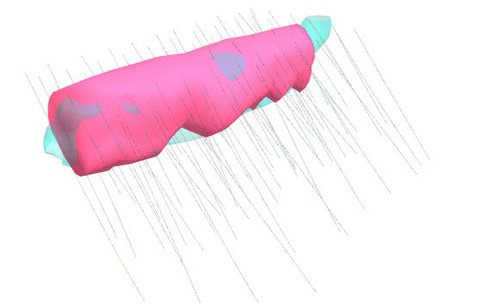
Two Independent Orebody Models
Same drilling, two methods, no shared code or assumptions
 | Section wireframe | GemPy implicit
Kind | explicit | implicit
Shape comes from | the digitised outlines | the data and the interpolation
AI involved | yes — Call 1 | no, none at any point
Volume | 6,007,755 m³ | 6,265,730 m³
+4.3%
volume difference between the two models
95.0%
of logged ore intercepts fall inside the implicit solid
Pink: the explicit section wireframe. Teal: the GemPy implicit surface, interpolated through the ore contacts. Turning makes the overlap readable.
Why build the same thing twice
Two methods this different agreeing is evidence; disagreeing is a question worth asking. Capture rate is the honest test — a potential field always produces a smooth, convincing surface, and that number says whether it actually contains the ore.
The same live model is one click away from slide 7.

Slide 12
Demonstration Run — Results
66-hole gold deposit, 16,506 assay intervals, start to finish in one command
11.30
Mt ore in pit
1.859
g/t mean ore grade
675.1
koz contained metal
1.22
w:o strip ratio
14.43
Mt in-situ resource
0.192
g/t cutoff grade
140
m pit depth
7
mining benches
Reading these numbers correctly
The resource figures are the model's. Tonnes, grade and contained metal come from the kriged block model constrained by the validated wireframe — they do not depend on any economic assumption.
The pit figures carry assumptions. This run used neutral defaults — US$2,000/oz, mining $3.00/t, processing $25.00/t, G&A $4.00/t, 90% recovery, 45° slope — each labelled “assumed_default” in the report's own assumptions table, not a costed study.
This run used deterministic mode. No language model was called; the cutoff and estimator came from coded convention, and the report states that in a banner at the top.

Slide 13
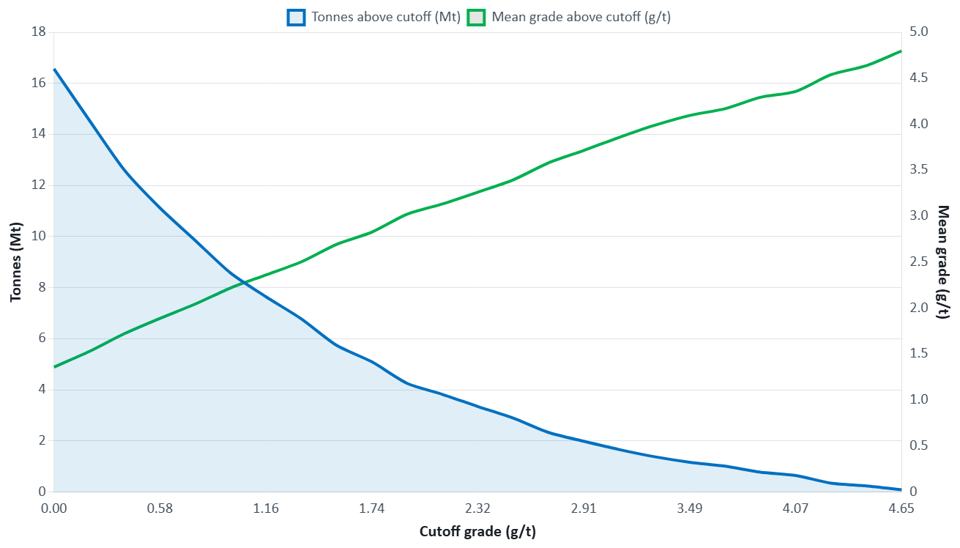
Grade–Tonnage and Price Sensitivity
The two curves that drive every investment conversation
How to read it
The trade-off is the whole point
Raise the cutoff and the grade improves but the tonnage falls away. The curve shows exactly how fast.
It makes the cutoff decision visible
Rather than a single number asserted in a paragraph, the consequence of choosing it is plotted.
Nested shells do the same for price
Running the optimizer from 0.4× to 1.2× the base price shows which tonnes pay for themselves even when prices are low.
Both come from the block model
Not from a model's prose — from the same estimated blocks that produced the resource statement.
Tonnes above cutoff and the mean grade of that material, across a sweep of 25 cutoff grades

Slide 14
How We Know The Numbers Are Right
Checked against known answers, not against previous output
Desurvey
against closed-form trigonometry
Solid volume & area
against an analytic cylinder, to within 0.3%
Point-in-solid
against Monte Carlo integration
Kriging weights
against the unbiasedness property (Σw = 1)
Pit optimizer
against brute-force enumeration, plus a closure check
Bench volumes
against the optimizer's own total, to machine precision
And what the report tells you about itself
Every data-quality issue found during ingestion appears in a banner near the top, before any result
Which route each judgement call took — paid model, local model or coded convention — is recorded and stated
Every economic input is listed with its origin: user_supplied or assumed_default
The full validation report, descriptive statistics, composite file and block model are included and searchable
Stated plainly, in the tool and here: this is decision support, not a JORC or NI 43-101 resource statement. The cutoff grade, the estimator choice and the pit economics need a mining engineer's review before any output informs a real decision.

Slide 15
Deployment and Where This Goes Next
Already runnable two ways; built to be embedded
Available today
Command-line tool — one command, four files, one report
FastAPI service — six endpoints, server paths or uploads
Offline mode — completes with no API calls and no cost
Open Python package, 31 modules, MIT licensed
Natural next steps
Calibrate economics to Ecomine's own cost model
Density by rock type from measured core, replacing the default
Validate against a deposit where a Surpac estimate exists
Underground / stope optimisation on the same block model
What we would need from Ecomine to prove it on your ground
1
A drilled deposit
Collar, survey, assay and geology in whatever format you hold them.
2
Your cost assumptions
Mining, processing and G&A per tonne, recovery, and the slope your geotechs accept.
3
A benchmark
An existing estimate for the same ground, so the two can be compared honestly.
A full technical reference for the system — architecture, control flow and every module — is available as a 52-page document.

Slide 16
Thank You
Ore Body AI — drillholes to ultimate pit limit, in one run

