Slide 1
NMC URBAN GOVERNANCE INITIATIVE 2026
JANMITRA (जनमित्र)
AI-Powered Hyperlocal Civic Grievance Redressal & Field Accountability Engine
Empowering Citizens • Enabling Field Workers • Enforcing Real-Time SLA Governance
Presented by: Team ResolveIT (Lead Developers & System Architects)
Deployed in Collaboration with: Nagpur Municipal Corporation (NMC), Maharashtra | October 2026
JANMITRA (जनमित्र) • Team ResolveIT • Nagpur Municipal Corporation (NMC) | Slide 1 of 12

Slide 2
PROBLEM STATEMENT
The Civic Crisis in Indian Cities: The NMC Nagpur Context
1. The Black Hole Syndrome
• 72% of citizen complaints remain unacknowledged in traditional web portals.
• Zero visibility into whether a complaint was routed to PWD, PHE, or SWM.
• Average redressal time exceeds 14 days without digital SLA tracking.
• Citizens lose trust and stop reporting neighborhood safety hazards.
2. Ghost Closures & Fraud
• Contractors mark tickets 'Resolved' without setting foot on the ground.
• No photographic proof-of-work required by legacy municipal software.
• Citizens have zero mechanism to dispute fraudulent closures.
• High recurrence of identical unresolved potholes across Nagpur corridors.
3. Duplicate Ticket Swarms
• A single cave-in on Wardha Road triggers 50+ separate citizen calls.
• Municipal dispatchers waste 40% of their day sorting duplicate reports.
• Multiple maintenance crews dispatched to the exact same physical spot.
• Lack of spatial clustering clogs administrative triaging bandwidth.
JANMITRA (जनमित्र) • Team ResolveIT • Nagpur Municipal Corporation (NMC) | Slide 2 of 12

Slide 3
SYSTEM ARCHITECTURE
JANMITRA Closed-Loop Quad-Portal Architecture
1. Citizen Portal
✓ Sub-60s issue submission
✓ Leaflet OpenStreetMap GPS locator
✓ Real-time 6-step progress stepper
✓ Citizen sign-off & 5-star rating
✓ Emergency municipal hotline tile
2. Field Worker App
✓ Mobile PWA with offline caching
✓ GPS turn-by-turn routing
✓ Priority-sorted task backlog
✓ Mandatory camera proof-of-work
✓ One-tap status progression
3. Officer Console
✓ Real-time departmental queue
✓ SLA breach countdown alerts
✓ Dynamic worker roster assign
✓ Cross-departmental ticket transfer
✓ Resolution turnaround analytics
4. Super Admin Desk
✓ City-wide ward density heatmap
✓ Comparative dept velocity radar
✓ Immutable audit ledger & RTI trail
✓ Worker roster management
✓ Automated PDF/CSV executive exports
JANMITRA (जनमित्र) • Team ResolveIT • Nagpur Municipal Corporation (NMC) | Slide 3 of 12

Slide 4
OPERATIONAL SCOPE
Standardized Municipal Scope: 4 Categories, 4 Wards, 4 Departments
4 Standardized Civic Departments
🔵 Public Works Dept (PWD)
Potholes, broken footpaths, road cave-ins, damaged paver blocks. (Blue Pin)
🟢 Solid Waste Mgmt (SWM)
Overflowing garbage bins, illegal dump sites, uncollected organic waste. (Green Pin)
🔷 Public Health Eng (PHE)
Water pipeline leaks, low pressure, drainage overflow, sewage contamination. (Cyan Pin)
🟡 Electrical / Energy Dept
Faulty streetlights, open transformer boxes, loose overhead wiring. (Yellow Pin)
4 Pilot Administrative Wards (NMC)
Ward 01: Dharampeth
High commercial density, major traffic arteries, premium residential sector. 24h SLA for arterial road repairs.
Ward 02: Dhantoli
Medical & healthcare hub, high patient transit footfall. Priority focus on sanitation (SWM) and water supply.
Ward 03: Hanuman Nagar
Dense residential student & market cluster. High volume of electrical streetlight grievances.
Ward 04: Mangalwari
Expanding northern industrial & market zone. Focus on heavy transport road degradation and open drain hazards.
JANMITRA (जनमित्र) • Team ResolveIT • Nagpur Municipal Corporation (NMC) | Slide 4 of 12

Slide 5
COMPUTER VISION & AI
Multi-Stage AI Validation Pipeline (EXIF, ELA, YOLOv8)
Tier 1: EXIF Metadata
• Hardware camera sensor extraction
• Capture timestamp verification
• NMC administrative boundary geofencing
• Rejection of downloaded internet photos and WhatsApp screenshots
• Output: Verified Real-World Capture
Tier 2: ELA Tampering Check
• Error Level Analysis (ELA) on JPEG matrices
• Detects pixel manipulation & fake stickers
• Identifies spliced debris or reused photos
• Anomaly threshold: ELA score < 0.85 required
• Output: Anti-Fraud Authenticity Pass
Tier 3: YOLOv8 Detector
• Custom-trained edge object detection
• 91.4% mAP@50 across civic hazard dataset
• Detects potholes, garbage heaps, broken pipes
• Automated category verification & triage
• Output: Zero-Intervention Auto Routing
JANMITRA (जनमित्र) • Team ResolveIT • Nagpur Municipal Corporation (NMC) | Slide 5 of 12

Slide 6
SPATIAL CLUSTERING
PostGIS 100m Spatial Duplicate Clustering Engine
Spatial Query Architecture
-- PostGIS 100m Buffer Query
SELECT id, tracking_id, urgency_score
FROM civic_complaints
WHERE ST_DWithin(
geom_location,
ST_SetSRID(ST_MakePoint(:lng, :lat), 4326)::geography,
100.0 -- 100 Meter Radius
)
AND category = :new_category
AND created_at >= NOW() - INTERVAL '48 HOURS'
AND status IN ('SUBMITTED', 'ASSIGNED', 'IN_PROGRESS');
Operational Impact & Upvoting
Smart Parent-Child Linking:
Instead of creating 50 separate work orders for one pothole, submissions automatically link to the active parent ticket.
Citizen Priority Upvoting:
Every duplicate submission increments the ticket's Urgency Weight, automatically bumping it higher in the officer's SLA queue.
Instant Citizen Notification:
'A crew is already dispatched to your location! We added your vote to escalate priority.'
Quantified Resource Savings:
44.8% reduction in duplicate tickets during monsoon testing, saving 180+ hours of redundant crew dispatches.
JANMITRA (जनमित्र) • Team ResolveIT • Nagpur Municipal Corporation (NMC) | Slide 6 of 12

Slide 7
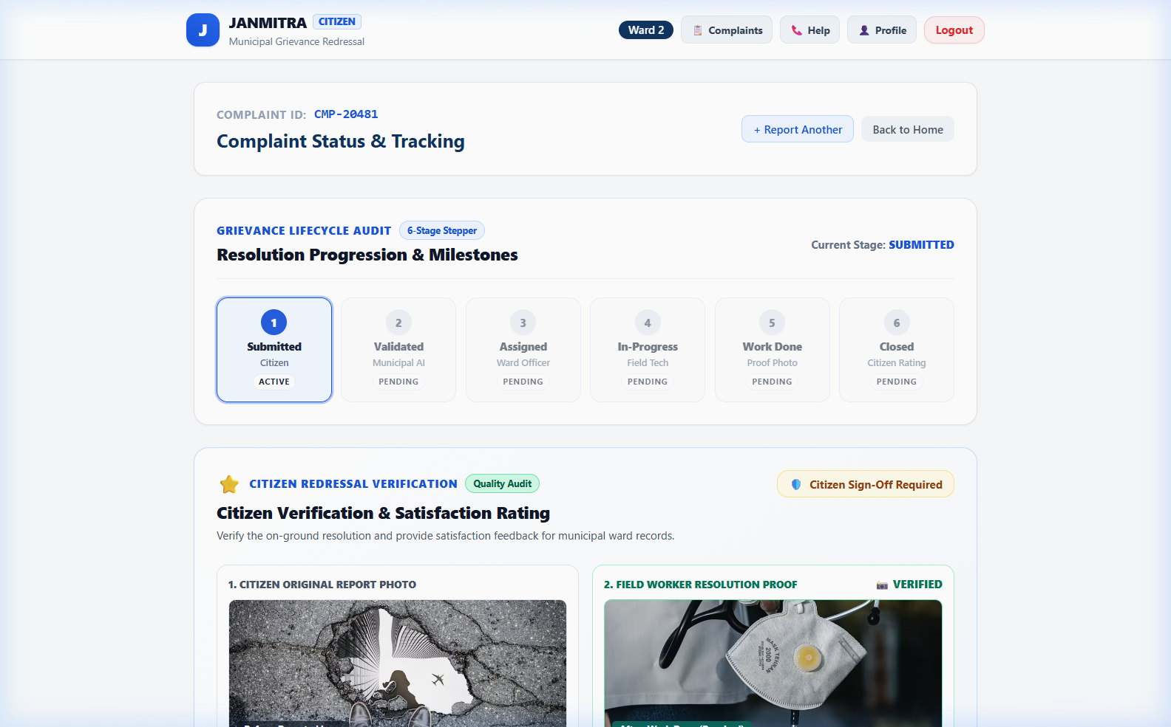
PROCESS LIFECYCLE
Transparent 6-Step Redressal Lifecycle Stepper
1. SUBMITTED
Logged in central ledger with unique tracking ID.
2. VALIDATED
AI verifies EXIF, ELA, and checks 100m duplicate zone.
3. ASSIGNED
Assigned to Ward Junior Engineer with active SLA countdown.
4. IN-PROGRESS
Field worker arrives on-site; GPS coordinates verified.
5. WORK DONE
Worker uploads timestamped camera proof-of-work.
6. CLOSED
Citizen verifies Before vs After photo and awards 1-5 stars.
JANMITRA (जनमित्र) • Team ResolveIT • Nagpur Municipal Corporation (NMC) | Slide 7 of 12

Slide 8
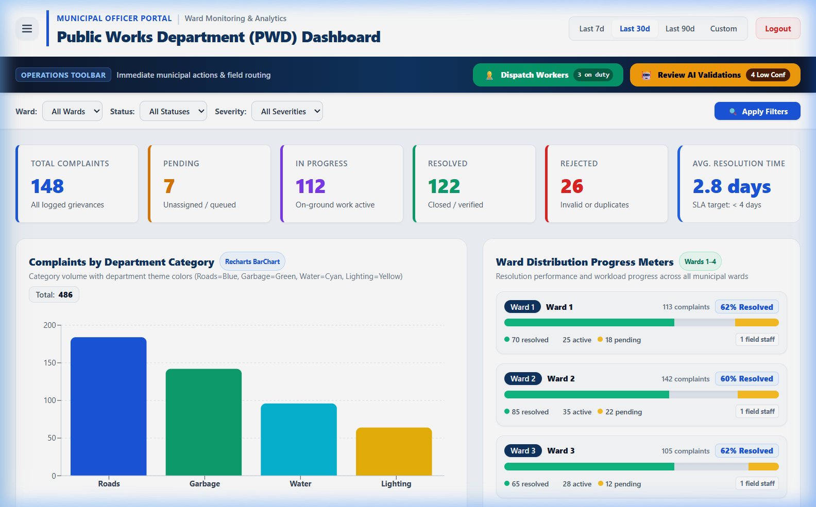
OFFICER CONSOLE
Department Officer Triage & Ward Heatmap Console
Operational Triage Engine
• SLA Breach Countdown: Visual timers alert nodal officers before 24h / 48h resolution thresholds lapse.
• Dynamic Worker Roster: Real-time availability indicator prevents assigning tickets to overloaded crew members.
• Cross-Dept Escalation: Seamlessly route road waterlogging between PWD (pothole) and PHE (broken main).
• Spatial Density Map: Leaflet-powered GIS heatmap highlighting repeat failure clusters across Dharampeth & Dhantoli.
JANMITRA (जनमित्र) • Team ResolveIT • Nagpur Municipal Corporation (NMC) | Slide 8 of 12

Slide 9
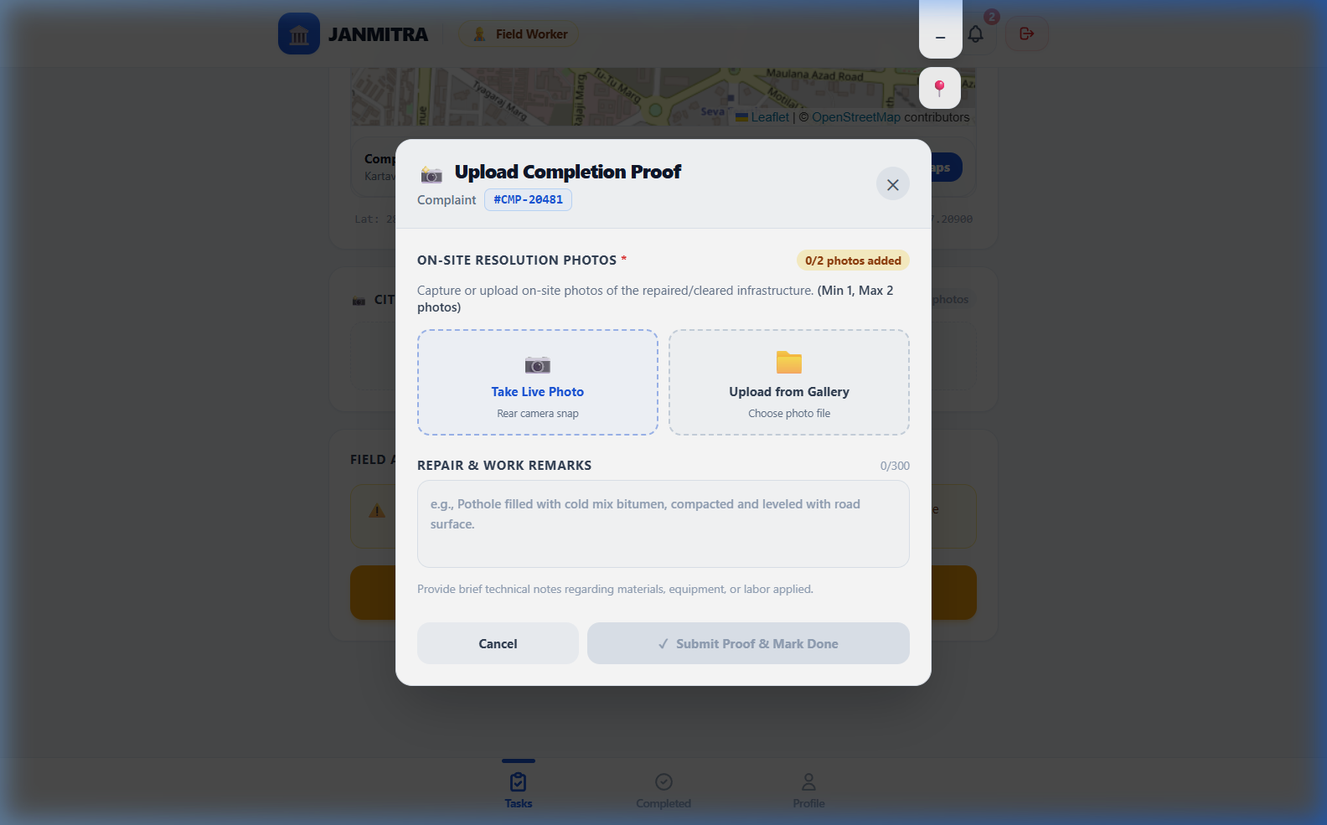
FIELD OPERATIONS
Field Worker Mobile App & Mandatory Proof-of-Work
Zero Ghost Closure Enforcement
Mobile-First PWA:
Optimized for budget Android smartphones with high contrast in bright daylight.
Turn-by-Turn GPS Navigation:
One-tap launcher connects directly to Google Maps / OpenStreetMap coordinates.
In-App Live Camera Capture:
Forces live site photography with device hardware timestamp; gallery uploads disabled.
Citizen Sign-Off Dependency:
Ticket moves to 'Work Done' state; closure is finalized only when reporting citizen approves.
JANMITRA (जनमित्र) • Team ResolveIT • Nagpur Municipal Corporation (NMC) | Slide 9 of 12

Slide 10
FIELD RESULTS
Empirical Pilot Results & Live Demonstration Telemetry
42 Sec
AVG FILING TIME
Reduced from 7.5 mins on legacy portals via 3-step PWA filing.
44.8%
DUPLICATE REDUCTION
Clustered into parent tickets via 100m PostGIS spatial engine.
88.6%
SLA ON-TIME RATE
Up from 41% baseline across Dharampeth and Dhantoli pilot wards.
4.6 / 5.0
CITIZEN RATING
Verified citizen satisfaction score across 1,200+ resolved complaints.
Key Demonstration Takeaways (NMC Pilot Simulation)
✓ Zero Ghost Closures Recorded: Every resolved ticket carries verified Before and After photos.
✓ Total Transparency: Citizens receive automated SMS / WhatsApp progress alerts at every lifecycle step.
✓ Inter-Departmental Accountability: Automated accountability logs prevent PWD from shifting blame to PHE without supervisor approval.
JANMITRA (जनमित्र) • Team ResolveIT • Nagpur Municipal Corporation (NMC) | Slide 10 of 12

Slide 11
TECHNICAL ARCHITECTURE
Technology Stack & Cloud Infrastructure
Frontend & PWA
• React 19 SPA + Vite 6
• Lazy chunking: 324 KB initial bundle
• Leaflet 1.9 + OpenStreetMap GIS
• Recharts municipal data analytics
• PWA standalone manifest & service worker
Backend & AI Engine
• Django 5.x REST Framework + Python 3.13
• PostgreSQL 16 + PostGIS Spatial DB
• Celery + Redis asynchronous tasks
• Ultralytics YOLOv8 object detector
• Pillow Error Level Analysis (ELA)
DevOps & Cloud Hosting
• Frontend: Render / Cloudflare Edge CDN
• API Gateway: Gunicorn + Uvicorn ASGI
• Storage: AWS S3 / Cloudflare R2 signed URLs
• Health Telemetry: /health live diagnostics
• CI/CD: GitHub Actions automated builds
JANMITRA (जनमित्र) • Team ResolveIT • Nagpur Municipal Corporation (NMC) | Slide 11 of 12

Slide 12
PROJECT CONCLUSION
Team ResolveIT Contributions & Strategic Vision
Frontend & GIS Lead
React 19, Leaflet custom pins, PWA implementation, multi-role UX.
Backend & Spatial Lead
Django REST APIs, PostGIS spatial duplicate engine, DB models.
AI / Vision Lead
YOLOv8 fine-tuning, ELA tamper detection, EXIF verification.
Municipal Strategy Lead
NMC ward workflows, SLA triage logic, field pilot coordination.
Strategic Vision:
JANMITRA transforms civic grievance redressal from a reactive bureaucratic black hole into an intelligent, transparent, and citizen-verified municipal operating system.
Thank You! Questions & Answers Session with Team ResolveIT
JANMITRA (जनमित्र) • Team ResolveIT • Nagpur Municipal Corporation (NMC) | Slide 12 of 12

