Slide 1

Predicting Diabetic Patient Readmission
Group 2
Aniket Nikhar
Anurag Wasnik
Himanshu Jaisal
Khushboo Thapa
Supriya Hadawale
Mentor:
Animesh Tiwari
1

Slide 2

Diabetes
What is diabetes ?
Causes of diabetes ?
2

Slide 3
Agenda
01
Data Description
02
Data Cleaning
03
Exploratory Data Analysis
04
Feature Engineering
05
Feature Selection
06
Statistical Analysis
07
Model Evaluation
08
Conclusion
3

Slide 4
Problem Statement
To identify the factors that lead to the high readmission rate of diabetic patients within 30 days of being discharge and correspondingly to predict the high-risk diabetic-patients who are most likely to get readmitted within 30 days so that the quality of care can be improved along with improved patient’s experience, health of the population and reduce costs by lowering readmission rates. Also, to identify the medicines that are the most effective in treating diabetes.
4

Slide 5
Dataset description
Encounter ID | Unique identifier of an encounter
Patient number | Unique identifier of a patient
Race Values | Caucasian, Asian, African American, Hispanic, other
Gender | male, female, and unknown/invalid
Age | Grouped in 10-year intervals
Weight | Weight in pounds
Admission type | 9 distinct values(Depends on patient situation)
Discharge disposition | 29 distinct values(discharged to home, expired, and not available
Admission source | 21 distinct values(Depends on patient)
Time in hospital | Days between admission and discharge
Payer code | 23 distinct values(Payment code)
Medical specialty | Specialty of the admitting physician
Number of lab procedures | Lab tests performed
Number of procedures | Procedures performed during the encounter
Number of medications | Generic names administered during the encounter
Number of outpatient visits | Outpatient visits within the year
Number of emergency visits | Emergency visits within the year
Number of inpatient visits | Inpatient visits within the year
Diagnosis 1 | Primary diagnosis
Diagnosis 2 | Secondary diagnosis
Diagnosis 3 | Additional secondary diagnosis
Number of diagnoses | No of diag. entered to the system 0%
Glucose serum test result | Prediabetic test(Range: >200, >300,normal,none)
A1c test result | Test for diabetic(Range: >8%, >7%, >7%-<8%)
Change of medications | Change in diabetic medications
Diabetes medications | Diabetic medication prescribed
24 features for medications | 24 different drugs that are used in treatment
Readmitted | Days to inpatient readmission
5

Slide 6
Data Cleaning
Missing Values
Variables | Percentage Missing value
Weight | 96.85
Medical Specialty | 49.08
Payer Code | 39.55
Race | 2.23
Diag_1 | 1.39
Diag_2 | 0.35
Diag_3 | 0.02
Sub levels in Admission_Type_id , Admission_Source_id, Discharge_disposition_id
 | Before | After
Admission_Type_id | 7 | 4
Admission_Source_id | 17 | 4
Discharge_disposition_id | 26 | 3
Dirty values in Diag_1,Diag_2,Diag_3
The entries under these 3 columns is a jumbled mix of medical codes denoting varies aliments
6

Slide 7
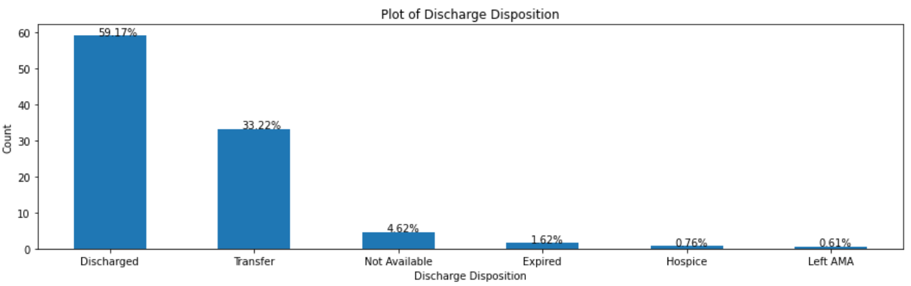
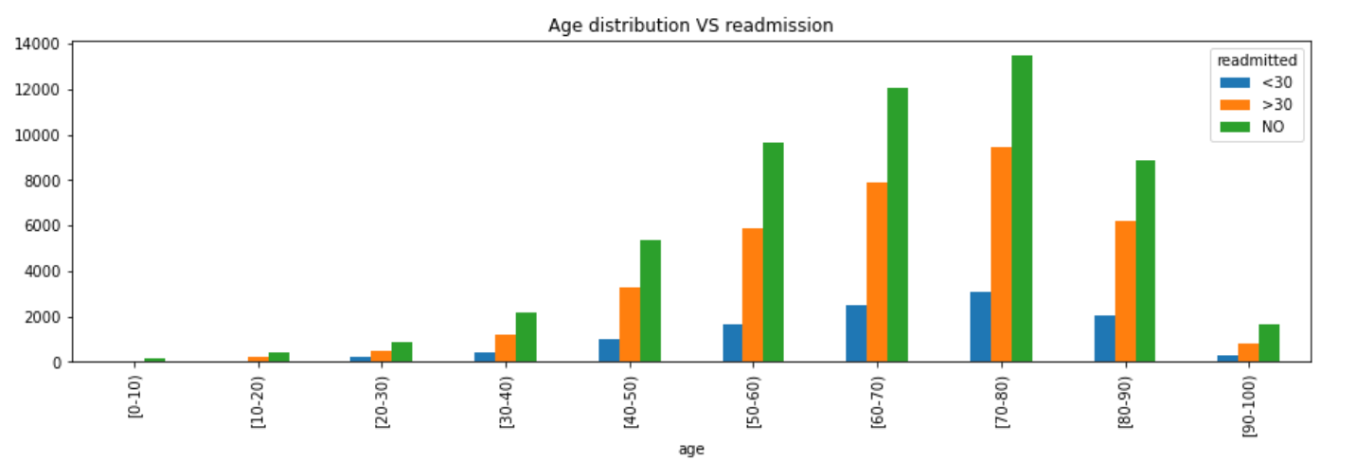
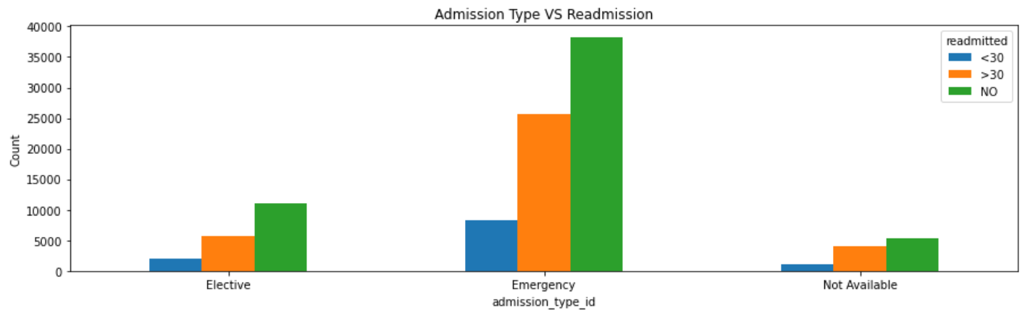
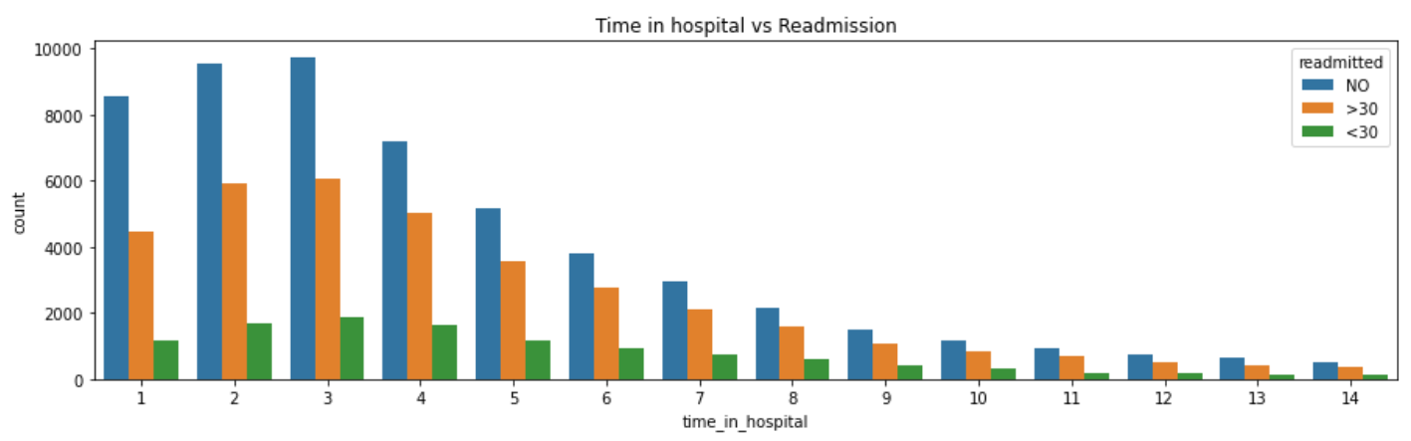
Exploratory Data Analysis
7

Slide 8
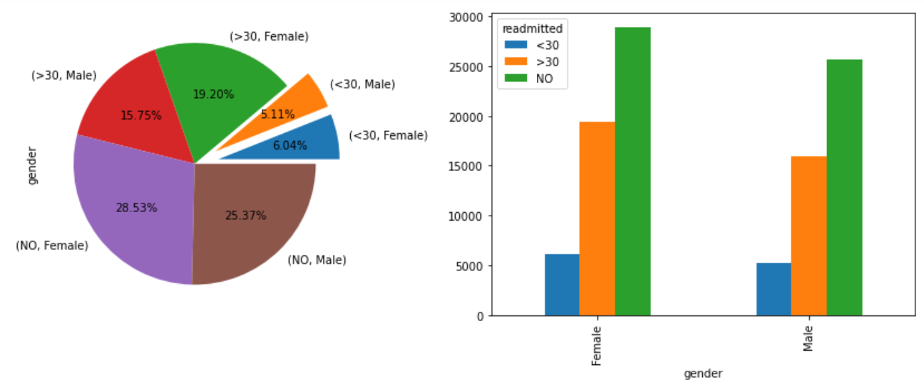
54%
46%
8

Slide 9
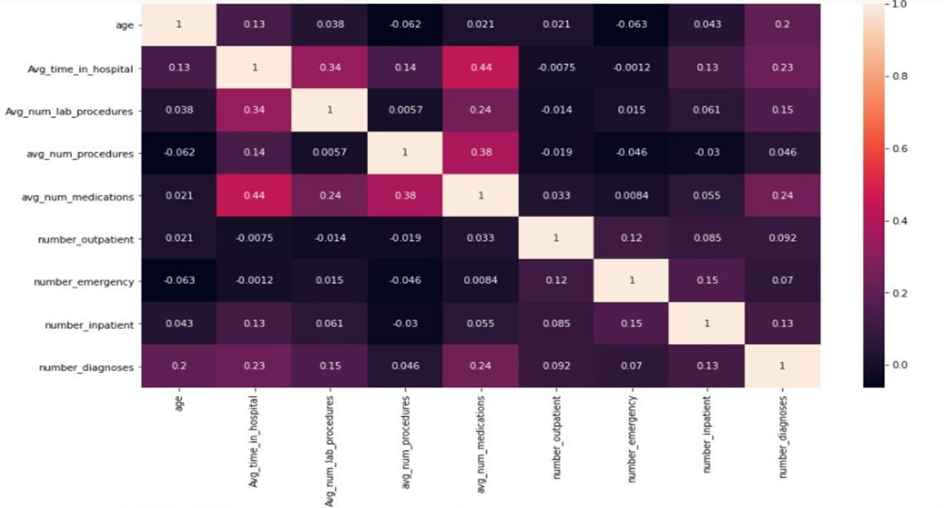
Correlation Plot of Independent Features
You can simply impress your audience and add a unique zing and appeal to your Presentations. Get a modern PowerPoint Presentation that is beautifully designed.
9

Slide 10
Feature Engineering
One Hot Encoding
Categorical Variable Names
Race, Admission_type_id, discharge_disposition_id, admission_source_id, diag_1, diag_2, diag_3
We map each category to a vector that contains 1 and 0 denoting the presence of the feature or not.
Imputing values
Variable Names
Gender, Change, DiabetesMed, Age, Readmitted, Change
Giving weights to the different levels in each of the variables
Outlier Treatment
Numerical Variable Names
Age,Avg_time_in_hospital, Avg_num_lab_procedures, avg_num_procedures, avg_num_medications, number_emergency, number_inpatient, number_diagnosis
IQR, Log transform, Square root transform, Power transform
Drop Duplicates
Variable Names
All
Dropping duplicates in all columns with respect to patient number
10

Slide 11
Feature Selection
Features | VIF
number_inpatient | 1.0425
number_emergency | 1.0961
number_outpatient | 1.1171
Avg_num_procedures | 2.4942
Avg_time_in_hospital | 5.9042
Avg_num_lab_procedures | 6.4601
Age | 7.027
Avg_num_medications | 7.500
01
Variance Inflation Factor
This was tested conducted for numerical variables. It is found that variable ‘number of diagnosis’ has a high inflation factor, which is consequently dropped.
02
ChiSquare Test
Categorical variables were test independently to test their significance. Following slide contains important features
11

Slide 12
Statistical Analysis
Important features post ChiSquare test
No of Visit | Pioglitazone | Change | discharge_disposition_id_Others
Gender | Miglitol | DiabetesMed | discharge_disposition_id_Transfer
Metformin | Insulin | avg_glu_serum_res | admission_source_id_Emergency Room
Repaglinide | race_Other | avg_A1Cresult | admission_source_id_Referral
Nateglinide | admission_type_id_Elective | race_AfricanAmerican | admission_source_id_Transfer
No of Visit | admission_type_id_Others | race_Asian | diag_1_Circulatory
Gender | discharge_disposition_id_Discharged | race_Caucasian | diag_1_Diabetes
Glipizide | diag_1_Respiratory | race_Hispanic | diag_1_Genitourinary
diag_1_Musculoskeletal | diag_2_Circulatory | diag_2_Injury | diag_3_Circulatory
diag_1_Neoplasms | diag_2_Diabetes | diag_2_Musculoskeletal | diag_3_Diabetes
diag_3_Genitourinary | diag_2_Digestive | diag_3_Injury | diag_3_Respiratory
S
T
W
O
12

Slide 13
Model Evaluation
Logistic Regression
01
02
Naïve Bayes
Decision Tree Classifier
03
Random Forest Classifier
04
05
XGBoost Classifier
13

Slide 14
Model Evaluation Matrix
Model | Accuracy | Precision | Recall | F1-score | Roc-Auc Score
Logistic Regression | 0.87 | 0.95 | 0.61 | 0.74 | 0.84
Naïve Bayes | 0.85 | 0.92 | 0.61 | 0.73 | 0.86
Decision Tree Classifier | 0.87 | 0.95 | 0.61 | 0.75 | 0.74
Random Forest Classifier | 0.87 | 0.94 | 0.63 | 0.75 | 0.87
XG Boost Classifier | 0.86 | 0.92 | 0.76 | 0.76 | 0.88
14

Slide 15
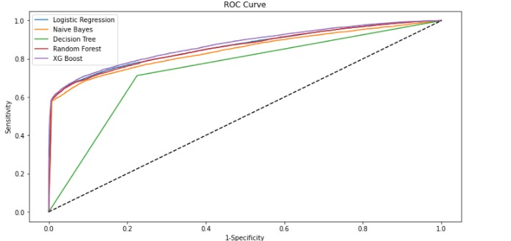
ROC Curve
Model | ROC – AUC Score
Logistic Regression | 0.84
Naïve Bayes | 0.86
Decision Tree | 0.74
Random Forest | 0.87
XG Boost | 0.88
ROC-AUC Score is highest for XG Boost Classifier.
15

Slide 16
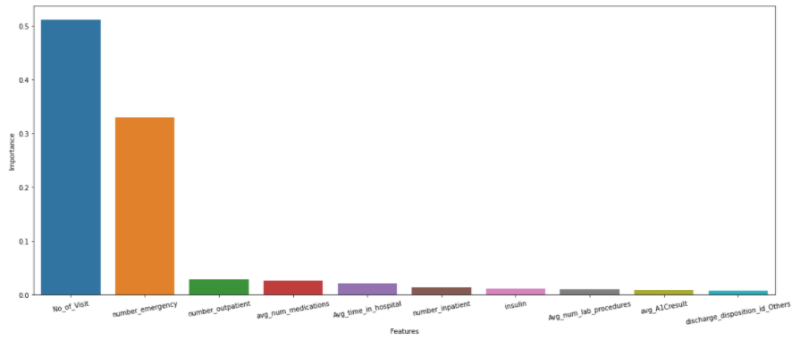
Feature Importance
Feature ‘No_of_Visit’ created by us based on the unique patient visit is giving us the highest importance.
Followed by ‘Number_emergency’ and so on
16

Slide 17

Conclusion
Early discharge, inadequate communication during discharge, and poor coordination of care can lead to hospital readmission.
Certain hospitalized patients with diabetes may be at higher risk of readmission than those without diabetes.
A mix of expert opinion and a handful of mostly small studies provide a number of potential strategies for reducing readmission risk.
Hospitals need to handle the discharge of patients based on there need of diagnosis or by demographic of the patient.
17

Slide 18

THANK YOU
18

