Slide 1
JUnit

Slide 2
Table of Contents
Day | Topics
Day 1 | Getting started
 | What is Test Driven Development? Why?
 | Test Driven Development Vs. Traditional development
 | TDD Vs. Agile Model Driven Development
 | Test First Development
 | Understanding and using JUnit for TDD
 | Introduction to Junit
 | JUnit in Eclipse
 | JUnit life cycle and JUnit 4 Annotations
 | Fixtures and Test cases
 | JUnit API, Assertions and writing tests
 | Different types of tests
 | Testing Exception Handling
 | Testing Timeout etc.
 | Using JUnit for Test Driven Development in real life example
 | Designing Test suits
 | Test runners

Slide 3
Module 1: JUnit Essentials
Notes:
(Participant Guide: Page 7)
Start with a discussion about the JUnit framework.
The JUnit framework is used for unit testing programs in the Java Language. Explain that the basic practice behind the JUnit framework is “first testing then coding,” which focuses on testing a unit of code before it is implemented.
The module explains the features and advantages of JUnit as a framework and how it ensures code reliability and tester productivity. You will learn about the syntaxes of JUnit (such as asserts and annotations) that help in writing efficient code and creating well-defined test cases. You will also learn about JUnit installation, use of JUnit components, and JUnit annotations and assert statements. The module describes how to compose, organize, and implement test cases and analyze the results—tasks critical to the development of a robust software application.

Slide 4
Module Objectives
Module 1: JUnit Essentials
At the end of this module, you will learn to:
Explain JUnit and its purpose.
Describe the concepts of testing.
Write a simple test case.
Execute a test case to check the results.
Notes:
4
(Participant Guide: Page 7)
Explain the module objectives and list the lessons in this module:
Lesson 1: An Overview of JUnit
Lesson 2: Jump-start with JUnit
Lesson 3: Exploring JUnit

Slide 5
Lesson 1: An Overview of JUnit
Notes:
(Participant Guide: Page 8)
Explain to participants that JUnit is a unit testing framework that is extensively used to test the code written in the Java programming language. In order to understand how to use JUnit in testing, it’s important to be aware of unit testing. This lesson explains unit testing as one of the types of software testing and the benefits and implementation of unit testing. Further, the lesson describes the features of JUnit and how they make JUnit work. In addition, the lesson describes JUnit syntaxes, versions, and fixtures and explains how you can use JUnit.

Slide 6
Lesson Objectives
Lesson 1: An Overview of JUnit
At the end of this lesson, you will learn about:
The purpose of JUnit in testing.
The role of JUnit in testing.
Notes:
6
State the lesson objectives.

Slide 7
Introduction to JUnit and Software Testing
JUnit: A unit testing framework that is extensively used to test the code written in Java.
Unit testing is a type of software testing.
Software testing: The process of examining whether the software and its components meet the specified requirements
Other types of software testing are as shown.
Beta Testing
Regression Testing
Acceptance Testing
Functional Testing
System Testing
Unit Testing
Integration Testing
Performance Testing
Usability Testing
Notes:
(Participant Guide: Page 8)
Explain to participants that JUnit is a unit testing framework, which is used to write repeatable tests.
Ask participants what do they know about unit testing.
Explain that unit testing is a type of software testing (process of examining whether the software and its components meet the specified requirements). After development, software is tested to evaluate it for aspects such as reliability, user-friendliness, functionality, effectiveness, and efficiency. In addition, testing helps to identify and fix errors or bugs in the software. Therefore, software testing is critical for the successful implementation of the software.
On the basis of the components or functions of the code being tested and the number of tests conducted on the same code, software testing is categorized into several types.
Show the different types of software testing on the slide. Ask participants if they can explain each type. Summarize the following for all participants:
Unit testing: Testing small bits or units of code for efficiency and workability
Integration testing: Testing groups of individual units of software to check whether they work well together
Functional testing: Is quality assurance testing, which checks the functionality of the software and compares the expected and actual output
System testing: Testing the complete system to verify its compliance with design specifications
Stress testing: Testing the software performance by deliberately placing it under stress
Performance testing: Testing the responsiveness and stability of a system in a particular condition
Usability testing: Testing the software on selected users to investigate its user-friendly features
Acceptance testing: Testing performed by selected users to check the functionality of the system
Regression testing: Testing software for bugs after changes or patches have been made
Beta testing: Testing the software on external users
Since the JUnit framework provides a platform for performing unit testing on Java-based applications, a better understanding of unit testing will help you use JUnit more effectively.

Slide 8
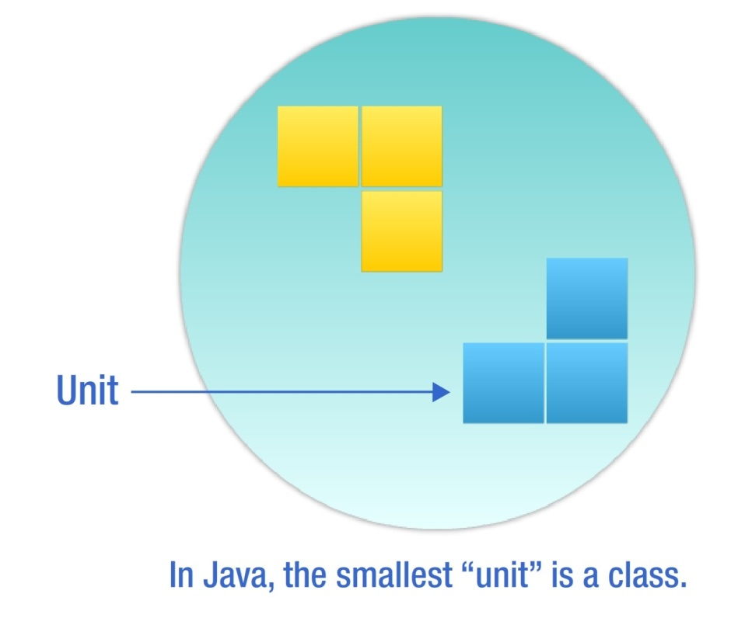
Unit Testing
Unit testing:
Is performed to validate the tester’s assumptions about the code design.
Is an effective method of testing. Each part of the program is isolated to determine which individual parts are correct
Involves testing the smallest unit of code under a variety of input conditions.
Class - Smallest Unit in Java
Notes:
(Participant Guide: Page 9)
Ask participants to share what they know about unit testing.
Explain that unit testing is performed to validate the tester’s assumptions about the design of the code, which means that it helps to check whether the code is doing what it is designed to do.
Explain that unit testing is an effective method of testing since by isolating each part of the program, it helps to determine which individual parts are correct. During a unit test, when the code is executed but the desired task is not performed, errors are identified and subsequently fixed.
Unit testing requires you to test the smallest unit of code under a variety of input conditions. In Java, this smallest unit of code is a class.
Ask participants to share some examples of a class.

Slide 9
Benefits of Unit Testing
The key benefits of unit testing are:
Ability to re-factor code with confidence
Proof that your code actually works
Availability of a regression-test suite
Demonstration of concrete progress
Notes:
(Participant Guide: Page 10)
Discuss the benefits of unit testing.
Ability to re-factor code with confidence: JUnit enables developers to re-factor code with confidence and by running the existing test cases, it makes sure that no new bugs are introduced.
Proof that your code actually works: Results in fewer bugs and better code
Availability of a regression-test suite: JUnit provides a low-effort way to catch bugs before the build goes off to QA.
Demonstration of concrete progress: Unit tests help you to demonstrate progress in parts and not wait for the entire code to be ready before it can be tested.
Ask participants to think of a scenario at work where unit testing might be best applicable.

Slide 10
JUnit Features
Asserts
Specify the expected output and compare it with the output received
Test setup and teardown
Sets up test data and tears down that data or context, before and after running the test, respectively
Exception testing
Tests and verifies whether an exception was thrown
Test suites
JUnit test cases are organized into test suites for better management
Parameterized testing
Creates tests that operate on sets of data that are fed into the tests
Rules
Extend the functionality of JUnit by adding behaviors to tests
Integration with popular build systems
Integrates with most of the popular build systems for Java, including ANT and Maven
Notes:
(Participant Guide: Page 12)
Explain to participants that they will now learn about JUnit’s role in testing. JUnit is packaged as a single jar file that is a library of functionality of unit testing code. For example, when you write unit testing code, you need a way to compare the output received with the output expected. JUnit provides you asserts and many ways of using them on common data types.
In addition to asserts, JUnit has many other features that simplify unit testing.
Discuss the features of JUnit.

Slide 11
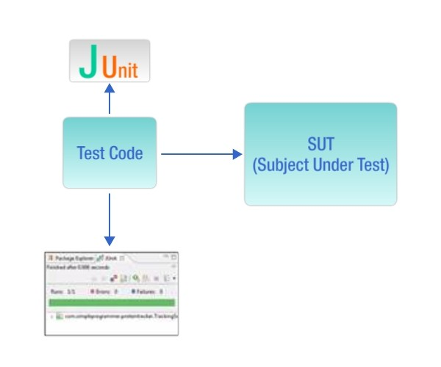
How JUnit Works
To test using JUnit:
Create a separate project for writing tests that test an SUT.
Use a JUnit runner to execute the test code. The runner:
Determines the tests that exist in the test code
Executes the tests
Reports the results, including reporting to a graphical view
Writing JUnit tests in an IDE helps you to get quick feedback regarding a test passing or failing.
Testing Using JUnit
Notes:
(Participant Guide: Page 12)
Explain how JUnit works.
To use JUnit for testing:
Create a separate project for writing tests that test an SUT, which is usually a Java class. The test code you write uses the capabilities of the JUnit framework to make it easier to compare results and set up and tear down tests.
Use a JUnit runner to execute the test code. The runner determines the tests that exist in the test code, executes them, and reports the results, including reporting to a graphical view. Usually, writing JUnit tests in an IDE helps you to get quick feedback regarding a test passing or failing.
In the testing-coding-testing cycle that JUnit follows, the test data for a piece of code is set up. This data can be first tested and then implemented. This approach increases the productivity of the programmer and the stability of the program code.

Slide 12
JUnit Syntaxes
Methods, annotations, and fixtures are some of the important parts of JUnit syntax.
Using annotations for creating and running JUnit tests has become easier and more effective.
Popular Annotations Used in JUnit
@BeforeClass
@Before
@Test
@After
@AfterClass
@Ignore
@Test(timeout=int)
@Test(expected=sampleexpected)
Notes:
(Participant Guide: Page 13)
Discuss JUnit syntaxes.
In order to write correct test cases in JUnit, it’s important to use the correct syntax. Methods, annotations, and fixtures are some of the important parts of JUnit syntax.
List the popular annotations used in JUnit test cases.
Explain that programs that use annotations are easier to read and write than the ones that do not use annotations. Let’s take up an example.

Slide 13
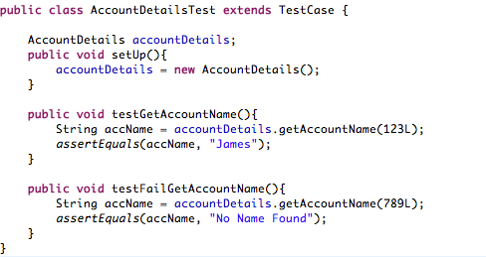
JUnit Syntaxes: Using Annotations
Test Case Without Annotations
Consider the test case for a program used to retrieve the name of an account holder based on an account ID. This test case does not use annotations.
Test Case Without Annotations
Notes:
(Participant Guide: Page 14)
Mention that JUnit versions that use annotations are easier to read and write than earlier versions that did not use annotations. Code Segment 1.1 on page 14 in the Participant Guide shows a simple program that is used to retrieve the name of an account holder based on an account ID.
For this program, the test case without annotations is as shown (refer to Code Segment 1.2 on page 14 in the Participant Guide). In this test case, the setup() method is used to initialize the test case and the “test” prefix is used to name the test case.
Next, let’s look at the test case that uses annotations.

Slide 14
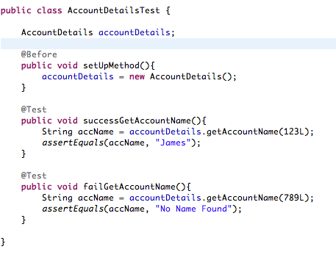
JUnit Syntaxes: Using Annotations
Test Case with Annotations
The test case for the same program, with the use of annotations.
The @Before and @Test annotations are used in this test case.
Test Case with Annotations
Notes:
(Participant Guide: Page 14)
Explain that in the later versions of JUnit, the setup() method and the “test” prefix are replaced by the @Before and @Test annotations, making it easy to recognize the initialization and test case. The code segment here shows the test case using annotations.
Earlier versions of JUnit needed you to prefix “test” to the test class while naming it. (refer to Code Segment 1.4 in the Participant Guide). In the later versions of JUnit, a method annotated with @Test is treated as a test case. Refer to Code Segment 1.5, which shows the use of the annotation @Test.

Slide 15
Test Methods
Test methods are used to create tests in JUnit.
To create a test method:
Define a method that:
Is public
Has a void return type
Add the JUnit test annotation @Test to it.
Note:
Test methods that test a specific class are usually grouped into one single class.
A test method should be named as descriptively as possible so that the name can help you to identify the purpose of the test.
Notes:
(Participant Guide: Page 16)
Explain that test methods are used to create tests in JUnit. To create a test method in JUnit 4:
Define a method that is public and that has a void return type.
Add the JUnit test annotation @Test to it.
Note:
Test methods that test a specific class are usually grouped into one single class.
A test method should be named as descriptively as possible so that the name can help you to identify the purpose of the test.
An example of a meaningful name is customerNameCannotBeNull (compared to testCase 1, which does not indicate the purpose of the test).

Slide 16
Basic Annotations
Annotations resemble meta-tags that you can add to your code.
Annotations apply to methods and provide information about methods.
The @Before and @After annotations allow you to specify some behavior to happen before and after each test is run.
import static org.junit.Assert.*;
import org.junit.Before;
import org.junit.Test;
public class ArthematicAddTest {
private int i, j;
@Before
public void setUp() {
i = 5;
j = 5;
}
@Test
public void testAdd() {
int result = i + j;
assertTrue(result == 10);
}
@After
public void tearDown() {
i = 0;
j = 0;
}
}
Using @Before and @After Annotations
Notes:
(Participant Guide: Page 16)
Discuss basic annotations. Annotations in JUnit are like meta-tags that you can add to your code. Annotations apply to methods and provide information about methods.
Example:
The @Before and @After annotations allow you to specify some behavior to happen before and after each test is run.
Explain that annotations will be covered in greater detail in the forthcoming lessons.

Slide 17
Fixtures
A test fixture is the fixed state of a set of objects that are the baseline for running tests.
The use of fixtures ensures that tests are run in a well-known and fixed environment to achieve repeatable results.
To achieve repeatable results, the tests are run multiple times.
Important: Maintain consistency in the testing environment while repeatedly running the tests.
Examples of Fixtures
A database loaded with specific, known data
A known set of files being copied
Preparing input data
Setting up or creating mock objects
Notes:
(Participant Guide: Page 17)
Explain that a test fixture is the fixed state of a set of objects that are the baseline for running tests.
Explain that the use of fixtures ensures that tests are run in a well-known and fixed environment to achieve repeatable results. To achieve repeatable results, the tests are run multiple times. To do this, it is important to maintain consistency in the testing environment. Stress on the importance of maintaining consistency in the testing environment while repeatedly running the tests.
Mention a few examples of fixtures.

Slide 18
Discussion
What are the JUnit syntaxes that you would use most in your work scenarios and why?
Notes:
Initiate a discussion among the participants. Some of the questions along with the possible discussion points are provided.
Question 1: What are the JUnit syntaxes that you would use most in your work scenarios and why?
This discussion should revolve around the following points:
The @Test annotation that instructs JUnit to run the public void method as a test case. To run the method, a fresh instance of the class is first constructed and annotated method is next invoked. JUnit reports failure when the test throws up exceptions.
The @Before annotation of a public void method enables that particular method to be run before the Test method.
Annotate a public static void method with no arguments with the @BeforeClass to make it run once before any of the test methods in the class.
Annotating a public void method with @After leads to that method being run after the Test method.
Applying the @AfterClass annotation to a public static void method causes that method to be run after all the tests in the class have been run.

Slide 19
Lesson 2: Jump-Start with JUnit
Notes:
(Participant Guide: Page 18)
Explain to participants that JUnit is so widely used that it is part of popular IDEs such as Eclipse and IntelliJ. You can always write tests without the help of an IDE but writing and running the tests in an IDE environment significantly improves your productivity and the stability of the program code because the IDE provides launch shortcuts, method templates, and run-time view to track test progress.
This lesson is aimed at providing an understanding of using JUnit after integrating it with Eclipse. In addition, the lesson describes how to write and run JUnit test cases and use annotations, keywords, and assert statements.

Slide 20
Lesson Objectives
Lesson 2: Jump-Start with JUnit
At the end of this lesson, you will learn to:
Use JUnit in integration with Eclipse.
Write and run JUnit test cases.
Use annotations, keywords, and assert statements.
Notes:
20
State the lesson objectives.

Slide 21
JUnit Installation, JUnit Integration with Eclipse, and Test Case Implementation
JUnit is included with Eclipse as a "JAR" containing a compressed archive of Java .class files and can be installed using the Eclipse IDE.
Installing and integrating JUnit with Eclipse are part of setting up JUnit.
To install JUnit in Eclipse using the JUnit 4 libraries that come prepackaged with Eclipse, perform the listed steps.
1. Right-click Project .
2. Click Property > Build Path > Configure Build Path.
3. Click Add Library > JUnit.
4. Choose JUnit 4.
5. Click Finish.
Installing JUnit in Eclipse
Notes:
(Participant Guide: Page 18)
Start by asking participants what they know about the Eclipse IDE.
Explain that JUnit is included with Eclipse as a "JAR" containing a compressed archive of Java .class files. It can be installed using the Eclipse IDE. Integrating JUnit with Eclipse allows manipulation of JUnit tests in the Eclipse IDE by running the test cases and analyzing test results.
Explain that setting up JUnit involves installing JUnit followed by integrating it with Eclipse. Explain the steps for installing JUnit in Eclipse using the JUnit 4 libraries.
Explain that if participants need to use a feature available in the latest version of JUnit 4, they need to perform the following steps:
Download the zipped JUnit distribution JAR file from http://www.junit.org.
Select Java Build Path in Project> Properties.
On the Libraries tab, select Add External Jars and select the JAR file you downloaded in Step 1.
Click OK to finish the installation.
Once JUnit is installed, it can be used to develop and run JUnit tests in Eclipse IDE. This method can be repeated to add the latest JUnit jars to the Eclipse IDE to access new libraries. (Refer to Figure 1.3 in the Participant Guide.)

Slide 22
Benefits of Using JUnit within the Eclipse IDE
Using JUnit within the Eclipse IDE is advantageous as it:
Can repeatedly run the same test. Use the following shortcuts:
Use Alt+Shift+X,t to re-run a test.
Use Alt+Shift+D,T to run a test in debug mode.
Improves coding efficiency with the use of the Eclipse editor template
Creates method stubs easily by using test method templates
Provides continuous updates for all tests running in a long test suite
Notes:
(Participant Guide: Page 19)
Explain that using JUnit within the Eclipse IDE provides several benefits:
While testing an application, you may need to run a test multiple times. This is made simpler by Eclipse, which re-runs a test when you press Alt+Shift+X,t and runs a test in the debug mode when you press Alt+Shift+D,T. Such launch shortcuts provided by Eclipse help to save time.
The Eclipse editor template helps in improving coding efficiency.
The Content Assist feature offers test method templates that can be used to create method stubs easily. To open Content Assist directly from a class, place the cursor where the new test method should be located, type test and press Ctrl+Space.
When running a long test suite, the JUnit view gives you a continuous update for all the tests that are running.

Slide 23
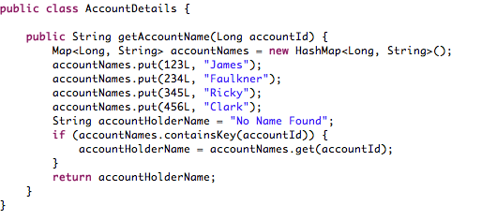
Writing JUnit Test Cases
Common practice: To write tests in another project that has the same name as the project to be tested (with “test” appended at the end).
Project Code for AccountDetails
Test Code for AccountDetailsTest
Notes:
(Participant Guide: Page 20)
Explain to participants that it is a common practice to write tests in another project that has the same name as the project you want to test, except that it will have ‘Test’ in the end. For example, if your project code is AccountDetails, then the name of the test project will be AccountDetailsTest (as shown).
To write a new JUnit test class:
In Eclipse, click File > New > JUnit Test Case. The New JUnit Test Case window of the New Wizard
Select the New JUnit 4 test radio button.
In the Name field, type the name of your test class. Figure 1.5 shows the New JUnit Test Case window. Refer to Figure 1.5 in the Participant Guide to know how the New JUnit Test Case window looks like.
Click Finish. The wizard, by default, creates a test class with a test method (annotated with @Test) and adds the necessary imports. This test method is ready to run. Refer to Code Segment 1.9 in the Participant Guide to know about the test case created for the JUnit class.

Slide 24
Writing JUnit Test Cases (Contd.)
To write a new JUnit test class, perform the following steps:
1. In Eclipse, click File > New >JUnit Test Case.
2. Select the New JUnit 4 test radio button.
3. In the Name field, type the name of your test class.
4. Click Finish.
The wizard, by default, creates a test class with a test method (annotated with @Test) and adds the necessary imports. This test method is ready to run.
Notes:
(Participant Guide: Page 20)
To write a new JUnit test class:
In Eclipse, click File > New > JUnit Test Case. The New JUnit Test Case window of the New Wizard opens.
Select the New JUnit 4 test radio button.
In the Name field, type the name of your test class. Figure 1.5 in the Participant Guide shows the New JUnit Test Case window.
Click Finish.
The wizard, by default, creates a test class with a test method (annotated with @Test) and adds the necessary imports. This test method is ready to run.
Code Segment 1.9 in the Participant Guide shows the test case created for the JUnit class.

Slide 25
Lab 1.1: Jump Start with JUnit
Problem Statement
Treasured Bank in Braddock has a simple application that allows clerks to access basic information of every customer who approaches a counter at the bank. This application accesses account information such as the customer’s name, account number, contact information, and account balance and a list of the latest account activities.
A recent upgrade to this system requires every customer to swipe their ATM card through a magnetic reader, which retrieves the customer’s information on the clerk’s computer screen. The new upgrade needs to be tested for accuracy and efficiency.
Notes:
Refer to the Lab Guide.
Lab 1.1: JumpStart with JUnit
The project files are part of the archive JUnit_Lab_Module 1.zip.
Problem Statement
Treasured Bank in Braddock has a simple application that allows clerks to access basic information of every customer who approaches a counter at the bank. This application accesses account information such as the customer’s name, account number, contact information, and account balance and a list of the latest account activities. A recent upgrade to this system requires every customer to swipe their ATM card through a magnetic reader, which retrieves the customer’s information on the clerk’s computer screen. The new upgrade needs to be tested for accuracy and efficiency.

Slide 26
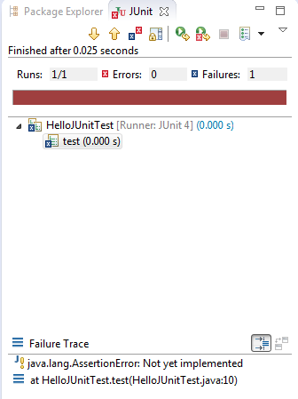
Running JUnit Test Cases
To run JUnit test classes in the Eclipse IDE, right-click a test case and select Run As > JUnit Test.
Alternatively, you can click the Run button on the Eclipse toolbar.
The test results will appear in the JUnit view. This view also shows:
The test run progress
The status
If there were multiple test methods in the class, all would run one by one.
JUnit View
Notes:
(Participant Guide: Page 22)
Discuss the running of JUnit test cases.
You can run JUnit tests in the Eclipse IDE with the JUnit plug-in. To run a JUnit test in the Eclipse IDE, right-click a test case and select Run As > JUnit Test or click the Run button on the Eclipse toolbar. The test results will appear in the JUnit view. This view shows you the test run progress and status, as shown in Figure 1.6 in the Participant Guide. Note that if you had multiple test methods in the class, all would run one by one.

Slide 27
Running JUnit Test Cases (Contd.)
Any of these methods can be used to run test cases, depending on the number of tests to be run:
Tests to be Run | Method
To run all tests | Click Run as > JUnit Test.
To run only one test method | In the Outline or Package Explorer, select the test method, and click Run as > JUnit Test.
To run a single test again | Select the test in the JUnit view and click Run.
Notes:
(Participant Guide: Page 22)
Explain the other methods that can be used to run test cases.
To run all tests included in a project, a source folder, or a package, select the required project, package, or source folder and click Run as > JUnit Test.
You can run only one test method. To do this, in the Outline or Package Explorer, select the test method and click Run as > JUnit Test.
To run a single test again, select the test in the JUnit view and click Run.
A test case is re-run after any bugs found in the first test run are fixed. You can do this by clicking the Rerun button on the JUnit view toolbar or by re-running the program that was invoked by activating the Run drop-down menu on the toolbar.
Example:
In the HelloJUnitTest class, commenting out the line where fail() function gets called, refer to Figure 1.7 in the Participant Guide to view the output for Rerunning a Test Case. Referring to the same figure, notice the icon that appears on the top bar when a test run is successful, but the workspace contents have changed since the last test run. Notice the difference in the icon, which appears when a test is successful.

Slide 28
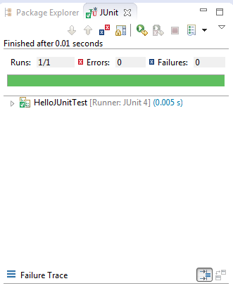
Running JUnit Test Cases (Contd.)
The output for re-running a test case is as shown:
This icon appears on the top bar when a test run is successful but the workspace contents have changed since the last test run.
This icon appears on the top bar when a test is successful.
Notes:
(Participant Guide: Page 22)
Explain the example of the HelloJUnitTest class. On commenting out the line where fail() function gets called, the output obtained is as shown. In the same figure, notice the icon that appears on the top bar when a test run is successful, but the workspace contents have changed since the last test run. Notice the difference in the icon, which appears when a test is successful.

Slide 29
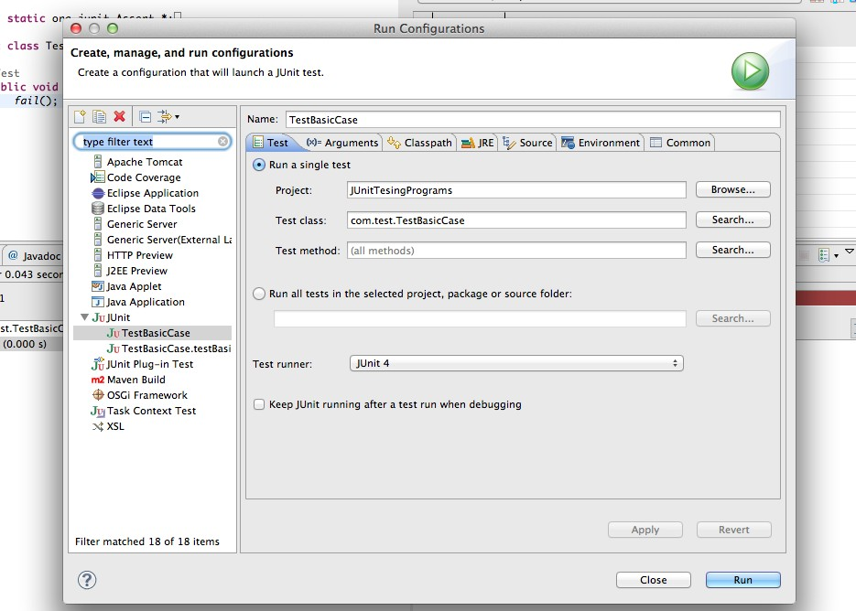
Customized Test Configurations
You can pass parameters to a test or customize the setting for a test run. To customize test configurations, use the options in the Launch Configuration Dialog.
Launch Configuration Dialog
Notes:
(Participant Guide: Page 24)
Explain how to customize test configurations. You can pass parameters to a test or customize the setting for a test run. To do this:
Open the Launch Configuration Dialog.
Select Open Run Dialog on the Run drop-down menu on the toolbar and specify:
The tests that should run from a given list
Parameters for the test, which allow the test to be run repeatedly with different variables
The test run-time classpath that looks for specific user-defined methods and classes to run
The Java run-time environment

Slide 30
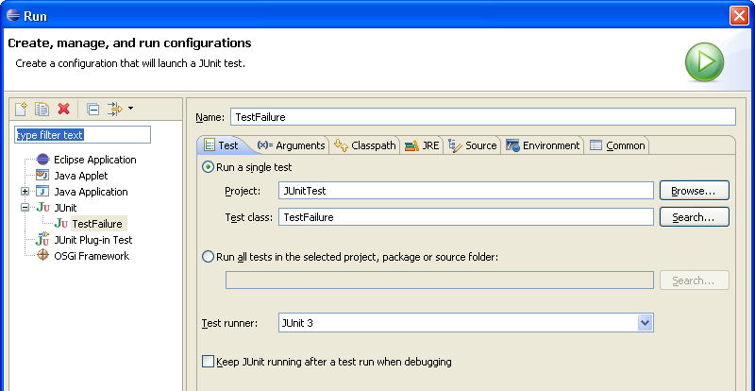
Debugging Test Failures
Debugging is the methodical removal of discrepancies in software to ensure it works to its full capacity.
When a test fails, you can debug it using the options on the Failure tab of the JUnit view.
To fix code and re-run tests, without having to restart the entire test run, select the checkbox for Keep JUnit running after a test run when debugging.
Fixing Code and Re-Running Tests
Notes:
(Participant Guide: Page 25)
Start by explaining that debugging is the methodical removal of discrepancies in software to ensure it works to its full capacity.
Initiate a discussion on why debugging a test failure is important.
Ask participants to share examples of debugging.
Explain that to debug a failed test, you can use the options on the Failure tab of the JUnit view. Double-click the failure entry to open the file in the editor. When the test code is displayed, add a breakpoint at the beginning of the test method. Select the test and select Debug as > JUnit test from the Debug drop-down menu.
The launch configuration has an option called “Keep alive,” which enables you to fix code and rerun tests, without having to restart the entire test run. To enable this feature, select the checkbox for Keep JUnit running after a test run when debugging.

Slide 31
Annotations and Assert Statements
Annotations:
Are tags that can be added to the code and then applied to methods or classes
Tell JUnit when to run a test method; in turn, promote efficiency by reducing the amount of coding required
Are predefined and can be implemented directly
Some predefined annotations available in JUnit are listed.
PREDEFINED ANNOTATIONS
@Test
@Before
@After
@BeforeClass
@AfterClass
@Ignore
Notes:
(Participant Guide: Page 26)
Start by discussing JUnit annotations and assert statements. Using annotations and assert statements make writing and reading JUnit tests easier. They help to improve the testing process by allowing you to set conditions and contexts for test methods and classes.
Annotations help in managing the run condition of the test method, and assert statements help by asserting conditions for the test method. Together, annotations and assert statements help in saving time and effort required to write JUnit tests.
Explain annotations in JUnit. Annotations are tags that can be added to the code and then applied to methods or classes. Explain that annotations set conditions for different test methods such as:
Specify that a test method should run before or after another specified method.
Specify that a test method should run before all other methods or after all other methods.
Specify that a test method should be ignored in a specified situation.
Identify the methods that are inclined to throw exceptions.
Explain how the use of annotations promotes efficiency as they reduce the amount of coding needed.
Example: An application converts input amounts in Dollars into Euro. Each method calculates the amount by performing the required multiplication. By annotating a method that acquires the latest conversion rates from the market to run first, you can ensure that all the conversions are up-to-date to the real-time values. In the absence of annotations, you would have to check if the conversion rates are current before each calculation. This would take longer to execute and much more coding will be required for every instance of conversion.
Annotations are predefined and can be implemented directly. Some of the predefined annotations available in JUnit are:
@Test
@Before
@After
@BeforeClass
@AfterClass
@Ignore

Slide 32
The @Test Annotation
Attached to a public void method
Informs JUnit that this method can be run as a test
Supports two optional parameters, expected and timeout
@Test
Expected
Timeout
Specifies that the test should throw a particular exception
Declares that a test has failed if it does not run within the given time limit
Notes:
(Participant Guide: Page 26)
Explain that the @Test annotation in JUnit is attached to a public void method and informs JUnit that this method can be run as a test. JUnit constructs a fresh instance of a class for the method it belongs to, before invoking the annotated method. JUnit reports any exception thrown by this method as a failure. The test is assumed to be a success if no exceptions are thrown.
Code Segment 1.10 in the Participant Guide shows an example of the use of the @Test annotation.
State that @Test supports two optional parameters, expected and timeout, which help to customize the @Test annotation and enable better reading of test results.
Expected: This argument specifies that the test should throw a particular exception. The test fails if it does not throw any exception or throws a different one.
Code Segment 1.11 in the Participant Guide shows an example of @Test that is successful.
Code Segment 1.12 in the Participant Guide shows see an example where the expected exception is not thrown, in which case the test will fail.
Timeout: This argument declares that a test has failed if it does not run within the given time limit (in milliseconds). If a proper timeout argument is not passed to a test, the test may go into an infinite loop.
Code Segment 1.13 in the Participant Guide shows an example of the timeout parameter.

Slide 33
The @Before and @After Annotations
These annotations are used when multiple tests need similar objects to run smoothly.
These objects are created in a superclass whose public void methods are annotated with @Before. As a result, the @Before methods of the superclass run before any of the Test class methods.
Annotating a public void method with @After causes it to run once after executing each test method, even if any of the @Before or Test class methods throw exceptions or fail.
Notes:
(Participant Guide: Page 28)
Explain that these annotations are used when multiple tests need similar objects to run smoothly.
These objects can be created in a superclass whose public void methods are annotated with @Before. This makes sure that the @Before methods of the superclass run before any of the Test class methods.
Code Segment 1.14 in the Participant Guide shows the use of the @Before annotation.
Resources allocated in the @Before method need to be released after the tests are run. Annotating a public void method with @After causes it to run once after executing each test method, even if any of the @Before or Test class methods throw exceptions or fail.
Code Segment 1.15 in the Participant Guide shows an example of the use of the @After annotation.

Slide 34
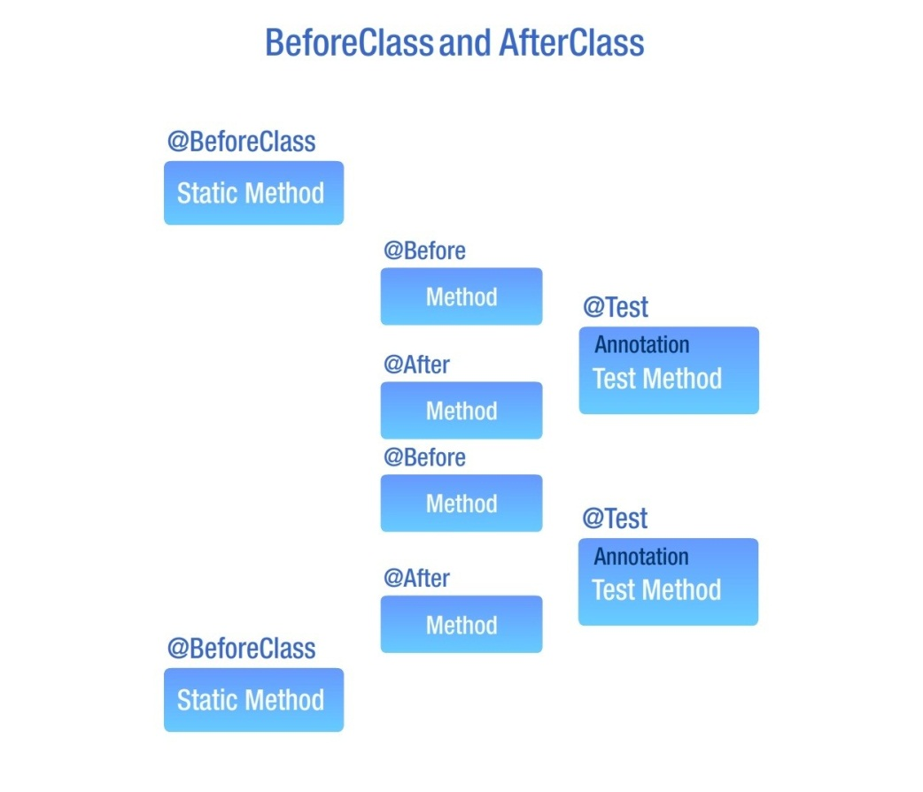
The @BeforeClass and @AfterClass Annotations
These annotations are used when several tests need to share expensive resources such as servers or databases.
A public static no argument method is annotated with @BeforeClass so that it runs once before any of the test methods in the current class are run.
A public static void method annotated with @AfterClass runs after all the other tests have run and releases the resources.
Notes:
(Participant Guide: Page 30)
Start by explaining that the @BeforeClass and @AfterClass annotations are used when several tests need to share expensive resources such as servers or databases to achieve optimization.
The @BeforeClass Annotation
Explain that a public static no argument method is annotated with @BeforeClass. This method will run once before any of the test methods in the current class are run. The @BeforeClass methods of superclasses are run before those of the current class. All the test methods that run thereafter will share resources.
Code Segment 1.16 in the Participant Guide shows an example of the use of the @BeforeClass annotation.
The @AfterClass Annotation
Resources allocated in @BeforeClass methods have to be released after all the tests in a class have run. A public static void method annotated with @AfterClass runs after all the other tests have run and releases the resources. A method annotated with @AfterClass will run even if @BeforeClass methods throw exceptions. The @AfterClass methods declared in the superclasses will be run after those of the current class.
This is used as a clean up after running tests, for instance, when disconnecting from a database.
Code Segment 1.17 in the Participant Guide shows an example of the use of the @AfterClass annotation.

Slide 35
The @Ignore Annotation
While testing, certain situations may not require a particular test or a group of tests.
All methods annotated with @Ignore are not executed, even if they are also annotated with @Test.
Annotating a class containing test methods with @Ignore will prevent all tests in that class from running.
Notes:
(Participant Guide: Page 33)
Discuss the @Ignore annotation. While testing, there may be situations that do not need a particular test or a group of tests. All methods annotated with @Ignore are not executed, even if they are also annotated with @Test. Annotating a class containing test methods with @Ignore will prevent all tests in that class from running.
Code Segment 1.18 in the Participant Guide shows an example of using the @Ignore annotation to prevent a particular test from running.

Slide 36
The Assert Class
Contains a set of assertion methods or assert statements that are used to write tests.
Assertion methods are statements that assert a condition set in the method.
Some important methods of the Assert class are:
Methods | Description
void assertEquals(boolean expected, boolean actual) | Checks if two primitives or objects are equal.
void assertFalse(boolean condition) | Checks if a condition set is false.
void assertNotNull(Object object) | Checks if an object is not null.
void assertNull(Object object) | Checks if an object is null.
void assertTrue(boolean condition) | Checks if a condition set is true.
void fail(string…) | Fails a test that has no messages.
Notes:
(Participant Guide: Page 34)
Explain that the Assert class contains a set of assertion methods or assert statements that are used to write tests. Assertion methods are statements that assert a condition set in the method. A method that is prefixed with “assert” becomes an assert statement and enforces the condition set in the method description.
When used in a test case, methods of the Assert class record only failed assertions. You can use these methods directly; however, they read better if they are referred by the static import methods. The table lists important methods of the Assert class.
Code Segment 1.19 in the Participant Guide shows an example of using methods of the Assert class.
Explain the assert keyword. In Lesson 1, you learned that assert is a keyword used in Java 1.4. The assert keyword helps testers to validate any assumptions made in a test case, allowing them to run the tests without exception handlers. Testers would find it confusing to differentiate between assert, the keyword, and assert, the class. To resolve this situation, JUnit 3.7 depreciated assert() and replaced it with assertTrue(). Similarly, JUnit 4 is compatible with the assert keyword, and assertions that fail are reported by JUnit.

Slide 37
Discussion
Discuss the various IDEs with which JUnit can be integrated.
What are the different ways in which JUnit annotations help us?
Notes:
Initiate a discussion among the participants. Some of the questions along with the possible discussion points are provided.
Question 1: Discuss the various IDEs with which JUnit can be integrated.
Discuss how popular IDEs like NetBeans, Eclipse, and IntelliJ provide support for JUnit.
Question 2: What are the different ways in which JUnit annotations help us?
This discussion should revolve around the following points:
JUnit annotations can be thought of as tags that are added to your code and apply them to classes and methods. These annotations give us information about test methods such as:
Which method is to run before running the test
Which method is to run after the test has run
Which of the tests are to be ignored
Which of the tests are most likely to throw exceptions
JUnit annotations make your test code easier to read and write.
Most annotations are predefined in JUnit 4.

Slide 38
Lesson 3: Exploring JUnit
Notes:
(Participant Guide: Page 37)
There are times when you may want to run multiple test classes together, without having to individually select and run each test class. JUnit provides a simple mechanism to do this through test suites. In JUnit, you can use test suites to run multiple test classes together. Moreover, you can combine and organize test suites into logical groups to gain a better control over the testing process and to run multiple tests with a single invocation.
This lesson describes how to compose test cases into test suites, combine and organize test suites, and execute them to show results.

Slide 39
Lesson Objectives
Lesson 3: Exploring JUnit
At the end of this lesson, you will learn to:
Compose tests with suites.
Combine test suites.
Organize test suites.
Execute a test case to show results.
Notes:
39
State the lesson objectives.

Slide 40
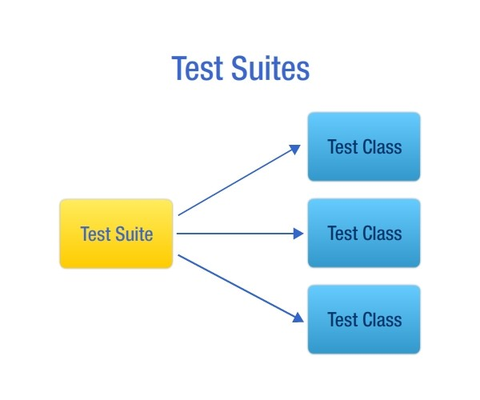
Composing Test Cases into Test Suites
In JUnit, when you group multiple test cases into a test suite, these test cases can be run together.
If bugs are detected on running the test suite, only the specific test case can be changed.
Test Suites
Notes:
(Participant Guide: Page 37)
Start by explaining to participants that in JUnit, when you group multiple test cases into a test suite in a logical manner, these test cases can be run together. If bugs are detected on running the test suite, it’s convenient to change only the specific test case, while leaving the others unchanged. Ask participants to point out a few real-life scenarios where test suites can be applied.
Share the example of an application used to test banking transactions that has test methods for credit testing, debit testing, and account creation grouped into separate suites. On running the suites, if bugs are detected in the debit portion of the code, you can change only the suite containing the debit testing methods, while leaving the other code stubs unchanged.
Proceed to explain about composing test suites into test cases.

Slide 41
Test Suites
Use the @RunWith and @SuiteClasses annotations to run the tests in a suite.
@RunWith: When you annotate a class with @RunWith or create a class that extends a class annotated with @RunWith, JUnit invokes the runner class mentioned in the annotation to run the tests.
@SuiteClasses: Specifies the list of test classes to be run.
An example of suites written using @RunWith and @SuiteClasses in JUnit is shown:
@RunWith(Suite.class)
@SuiteClasses(ATest.class, BTest.class)
public class ABCSuite{
…..
}
Notes:
(Participant Guide: Page 38)
Discuss the test suites. Tell participants that they can use the @RunWith and @SuiteClasses annotations to run the tests in a suite.
@RunWith: When you annotate a class with @RunWith or create a class that extends a class annotated with @RunWith, JUnit invokes the runner class mentioned in the annotation to run the tests.
@SuiteClasses: Specifies the list of test classes to be run.
An example of suites written using @RunWith and @SuiteClasses in JUnit is shown.

Slide 42
Combining Test Classes into a Suite with JUnit
Grouping test methods into suites allows ease of identification and manipulation.
Combining tests into a suite is a 3-step process:
1. Create a Java class.
2. Annotate the class with @RunWith(Suite.class).
3. Use @SuiteClasses to refer the JUnit classes.
Notes:
(Participant Guide: Page 38)
Start by explaining that methods in any programming language can be grouped logically for ease of identification and manipulation. Without such logical groups, a method can get lost in miles of coding and become difficult to change or replace. JUnit allows you to group test methods into suites.
Next state the three steps involved in combining tests into suites:
Create a Java class.
Annotate the class with @RunWith(Suite.class).
Use @SuiteClasses to refer the JUnit classes.

Slide 43
Combining Test Classes into a Suite with JUnit - Example
1. Create a Java class Account.java that defines these functions for a bank account—money transfer, money withdrawal, and money deposit in an account
2. Create test case classes by annotating a class with @RunWith(Suite.class).
3. Create a test suite that contains the test classes SavingsAccountTest and AccountTest.
Result: Two test case classes SavingAccountTest and AccountTest created and combined into a test suite named OverallBankingTester. When you run the suite, the results include:
The number of test cases that were run
The number of test cases that failed
The reason for failure of each test case that failed
Notes:
(Participant Guide: Page 38)
Discuss an example to show how to combine test classes into a suite:
1. Create a Java class that defines the following functions for a bank account:
Money transfer
Money withdrawal
Deposit money into an account
Code Segment 1.21 in the Participant Guide shows the creation of a class named Account.java.
Next, create a second Java class named SavingsAccount that calculates the interest for the amount in an account.
Code Segment 1.22 in the Participant Guide shows creating another class that extends the class Account.java that calculates the interest for the amount in the account.
2. Create test case classes by annotating a class with @RunWith(Suite.class). As there are two Java classes, you need to create two test classes and group them into a test suite.
Code Segment 1.23 in the Participant Guide shows how to create a test case class named SavingsAccountTest.java.
In this class, an exception is thrown when a transaction tries to withdraw an amount greater than the account balance, for example, withdrawing USD200 from an account that holds only USD100. You also create a test case class for the Java class Account.
Code Segment 1.24 shows how to create a test case class named AccountTest.java.
Note that the SavingsAccountTest and AccountTest classes are the test cases for SavingsAccount and Account.
3. Combine the test cases into a test suite. Create a test suite that contains the test classes SavingsAccountTest and AccountTest.
Code Segment 1.25 shows the creation of the test suite called OverallBankingTester.java.
Explain the results of the entire exercise. Two test case classes SavingAccountTest and AccountTest are created and combined into a test suite named OverallBankingTester. When you run the suite, the results will include:
The number of test cases that were run
The number of test cases that failed
The reason for failure for each test case that failed

Slide 44
Combining Test Suites
Multiple suites can be combined into a master suite.
Combining test suites logically and functionally helps in calling nested tests within each of the suites with just one invocation.
Suppose you are working with two test suites, and each suite contains two test classes, as listed:
OverAllCounterTester(Suite)
DecrementCounterTest IncrementCounterTest
OverallBankingTester(Suite)
AccountTest SavingsAccountTest
How do you combine these two test suites?
Notes:
(Participant Guide: Page 44)
Ask participants whether they have ever combined test suites.
Explain that multiple suites can be combined into a master suite. Just as combining tests into a suite helps in calling all the tests within the suite without having to invoke each test, combining test suites logically and functionally helps in calling nested tests within each of the suites with just one invocation.
Example:
Let’s consider a banking application that SmartSave Bank Inc. uses. The bank has multiple sectors, such as individual, business, and investment account holders, each of which has similar credit, debit, and billing transactions. The test methods for each type of transactions are grouped into suites. These suites can be further grouped into master suites for each sector. For example, all test suites for business account transaction tests can be combined into a master suite named BusinessAccountTests.
Suppose you are working with two test suites, and each suite contains two test classes, as listed:
OverAllCounterTester(Suite)
DecrementCounterTest
IncrementCounterTest
OverallBankingTester(Suite)
AccountTest
SavingsAccountTest
How do you combine these two test suites?

Slide 45
Combining Test Suites (Contd.)
Classes
DecrementCounter
IncrementCounter
Account
SavingsAccount
Test Classes
DecrementCounter
Test
IncrementCounter Test
AccountTest
SavingsAccount
Test
Suites
OverAllCounterTester
OverallBankingTester
Master Suite
OverallCombiningSuites
Notes:
(Participant Guide: Page 44)
To combine these test suites into a master suite, follow a method similar to the method for combining test cases into a suite. You create the Java classes DecrementCounter and IncrementCounter, write test case classes for these Java classes, and combine them in a test suite named OverAllCounterTester.
Create the first class DecrementCounter and its test class called DecrementCounterTest (Code Segments 1.26 and 1.27 in the Participant Guide).
Create the second class IncrementCounter and its test class IncrementCounterTest (Code Segments 1.28 and 1.29 in the Participant Guide).
Create a test suite called OverAllCounterTester (containing the test cases from DecrementCounterTest and IncrementCounterTest). (Code Segment 1.30 in the Participant Guide).
Combine the two test suites OverAllCounterTester and OverallBankingTester (containing test cases from AccountTest and SavingsAccountTest, as created in the previous topic) to create the mastersuite named OverallCombiningSuites (Code Segment 1.31 in the Participant Guide).
When you run the master class OverallCombiningSuites, you invoke both the subsuites it contains, OverAllCounterTester and OverallBankingTester. These suites, in turn, call all the test classes: SavingsAccountTest, AccountTest, IncrementCounterTest, and DecrementCounterTest. Therefore, a single invocation runs four different tests for four different classes. This is a significant advantage of using test case suites.

Slide 46
Organizing Test Suites
JUnit organizes test suites or you may do it manually.
Whenever a test case is created, JUnit automatically adds it to a suite.
To manually organize tests into suites:
Construct an instance of junit.framework.TestSuite.
Pass an object of the test class to the test suite constructor.
The syntax for the suite() method in the example class Games is:
public class Games extends TestCase{
public static TestGame suite(){
return new TestSuite(Games.class);
}
}
Syntax for the suite() Method
Notes:
(Participant Guide: Page 49)
Explain to participants that JUnit organizes test suites or it can be done manually. By organizing test suites, you can keep track of your testing code.
When you run a test case using text or graphical test runners, JUnit looks for the public static Test suite ( ) method. If JUnit cannot find this method, it uses reflection to automatically locate all test() methods in the test case, adds these to a suite, and runs these automatically.
Whenever a test case is created, JUnit automatically adds it to a suite.
Explain how you can manually organize tests into suites. Start by constructing an instance of junit.framework.TestSuite. Next, you pass an object of the test class to the test suite constructor. For example, a class Games contains methods to be added to a suite named TestGame. To the constructor of TestGame, pass an object of the class Games to add the class Games to the suite TestGame. The syntax for the suite() method is shown.
Explain that the syntax for the suite() method tells JUnit to add all the test* methods of the Games class to the suite TestGame and run these methods when invoked. You can also specify the order in which the tests are run using the suite() method, as shown in Code Segment 1.33 in the Participant Guide.

Slide 47
Discussion
Discuss various work-related scenarios, where combining test suites is most beneficial.
Discuss key criteria that influence the organizing of test suites.
Discuss the reasons why JUnit is the most popular and preferred unit testing framework.
Notes:
Initiate a discussion among the participants. Some of the questions along with the possible discussion points are provided.
Question 1: Discuss various work-related scenarios, where combining test suites is most beneficial.
Divide the class into groups. Ask each group to come up with the best strategy to combine their tests into a suite. Ask each group to identify the best strategy and share it with the other groups.
Question 2: Discuss key criteria that influence the organizing of test suites.
The discussion should revolve around the following points:
Test suites should be maintainable over long periods of time and should be accommodative of workflow changes.
Level of modularity required, depending upon the number of existing test cases that make test automation highly effective.
Using variables and parameters to ensure that different test data are used efficiently for different tests
Importing other test suites into the existing test suites
Organizing test suites on the basis of the knowledge level of test engineers
Placing components at the appropriate levels in any project
Question 3: Discuss the reasons why JUnit is the most popular and preferred unit testing framework.
This discussion should revolve around the following points:
Allows writing of test cases and also running them automatically whenever required.
Provides test results in report format especially when used with Maven.
Is a unit testing framework for the Java Programming Language.
Integrates well with tools such as Maven, ANT, and Eclipse that provide out-of-the-box support for JUnit.
Primarily focuses on Test Driven Development (TDD) aspect than the testing aspect.
Has unique features such as a set of assertions, allowing test setup and teardown, enabling exception testing.

Slide 48
Executing and Showing Results
When you execute the test suite, you obtain results.
Test results indicate whether the code logic works as defined in the project design and scope.
To execute the test suite:
Create a test runner class.
Compile all Java classes using javac.
Run the test runner, which, in turn, runs all test cases in the class.
Test runners are command line–based tools in Java programming language that run the invoked test methods.
Notes:
(Participant Guide: Page 50)
Until this point in the lesson, you created Java classes, their test case classes, and a test suite to hold the tests.
Next, explain executing the test suite and showing results. The test results indicate whether the code logic works as defined in the project design and scope. If the tests fail, you need to change or replace the code so that the project meets the requirement.
To execute the test suite:
Create a test runner class.
Compile all Java classes using javac.
Run the test runner, which, in turn, runs all test cases in the class.
Test runners are command line–based tools in Java programming language that run the invoked test methods. You can use these tools to start, stop, and repeat tests. You can also use them to retrieve test status or specify the number of times a test should be run.

Slide 49
Executing and Showing Results - Example
To create an example test runner named BankTestRunner.java:
Create a test runner named BankTestRunner.java in C:\ > JUNIT_WORKSPACE.
Executes the two suites OverallBankingTester and OverAllCounterTester, which are part of the master test suite, called OverallCombiningSuites
The test suite gives the result.
Notes:
(Participant Guide: Page 50)
Discuss the example of creating a test runner named BankTestRunner.java in C:\ > JUNIT_WORKSPACE.
This test runner will execute the two suites OverallBankingTester and OverAllCounterTester, which are part of the master test suite, called OverallCombiningSuites created earlier in this lesson.
Code Segment 1.34 in the Participant Guide shows how to create the test runner.
After execution, this test suite will give the result.

Slide 50
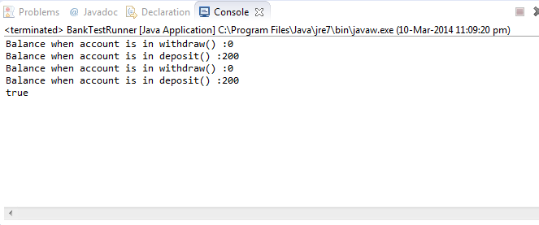
Executing and Showing Results – Example (Contd.)
The result given by the test suite is:
Result for Running the Suite OverallCombiningSuites
Notes:
(Participant Guide: Page 50)
The result given by the test suite is displayed on the screen.
Compared to this custom runner, if you were to execute OverallCombiningSuites.java in Eclipse (using Run as JUnit), you would obtain the output, as shown in Figure 1.13 in the Participant Guide.

Slide 51
Custom Test Runners
To write custom test runners, JUnit 4 provides the JUnit internal class BlockJunit4ClassRunner.
You can annotate a test with @RunWith and pass the test runner as an argument.
Consider an example of two simple test classes TestA and TestB:
Create a suite TestForUS for these classes with a test class Runtest.
To compile and test this suite, write a custom test runner programmatically.
Custom runners are easy to write and are useful for fixing specific problems during any part of the code development process.
Notes:
(Participant Guide: Page 51)
Discuss custom test runners. You can create custom test runners when JUnit does not have the test runners you need for your project environment. To write custom test runners, JUnit 4 provides the JUnit internal class BlockJunit4ClassRunner. You can annotate a test with @RunWith and pass the test runner as an argument. Running a test suite is quite flexible and allows new operations to be potentially inserted at any point.
Consider an example of two simple test classes TestA and TestB. Suppose you create a suite TestForUS for these classes with a test class Runtest, as shown in Code Segment 1.35 in the Participant Guide.
TestForUS will run the TestA and TestB classes. To compile and test this suite, you can write a custom test runner programmatically, as shown in Code Segment 1.36 in the Participant Guide.
Explain the benefits of custom runners. A key benefit is that they are easy to write and are useful for fixing specific problems during any part of the code development process. As a result, you can fix bugs and insert new methods into the source code without changing or examining the entire code.

Slide 52
Discussion
Discuss the reasons why JUnit is the most popular and preferred unit testing framework.
Notes:
Initiate a discussion among the participants. Some of the questions along with the possible discussion points are provided.
Question: Discuss the reasons why JUnit is the most popular and preferred unit testing framework.
This discussion should revolve around the following points:
Allows writing of test cases and also running them automatically whenever required.
Provides test results in report format especially when used with Maven.
Is a unit testing framework for the Java Programming Language.
Integrates well with tools such as Maven, ANT, and Eclipse that provide out-of-the-box support for JUnit.
Primarily focuses on Test Driven Development (TDD) aspect than the testing aspect.
Has unique features such as a set of assertions, allowing test setup and teardown, enabling exception testing.

Slide 53
Lab 1.2: Exploring JUnit
Problem Statement
You need to organize the test classes you created in the previous lab. To do this, create test suites and add the test classes into the test suites.
Notes:
Refer to the Lab Guide.
Lab 1.2: Exploring JUnit
The project files are part of the archive JUnit_Lab_Module 1.zip.
Problem Statement
You need to organize the test classes you created in the previous lab. To do this, create test suites and add the test classes into the test suites.

Slide 54
Best Practices
Run tests completely in memory.
Write each test such that it is independent of others.
Run every test.
Write each test to perform only one assertion.
Write tests with the strongest assertion possible.
Use the most appropriate assertion methods.
Use assertion parameters in the proper order.
Ensure that the test code is separate from the production code.
Rewrite before debugging
Add a timeout.
Name your tests well.
Target exceptions.
Do not use static members.
Keep the test hard to pass.
Notes:
(Participant Guide: Page 53)
To start with, ask participants to share the best practices they use to write JUnit tests in an efficient manner. Discuss the best practices will enable you to write JUnit tests that run quickly and are extremely reliable:
Run tests completely in memory: JUnit tests that make HTTP requests or access a database or a file system become slow and unreliable. Such activities involve location configuration, which may get complicated and also require external files to be added to the source control. These activities are better tested using functional tests.
Write each test such that it is independent of others: Nesting test cases will prevent you from finding the root cause and location of a test failure. This also creates a dependency, such that if you need to change one test case, it will affect all the others. It is recommended that you use the @Before and @After methods to set up prerequisites for your test case.
Run every test: There are numerous tests in a given test code. There are methods to skip tests like JUnit’s @Ignore annotation or Maven’s maven.test.skipproperty. These should be avoided. Skipping does not offer any benefit as all the tests are checked out of the source control and compiled. Instead of skipping tests, it is better to remove them altogether from the source control.
Write each test to perform only one assertion: When a test performs a single assertion, it becomes easier to determine what went wrong in the event the test code fails. For instance, suppose a test carries three assertions and the first assertion throws an exception. The second and third assertions do not happen. JUnit reads the test as a failure and moves on to run the next test method. Therefore, it is better to write a single assertion for performing a test.
Write tests with the strongest assertion possible: Writing tests with strong assertions ensures coverage and the production code behaving properly.
Use the most appropriate assertion methods: There are many assertion methods available in the latest version of JUnit. You need to be aware of them and use the best to have readable test code. For example:
Use assertTrue(classUnderTest.methodUnderTest()) rather than assertEquals(true, classUnderTest.methodUnderTest()).
Use assertEquals(expectedReturnValue, classUnderTest.methodUnderTest()) rather than assertTrue(classUnderTest.methodUnderTest().equals(expectedReturnValue)).
Use assertEquals(expectedCollection, classUnderTest.getCollection()) rather than asserting on the collection's size and each of the collection's members.
Use assertion parameters in the proper order: The parameters in JUnit assertions are of two types, expected and actual. The expected parameter should precede the actual parameter. This ensures that the code message is accurate.
Test code vs. Production code: Ensure that the test code is separate from the production code. It is preferred to put the test classes into the same package as the project classes they test, but in a different physical directory, as shown:
myproject/src/com/foo/Bar.java
myproject/test/com/foo/BarTest.java
In a Maven project, it would look like this:
myproject/src/main/java/com/foo/Bar.java
myproject/src/test/java/com/foo/BarTest.java
The main advantage is that the test classes can access (and test) package-scope classes and members. Since the test classes have the name of the tested class plus Test as a suffix, this helps finding them quickly.
Rewrite before debugging: When a test case fails, write more test cases to track down the problem before accessing the debugger. Also, add a new test case for every bug you find and fix to re-check the code.
Add a timeout: To every test case you write, add a default timeout to prevent it from going into an infinite loop. Also ensure that your tests are time independent.
Name your tests well: All the test cases you write should be named clearly and consistently. The name of the test case must reflect what the test case actually does or tests.
Target exceptions: Create unit tests that target exceptions. Use the expected attribute of the @Test annotation. Avoid catching exceptions in the catch block and using the fail/assert method to complete a test.
Do not use static members: In a test class, do not use static members, as each test case should be kept independent of the others. If you have any static members, then re-initialize them to their initial value before executing the test.
Keep the test hard to pass: A well-written test is hard to pass. If a test case passes easily, then it may not be evaluating the test object accurately or thoroughly. Also, ensure that you test everything that can possibly break in your code.

Slide 55
Module Summary
In this module, you learned about the following:
Need for software testing
Introduction to unit testing
JUnit installation and integration with Eclipse IDE
Writing and testing JUnit test cases
Executing a test case
Notes:
(Participant Guide: Page 55)
Summarize the key learning points.
Conduct a brief question-and-answer session to clarify doubts, if any.
Relate how the test cases created in JUnit will be used to run JUnit tests using Maven and create reports, which will be covered in Module 2.

