Slide 1

University Home Page
Performed by - ANURAG

Slide 2
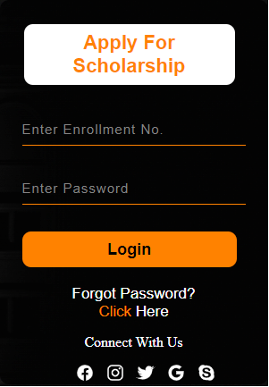
HREF Attribute

Slide 3

Div class menu

Slide 4

Thankyou

