Slide 1
Pizza Sales SQL Analysis
Anurag Singh | Tools: MySQL, Excel

Slide 2
Dataset Overview
- Orders table with timestamps
- Pizza types, name, sizes
- Order details including quantity and price

Slide 3
Project Objective
- Analyze pizza sales trends
- Identify top products and sizes
- Understand revenue patterns

Slide 4
SQL Approach
- Used JOINs, GROUP BY, Rank, PARTITION BY, ORDER BY
- Segregated queries into basic, intermediate, advanced
- Calculated revenue, quantities, trends

Slide 5
Key Insights
- Large-sized pizzas are most ordered
- Peak order time is between 12–1 PM & in evening 4-8 PM
- Most ordered pizza - The Classic Deluxe Pizza
- Most Revenue Generated pizza - The Thai Chicken Pizza

Slide 6
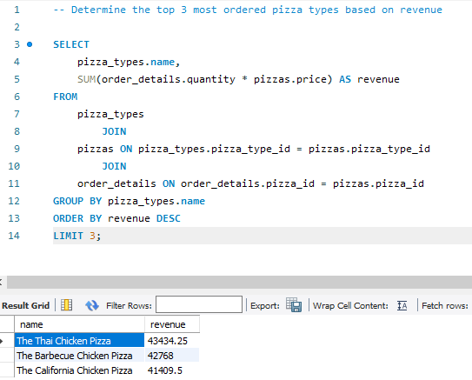
Top 3 pizza by revenue

Slide 7
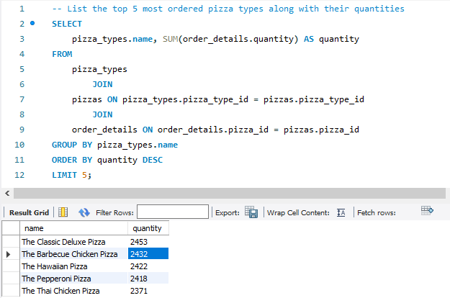
5 Most Ordered Pizza

Slide 8
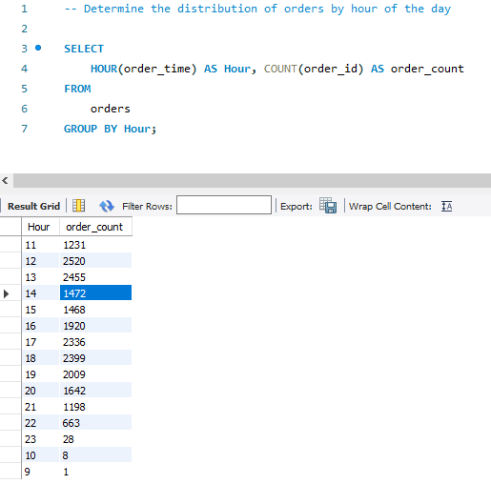
Order Distribution by Hours

Slide 9
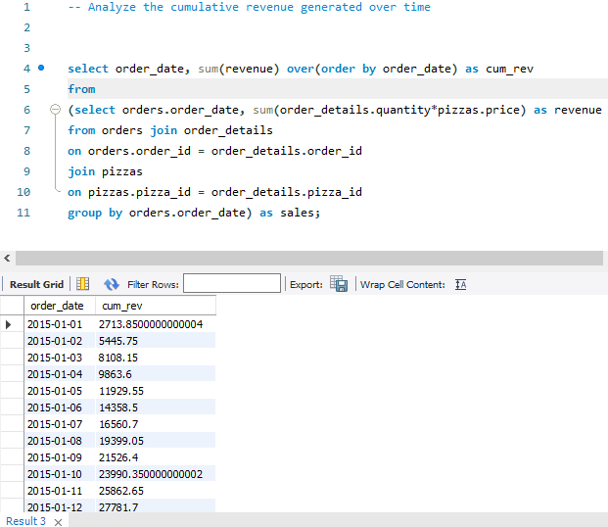
Cumulative revenue Generated over time

Slide 10
Conclusion & Recommendations
- Focus marketing on best-selling pizzas
- Promote less popular categories during peak hours
- Expand popular sizes and combos

