Slide 1



PODSCRIBE!
An AI tool that is more than just a summarizer, it's your personal podcast concierge!

Slide 2
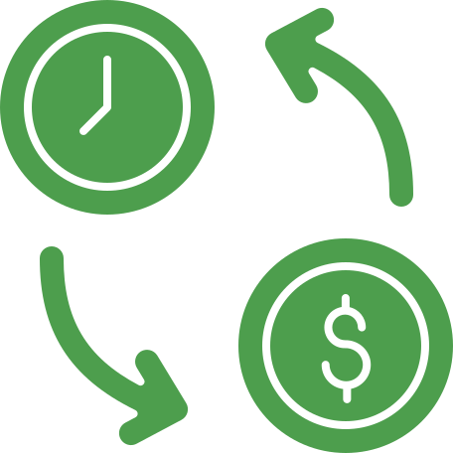
THE PROBLEM...
Information Overload: The Podcast Conundrum
Consuming entire podcast episodes can be time-consuming, making it difficult to keep up with content you’re interested in.
Traditional methods of note-taking can be cumbersome and inefficient.

Slide 3
Personalized Consumption
Quickly assess if a podcast aligns with your needs before committing, to curate a personalized learning experience
Why do we even need to summarize a podcast?
Time Crunch Savior
learn on-the-go
Content Discovery Made Easy
Browse summaries to find podcasts relevant to your interests, no time wasted sampling full episodes
The human attention span “8.5” seconds
and with the growth of short-form content of fast media it is bound to decrease
Accessibility
Benefit those with auditory processing difficulties or who prefer text-based learning
Boost Learning & Retention
Focus on key takeaways with summaries, and improve information recall and understanding

Slide 4


Applications
Educational
& Corporate
Medical
Finance
Medical Student/Resident Learning AidTime-Saving Tool
Clinical Trial Summarization
Patient Education
Market News Summarization
Investment Research Support
Financial Literacy Tool
Class recording summarization
Personalized Learning
Meeting summarization

Slide 5
TECH STACK
Gemini flow
Flask
HTML CSS JS
Gemini API
ASSEMBLY AI API
Azure flow
Azure speech service
Azure Language service
Azure storage

Slide 6

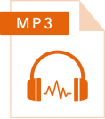

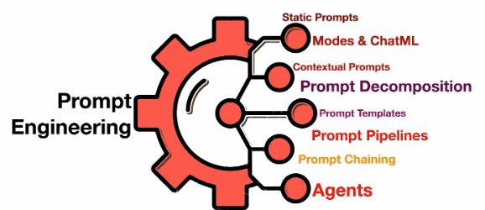


Transcription
Youtube Link
Download MP3 using Python
Technical Deep Dive
Behind the Scenes: Podscribe’s Gemini flow
Summarization
Summary

Slide 7
DEMO 1

Slide 8
Limitations of PodScribe Gemini Flow
There may be inconsistencies with speaker name identification
Any use of profanity within the podcast may lead to the model not giving a summary due to the terms of use of Gemini
Larger podcasts might contain too many tokens for the model

Slide 9
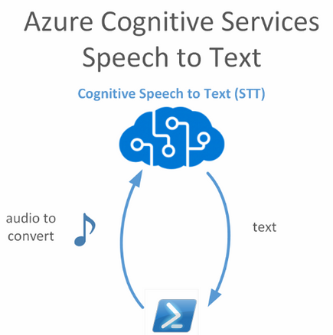
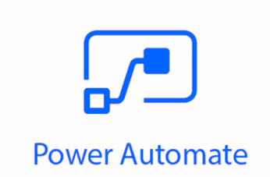
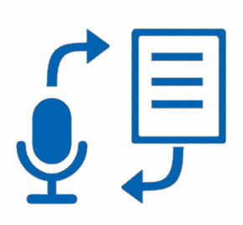
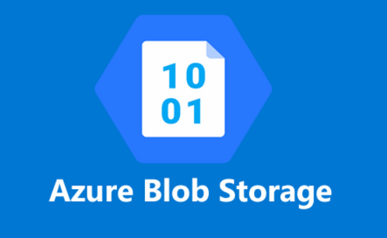
Technical Deep Dive
Behind the Scenes: Podscribe’s Gemini flow
Youtube Link
Download MP3 using Python
Azure speech-to-text
Summary

Slide 10
DEMO 2

Slide 11
Limitations of PodScribe Azure Flow
The transcription is accurate but slow
The free model only checks for updates every 5 minutes
Testing is difficult due to the time taken for the flow

Slide 12



WE INVITE YOU TO JOIN US IN REVOLUTIONIZING PODCAST CONSUMPTION!
Like
Share
PodScribe!

