Slide 1
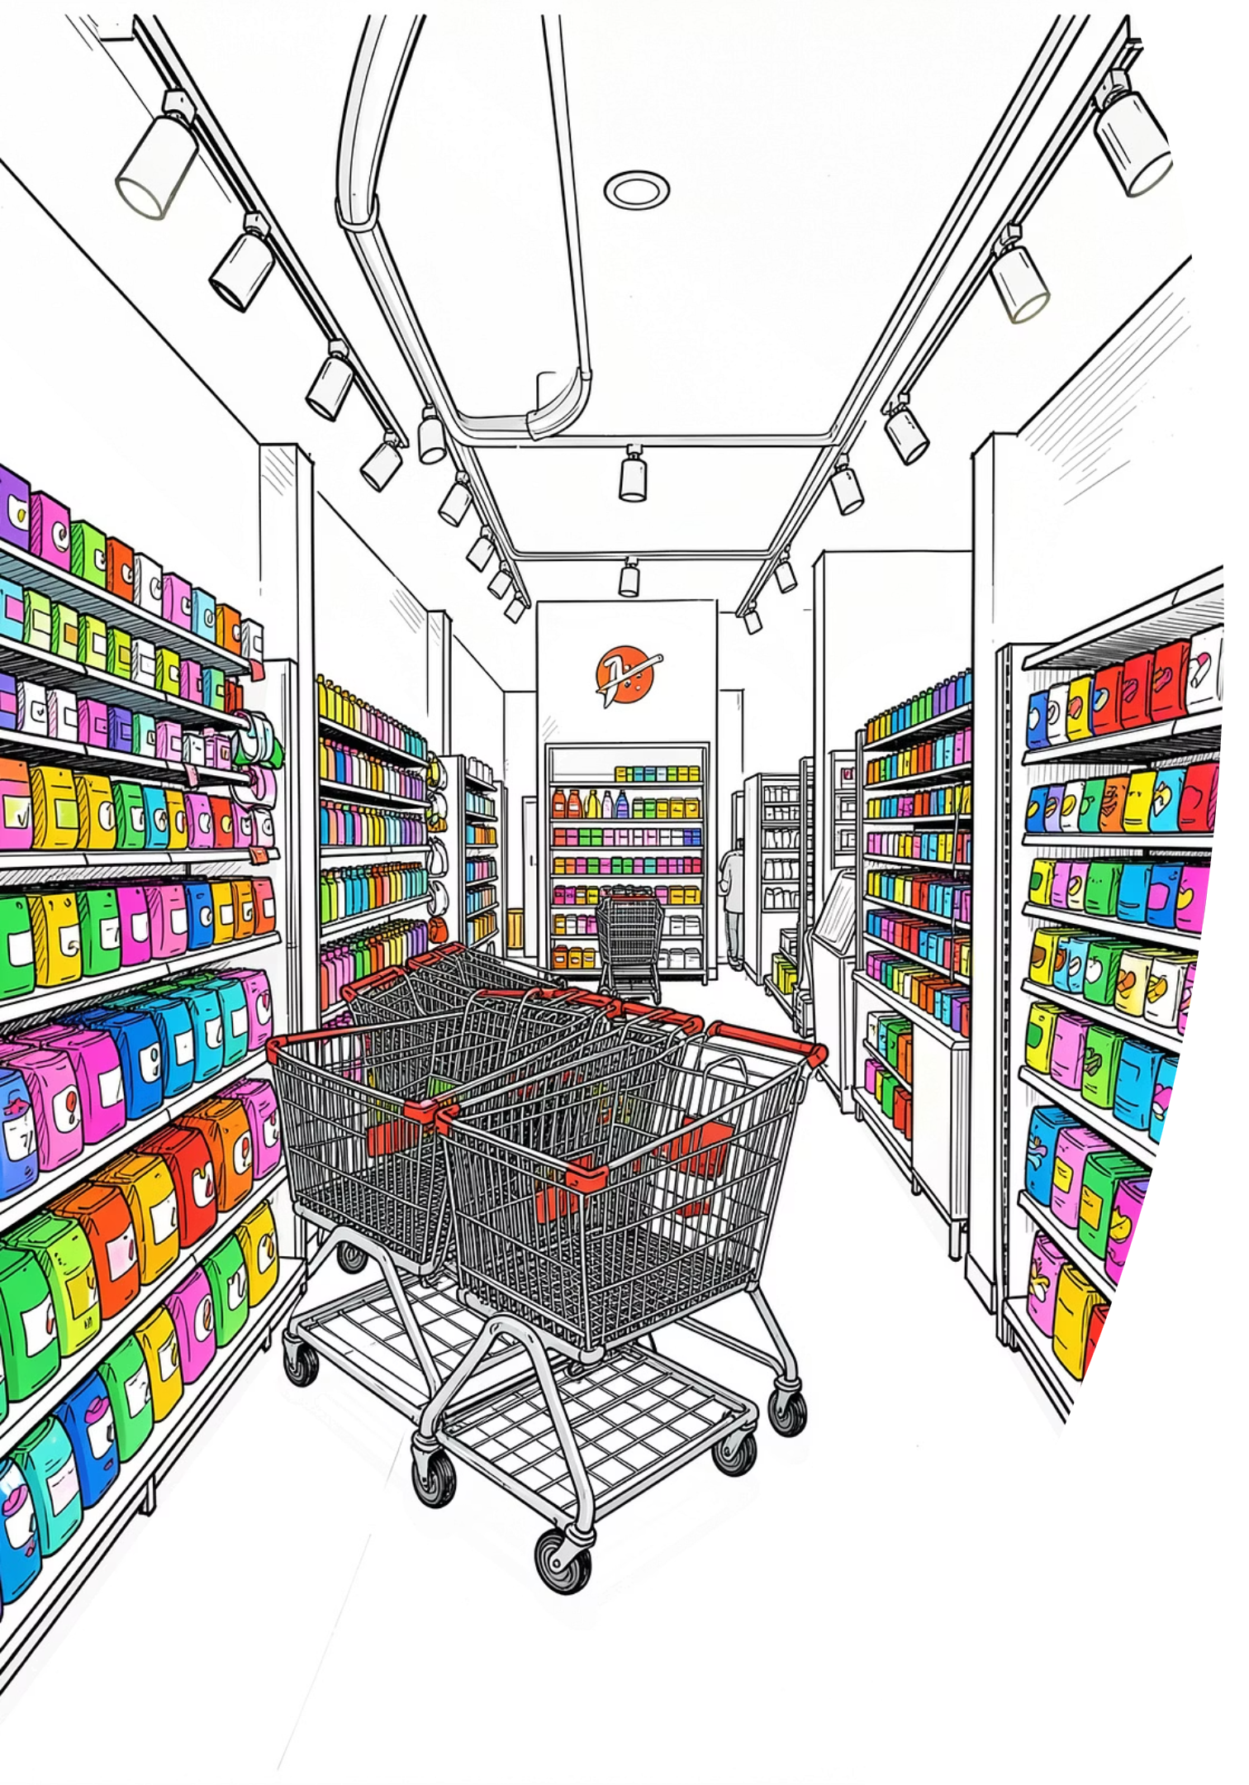

Customer Shopping Behavior Analysis
Uncovering insights from 3,900 transactions across demographics, preferences, and spending patterns.

Slide 2
Dataset at a Glance
3,900
18
Transactions
Features
37
$59.76
Missing Values
Avg Purchase
Review Rating only
Features span demographics, purchase details, and shopping behavior.

Slide 3

Data Preparation in Python
01
Load & Explore
pandas, df.info(), describe()
02
Clean & Impute
Median fill for Review Rating
03
Feature Engineer
age_group, purchase_frequency_days
04
Load to PostgreSQL
Cleaned DataFrame to DB

Slide 4
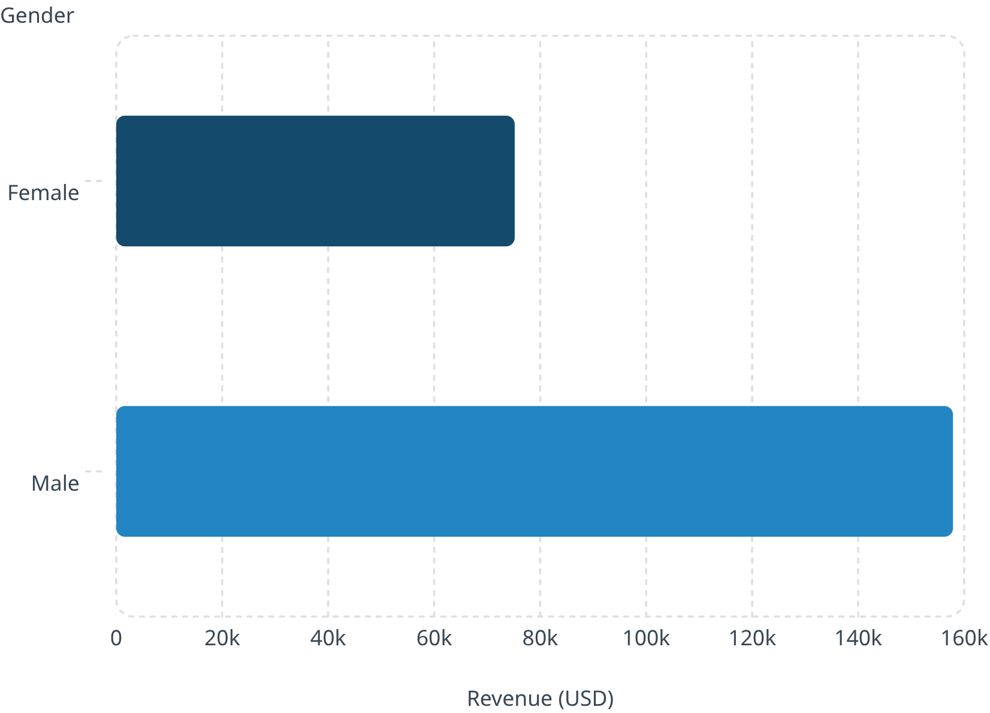

Revenue by Gender
Key Finding
Male customers generate 2.1× more revenue than female customers — a critical segmentation insight.
Male: $157,890 · Female: $75,191

Slide 5
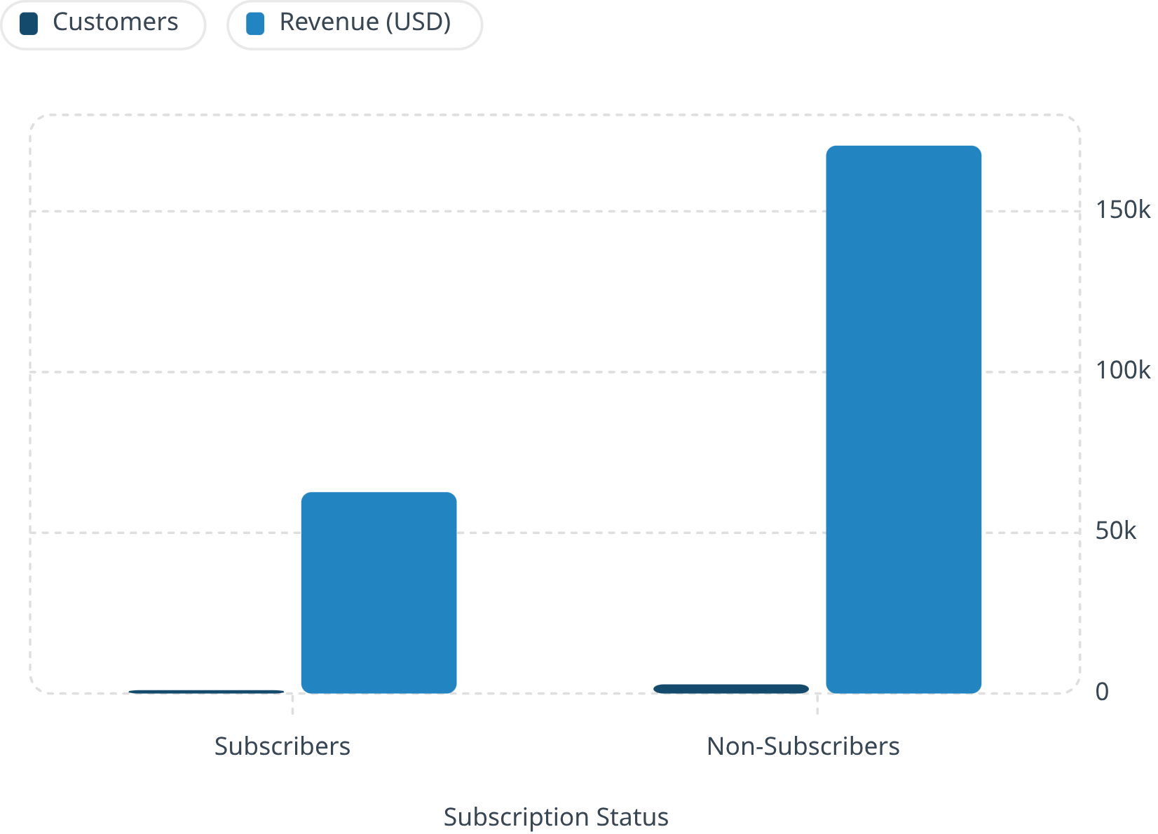
Subscribers vs. Non-Subscribers
Insight
Non-subscribers drive 73% of customers and 73% of revenue. Huge opportunity to convert.
Avg spend nearly identical (~$59.50)
Subscribers: 27% of base

Slide 6
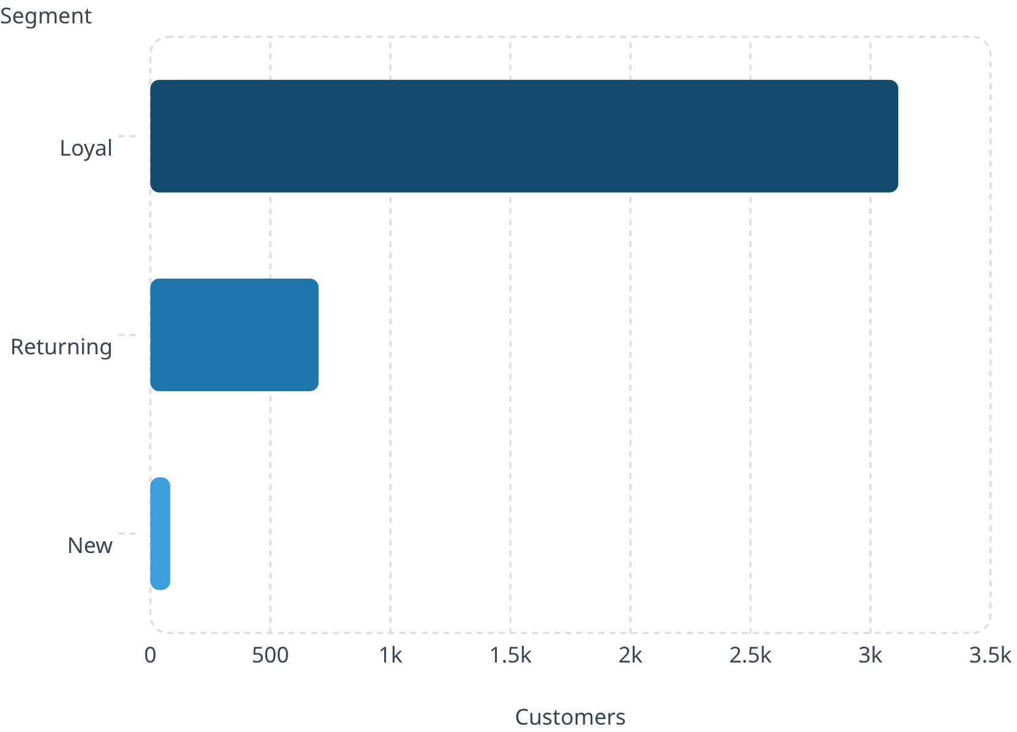

Customer Segmentation
Segment Breakdown
Loyal — 80%
3,116 customers
Returning — 18%
701 customers
New — 2%
83 customers

Slide 7
Products & Discounts
Top Rated Products
Highest Discount Rates
Item
Avg Rating
Item
Discount %
Gloves
3.86
Hat
50%
Sandals
3.84
Sneakers
49.66%
Boots
3.82
Coat
49.07%
Hat
3.80
Sweater
48.17%
Skirt
3.78
Pants
47.37%

Slide 8
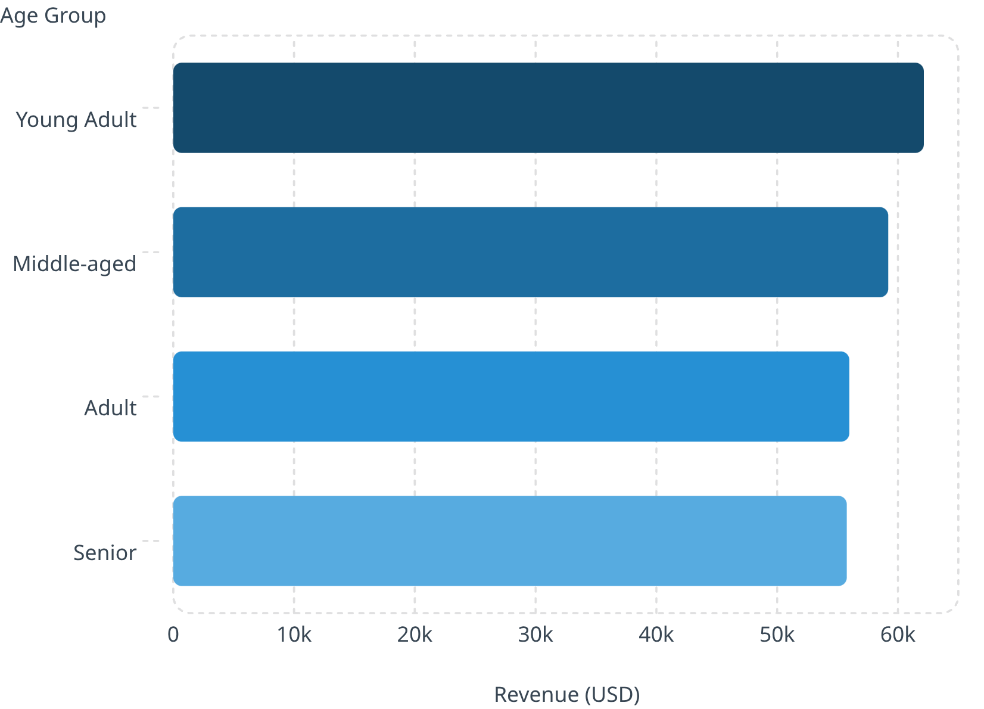
Revenue by Age Group
Insight
Young Adults lead revenue at $62K. Revenue is fairly distributed — all groups are valuable targets.
Express shipping users spend slightly more ($60.48 vs $58.46)

Slide 9
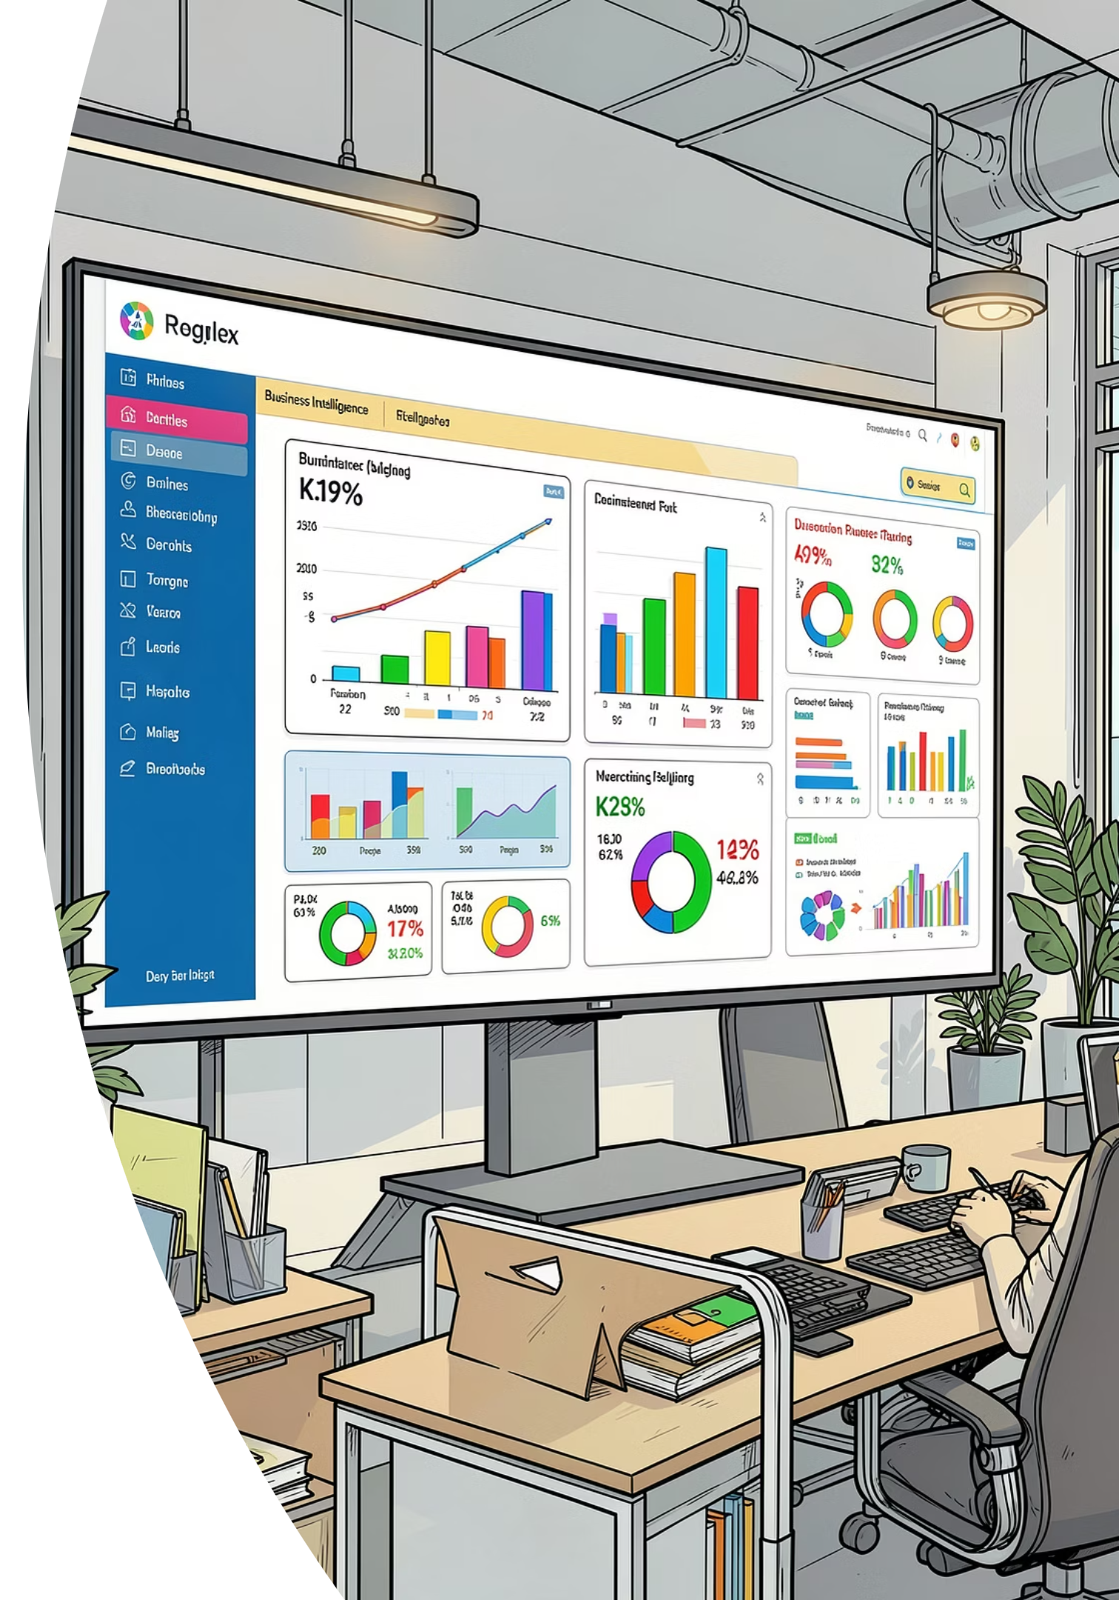
Power BI Dashboard
3.9K Customers
$59.76 Avg Purchase
3.75 Avg Rating
27% Subscribers
Interactive views: subscription status, revenue by category, sales by age group.

Slide 10





Business Recommendations
Boost Subscriptions
Promote exclusive subscriber benefits
Loyalty Programs
Reward repeat buyers → Loyal segment
Review Discount Policy
Balance sales lift with margin control
Targeted Marketing
Focus on high-revenue age groups & express shipping users

