Slide 1

Stock Price Prediction Using Machine Learning
Graphic Era Hill University Dehradun
This presentation discusses how a stock price-predicting machine learning model is built and deployed. We will look at data preparation, model selection, performance posting, and deployment using Streamlit.
Anurag Verma G2/14

Slide 2
Understanding the Data Sources
Financial Data
Using financial data sources, such as Yahoo Finance, enables us to collect historical stock prices, economic aggregates, and so on.
Alternative Data
Exploring alternative data sources such as
social media sentiment, news articles, and
consumer behavior data can enhance model accuracy.

Slide 3

Preprocessing the Data
1
Data Cleaning
Addressing missing values and outliers ensures data integrity .
2
Data Transformation
Transforming data using techniques like scaling or normalization ensures consistency and facilitates model training.
3
Feature Engineering
Creating new features from existing ones can improve model performance by capturing complex relationships.

Slide 4
Building the Machine Learning Model
Model Selection
Choosing an appropriate model based on the dataset and desired outcome.
1
Model Training
Training the model using historical data to learn patterns and relationships.
2
Hyperparameter Tuning
Optimizing model parameters to achieve optimal performance and minimize errors.
3

Slide 5
Evaluating the Model Performance
Metrics
Evaluating model performance using metrics such as mean squared error (MSE), root mean squared error (RMSE), and R- squared.
Backtesting
Testing the model on historical data to assess its ability to predict past price movements.

Slide 6
Deploying the Model with Streamlit
Model Integration
Integrating the trained model into a Streamlit application for user interaction.
User Interface
Creating a user-friendly interface for inputting stock details and viewing predictions.

Slide 7
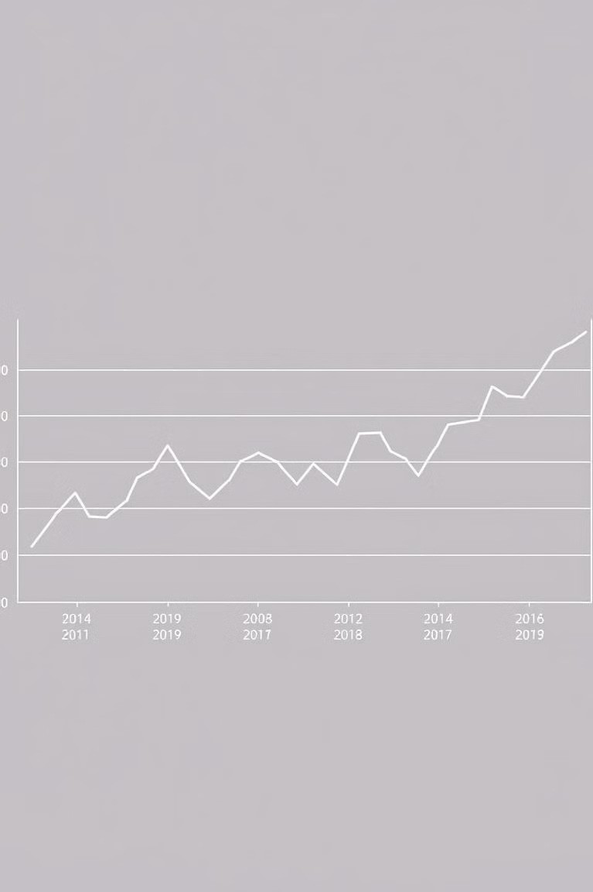
Visualizing the Predictions
1
Actual vs. Predicted
Visualizing the predicted stock prices alongside actual prices to assess accuracy and model performance.
2
Trend Analysis
Analyzing the predicted trends and identifying potential buying or selling opportunities.

Slide 8
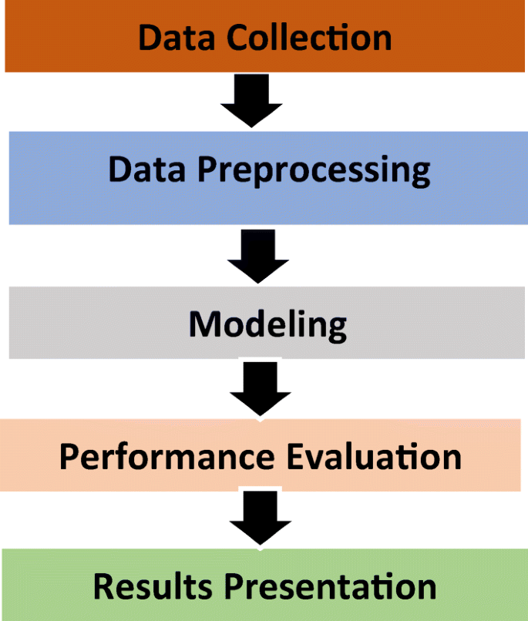
Conclusion and Next Steps
Future Improvements
Exploring further data sources, model architectures, and testing on larger datasets to enhance accuracy .
Real-Time Predictions
Integrating real-time data updates to generate continuous predictions and adapt to changing market conditions.

Slide 9
Thank You

