Slide 1
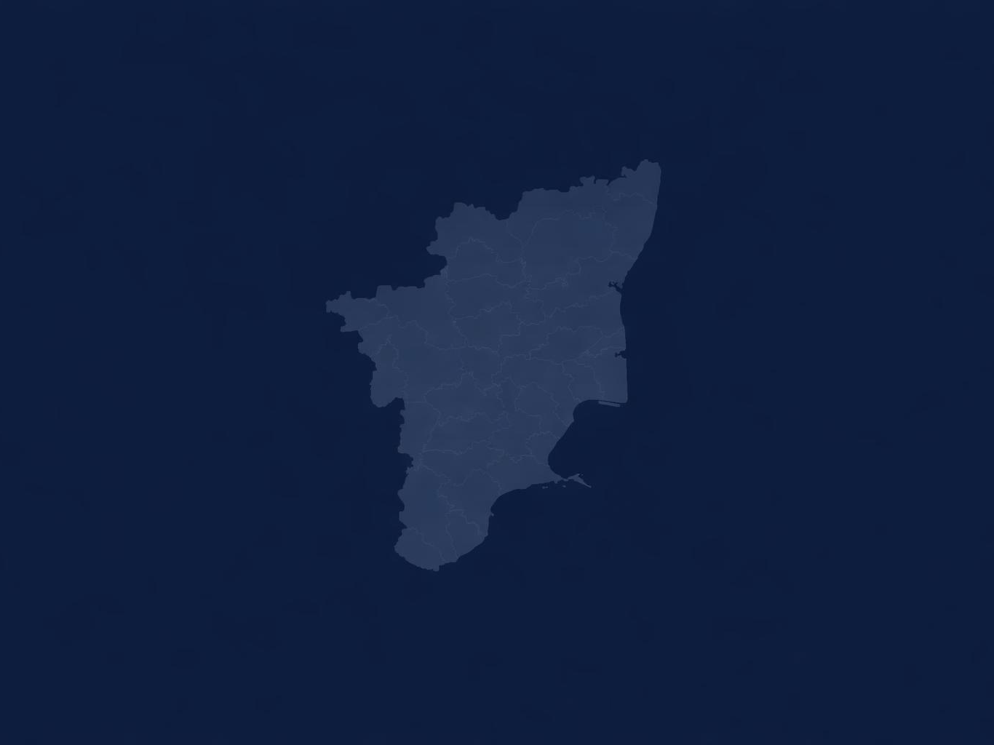
DATA ANALYTICS PROJECT
Tamil Nadu Election 2021 vs 2026
Regional and Electoral Shift Analysis
By ANURAG GUPTA
TOOLS USED
Python
Power BI
Pandas
Plotly

Slide 2
Project Objective
This project analyzes how Tamil Nadu’s political landscape changed between the 2021 and 2026 elections using regional, constituency, and vote-share level analysis.
01
02
Regional Political Shifts
Constituency Volatility
Analyze how party dominance changed across Tamil Nadu’s six regions.
Identify constituencies and regions where electoral control changed hands.
03
04
Vote Redistribution
TVK Emergence
Compare party-wise vote gains and losses between elections.
Examine the rise of TVK as a statewide electoral force in 2026.

Slide 3
Methodology
01
02
03
04
05
Data Collection
Data Cleaning
Election Comparison
Regional & Vote Analysis
Power BI Storytelling
Compiled 2021 and 2026 election datasets.
Cleaned constituency, party, and regional data for consistency.
Compared winners, votes, and seat changes across elections.
Aggregated results by region to study fragmentation and redistribution.
Built storytelling dashboards to communicate insights visually.
CSV • Python
Pandas
Python
Pandas
Power BI
TOOLS USED
Python
Data Processing
Pandas
Cleaning & Aggregation
Plotly
Exploratory Visualization
Power BI
Dashboard Storytelling

Slide 4
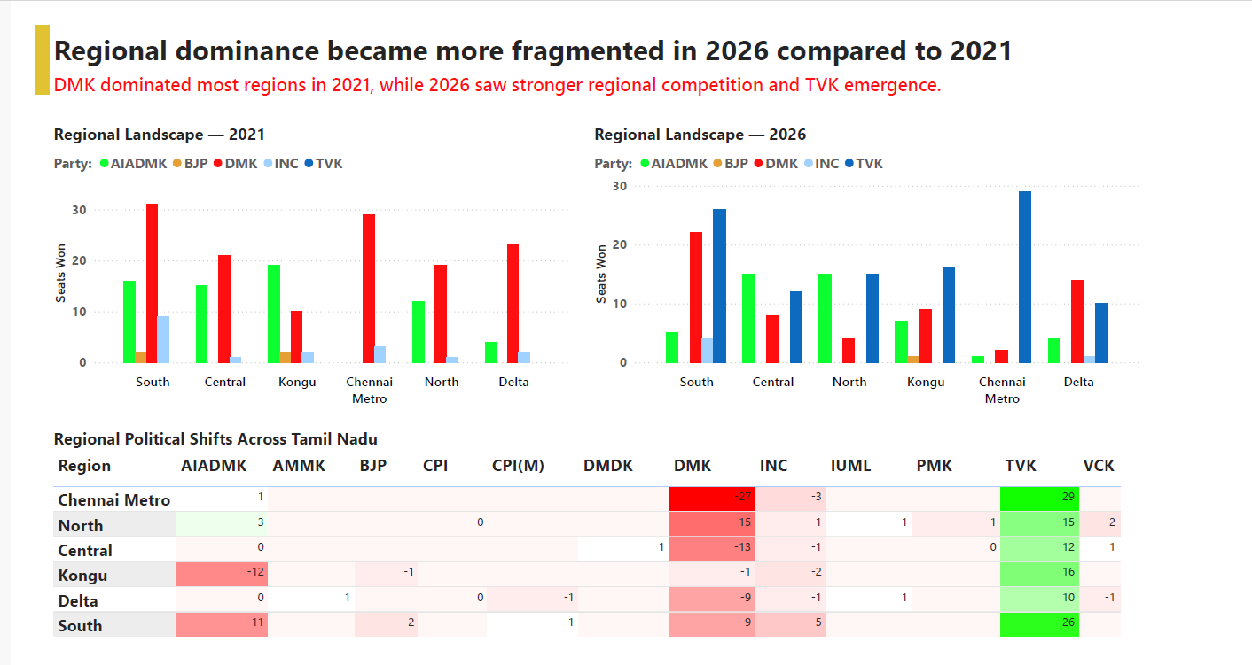
Regional Political Landscape: 2021 vs 2026
KEY INSIGHTS
1
DMK dominated most regions in 2021 but lost ground across the board.
2
TVK emerged strongly in Chennai Metro and South in 2026.
3
Regional political competition intensified across Tamil Nadu.
4
No single formation maintained uniform statewide dominance in 2026.

Slide 5
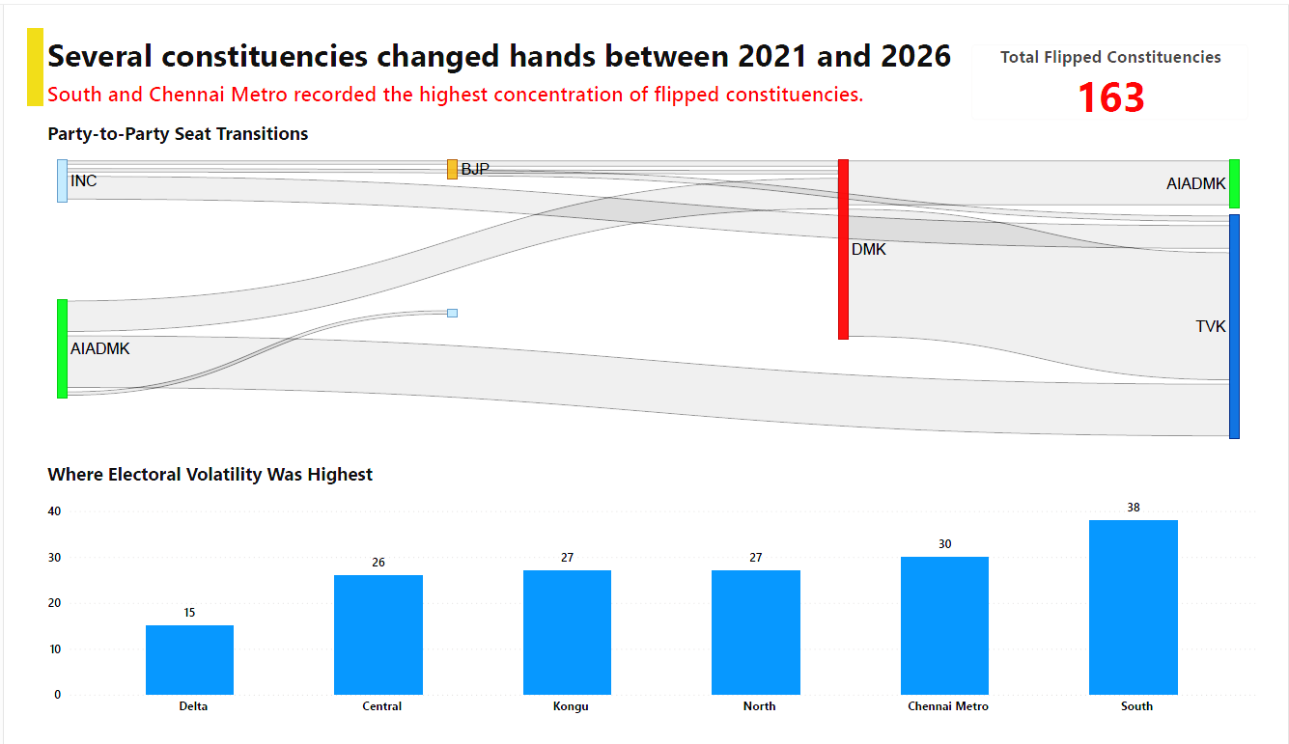
Constituency Shifts Across Tamil Nadu
KEY INSIGHTS
1
163 constituencies changed hands between elections.
2
South and Chennai Metro recorded the highest concentration of flipped constituencies.
▶
3
Major seat transitions flowed toward TVK.
Flip Story Dashboard
Replace with Power BI screenshot
4
Electoral volatility became unevenly distributed across regions.

Slide 6
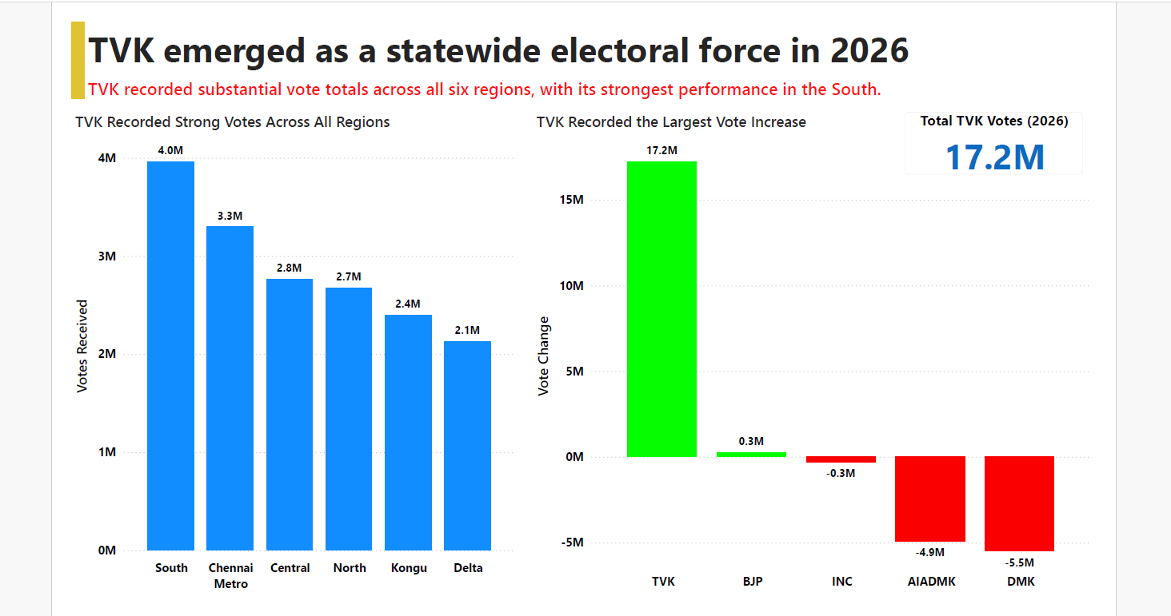
TVK Emerged as a Statewide Electoral Force
KEY INSIGHTS
1
TVK recorded approximately 17.2 million votes in 2026.
2
TVK secured substantial vote totals across all six regions.
3
South and Chennai Metro recorded TVK's strongest performances.
4
TVK registered the largest vote increase among major parties.
17.2M
Largest Statewide Vote Surge

Slide 7
Final Conclusions
The 2026 Tamil Nadu election reflected a transition from concentrated regional dominance toward a more competitive and fragmented political landscape, accompanied by significant constituency-level volatility and the emergence of TVK as a statewide electoral force.
01
Regional Fragmentation
02
Electoral Volatility
03
TVK Emergence
No single political formation maintained uniform regional dominance in 2026.
163 constituencies changed hands, reflecting substantial political movement.
TVK established measurable electoral presence across all six regions.
163
17.2M
6
Constituencies Flipped
TVK Votes
Regions Analyzed

Slide 8
Skills & Tools Demonstrated
ANALYTICAL SKILLS
TOOLS USED
Data Analysis
Data Cleaning • Aggregation & Comparison • Exploratory Data Analysis • Regional Analysis
Python
Data Processing
Pandas
Cleaning & Aggregation
Storytelling
Dashboard Storytelling • Insight Communication • Analytical Narratives • Visual Interpretation
Plotly
Exploratory Visualization
Power BI
Dashboard Storytelling
Visualization
Dashboard Design • Interactive Visualization • Election Data Presentation
This project demonstrates end-to-end analytical storytelling — from raw election data processing to insight-driven dashboard presentation.

