Slide 1

Basic Details of the Team & Problem Statement
Organization Name: Cyber Cell
PS Code: LO-03
Problem Statement Title: Face Detection from the blur or unclear image
Team Name: Crew-X
Team Leader Name: Anurag Bisen
Institute Name: Sagar institute of Science Technology & Research Ratibad Campus , Bhopal
Theme Name: Law and Order

Slide 2
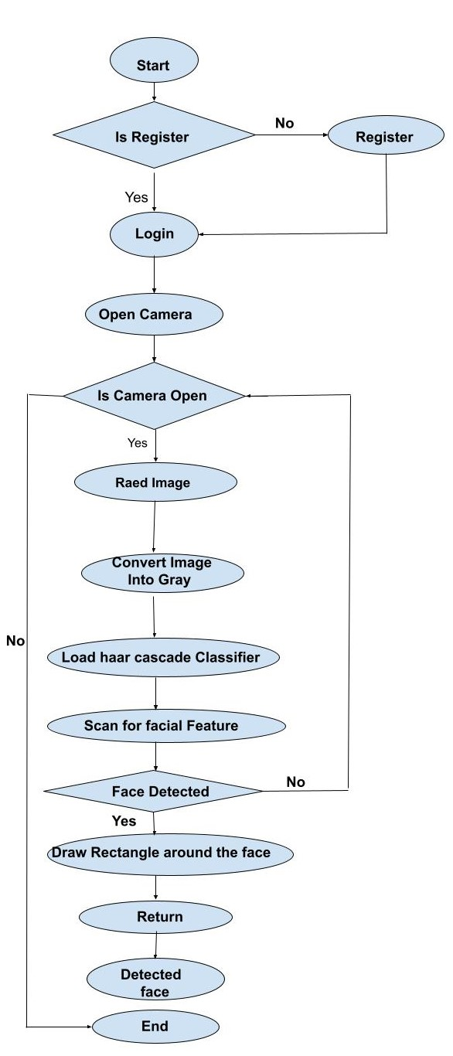


Idea/Approach Details
Describe Your Idea/Approach Here:
Preprocessing: Detecting blur and enhancing image quality.
Feature Extraction: Using deep learning-based methods for feature extraction from low-quality images.
Face Detection: Employing algorithms like Haar cascades or deep learning-based methods to locate faces.
Post-processing: Refining detected faces and optionally performing facial landmark detection.
Similar Face Matching: Using face recognition models to match detected faces against known faces.
Evaluation and Feedback: Implementing a feedback mechanism for continuous system improvement.
This approach aims to improve face detection accuracy and assist in solving cases by identifying individuals from challenging image conditions.
Technology Stack:

Slide 3
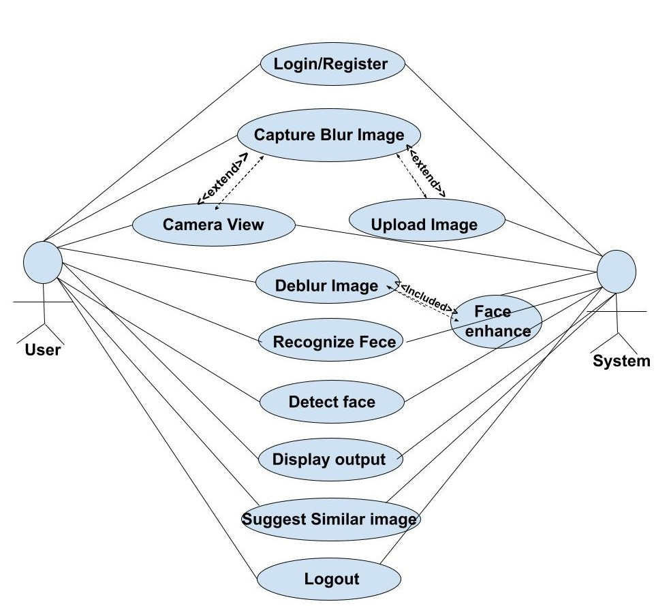
Idea/Approach Details
Describe Your Dependencies Here
Image Processing and Computer Vision Libraries:
Dependency: OpenCV, scikit-image
Description: These libraries provide essential functions for image processing, including blur detection, image enhancement, and post-processing of detected faces.
Deep Learning Frameworks:
Dependency: TensorFlow, PyTorch
Description: These frameworks are essential for implementing deep learning-based feature extraction and face recognition algorithms. They provide tools for building, training, and deploying neural networks.
Pre-trained Models and Datasets:
Dependency: VGGFace, FaceNet, LFW Dataset
Description: Pre-trained models like VGGFace and FaceNet offer feature extraction capabilities for face recognition tasks. The LFW Dataset provides labeled face images for training and evaluation purposes.
Face Detection Algorithms and Models:
Dependency: Haar cascades, HOG, SSD, Faster R-CNN, Dlib
Description: These are algorithms and models used for face detection in images. Haar cascades and HOG are traditional computer vision techniques, while SSD and Faster R-CNN are deep learning-based methods. Dlib provides a toolkit for face detection and other computer vision tasks.
Web Framework :
Dependency: Flask, Django
Description: If the system requires a web interface for user interaction, a web framework like Flask or Django can be used to develop RESTful APIs for serving the face detection and recognition functionalities.
Describe Your Use Cases Here

Slide 4
Team Member’s Details
Sr. No. | Name of Team Member | Branch | Stream | Year
1. | Anuarg Bisen | B.Tech | Aiml | Year( III)
2. | Bhumika Kori | B.Tech | Aiml | Year( III)
3. | Aaysha Khilji | B.Tech | Aiml | Year( III)
4. | Kanchan Lowanshi | B.Tech | Aiml | Year( III)
5. | Manish Chaudhary | B.Tech | Aiml | Year( III)
Team Mentor’s Details
Sr. No. | Name of Mentor | Category | Expertise | Domain Experience
1. | Priyanka Bhatele | Academic/Industry | Machine Learning | Domain Experience in 7 Year

Slide 5
Important Points
Kindly keep the maximum slides limit to 4 pages
All the topics should be utilized for description of your idea
Try to avoid paragraphs and post your idea in points
Keep your explanation precisely and easy to understand
Idea should be unique and novel. If it has a business potential more weightage will be given.
Apart from this PPT abstract of your idea will be asked separately while submitting
You need to save the file in PDF and upload the same on portal. No PPT, Word Doc or any other format will be supported
You can delete this slide (Important Points) when you upload the details of your idea on SISTec Innovation Hackathon Portal.

