Slide 1


Slide 2
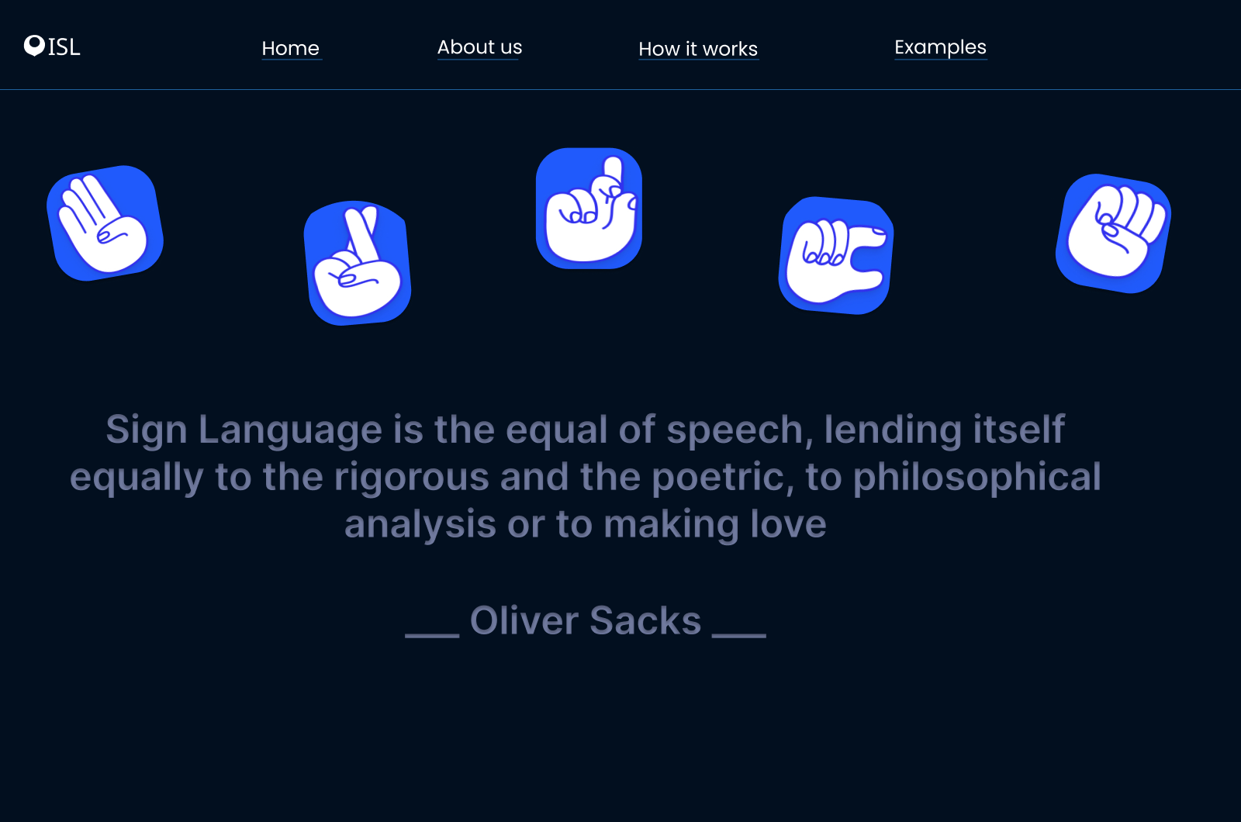

Slide 3


Slide 4


Slide 5


Slide 6


Slide 7
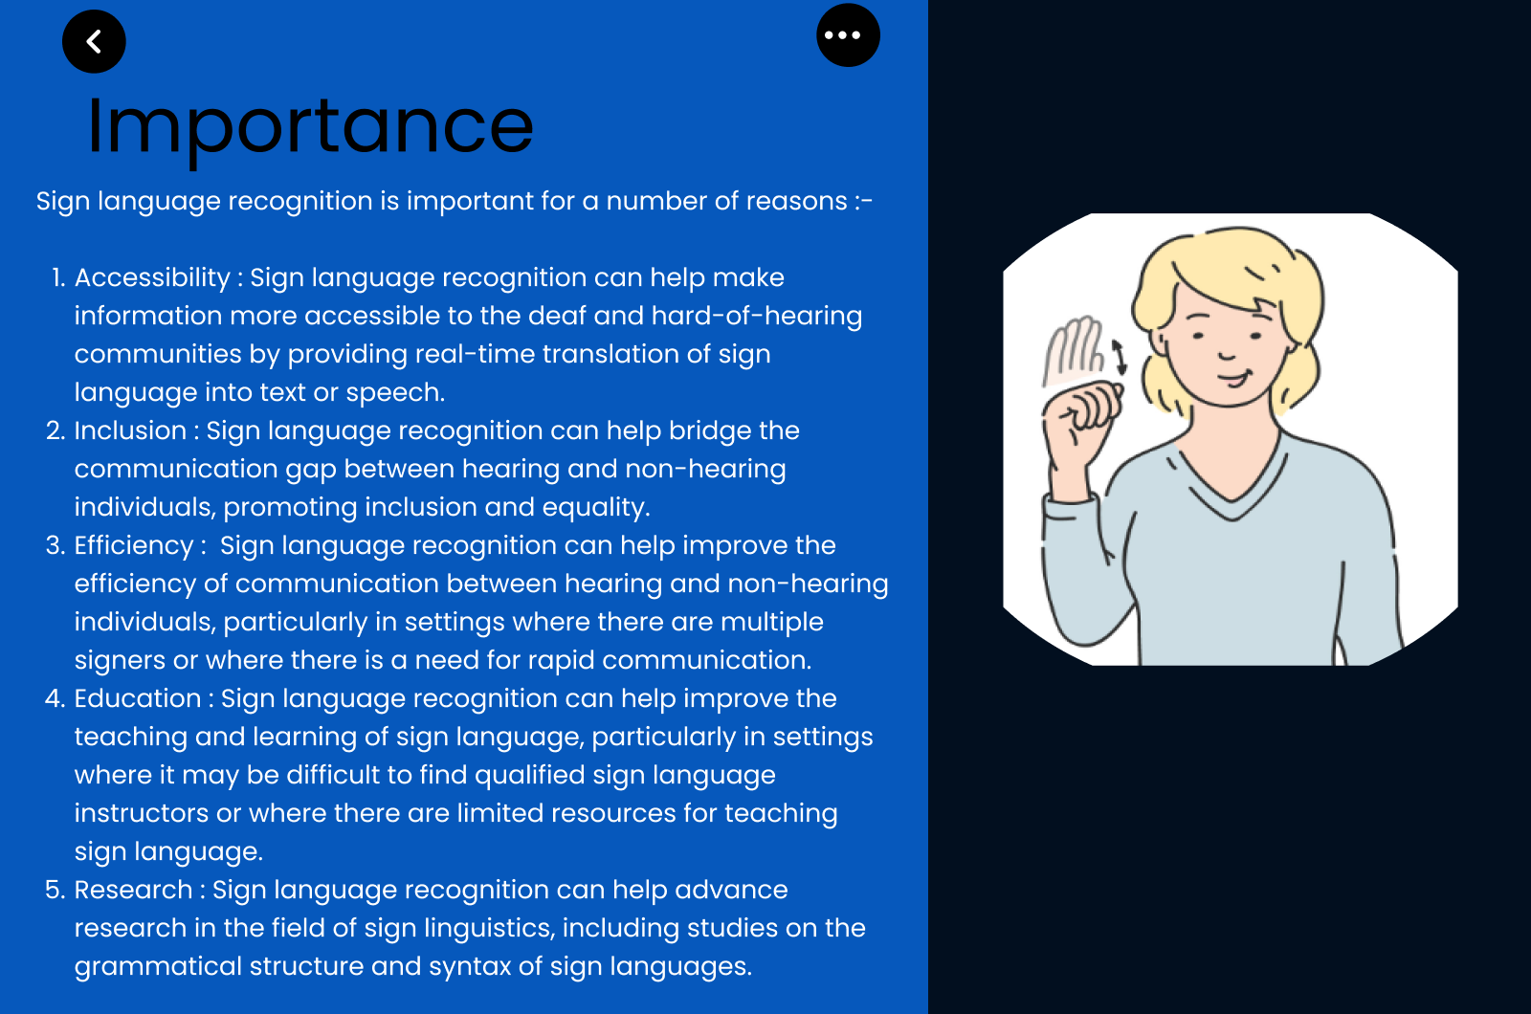

Slide 8
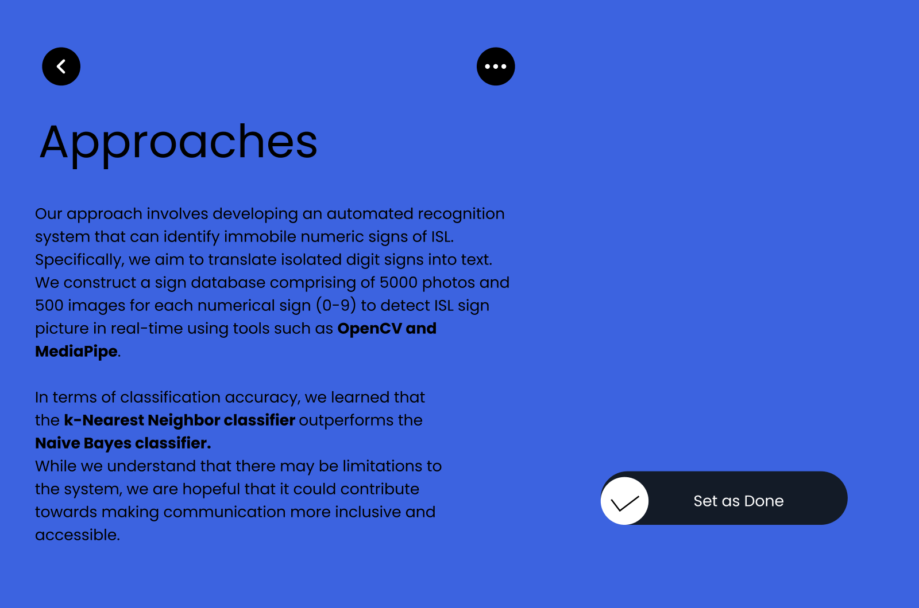

Slide 9


Slide 10


Slide 11


Slide 12

Project Members :
Meghna Jena (20051291)
Siddharth Sachdev (20051306)
Akash Nair (20051314)
Anurag Kanungo (2005296)

