Slide 1
LOGIFLOW LOGISTICS GMBH • PORTFOLIO PROJECT
Delivery Operations Analytics
& Bottleneck Diagnosis
Turning 105,000 delivery records into a data-backed diagnosis of why 15% of deliveries were late — and what to do about it.
Anurag Panwar
Junior Business Analyst | MySQL · SQL · Power BI

Slide 2
THE BUSINESS PROBLEM
LogiFlow's late deliveries were hurting customers —
but nobody knew exactly where the problem started.
OVERALL LATE
DELIVERY RATE
15%
across 6 German warehouses
Answering that question was the goal of this project — using SQL and Power BI to trace the 15% back to its source.
105,000
6 warehouses
1 question
delivery records analysed, spanning a full year of operations (Sep 2025 – Aug 2026)
Berlin, Munich, Hamburg, Frankfurt, Cologne, Stuttgart — each with its own routes and drivers
Is the 15% late rate spread evenly across the network, or concentrated somewhere specific?
LogiFlow — Delivery Operations Analytics
2

Slide 3
APPROACH & TOOLS
From raw data to a data-backed diagnosis
01
02
03
04
Database & SQL
Analysis
Visualisation
Recommendations
Designed a MySQL database and loaded 105,000 records, cleaning realistic data-quality issues (missing distance, cost, and delivery-time values) with NULLIF and STR_TO_DATE.
Wrote SQL aggregation queries comparing warehouses, routes, and delivery outcomes to isolate exactly where and why delays occur.
Built an interactive Power BI dashboard with custom DAX measures — KPI cards, warehouse/route breakdowns, and a 12-month trend.
Translated findings into prioritised, business-impact-driven recommendations for management.
MySQL
SQL
Power BI
DAX
Jira (Agile/Scrum)
Draw.io
LogiFlow — Delivery Operations Analytics
3

Slide 4
KEY FINDING 01
Hamburg is a systemic warehouse bottleneck
Late delivery rate by warehouse
Hamburg
25.6%
2.7x
Hamburg's late rate is nearly 3x Berlin's — the network's best-performing warehouse.
Frankfurt
15.2%
Munich
14.6%
Stuttgart
14.3%
20.96 min
Hamburg's average warehouse loading time — vs ~12 min everywhere else
Cologne
13.6%
Berlin (best)
9.3%
32.02 min
Hamburg's average order processing time — vs ~18 min everywhere else
The delay happens before the parcel leaves the warehouse — pointing to internal operations, not traffic or driving distance.
LogiFlow — Delivery Operations Analytics
4

Slide 5
KEY FINDING 02
A second, separate problem: isolated outlier routes
Outside Hamburg, four routes underperform badly despite their home warehouses running normally — pointing to route-specific causes (traffic, distance, driver assignment) rather than a warehouse-wide issue.
!
!
!
!
COL-R6
FRA-R1
MUN-R4
STU-R2
Cologne
Frankfurt
Munich
Stuttgart
33.8%
33.6%
33.5%
33.5%
late rate
late rate
late rate
late rate
Why this matters: a single warehouse-wide fix wouldn't touch these routes — each needs its own investigation into drivers, traffic, or distance.
LogiFlow — Delivery Operations Analytics
5

Slide 6
BUSINESS IMPACT
Late delivery isn't just an ops problem —
it's a revenue problem
CUSTOMER COMPLAINT RATE
REPEAT CUSTOMER RATE
3.0%
→
35.3%
55.5%
→
30.9%
on-time
late
on-time
late
A late delivery makes a complaint roughly 12x more likely than an on-time one.
A 24.6-point drop in repeat customers — directly tying operations to customer lifetime value.
LogiFlow — Delivery Operations Analytics
6

Slide 7
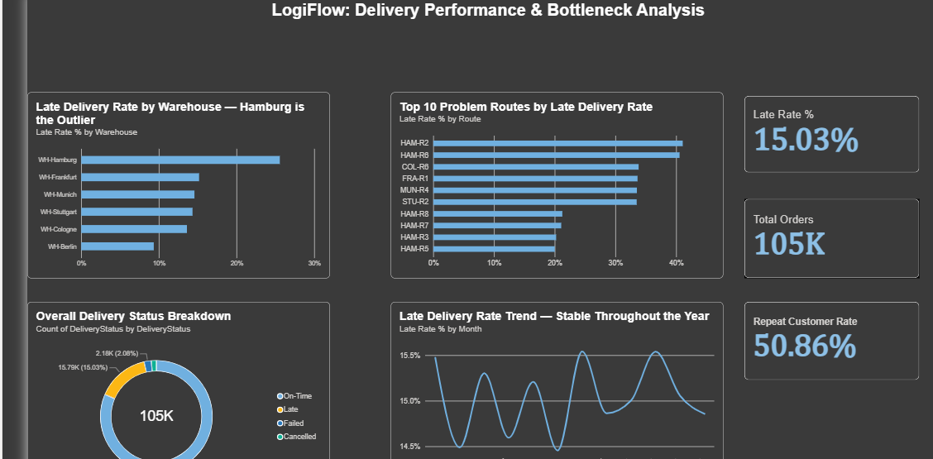
THE DASHBOARD
An interactive Power BI dashboard to track it going forward
LogiFlow — Delivery Operations Analytics
7

Slide 8
RECOMMENDATIONS
Two problems, two separate action plans
1
Review Hamburg's warehouse operations
2
Investigate the 4 outlier routes individually
Audit staffing, shift patterns, and workflow layout, benchmarked against Berlin — the highest-impact fix available.
COL-R6, FRA-R1, MUN-R4, STU-R2 need driver- and traffic-specific review, not a warehouse-wide fix.
3
Treat this as a retention initiative
4
Monitor ongoing performance
Late deliveries cost ~25 points of repeat-customer rate — this is a revenue issue for senior management, not only an ops one.
Refresh the Power BI dashboard monthly to confirm whether interventions are actually working.
LogiFlow — Delivery Operations Analytics
8

Slide 9
Thank you
Happy to walk through the SQL, the DAX measures, or the full analysis in more detail.
Anurag Panwar
Anuragg.panwarr@gmail.com
linkedin.com/in/panwaranurag
github.com/Anuragg26

