Slide 1
Predicting Claims from FNOL
By
Satya Venkataswamy

Slide 2
UNDERSTANDING THE PROBLEM
Business Objective
Problem Statement
Given the historical data of First Notification of Loss data, predict the claim amounts of each of the insurers.
Since Incurred values is a continuous value, it is a regression task.

Slide 3
My Approach
01
02
03
FURTHER STEPS & IMPLEMENTATION
ISSUES & DATA CLEANING
FEATURE SELECTION & MODEL BUILDING
Otaining the data, issues with the data, clraning techniques identified
EDA, Feature Selection and Model Selection through Nested Cross Validation
Suggestions on Model Improvements and Practical challenges.

Slide 4
Dataset Dimensions
Data Types
Time Frame
Missing Values
Overview of the Dataset
7,691 records and 46 features
9 categorical features and 37 numerical ones
Claims range from April 2003 to June 2015
~4.5% of missing values in the weather_conditions column

Slide 5
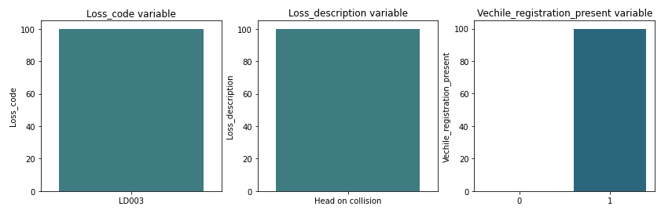
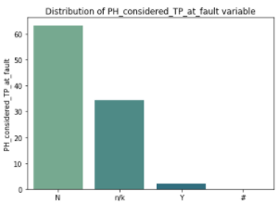
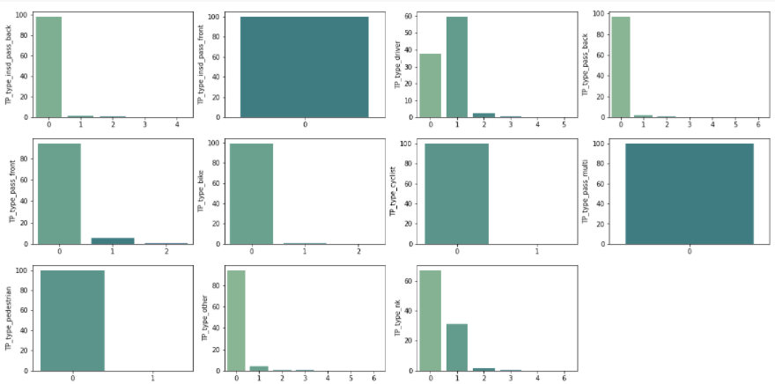
Issues with the Dataset
3 Columns (Loss_code, Loss_description and Vehicles_registration_present) with zero variance or near zero variance.
4 Third party type related variables with zero or near zero variance amongst them.
Records with ‘#’ values in the PH_considered_TP_at_fault variable.
3 records with Negative values in the Notification_Period variable.
Multivariate analysis and correlation maps of TP variables

Slide 6
My Approach
01
02
03
FURTHER STEPS & IMPLEMENTATION
ISSUES & DATA CLEANING
FEATURE SELECTION & MODEL BUILDING
Otaining the data, issues with the data, clraning techniques identified
EDA, Feature Selection and Model Selection through Nested Cross Validation
Suggestions on Model Improvements and Practical challenges.

Slide 7
Splitting Schema of the Dataset
Dataset
(7691 X 46)
Train Dataset
(5292 X 39)
Temporal Splitting
Test Dataset
(2395 X 39)
Records from April’2003 to Dec’2013.
Records from Jan’2014 to June’2015.
One Hot Encoding of the Categorical Features
Scaling of the features using MinMaxScaler

Slide 8
Feature Selection Approach
Baseline Model (Linear Regression)
MAE Score: 12,019
Feature Selection Methods
Recursive Feature Elimination with CV
Lasso Regression model coefficients with CV
22 Features were selected
22 Features were selected
Base Model (Linear Regression)
Base Model (Linear Regression)
Feature Selection Method 1
MAE Score: 11,553.29
Feature Selection Method 2
MAE Score: 11,539.89

Slide 9
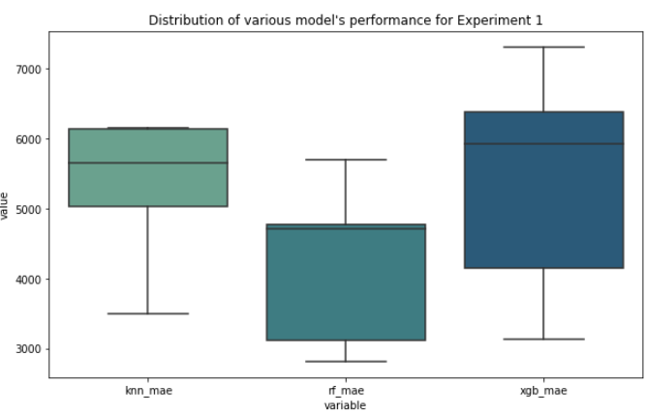
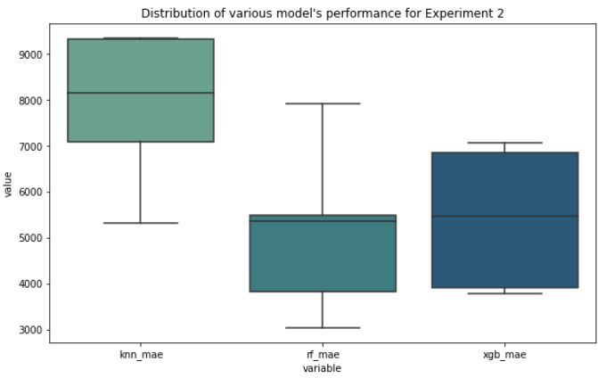
HyperParameter Tuning and Model Evaluation
Distribution of Results
Experiment Description
2x5 Nested Cross Validation
Inner Loop
Outer Loop
EXP1: Features Selected through Recursive Feature Elimination
Hyperparameter Optimization
Model Evaluation
Feature Importance on Best Models
EXP1(A): Features with high feature importance are isolated and Exp1 is repeated
EXP2: Features Selected through Lasso Regression Coefficients
Same Process as above
EXP2(A): Features with high feature importance are isolated and Exp1 is repeated

Slide 10
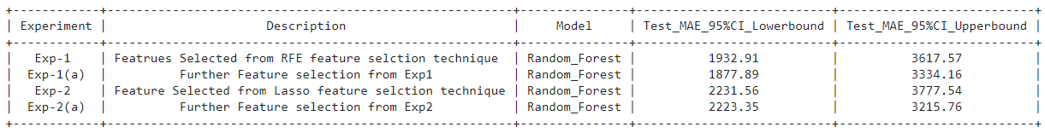
Model Selection
Leveraged Bootstrapping in order to create a distribution of Test dataset performances.
As a part of bootstrapping the selected model (best hyperparameters) of each experiment was fit on the train dataset and evaluated on the Test dataset.
The above process was repeated for a total of 20 iterations and the Mean Test MAE and Standard Error of the MAE was used to create a 95% confidence interval.
(By assuming the test MAE follows a t-distribution as the number of samples are less than 30 and the standard deviation of the population is unknown).

Slide 11
My Approach
01
02
03
FURTHER STEPS & IMPLEMENTATION
ISSUES & DATA CLEANING
FEATURE SELECTION & MODEL BUILDING
Otaining the data, issues with the data, clraning techniques identified
EDA, Feature Selection and Model Selection through Nested Cross Validation
Suggestions on Model Improvements and Practical challenges.

Slide 12
Future Steps and Challenges
Future Steps
Explore the performance of other categorical encoding techniques such as Target Encoding etc..
Use of Non-linear base models in feature selection techniques.
Use Feature Selection techniques such as Mutual Information Gain in SelectKBest Models in order to isolate the important features.
Experiment with other implementations of Boosting techniques such as LightGBM etc..
Use of RMSE score as an evaluation metric in order to minimize the error on outlier data points.
Challenges
Since Nested Cross validation is employed, processing needs would be on the higher side.

Slide 13
Thank You

