Slide 1


“HELLO DOCTOR”
INSTITUTE FOR ADVANCED COMPUTING AND SOFTWARE DEVELOPMENT(IACSD),AKURDI.
Presented by-
Anurag Nandkishor Kanoje(1087)
J K Birajdar (1034)
Mr. Prashant Karhale
Centre Coordinator
Mr. Milind Arjun
Project Guide

Slide 2
INDEX
Introduction
Motivation
Existing System
Proposed System
Objectives
System Architecture
Description of system
Applications
Advantages and Disadvantages
Screenshots
Future scope
Conclusion
References

Slide 3
INTRODUCTION
Hospitals are very case sensitive areas specially in this pandemic situation. People should not make crowd at hospital places, because of this pandemic hit very bad on the society.
To make the process entirely computerized so as to help people accordingly for the convenience of people in real time.
The purpose of this project to make the entire hospital system systematic and using web application so that people can get benefit of it and stop their wastage of time in hospitals and no need to suffer during the emergency.

Slide 4
MOTIVATION
Admin can have full access and permissions to add, delete or modify the data.
One can find blood donor in their city of their choice of blood group easily and can get the contact details of that person.
Ease of taking appointments with doctors and also can check the fees of the doctor.
To produce a web-based system that allow the admin to add doctors, blood donors and provide functionalities to its role.
To make entire process simple and easy to use over wider range.

Slide 5
EXISTING SYSTEM
Existing System are not that matured to provide various facilities.
Existing systems are specifically designed for particular hospitals and clinics for their own use.
Existing system doesn’t provide blood donor related information. Systems are not so convenient and easy to use.
To take the appointment and consultation from another one can need to visit the that doctor’s own platform which is sort of irritating thing.

Slide 6
PROPOSED SYSTEM
Book appointment with doctor:-It provides facility to take an appointment with doctor with doctor’s available time slots. Doctor can see the details of the patients and cancel the appointment any time. Patients can check their current active appointment and history of appointment.
Search for blood donor:- Project provides facility to search the blood donor of their choice of blood group from and any city of they want and also see the contact details of the blood donor. That will help during emergency situation.
Verified personal details data security:-Administrator can only add the blood donor so as to avoid any false information on the platform. Admin can see the donors and doctors list and can delete any time.

Slide 7
OBJECTIVES
To produce a web-based system that allow the admin to add doctors, blood donors and provide functionalities to its role.
To ease for booking appointment with doctor.
To make entire process simple and easy to use over wider range.

Slide 8
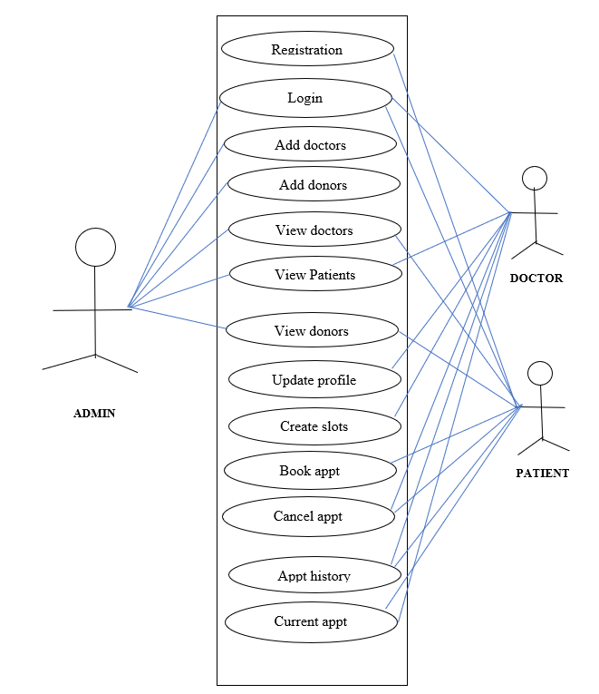
SYSTEM ARCHITECTURE & USE CASE DIAGRAM

Slide 9
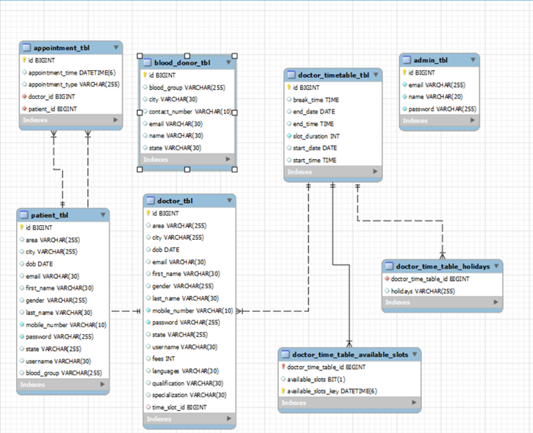
ER Diagram

Slide 10
DESCRIPTION OF THE SYSTEM
•All the users will see the same page when they enter in this website. This page gives the option to signup for patients and common login option to all admin, doctor and patients.
•After being authenticated by correct username and password, user will be redirect to their corresponding profile where they can do various activities.
The user interface will be simple and consistence, using terminology commonly understood by intended users of the system. The system will have simple interface, consistence with standard interface, to eliminate need for user training of infrequent users.

Slide 11
APPLICATIONS
This system will serve as an web application for efficient online appointment booking without any hassle.
No need to physically visit any places especially in the pandemic for booking.
Search for blood donor and get contact details.
maintain records or patient and doctors without physical documentation tension
Used for small clinics as well as hospitals.

Slide 12
ADVANTAGES & DISADVANTAGES
Advantages-
It is user- friendly greater Efficiency and easy to use.
Addition of new features and improvements are possible.
User’s data kept safe and secure and admin having control over other characters.
Disadvantage-
Cannot work without internet connection.

Slide 13
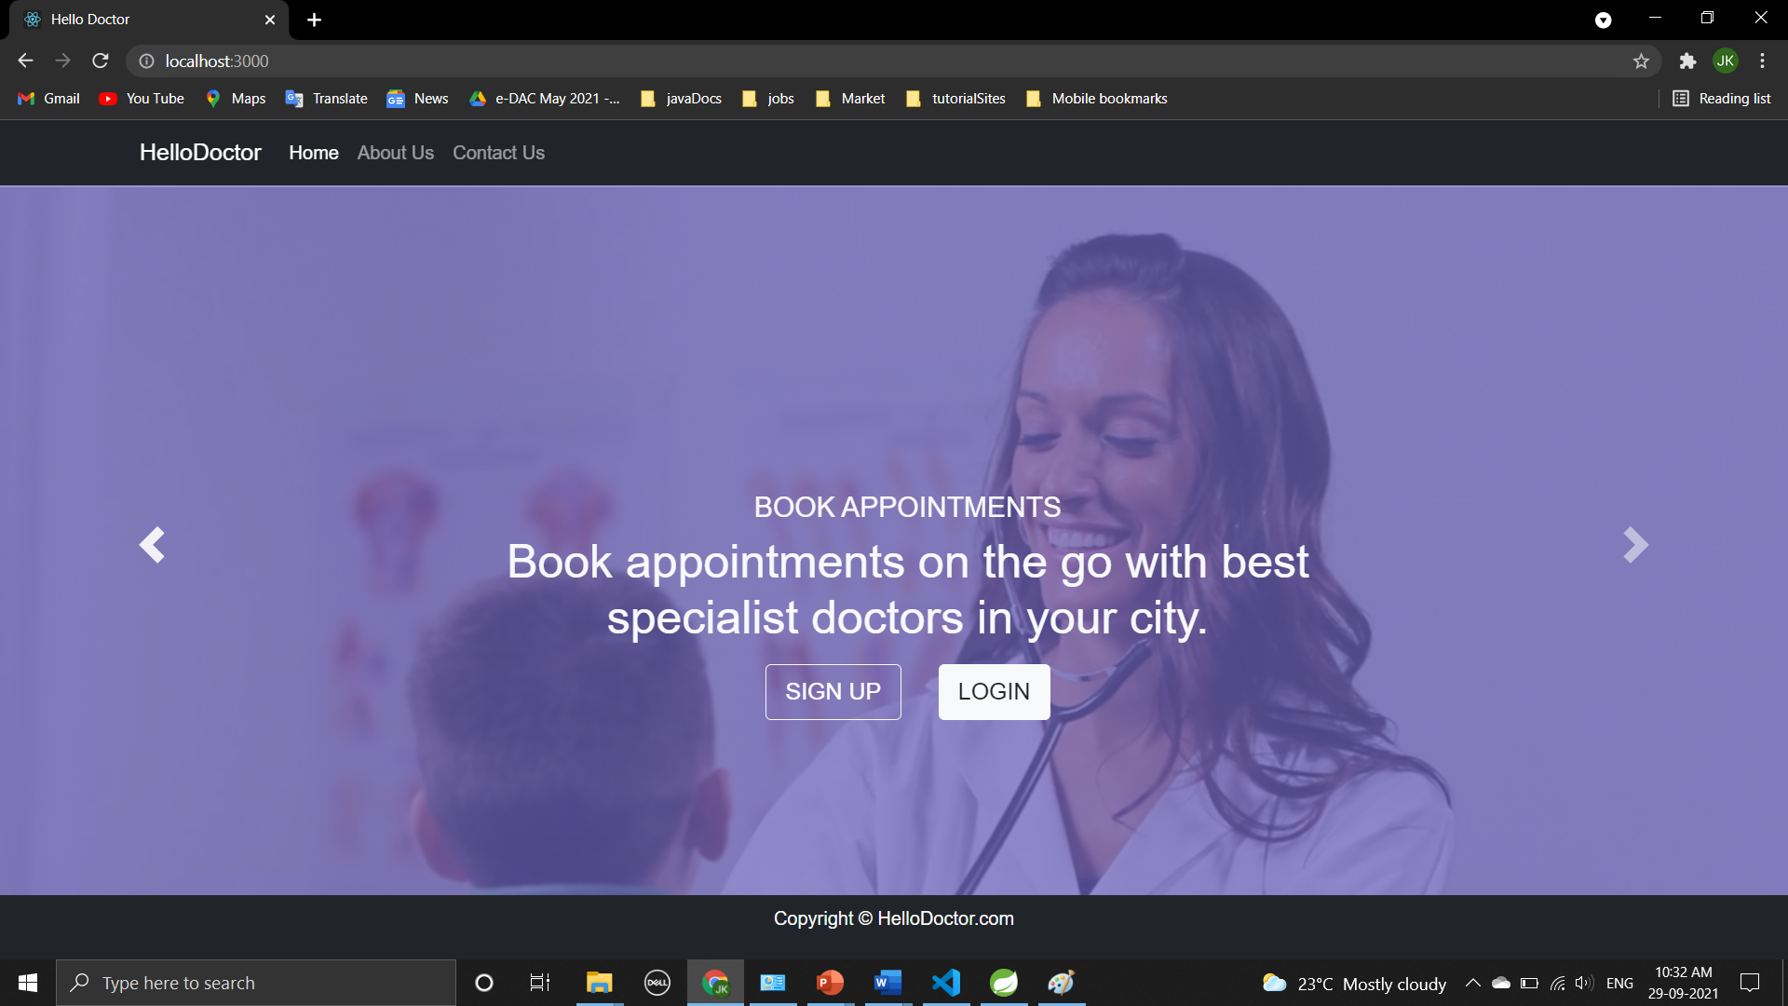
SCREENSHOTS-
Homepage

Slide 14
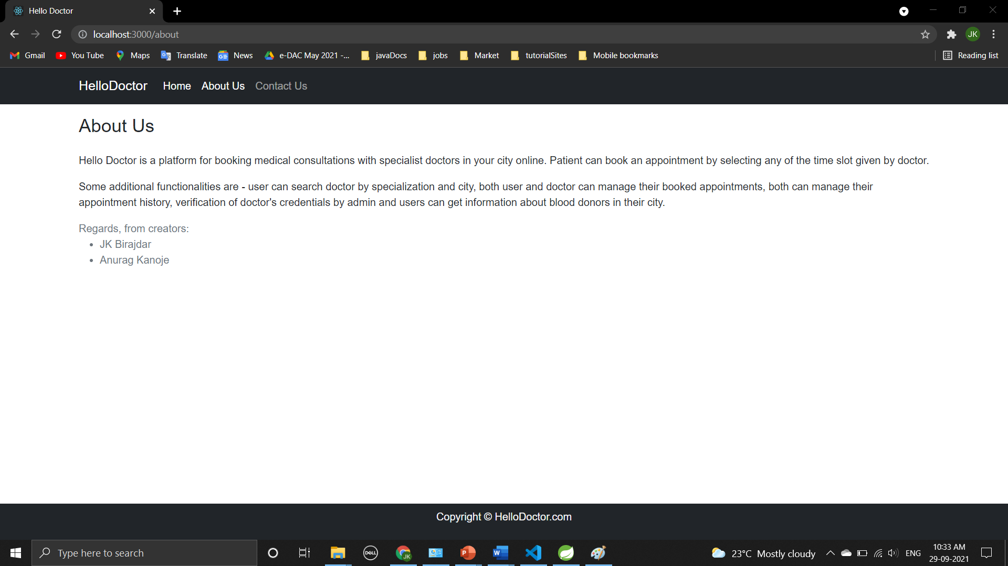
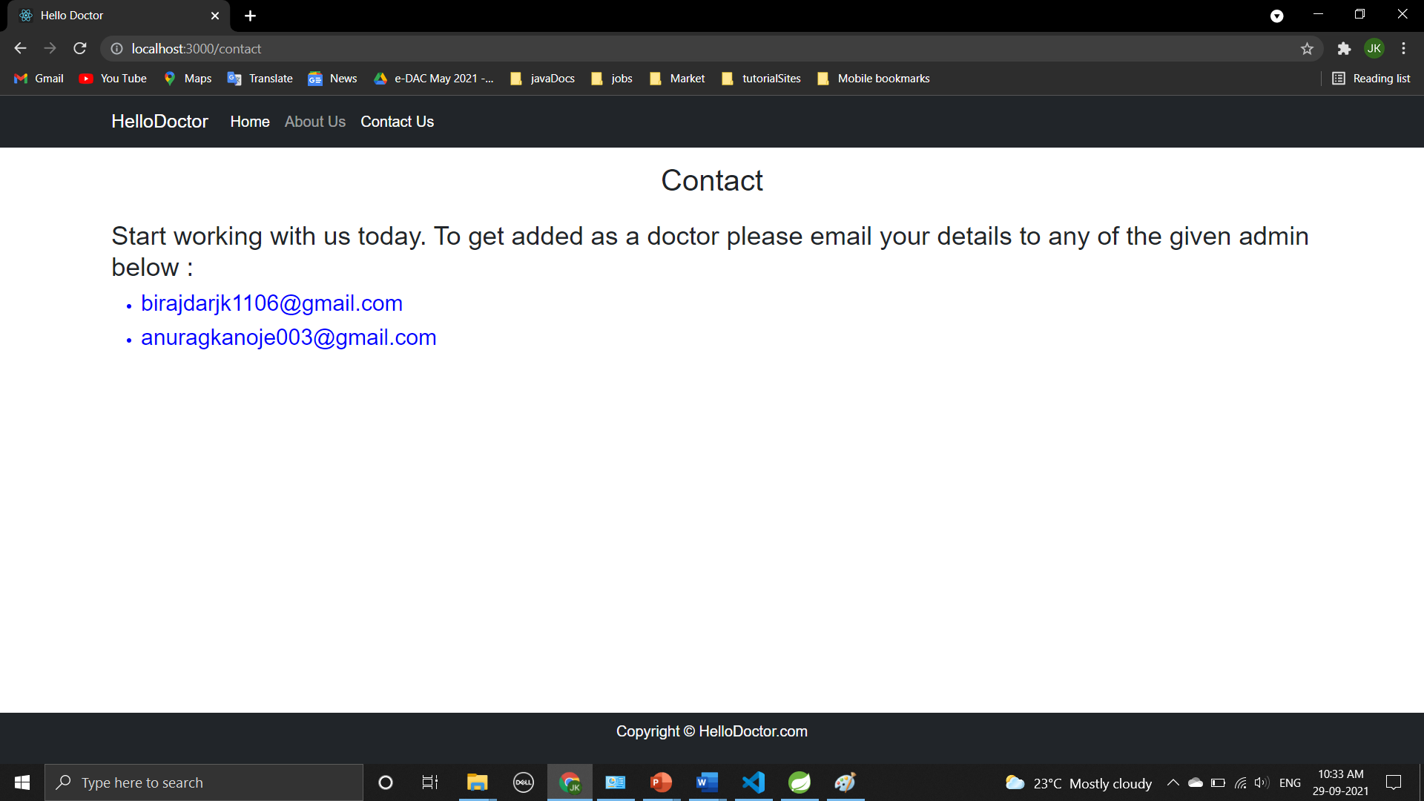
ABOUT US AND CONTACT US

Slide 15
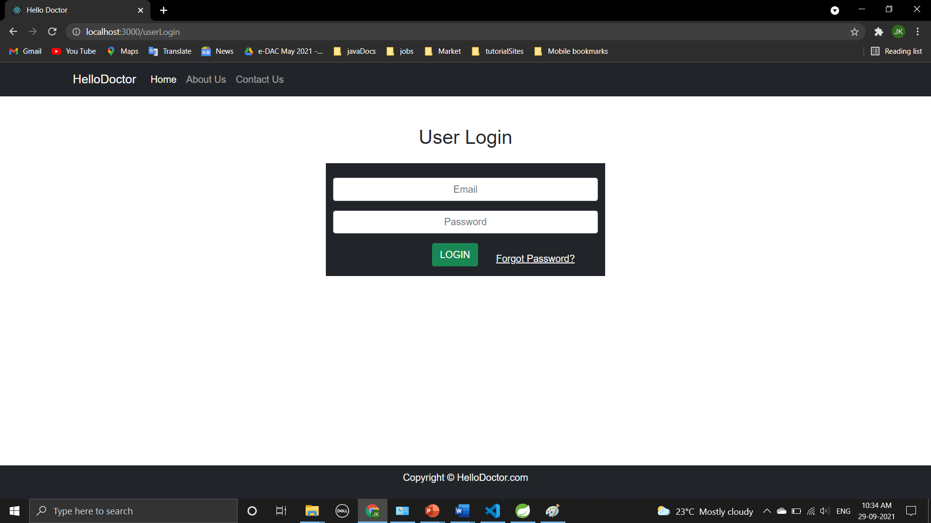
ROLE BASED LOGIN WITH VALIDATION

Slide 16
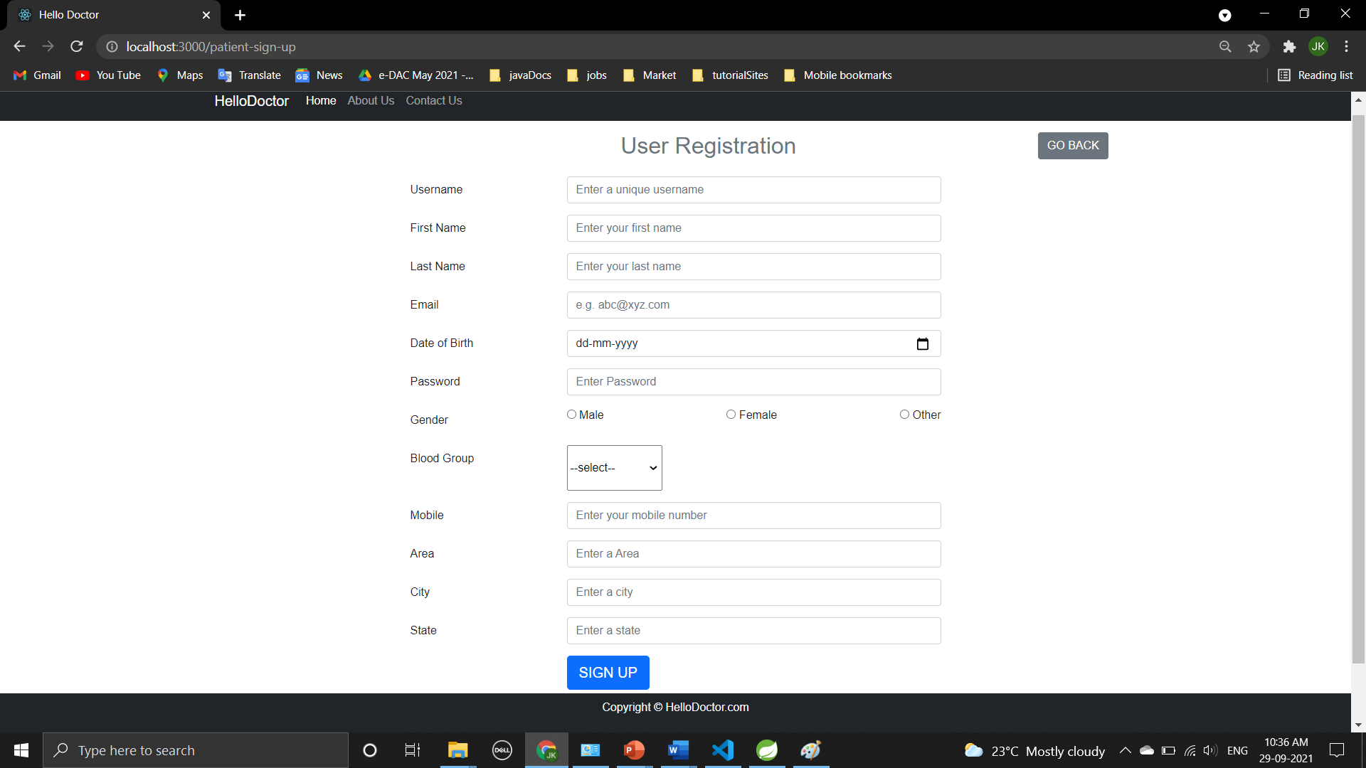
NEW PATIENT REGISTRATION

Slide 17
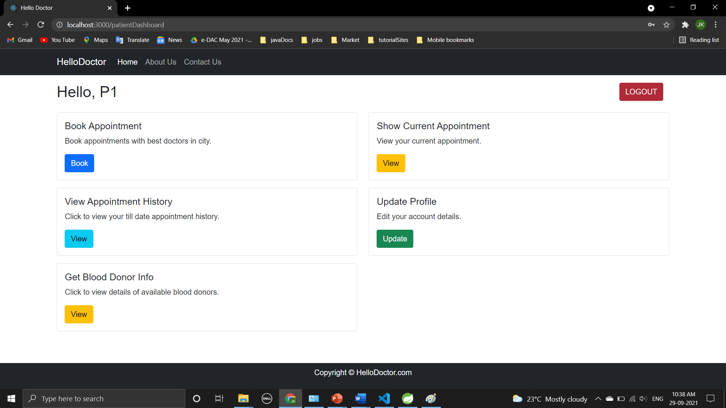
PATIENT LOGIN WITH DASHBOARD

Slide 18
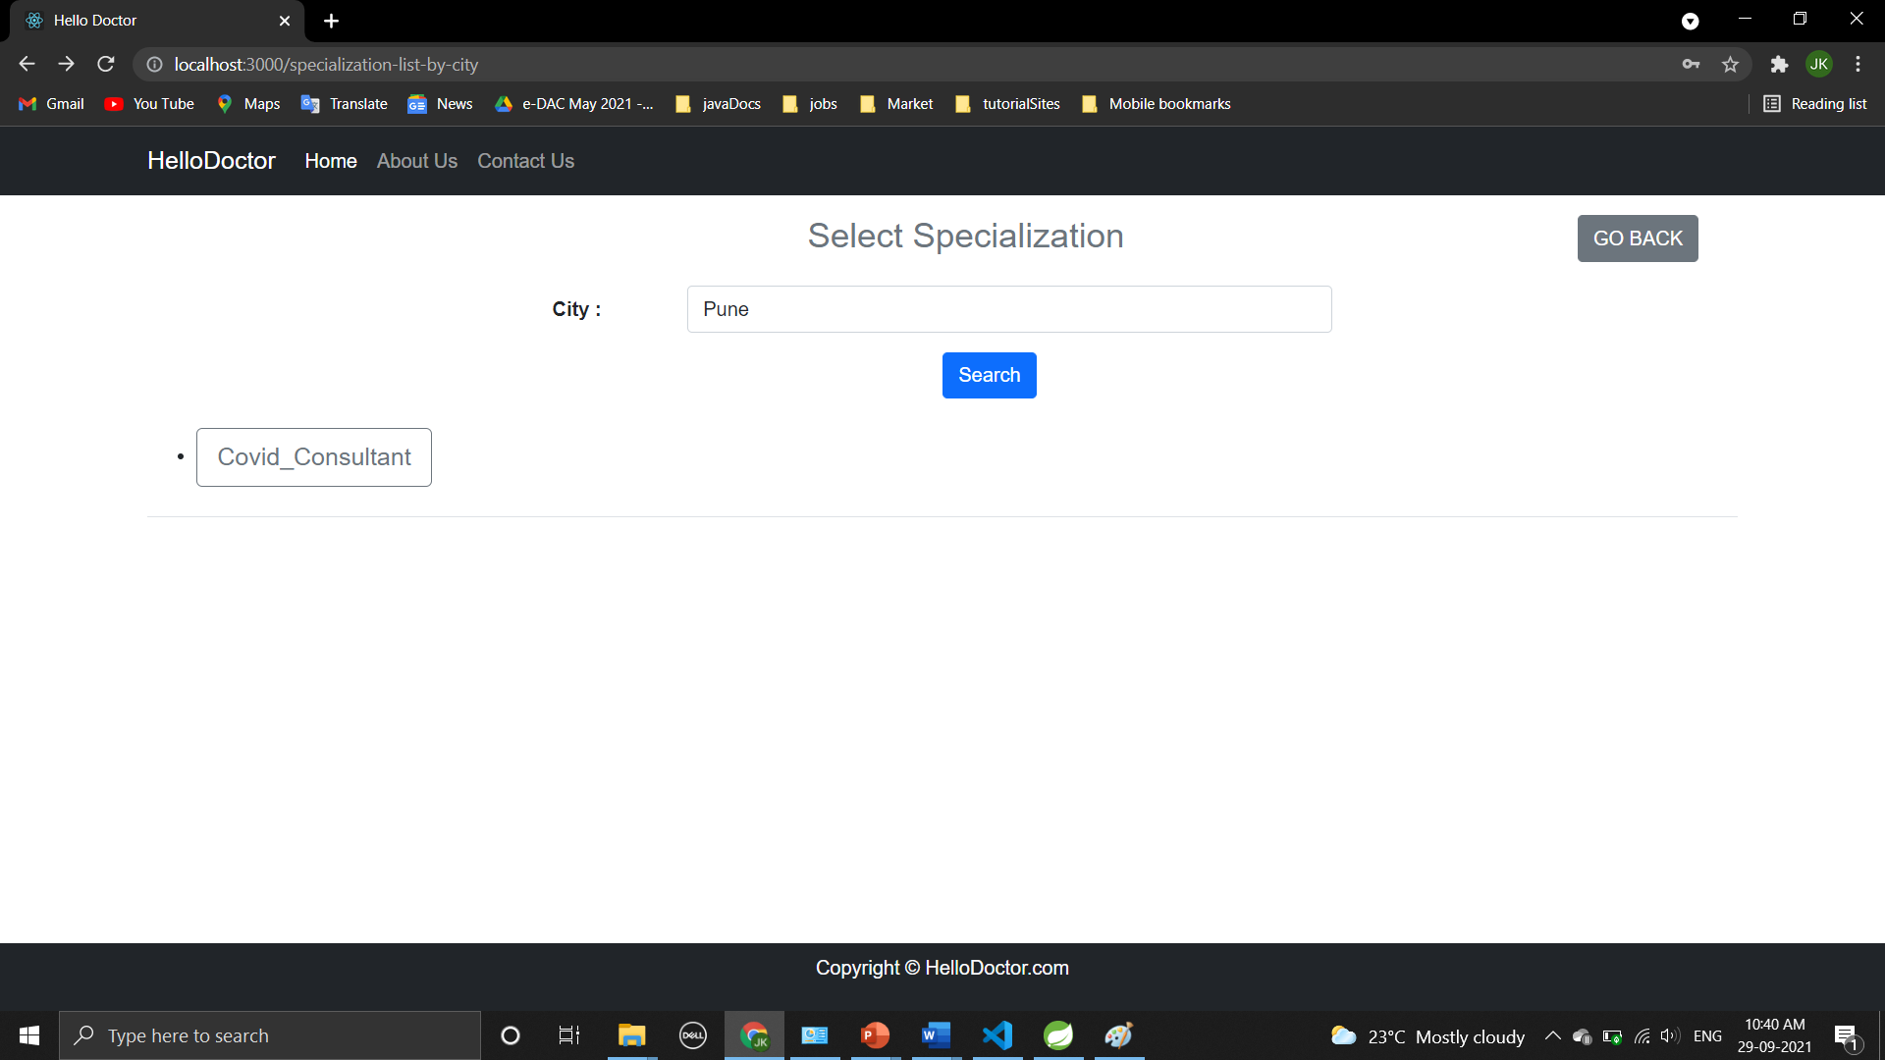
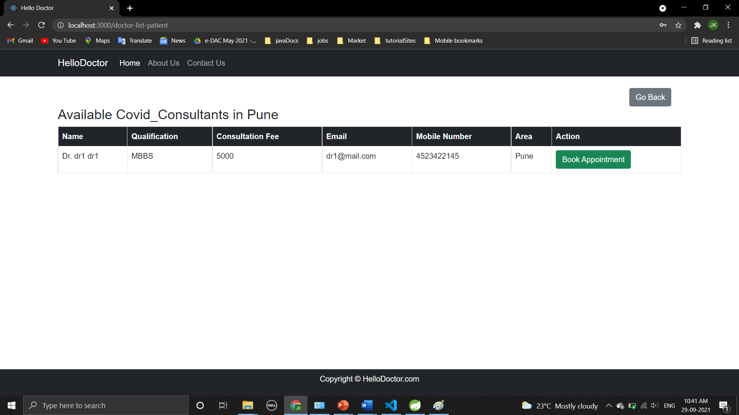
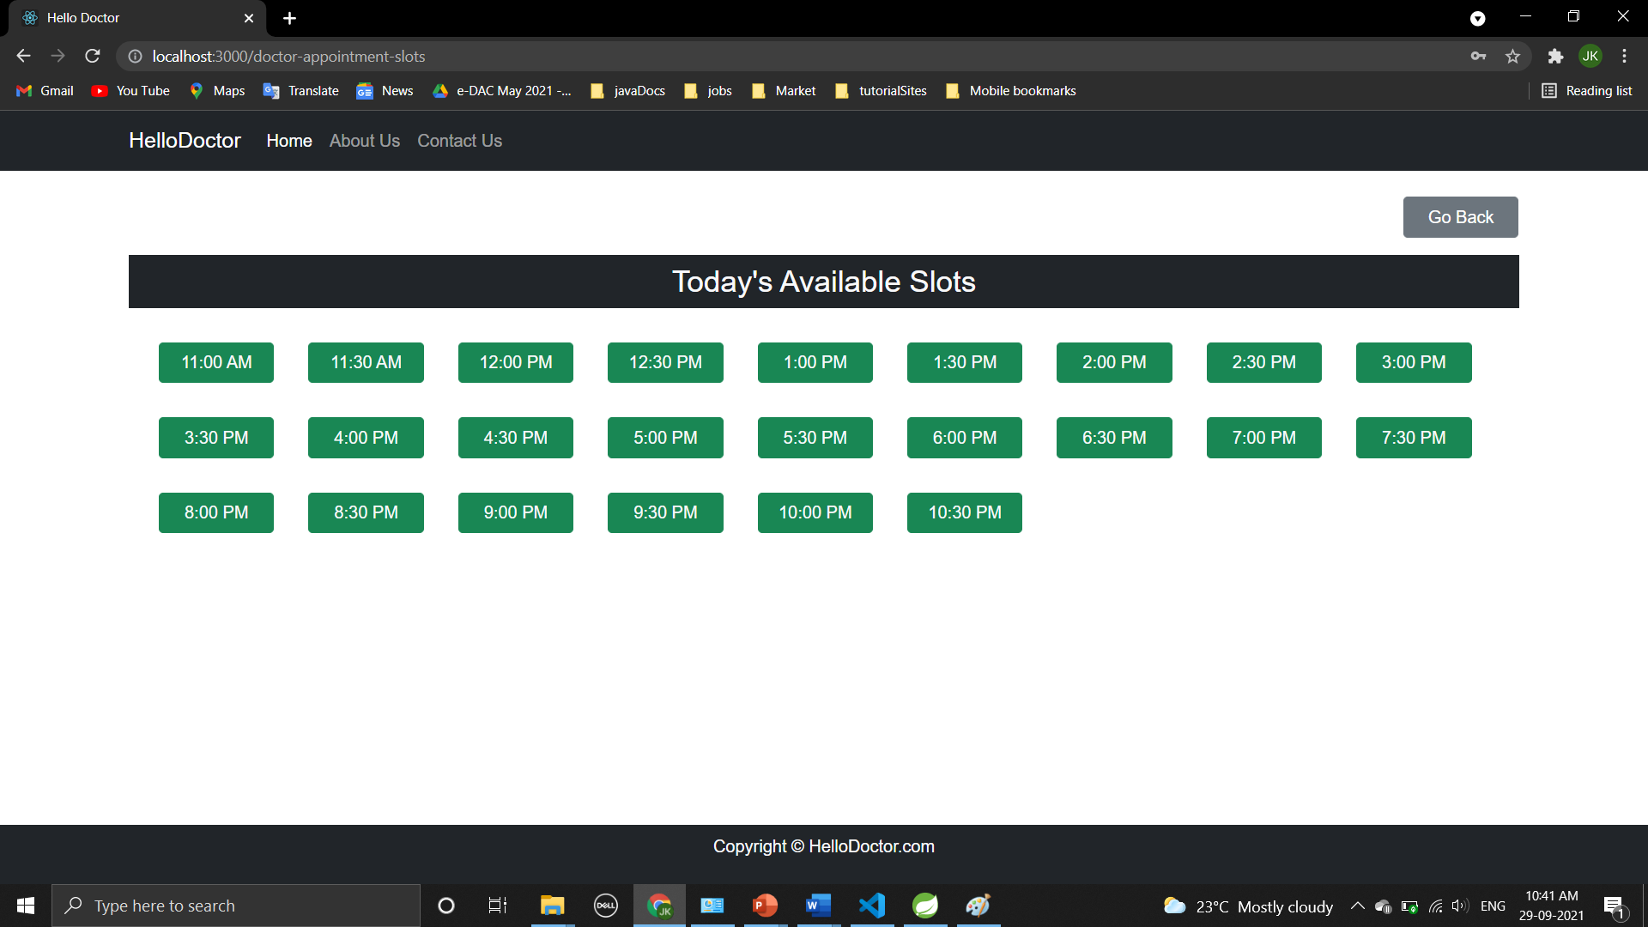
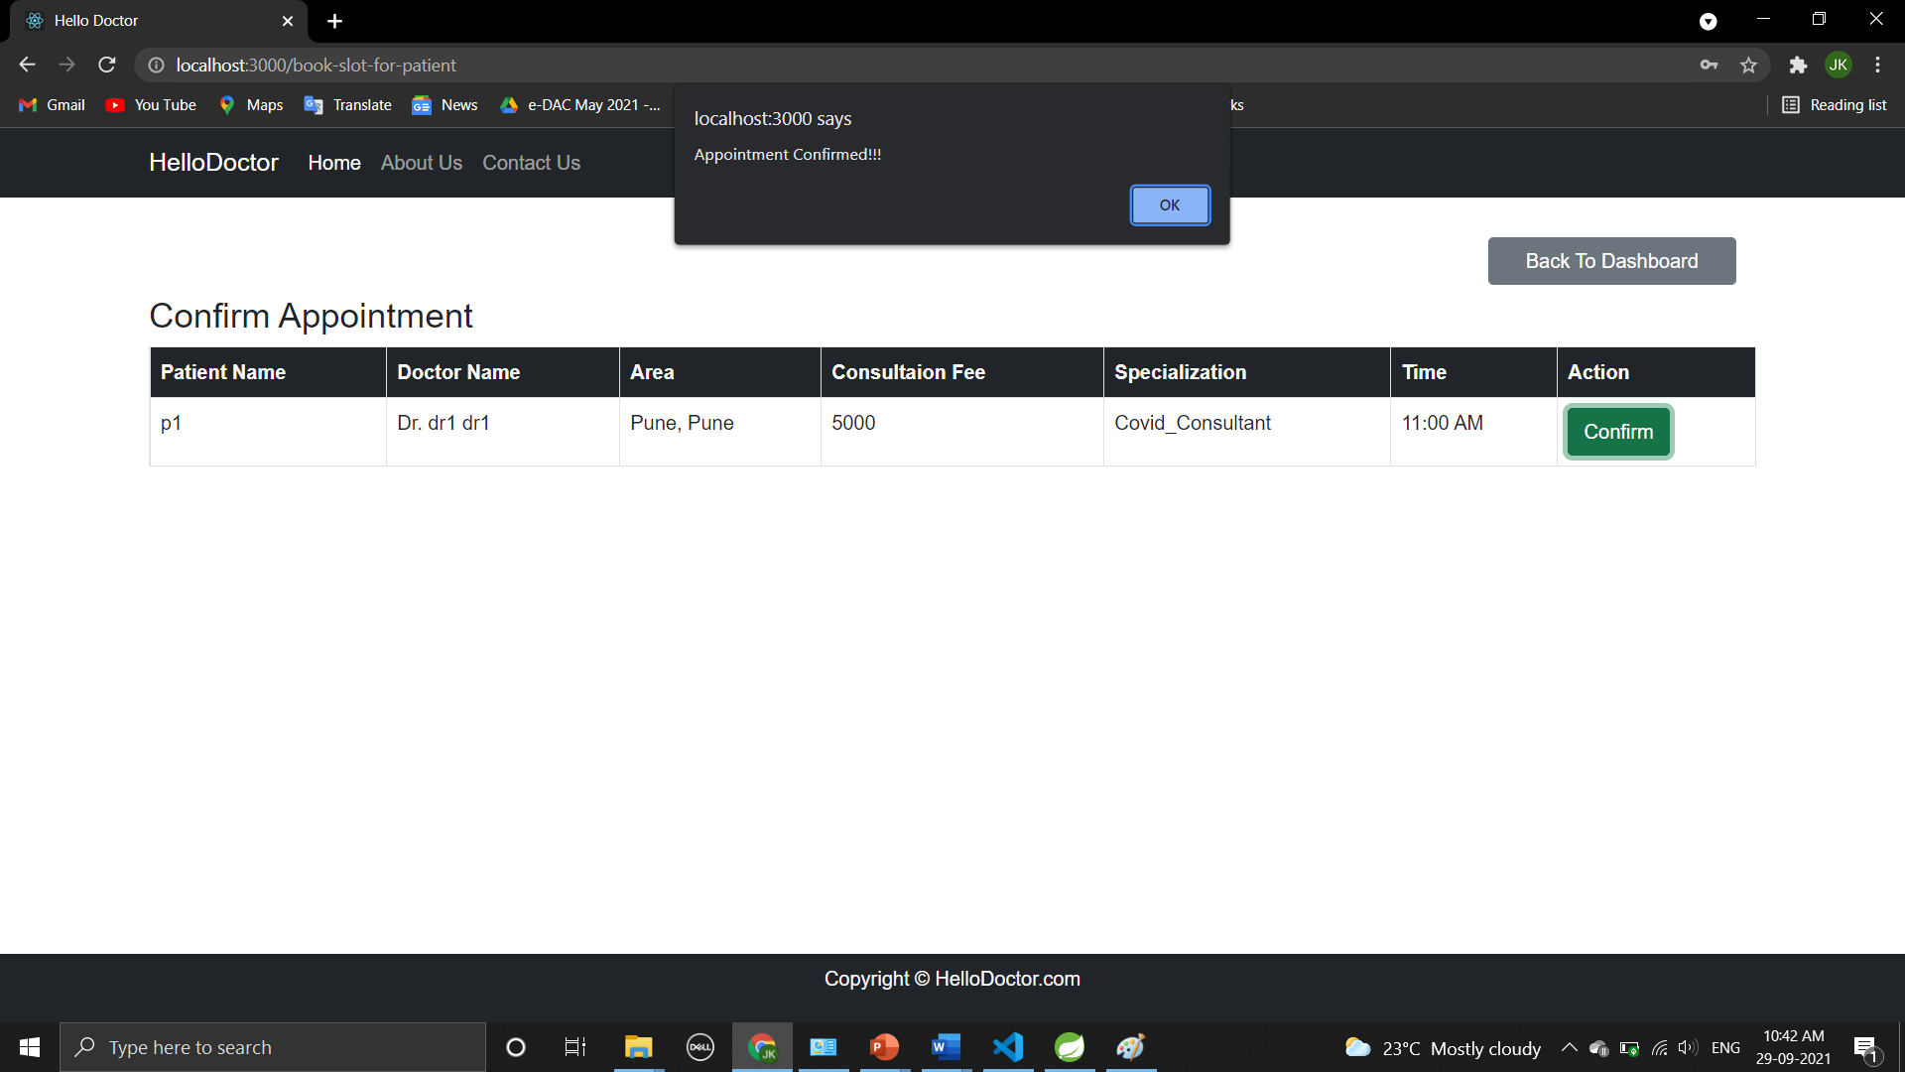
PATIENT’S APPOINTMENT PROCESS FLOWS

Slide 19
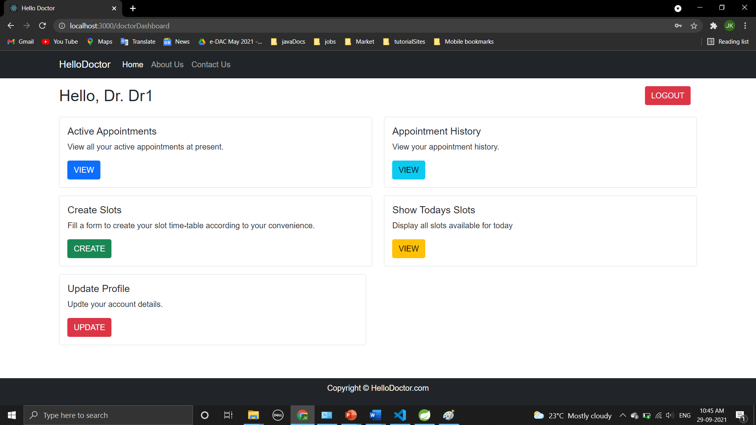
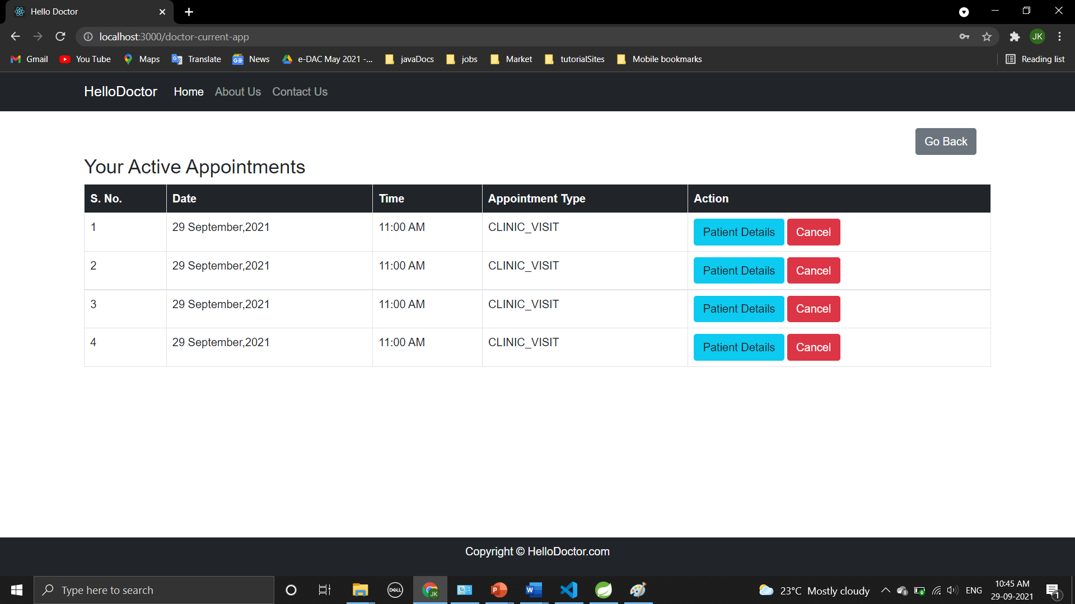
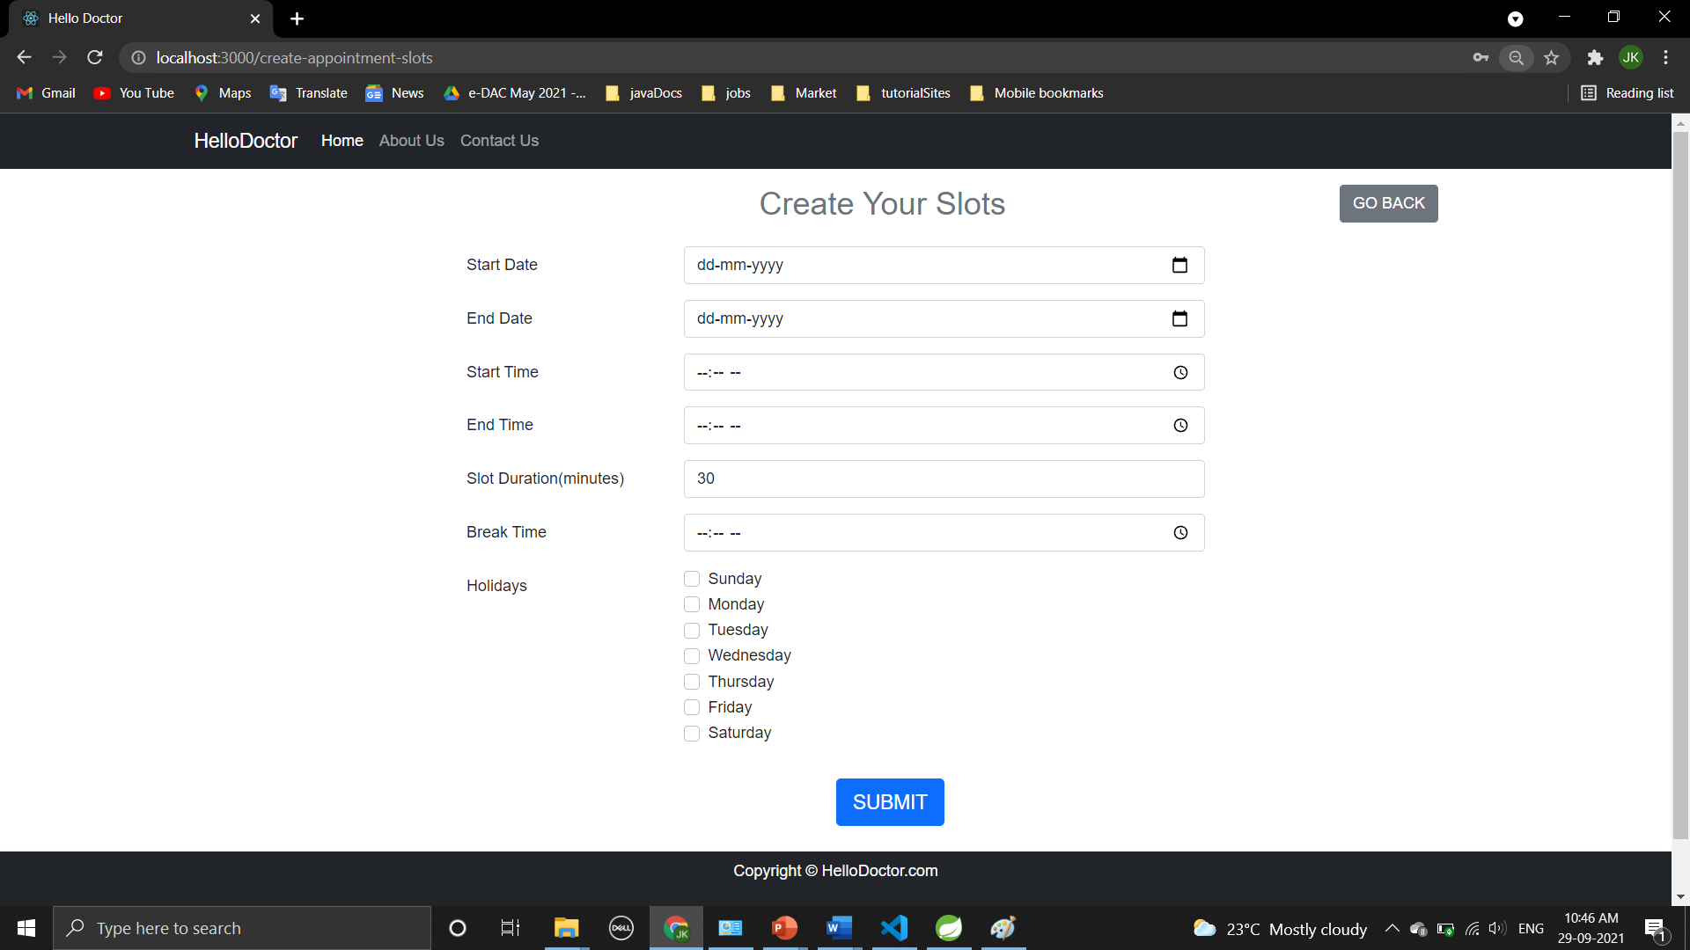
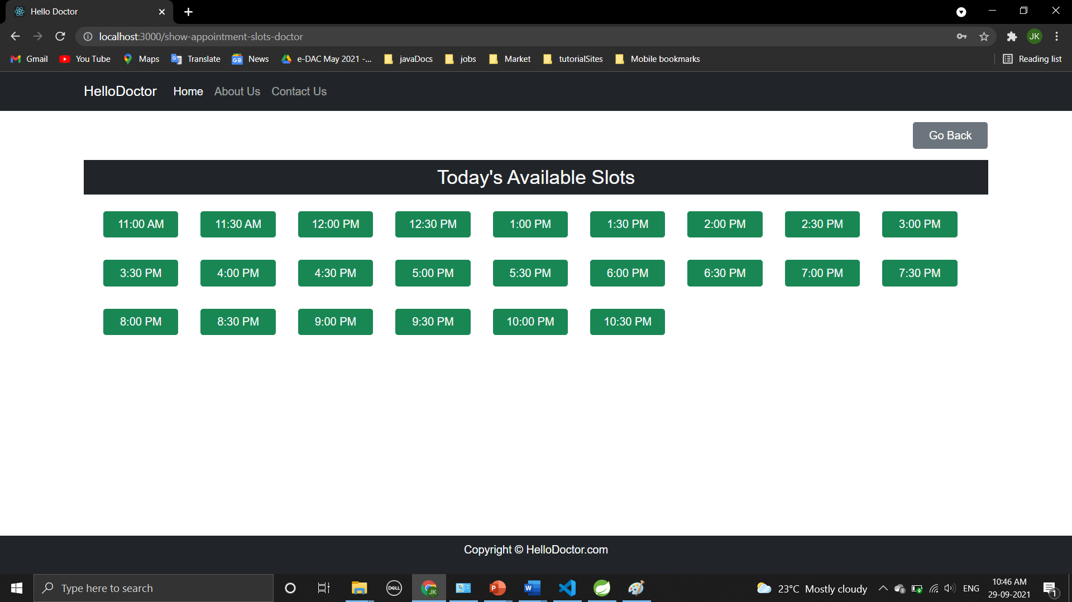
DOCTOR LOGIN DASHBOARD AND PEOCESS FLOWS

Slide 20
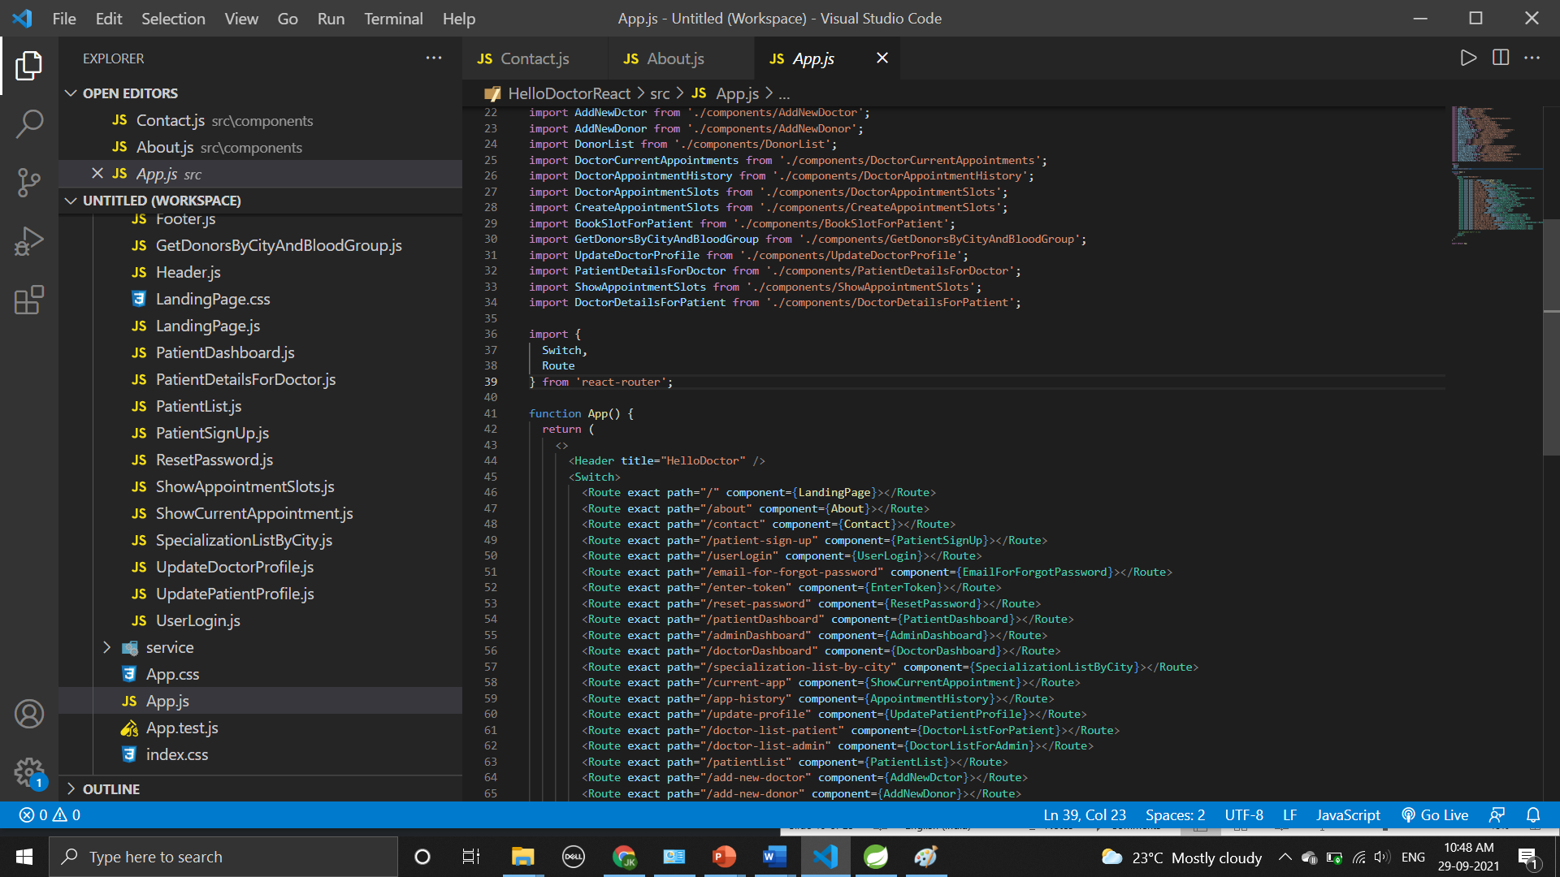
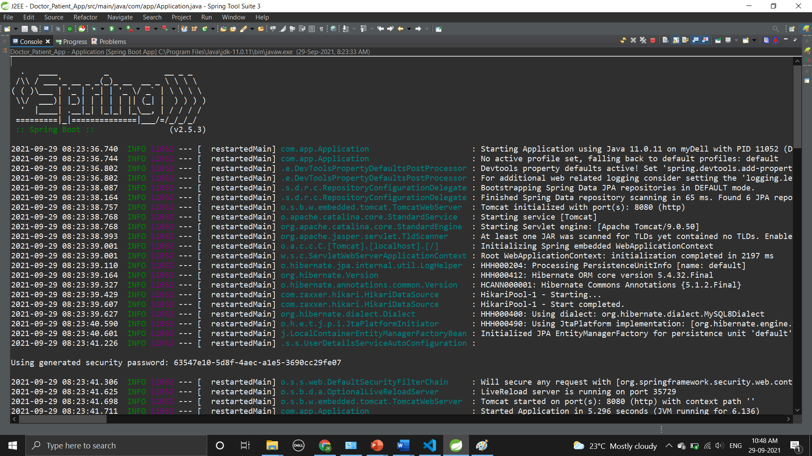
FRONTEND AND BACKEND

Slide 21
FUTURE SCOPE
The Project can be further extended to provide it with a reliable and genuine Payment System. Also the project can be extended in to allow the tracking of the locations of hospitals. Many other functionalities such as subscribing to future events, online consultation make the system more efficient and more reliable.

Slide 22
CONCLUSION
This project helps in making paperless activities. It reduces the workload from Doctor and Receptionist. It provides more ease and flexibility to Doctor, Administrator and Receptionist.
This digitalization has reduced costs of Hospital. This work has created a little awareness and promotes the idea that the concept of paperless office is reality.
Online appointment helps to reduce people’s wastage of time and also reduce the crowd at hospitals specially in this pandemic.

Slide 23
REFERENCES
Google for problem solving
Head First Java 2nd Edition
http://www.javatpoint.com/java-Latorial
http://www tutorialspoint.com/mysql/
https://www.w3schools.com/
https://www.geeksforgeeks.org/

Slide 24
Thank you!

