Slide 1


Product Identified under Product Development
in Chemicals Division
Name: Chinmay Soni
Project Guide – Sir P.S. Bindra
Dept. Chemical marketing

Slide 2
Phosphoric Acid (H₃PO₄)
Phosphoric acid is produced by reacting sulfuric acid (H2SO4) with naturally occurring phosphate rock.
Two grades- Fertilizer Grade and Technical Grade
Phosphoric acid is made by two processes:
The 'wet' process
Thermal process
Market Potential (India)
Current market demand (2018 Data)
- 4948(KTPA- Kilo tonnes per annnum) =4948000 tonnes
CAGR of 5.96% till 2030 will reach to 8773 KTPA
Mostly used in Western region of India.
Reasons for growth
-Growing Fertilizer industry owing to demand in food production
-Mostly used in Agriculture And Fertilizer Industry
-Various subsidies of government on Fertilizers
-Used in formation of phosphate fertilizers

Slide 3
Current Manufacturers –Major players in the Market
Gujarat State Fertilizers limited
IFFCO
Paradeep Phosphates
PRICING
Range 60-114/kg mostly concentrated round 64-65/kg
Customer or the industry where Phosphoric acid is used
Fertilizers
Pharmaceutical
Food & Beverage
Detergent
Metal Treatment
Water Treatment
Top countries Importing Phosphoric Acid
India- 3-4 Million MT
European Union- 1-5 Million MT

Slide 4
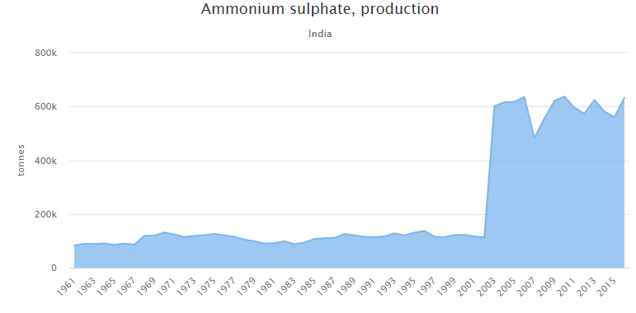
Ammonium Sulphate (NH₄)₂SO₄
Ammonium sulfate is prepared from ammonia and Sulfuric acid.
Two grades –
Technical Grade
Reagent Grade
Market Potential (India)
Current market production around 700000 tonnes
-(+12.96% increase in production from last year)
CAGR of 4.9%(Globally)
Reasons for growth in the industry-
Growth in Fertilizer industry
Government gives Subsidy for ammonium Sulphate on the basis
Nutrient Content.

Slide 5
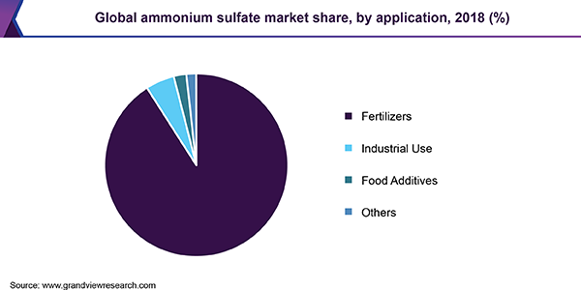
Current Manufacturers –Major players in the Market
Indian Potash Limited
GSFC
Deepak Fertilizers
PRICING
Range 13-93/kg mostly concentrated round 50/kg
Customer or the industry where Phosphoric acid is used
Fertilizer
Pharmaceuticals
Dyes
Water treatment

Slide 6
Hydrofluoric acid
Hydrofluoric acid is produced by treatment of the mineral fluorite (CaF2) with concentrated sulfuric acid.
Four grades –
Technical Grade
Bio-Tech Grade
Analytical Grade
Electronic grade
It can be used in the anhydrous form -- anhydrous hydrofluoric acid (AHF) -- or in the dilute form -- aqueous hydrofluoric acid .
Market Potential (Globally)
1.57 Million tonnes –growth up to 2.57 million tonnes.
CAGR of 5.5%(Globally)
India to increase demand by more than 5% until 2021
Reasons for growth in the industry-
India and China are the highest importer of the same.
Manufacturing of fluorochemicls owing to application in home appliances

Slide 7
Current Manufacturers –Major players in the Market
S.B. Chemicals
Tanfac industries
PRICING
Most of the products of Hydrofluoric Acid ranges from Rs 76 to 195 per Kg
Hydrofluoric Acid Price Range No. of Products(%)
Rs 76 – 96 -14%
Rs 96 – 120 -19%
Rs 120 – 150- 27%
Rs 150 – 195 -20%
Customer or the industry where Hydrofluoric acid is used
Semiconductors and microelectronics applications
Electronic and IOT enabled equipments.
Metal processing, steel pickling, metal surface treatment,

Slide 8
Chlorosulphonic acid(HSO₃CL)
The industrial synthesis entails the reaction of hydrogen chloride with a solution of sulfur trioxide in sulfuric acid
  HCl + SO3 → ClSO3H
Grades available
Pharmaceutical Grade
Industrial Grade
Market Potential
CAGR of 8.50% over FY2017-FY2022
India to increase demand by more than 5% until 2021
Reasons for growth in the industry-
Stabilization of sales prices of dyes and intermediates
Growth in pharmaceuticals industry

Slide 9
Current Manufacturers –Major players in the Market
Aarti Industries – Gujarat
Joshi group
Shivshakti acid
PRICING
Most of the products of chlorosulphonic acid ranges from – 20.5-45/kg
Customer or the industry where Chlorosulphonic acid is used
DYES
Pharmaceutical
Agrochemical
Plastic Industries
Others

Slide 10
Dimethyl Sulphate (CH₃0₂)SO₂
Dimethyl sulfate can be synthesized in the laboratory by many different methods,
the simplest being the esterification of sulfuric acid with methanol,.
Grades available-
Purity 98%
Purity 99%
Others
Market Potential
Application
Dyes and photographic chemicals
Methyl ethers like anisole and anisole derivatives
Flocculants for water treatment

Slide 11
Current Manufacturer
Remik industries-Gujarat
Aarti industries-Maharashtra
ISPCL Gujarat
Chem india
Kevya chem
Pricing
Industrial grade 40-65/kg
Mostly concentrated around 60/kg
Customers Potential Clients
Agrochemicals Ranbaxy, Dr. Reddys, Du pont, 3M, Bayer
Aromatics,
Water treatment
wood pulp industries
Dyestuff industries

Slide 12
Sulphamic acid(SO₃NH₃)
Sulfamic acid is produced industrially by treating urea with a mixture of sulfur trioxide and sulfuric acid (or oleum)
Grades available
GP Grade: The GP grade may be used for removing scales obtained from water in heating and cooling systems e.g. boilers, heat exchangers, condensers, jackets and coils.
SR Grade: This formulation is recommended for scales containing high silica. Typical examples are scales found in caustic evaporators in the Aluminum industry and black liquor evaporator in the pulp industry.
TM Grade: This formulation is recommended for removal of scales from heat exchangers made of Titanium metal.
Sulfamic Acid Market by Type: Crystal. Powder. Liquid. Others
Market Potential
Reasons for growth in the industry-
Stabilization of sales prices of dyes and intermediates
Growth in pharmaceuticals industry

Slide 13
Current Manufacturer
Raviraj chemicals
Mingda chemicals
Nissan chemicals
Pricing
Industrial grade 37-60/kg
Customers
Plastic industry as a curing agent
Descalant – GP grade
Electroplating, Electrorefining
Chlorine stabilisation

Slide 14
OLEUM (YSO₃NH₃)
Oleum is produced in the contact process, where sulfur is oxidized to sulfur trioxide which is subsequently dissolved in concentrated sulfuric acid. Sulfuric acid itself is regenerated by dilution of part of the oleum.
Oleum is a liquid at moderate temperatures and is stored in specially designed and vented
storage tanks.
Two grades- 23% ,65%
Market Potential
Reasons for growth in the industry-
Sulphuric acid production
As an intermediate for transportation
Organic chemistry research
Explosive manufacturing

Slide 15
Current Manufacturer
Kiri Industries
Aarti Industries
Pricing
Not much different than sulphuric acid.
Mostly concentrated around 9-10/kg
Customers
Basic chemical for sulfonation processes (chemically adding sulfate),
Nylon manufacturing
The production of dyes
Nitrating reactions
Hydrofluoric acid (HF) production

Slide 16
THANK YOU

