Slide 1


PROJECT PROPOSAL
Name: Anurag Kedia
Guide: Vineet Shreedharan
Dept. IT

Slide 2
Smart office
WHAT MAKES OFFICE SMART:
Unify operations under 1 system.
Communication, collaboration and creativity.
3 STAGES OF IMPLEMENTATION:
Define workplace strategy.
Locate, design and build.
Operate, optimize and adapt.
CAUTION:
May lead to confusion, conflict and spiraling cost.

Slide 3
Contents
Real time inventory management
Indoor positioning
Aware Building
Virtual stores
Smart lighting
Unified app
Work allotter
Green office
Hot desking
Product Tracing
Smart presentation
Room reservation system
Product cataloguing
Security camera footage analytics

Slide 4
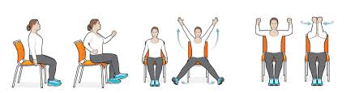
Reduce chair time
Concept:
Employees spending great amounts of time on the chair. Leads to health issues.
Work timings allow for little time and motivation for personal health.
Proposal:
Break notifications after said time of work – message for certain exercises that can be performed while sitting on the desk or walk around.
Stand-up meetings - focus on important points - saves time, promotes agility.
Standing workstations – manage space, promotes agility.

Slide 5

Employee wellness plans
Ideas:
Promote participation in charity runs, run for fun.
Track sports activites and maintain leaderboards
Inter department weekly sports events at plants and in the corporate office. Can be converted into leagues.
100 day challenge.
Weekly health day – Only healthy food brought, canteens provide no junk food.
Promote club culture- inter department interaction.
Weekly meditation/yoga/reflection sessions.

Slide 6
Beat the Monday blues
Concept:
Monday should be associated with fun - employees looking forward to join the company after the weekend.
Proposal:
Newsletters published every Monday- informative, interactive – for entertainment not propaganda.
Employee interviews.
Fun activities like games, department parties etc.

Slide 7
Reduce Canteen Wastage
Current:
Excess food produced in some meals, out of stock on others.
Proposal:
Canteen preording system, vendor knows the estimated amount of food to produce.
Incentives given to the orderers in the form of discounts.
Info on daily wastage displayed in the courtyard, short term goals to reduce wastage.
Provision of excess food to needy.
Zero wastage days.
Segregation of waste using 2 bins.

Slide 8
Visual Media
Concept:
Display of production parameters in the courtyard.
Info creates sense of belonging.
Departments that remain cut-off.
Motivational posters.
Library rejuvenation and e-library development.

Slide 9
Better Puching system
CURRENT SYSTEM:
Employee's have to check the system for irregularities in the punches recorded within themonth.
Much more error in plants when more than 2 punches required per day.
PROPOSED SYSTEM:
Automatic updates if not punched in/out at the required time addded with some buffer time.
Access of atttencdence records on the phone.
Allerts before end of month if some irregularities present such as single punch in a day, punched out at the expected time of entry or vice versa.

Slide 10
New employee starter pack
Asset allotement before coming to the office, new employees should have SAP ID's, emails, workstation before arrival - leads to non-productivity in the intial days.
Recorded tutorials for newcomers.
Sessions on maintaining work-life ballance, prevent wastage, importance of team work. Department welcome, introduction.
SAP suggestions:
  Weekly leaning sessions on existing modules.
  Cross learning to remove redundancy between different teams, efficiency improvement.

Slide 11
Hot Desking (Office space utilization)
CURRENT SITUATION:
Office seen to filled to the brink on some days, with some employees working in the basement and majorly empty on others.
THE CONCEPT:
Dynamic allotment of workstation.
Smart scheduling of GEMBA leaves, WFH, half days.
Very popular concept. Adapted in Intel SRR3, Bangalore as well as The Edge Amsterdam (the smartest building of the world)
The edge has an employee to workplace ratio of 5:2.
THE BENEFITS:
Spirit of teamwork and collaboration.
Chance encounters, creativity.
Space for new employees.

Slide 12
Hot Desking (Office space utilization)
Survey for IT department:
No. of employees:
No of workstations:
Average attendance:
Least attendance:
Feasibility check:
Extensions:
Hoteling: Reserve desks in advance.
Zoning: Temporary arrangement for a project for a team to get designated area to work.
Ownership of space missing: provide lockers.

Slide 13
Security camera footage analytics
Description:
IP security cameras present in the campus. Have features for motion sensing and detecting line crossing. Other services can be paid for.
Analytics such as crowd detection, foot count determination as well as restricted area access possible using openCV.
Advantages:
Automation in the vigilant eye team.
Drawbacks:
Achieved accuracy may not be very high, could lead to false alarms. Hence, human monitoring could be required.
Implementation/requirements:
Requires installation of openCV library for python which is free.
Time constrain may be an issue, given the learning curve.

Slide 14
Real time inventory management
Concept:
Real-time inventory management is the process of recording sales and purchases of inventory immediately using unified software.
Enables organization to react quicker to supply chain needs compared to periodically updating inventory.
Can be supplemented with technology such as RFID, bar codes for automation.
Advantages:
Customer satisfaction: On seeing ‘out of stock’ for a desired product, customer is most likely to not return to the brand (mostly true for online retail).
Warehouse organized, error detection easier, asset to the marketing and finance teams.
Accuracy, transparency, efficiency (no double data entry).

Slide 15
Indoor positioning (BLE/zigbee)
Description:
Bluetooth low energy (BLE) devices installed throughout the building
Very energy efficient (6-8 years of battery life) and cost efficient.
Can get RSSI (received signal strength indicator) from labelled beacons.
Applications:
Indoor navigation : pre-fed directions.
Theft protection : beacons attached to valuable objects, alarm when leaves area.
Inventory management : Beacons placed on batches of goods.
Analytics : hot-spots, less popular ones.
Drawbacks:
Bluetooth and wifi use the same frequency range, may cause interference. Workaround is suitable configuration of wifi.
Non directional transmission, for accuracy data from 3 beacons required for exact coordinate determination (less than 3m inaccuracy).

Slide 16
Aware building
Broad Idea:
Employees connected with the office building.
Description:
Server maintains data about current residents.
Number plate recognition and linking to ID - easy attendances, smart security.
Info about workplace preferences, location for allotment.
Aware about meeting timings, other events for every employee, sends notification via the unified app.
Advance:
Learn from the usage, preference data of employees to fine tune a ML algorithm to optimise operations.

Slide 17
Smart lights
About 30% energy saving possible by switching to a controlled LED lighting system.
Motion sensing lights with 10min time limit in washrooms, other lesser used areas.
Ability to pre-set, dim, and light each room according to time of day, programmed schedule, or room occupancy.
Natural light sensing, motion sensing possible.
Workspace lighting customisability option - satisfaction drives performance.
Preferences stored, suitable setting for the allotted station – hotdesking, smart building.
Providers such as Philips Hue lighting.

Slide 18
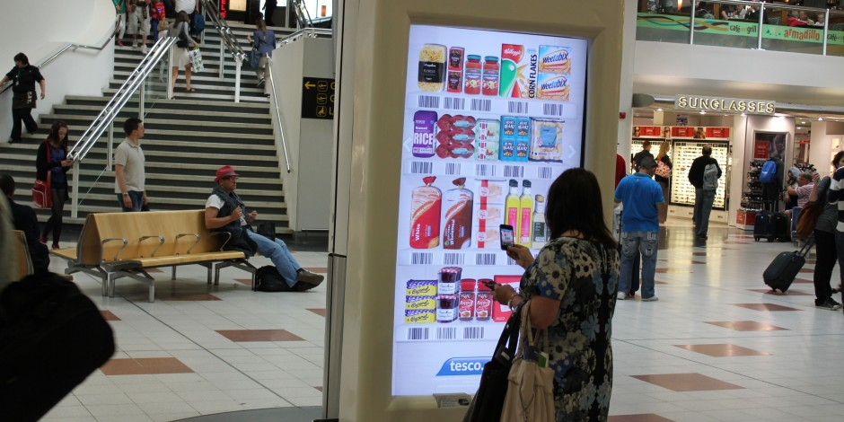
Virtual stores
Description:
Low cost retail, samples of products placed on shelf – photos enough for non cloth products.
QR code scanned to add products to cart.
Product delivered at home.
Applications:
Low cost, more satisfying than online shopping.
Advance:
Smart shop concept – build customer experience rooms, explaining manufacturing process can be build over AR – investment required.

Slide 19
Work allotter:
Idea:
Many small tasks/corrections are conveyed in the verbal manner. Which get forgotten, requiring follow-ups.
Supervisor types the work to be done, which gets updated on the to-do list of the team member (possibly display on the one app).
Advantages:
Better workflow.
Follow-ups not required, after completion list updated.

Slide 20
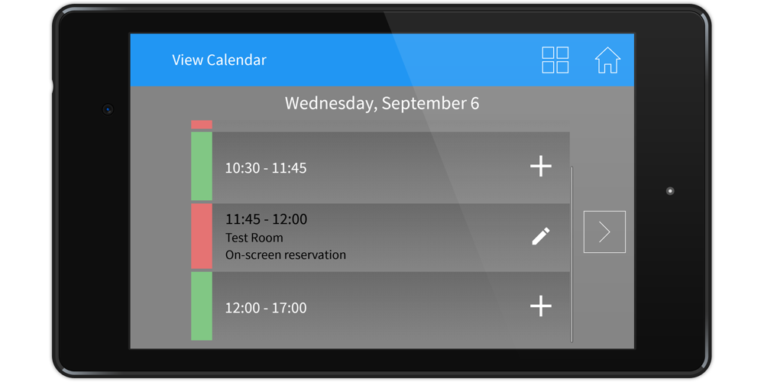
Small projects
Presentation tools:
RFID tags, sensors used to incorporate physical elements in the presentation.
Gesture control using motion sensing technologies. Eg. Kinect by Microsoft
Smart room reservation:
Tabs placed outside meeting rooms for real-time booking.
Meeting notifications.
Room usage display board to show the future bookings/request changes.
Can be booked using “the one app”.

Slide 21
Green office
Place info about type, benefits of a tree, on that tree - creates awareness about cleanliness and environment protection in the campus.
Plastic free office.
Encourage desk plants.
Introduction of a ‘power saving mode.’
  Stage 1: Before infrastructural changes, define parameters for employees to follow during last hour of work. Say after 5pm.
  Stage 2: Slowly work towards automation : sensors to detect light intensity and achieve at least BEE 4-star rating for the building (less than 105 kWh/sqm/year).
Temperature control optimization would require more efficient ways of cooling, current systems being used very optimally by the employees.
Automatic low-cost Waste segregation and subsequent recycling.
Water Reuse :- NEED MORE INFORMATION.

Slide 22
Unified employee's app
FUNCTIONALITY SCOPE:
Enabler for other ideas
Employee chat-room :- broadcast messages for problems faced by employees. Enhance collaboration in employee community.
Car pooling facilitation :- Traveling to/from work made easier.
Work space allotment :- compatibility with hot-desking principle.
Conference/meeting room booking :- real time bookings. Provision of tabs right outside the rooms.
Notification for news or events of the office.
Canteen menu updates.
Can be further extended to store employee preferences.
Work allotment : proffered over verbal method of assigning work.
Leave applications etc. compatibility with current systems.

Slide 23
Product Tracing
“STORY OF A PRODUCT”
THE CONCEPT:
Trace finished goods back to the farm which generated the raw material.
Display this on the scan of a QR code to customer, information in first person narrative. Can be displayed in various ways.
Brings transparency, clarity to the manufacturing process.
CHALLENGES:
Maintaining a tag for products may be difficult, considering the discreet method of manufacturing and various intermediate products.

Slide 24
Product Cataloging
Description:
Displaying product information on a 3D model emerging from the QR-code/marker placed on the product .
Uses AR.js – remotely available, no installations required.
We have products (packaged/un-packaged) where this could be implemented on the boxes/covers or tags. It could also be added in magazines/boards etc where product ads are placed.
Advantages:
Easy access to information of any product.
Creates Wow effect for customer and adds to enhanced customer experience.
More customer conversions and could drive more sales of products.
Browser based implementation possible, requiring no installation by the user.
Can be scaled to provide AR based user trainings of various products as well as in logistics.
Drawbacks:
New users may prefer traditional man-to-man form of information delivery.
Implementation/requirements:
Require info about certain products, should check with Design and marketing teams if data is hosted and could be accessible.
Customer experience and feedback can be used to judge effective outcome of the product.

Slide 25
THANK YOU

