Slide 1


Product Identified under Product Development
in Chemicals Division
Name: Chinmay Soni
Project Guide – Mr P.S. Bindra
Dept. Chemical marketing

Slide 2
Contents – Different products
Phosphoric Acid
Ammonium Sulphate
Hydrofluoric Acid
Chlorosulphonic Acid
Dimethyl Sulphate
Sulphamic Acid
Oleum
Poly Aluminum Chloride (PAC) – Identified from Market Survey
Acid Slurry – Identified from Market survey
Single Super Phoshate

Slide 3
Phosphoric Acid (H₃PO₄)
Phosphoric acid is produced by reacting sulfuric acid (H2SO4) with naturally occurring phosphate rock.
Two grades- Fertilizer Grade and Technical Grade
Phosphoric acid is made by two processes:
The 'wet' process
Thermal process
Market Potential (India)
Current market demand (2018 Data)
- 4948(KTPA- Kilo tonnes per annum) =4948000 tonnes
CAGR of 5.96% till 2030 will reach to 8773 KTPA
Mostly used in Western region of India.
Demand in Punjab Region - Around 15-16 tonnes required by Tez Acids and Gagan vanaspati,
also other oil refinery in Punjab
Reasons for growth
-Growing Fertilizer industry owing to demand in food production
-Mostly used in Agriculture And Fertilizer Industry , other industry procure it through spent.
-Various subsidies of government on Fertilizers
-Used in formation of phosphate fertilizers

Slide 4
Current Manufacturers –Major players in the Market
GACL
Grasim chemicals
Paradeep Phosphates
PRICING
Range 60-114/kg mostly concentrated round 65-70/kg (72/kg retail price)
Customer or the industry where Phosphoric acid is used
Fertilizers
Pharmaceutical
Food & Beverage (cold drinks)
Detergent
Metal Treatment (Electroplating)
Water Treatment
Top countries Importing Phosphoric Acid
India- 3-4 Million MT
European Union- 1-5 Million MT

Slide 5
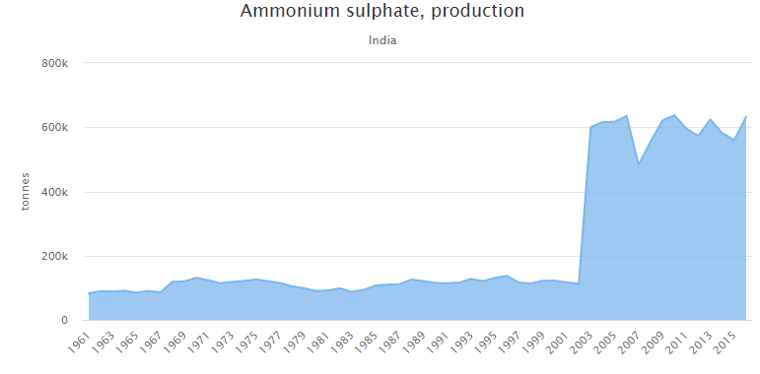
Ammonium Sulphate (NH₄)₂SO₄
Ammonium sulfate is prepared from ammonia and Sulfuric acid.
Two grades –
Technical Grade
Reagent Grade
Market Potential (India)
Current market production around 700000 tonnes
-(+12.96% increase in production from last year)
CAGR of 4.9%(Globally)
Reasons for growth in the industry-
Growth in Fertilizer industry
Government gives Subsidy for ammonium Sulphate on the basis
Nutrient Content.

Slide 6
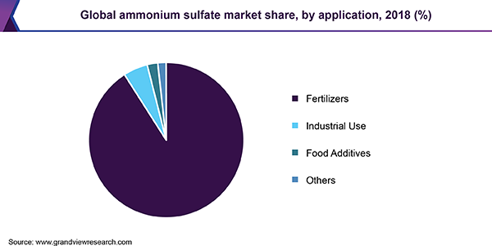
Current Manufacturers –Major players in the Market
Indian Potash Limited
GSFC
Deepak Fertilizers
PRICING
Range 13-93/kg mostly concentrated round 50/kg
Customer or the industry where Phosphoric acid is used
Fertilizer
Pharmaceuticals
Dyes
Water treatment

Slide 7
Hydrofluoric acid
Hydrofluoric acid is produced by treatment of the mineral fluorite (CaF2) with concentrated sulfuric acid.
Four grades –
Technical Grade
Bio-Tech Grade
Analytical Grade
Electronic grade
It can be used in the anhydrous form -- anhydrous hydrofluoric acid (AHF) -- or in the dilute form -- aqueous hydrofluoric acid .
Market Potential (Globally)
1.57 Million tonnes –growth up to 2.57 million tonnes.
CAGR of 5.5%(Globally)
India to increase demand by more than 5% until 2021
Reasons for growth in the industry-
India and China are the highest importer of the same.
Manufacturing of fluorochemicls owing to application in home appliances

Slide 8
Current Manufacturers –Major players in the Market
S.B. Chemicals
Tanfac industries
Naveen fluoric(From market survey)
PRICING
Most of the products of Hydrofluoric Acid ranges from Rs 76 to 195 per Kg
Hydrofluoric Acid Price Range No. of Products(%)
Rs 76 – 96 -14%
Rs 96 – 120 -19%
Rs 120 – 150- 27%
Rs 150 – 195 -20%
Customer or the industry where Hydrofluoric acid is used
Semiconductors and microelectronics applications
Electronic and IOT enabled equipments.
Metal processing, steel pickling, metal surface treatment,

Slide 9
Chlorosulphonic acid(HSO₃CL)
The industrial synthesis entails the reaction of hydrogen chloride with a solution of sulfur trioxide in sulfuric acid
  HCl + SO3 → ClSO3H
Grades available
Pharmaceutical Grade
Industrial Grade
Market Potential
CAGR of 8.50% over FY2017-FY2022
India to increase demand by more than 5% until 2021
Reasons for growth in the industry-
Stabilization of sales prices of dyes and intermediates
Growth in pharmaceuticals industry

Slide 10
Current Manufacturers –Major players in the Market
Aarti Industries – Gujarat
Joshi group
Shivshakti acid
PRICING
Most of the products of chlorosulphonic acid ranges from – 20.5-45/kg
Customer or the industry where Chlorosulphonic acid is used
DYES
Pharmaceutical
Agrochemical
Plastic Industries
Others

Slide 11
Dimethyl Sulphate (CH₃0₂)SO₂
Dimethyl sulfate can be synthesized in the laboratory by many different methods,
the simplest being the esterification of sulfuric acid with methanol,.
Grades available-
Purity 98%
Purity 99%
Others
Market Potential
Application
Dyes and photographic chemicals
Methyl ethers like anisole and anisole derivatives
Flocculants for water treatment

Slide 12
Current Manufacturer
Remik industries-Gujarat
Aarti industries-Maharashtra
ISPCL Gujarat
Chem india
Kevya chem
Pricing
Industrial grade 40-65/kg
Mostly concentrated around 60/kg
Customers Potential Clients
Agrochemicals Ranbaxy, Dr. Reddys, Du pont, 3M, Bayer
Aromatics,
Water treatment
wood pulp industries
Dyestuff industries

Slide 13
Sulphamic acid(SO₃NH₃)
Sulfamic acid is produced industrially by treating urea with a mixture of sulfur trioxide and sulfuric acid (or oleum)
Grades available
GP Grade: The GP grade may be used for removing scales obtained from water in heating and cooling systems e.g. boilers, heat exchangers, condensers, jackets and coils.
SR Grade: This formulation is recommended for scales containing high silica. Typical examples are scales found in caustic evaporators in the Aluminum industry and black liquor evaporator in the pulp industry.
TM Grade: This formulation is recommended for removal of scales from heat exchangers made of Titanium metal.
Sulfamic Acid Market by Type: Crystal. Powder. Liquid. Others
Market Potential
Not much demand in Punjab region ,hardly around 20-50 tonnes as collected from Market Survey
Reasons for growth in the industry-
Stabilization of sales prices of dyes and intermediates
Growth in pharmaceuticals industry

Slide 14
Current Manufacturer
Raviraj chemicals
Mingda chemicals
Nissan chemicals
Pricing
Industrial grade 30-60/kg, mostly at 36/kg
Customers
Plastic industry as a curing agent
Descalant – GP grade
Electroplating, Electrorefining , In Boilers
Chlorine stabilisation

Slide 15
OLEUM (Y*SO₃NH₃)
Oleum is produced in the contact process, where sulfur is oxidized to sulfur trioxide which is subsequently dissolved in concentrated sulfuric acid. Sulfuric acid itself is regenerated by dilution of part of the oleum.
Oleum is a liquid at moderate temperatures and is stored in specially designed and vented
storage tanks.
Two grades- 23% ,65%
Market Potential
Reasons for growth in the industry-
Sulphuric acid production
As an intermediate for transportation
Organic chemistry research
Explosive manufacturing

Slide 16
Current Manufacturer
Kiri Industries
Aarti Industries
Pricing
Not much different than sulphuric acid.
Mostly concentrated around 9-10/kg
Customers
Basic chemical for sulfonation processes (chemically adding sulfate),
Nylon manufacturing
The production of dyes
Nitrating reactions
Hydrofluoric acid (HF) production

Slide 17
PAC(Poly aluminium chloride-AL2CL(OH)5)
Powder Form –Major demand.
Is a By-Product of several Alkalies Unit
Major Raw Materials - Sulphuric acid/HCL,Aluminium Hydroxide
Market Potential
Demand in Punjab region-Around 500 tonnes.
NFL ,Oswal fertilizers, Paradeep phosphates uses in huge quantity.
In Textile Industry Uses , paper industry such as Haripur paper uses.
Plant costs around 3 to 4 crores and in a space of 1000 sqft
Reasons for Growth
Coming up as an replacement of alum
Less alkaline in nature than alum
Maintains the purity of water in water treatment (Likely to grow market)
Only two to three major players

Slide 18
Current Manufacturers
GACL, GRASIM Industries, DCM Kota, Kanoria chemicals
By product of IOL in Punjab around 3000 tonne sale of 9-10%
400-500 tonne sale of 14%
200-300 tonne sale of 12%
PRICING (Data as collected from market survey)
32-33/KG in the market
28% powder form priced at 30/kg
12% priced 4000-4500/ kg
14% priced at 5000-5500/kg
18% priced at basic of 8000/tonne
USES
-Substitute of alum in Water treatment industry
-Majorily in PaperMill industry. Around 60-70%of paper industry (Input from Market survey)
-Cosmetics Industry
-Oil and Gas industry
-paper industry

Slide 19
Acid Slurry (ALKYL BENZENE SULPHONATE)
Sulphonation product made by sulphonation of linear alkyl benzene by oleum or so3 or Sulphuric acid or combinations of above. It is used in manufacturing of various detergents
Oleum is getting replaced by Acid slurry these days.
Using Sulphuric Acid,Benzyne etc
Raw material consumption per tonne of 85-88% acid slurry is given below:
(a) Linear alkyl benzene 700-750 Kg.
(b) Sulphonating agent 20% oleum800- 900 Kg. 98% Sulphuric acid - 110–120 Kg.
Market Potential (India)
Concentrated around Bombay Region.
Reasons for growth
Easy to produce
Oleum replacement

Slide 20
Current Manufacturers
Pricing
65-95/kg
Uses
Textile industry, Dye industry

Slide 21
Single Super Phosphate
Superphosphate is manufactured by reacting insoluble phosphate rock with sulfuric acid to form a mixture of soluble mono-calcium phosphate and calcium sulphate (approximately 9% phosphorous) which is able to be used by plant
Prepared in three grades same as sulphuric acid
LR grade , Battery grade , Commercial Grade
Market Potential (India)
Reasons for growth

Slide 22
Current Manufacturers
Khaitan chemicals
Pricing
8-9/kg
Uses
Single Super Phosphate (SSP) fertilizer is mainly used for improving root growth and chlorophyll synthesis and thus improves product quality.
As a fertilizer.

Slide 23
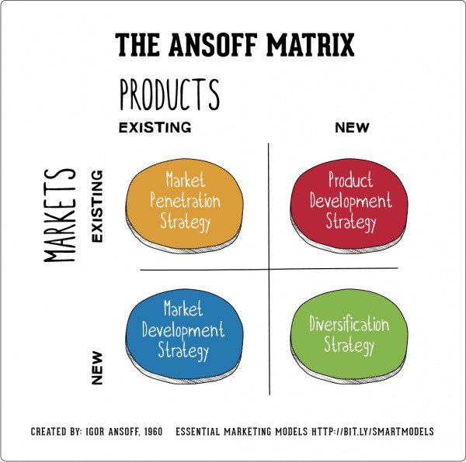
Market Survey and Analysis
Aim - To Identify the Market potential and Manufacturing scope of various value added products from Sulphuric acid.
Resources used
Primary research
Internet Search and Library
Secondary research
Visiting Dealers and Cold calling

Slide 24
Questionnaire
Any generalized information about the products if any?
Who are the major producers of the same chemical?
Effective Demand In Punjab/North Region ?
Feasibility in Producing the same?
Major Consumers?
What is the current prevailing price in the market?
Best to produce among all set of chemicals?
Phosphoric Acid
Ammonium Sulphate
Hydrofluoric Acid
Chlorosulphonic Acid
Dimethyl Sulphate
Sulphamic Acid
Oleum
Poly Aluminum Chloride (PAC)
Acid Slurry
Single Super Phosphate
Any other source of information which will be helpfull for the survey?
Any other value added products you want to suggest?

Slide 25
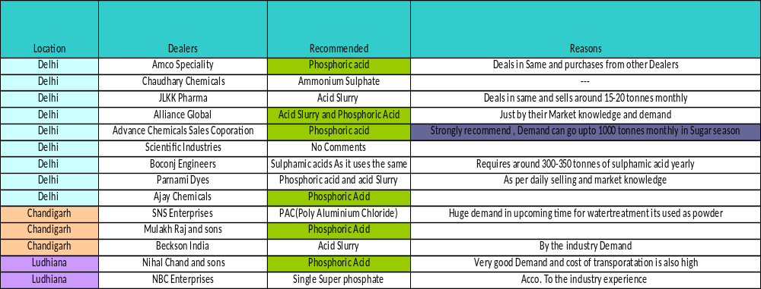
Analysis
Places Visited Chandigarh, Ludhiana local market, Delhi.
Total no. of Dealers Visited= 14
Recommendation and Demand according to producers

Slide 26
Quantitative Data as collected from Secondary research For most demanded products
Products | Demand | Pricing | Manufacturers
Phosphoric Acid | 500 Tonnes and can go upto 1000 tonnes in sugar season in and around Delhi Region | 60-65/kg | GACL, Grasim , Paradeep Phosphates
Sulphamic Acid | 100-200 region in Delhi Region | 28-30/kg | Raviraj Chemicals, Nissan Chemicals
Acid Slurry | 200-300 Tonnes | 85/kg for 90% | Not concentrated around one
PAC | 500 Tonnes in Punjab region owing to more use in water treatment | 32-33/kg | IOL, GACL, GRASIM By Aditya Birla

Slide 27
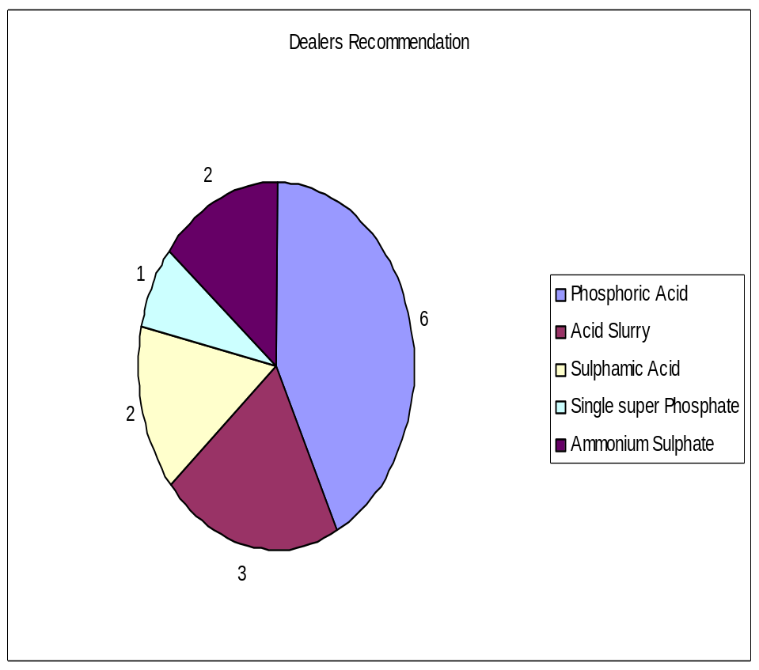
Out of all the Dealers met in Ludhiana, Chandigarh , Delhi
6 dealers recommended for PHOSPHORIC ACID
3 recommended for Acid Slurry
2 recommended for Sulphamic Acid
2 for ammonium Sulphate
1 recommended for Single super Phosphate

Slide 28
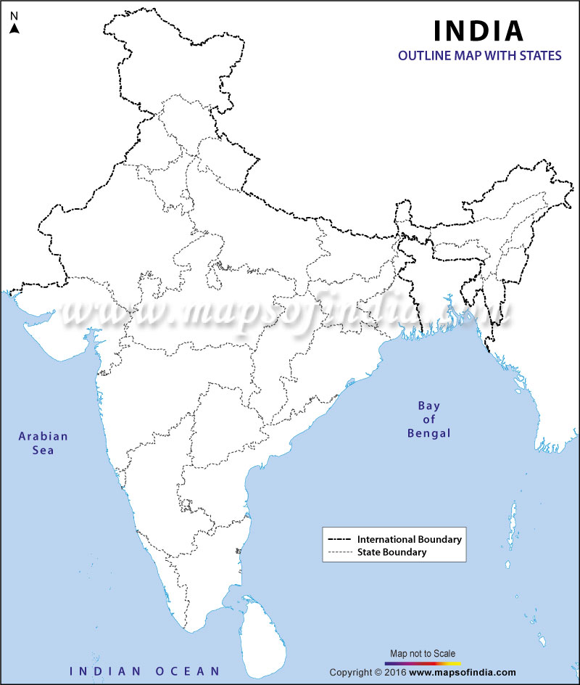

Phosphoric Acid (Manufacturers)
We are here
AARTI Industries
GACL
Paradeep Phosphates
GRASIM by Aditya Birla

Slide 29
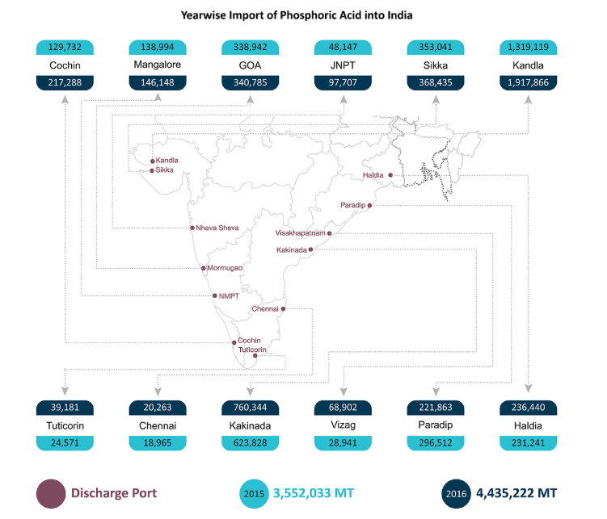
Importing ports of PHOSPHORIC ACID

Slide 30
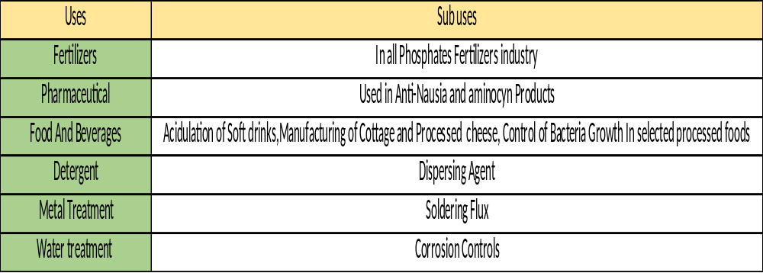
Some additional Information
Out of total 100% consumption in INDIA, 45% of Phosphoric Acid is being imported
India imports around 3-4 Million MT

Slide 31
Important Conclusions
Out of 14 dealers visited across places such as Delhi, Ludhiana, Chandigarh and all the primary Research done Phosphoric Acid tops the Product List with Highest Demand and less supply .
Phosphoric Acid to be manufactured by Wet process which uses sulphuric Acid should be manufactured with high quality output.
Most of the manufacturers of phosphoric acid lie around Gujarat region which increases the transportation cost.
Acid slurry and Sulphamic Acid have the most demand after phosphoric acid and is required in some niche areas
PAC (Powder form) can also turn out to be one of the important products as the Growing demand of water treatment in the present scenario.
OLEUM has been totally replaced by acid slurry in market .

Slide 32
THANK YOU

