Slide 1
AGARWAL AUTOMOBILES FUEL STATION FORECASTING AND INVENTORY MANAGEMENT
ADSDS BATCH 3 - GROUP 15
ANUPAM DEEP VERMA
ANURAG KUMAR

Slide 2
BACKGROUND OF CASE
Agarwal Automobiles was an authorized fuel station for Bharat Petroleum Corporation Limited (BPCL), a major oil and gas company located in the Sagar district of Madhya Pradesh, India.
It sold three main products at the fuel station: Petrol, Diesel and High-Speed Petrol (HSP).
Agarwal Automobiles had three separate storage tanks, each with a different capacity, for each of the three fuel types. In March 2015, the fuel station was renovated to increase the inventory capacity.
DETAILS OF FUEL STORAGE TANKS AT THE FUEL STATION
Tank | Fuel Type | Capacity (Litres)
Tank 1 | Diesel | 20,000
Tank 2 | Petrol | 15,000
Tank 3 | High-Speed Petrol (HSP) | 10,000

Slide 3
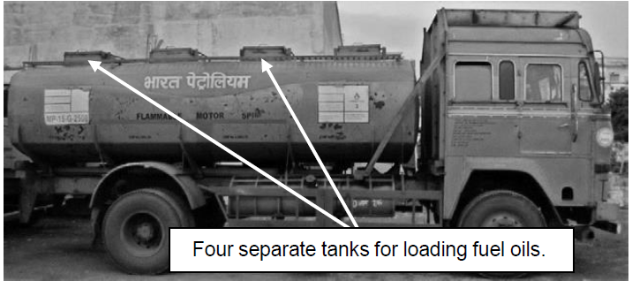
BPCL introduced an online automatic ordering system for its fuel stations, which Agarwal Automobiles used to place frequent orders.
Essentially, the procedure required that an order be placed before 3:00 p.m. for the next day’s requirements.
The tanker that carried fuel from supplier to fuel station had 04 compartments, each with the capacity to store 3,000 litres.

Slide 4
The supplier would refuse to deliver fuel unless the order amounted to exactly 12,000 litres, either for an individual fuel or a combined order of the three different fuel type.
Approximately once each month, an order failed to be placed and the tanker would be unable to load the required fuel, due to unforeseen technical glitches such as server failure on the supplier’s end.
To unload the fuel, sales had to be stopped for approximately 10 minutes. The fuel station manager estimated the ordering cost at ₹150, based on the approximate loss of potential sales during this time.

Slide 5
On an average, if the company ordered 1,000 litres of any type of fuel, it was expected that approximately 996 litres would be the final quantity available for sale after the inventory had been replenished. The loss of four litres per thousand was incurred due to leakage or evaporation of that particular fuel, either in transit or while unloading.
Inventory holding costs were not directly accounted for, in the above process, although the company confirmed that the cost of capital could be estimated at 10 per cent.
Agarwal Fuel Station did not use any formal analytical techniques to govern ordering and inventory management policies.
Most of the operating decisions of the business were based on simple operating principles combined with managerial intuition.

Slide 6
DATA AVAILABLE
Monthly Sales data from April 2009 to May 2016
Daily Sales Data from 1st May 2015 to 31st May 2016
Daily Order Placed on BPCL from 31st Dec 2015 to 31st May 2016
PRICE AND MARGIN FIGURES FOR THE PRODUCTS
Fuel Type | Unit Price (in ₹) | Contribution Margin (in ₹)
Diesel | 60 | 1.50
Petrol | 70 | 2.33
High-Speed Petrol | 73 | 2.50

Slide 7
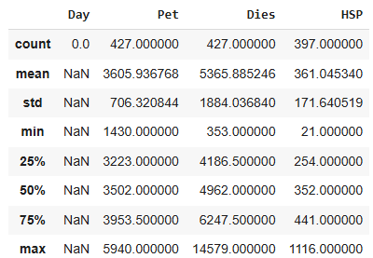
DESCRIPTIVE ANALYSIS ON THE DAILY SALES DATA
Mean and Standard Deviation (Central Tendency & Variability):
Pet has a mean of approximately 3605.94, with a standard deviation of 706.32. This indicates a relatively low variability compared to its mean.
Dies has a mean of 5365.89, with a higher standard deviation of 1884.04, indicating more variability in this data.
HSP has a mean of 361.05, with a standard deviation of 171.64, showing moderate variability relative to its mean.

Slide 8
Range (Min and Max):
Pet ranges from 1430 to 5940, a relatively wide range indicating significant differences in values.
Dies has the largest range, from 353 to 14579, indicating extreme variability.
HSP ranges from 21 to 1116, showing lower variability compared to the other variables.

Slide 9
Percentiles (25%, 50%, 75%):
The interquartile range (IQR) can be observed for each variable:
Pet: Q3 (75%) is 3953.5, and Q1 (25%) is 3223, indicating an IQR of 730.5
Dies: Q3 is 6247.5, and Q1 is 4186.5, giving an IQR of 2061.
HSP: Q3 is 441, and Q1 is 254, resulting in an IQR of 187.
Insights from the table of daily data
Dies Column: This has the highest variability (largest standard deviation and range), which suggests significant differences across observations.
HSP Column: While it has relatively smaller variability, the presence of missing data should be addressed before analysis.
Potential Outliers: The extreme maximum values in Dies (14579) and HSP (1116) compared to the 75th percentile suggest potential outliers.

Slide 10
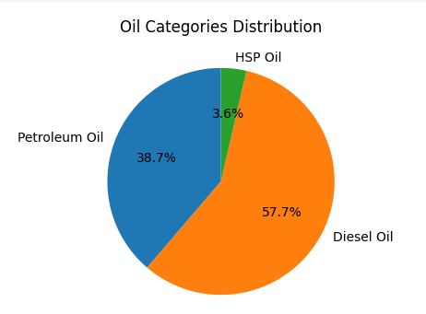
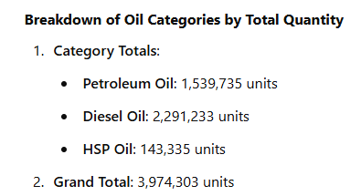
Oil Categories Breakdown: Diesel, Petroleum, and HSP“ visualization

Slide 11
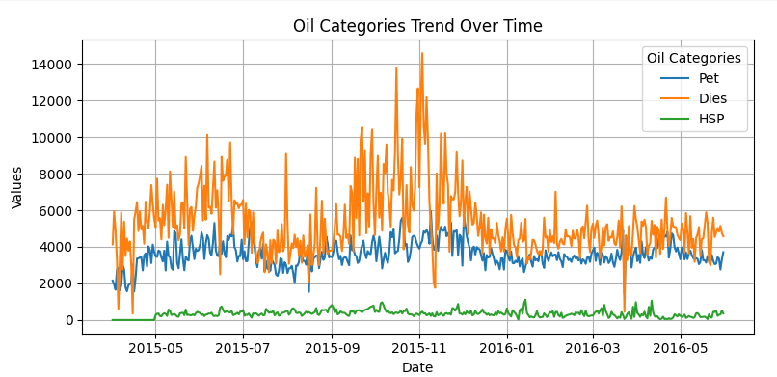
Trend Chart of Oil Category
Value Trends:
Pet (Blue Line):
Values are relatively stable with slight fluctuations, averaging between 2,000 and 5,000. Indicates steady demand or consistent pricing over time.
Dies (Orange Line):
Shows the most significant variations and peaks around 10,000 in late 2015. Suggests a spike in demand, pricing, or other external factors during this period.
HSP (Green Line):
Values remain low and stable, consistently under 1,000. Likely indicates low usage, demand, or availability compared to other categories.
Key Events and Anomalies:
Late 2015: A notable spike in the "Dies" category may indicate a significant external factor like increased demand, policy changes, or market disruptions.
Pet Category Stability: Reflects consistent performance, possibly due to predictable consumption patterns.
Low Values of HSP: Indicates minimal significance or niche usage compared to "Pet" and "Dies.”

Slide 12
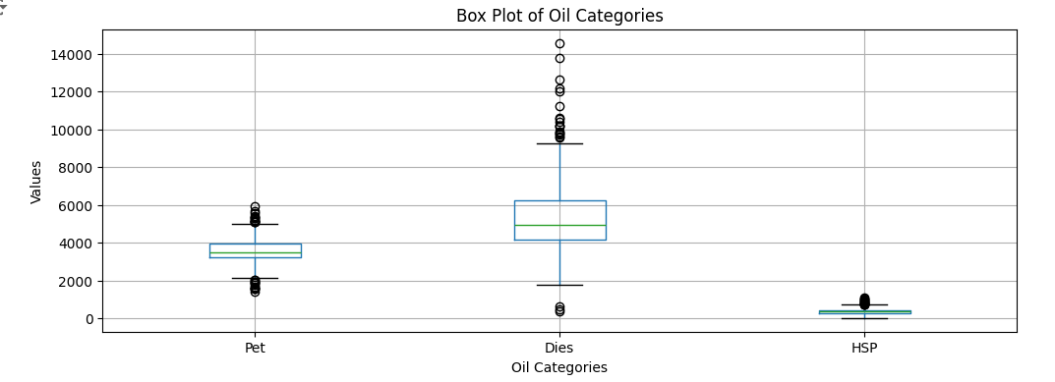
"Box Plot Analysis of Oil Categories: Petrol, Diesel, and HSP"
Insights from the Diagram:
Petro(Pet):
The distribution is relatively compact, with a smaller interquartile range (IQR), indicating low variability.
There are outliers above the upper whisker, suggesting occasional higher values.
Diesel (Dies):
The box plot shows the widest IQR, indicating high variability in diesel values.
Significant outliers above the upper whisker, with some values exceeding 14,000, highlight extreme cases or unusual patterns.
HSP:
The distribution is very narrow, with a small IQR, indicating consistency in values.
A few minor outliers are visible, but the range of variation is minimal compared to other categories.
Comparative Insights:
Diesel has the highest variability and most extreme outliers, suggesting it is the most unpredictable category.
Petroleum shows moderate variability with some outliers, but it is more stable than diesel.
HSP is the most stable category, with minimal spread and fewer outliers.
Observation:
The presence of outliers, especially in diesel, might require further investigation to identify reasons for extreme values (e.g., operational inefficiencies or demand spikes).

Slide 13
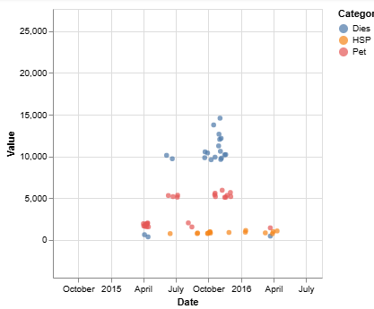
"Scatter Plot of Outliers in Oil Categories Over Time”
Insights from the Scatter Plot of Outliers:
Diesel (Blue Points):
Diesel exhibits the most extreme outliers, with values exceeding 14,000 observed between October 2015 and early 2016.
It has the widest range of variability, indicating significant fluctuations in production, consumption, or data irregularities.
Petroleum (Red Points):
Petroleum outliers are moderate, ranging between 3,000 and 6,000.
These outliers are distributed more evenly over time compared to Diesel, reflecting moderate irregularities.
HSP (Orange Points):
HSP has the smallest and most consistent outliers, primarily below 2,000.
The sparse distribution of HSP points indicates a relatively stable category with limited variability.
Temporal Trends:
Most extreme outliers occur between July 2015 and March 2016, suggesting an unusual period for all categories.
Outside this time frame, the values for all categories appear more stable.
Key Observation:
Diesel’s extreme variability requires deeper investigation into its underlying causes, while HSP remains the most stable category.

Slide 14
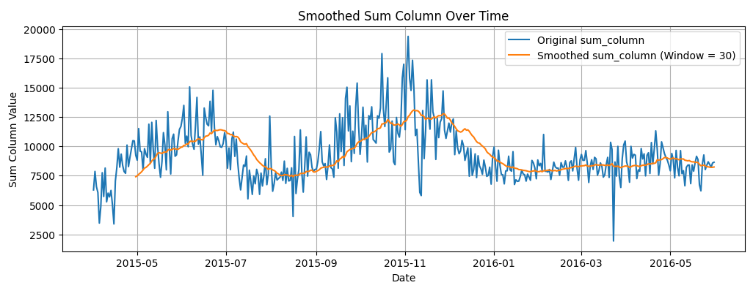
Trend Chart of total daily sales data
(Petrol+Diesel+HSP)
Insights and Interpretations on the daily basis
Seasonality The peak from September to November 2015 suggests a potential seasonal pattern or a period of high demand/activity. For example: Increased sales or activity during a holiday season. Annual events or trends driving higher values.
b. Decline Post-November The decline from November 2015 to March 2016 could indicate: A return to normal levels after a period of high activity. Potential impacts of market trends, seasonal slowdowns, or reduced demand.
c. Consistent Fluctuations The frequent spikes and dips throughout the timeline suggest: High sensitivity to external factors. Possible anomalies in the data or irregular activities influencing the values.
d. Stabilization in 2016 The stabilization around April 2016 may reflect the system returning to a predictable and steady state

Slide 15
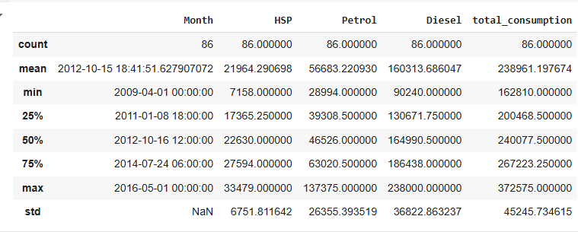
DESCRIPTIVE ANALYSIS ON BASIS OF MONTHLY DATA

Slide 16
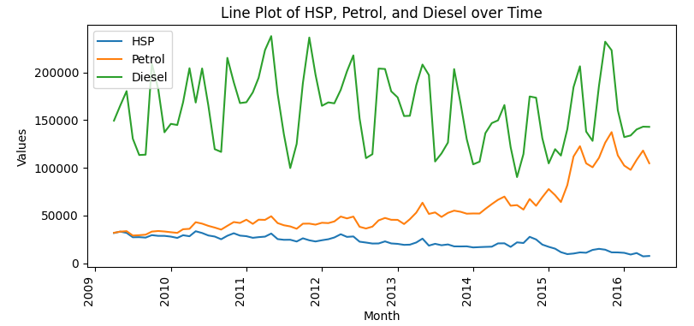
DESCRIPTIVE ANALYSIS ON BASIS OF MONTHLY DATA
1. Diesel (Green Line):
Dominates the Plot: Diesel consistently has the highest values among the three categories, ranging between 150,000 and 250,000.
Seasonal Pattern: A clear cyclic pattern is observed, indicating periodic rises and falls over time. Peaks appear approximately every year.
Decline in Later Months: There is a gradual decrease in peak values toward the end of the timeline (2015–2016).
2. Petrol (Orange Line): Moderate Growth: Petrol shows a steady upward trend over time, with values gradually increasing.
Less Variability: Unlike Diesel, Petrol does not exhibit significant peaks or troughs, suggesting stable growth without seasonal fluctuations. Range: Values consistently remain between 30,000 and 60,000.
3. HSP (Blue Line): Lowest Values: HSP has the lowest values among the three categories, consistently below 50,000.
Flat Trend: There is minimal variation over time, indicating little to no growth or decline.
Stable Demand:The flat line suggests a steady but limited demand for HSP compared to Petrol and Diesel.

Slide 17
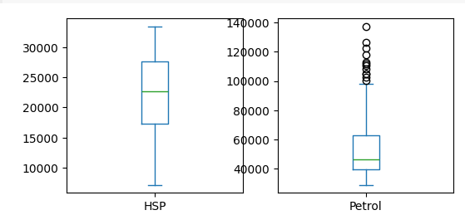
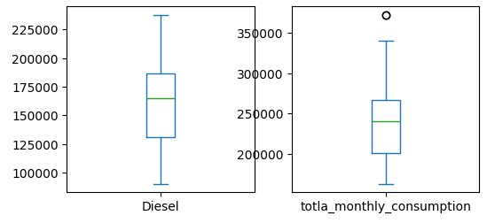
Box Plot on The Basis of the Monthly Data
Interpretation from the Box Plot
HSP (Top Left Box)
Median: The median value lies near 25,000, indicating this is the central tendency for HSP.
IQR (Box Width): The middle 50% of data (IQR) ranges from approximately 20,000 to 30,000, showing moderate variability.
Range: The data ranges from 10,000 to 35,000, with no outliers. Interpretation: HSP consumption is stable with minimal variability and no extreme values.
b. Petrol ( Right Box)
Median: The median value lies around 60,000, suggesting this is the central tendency for Petrol.
IQR (Box Width): The middle 50% of data ranges between 40,000 and 80,000, indicating moderate variability.
Outliers:There are several outliers beyond 120,000, indicating occasional extreme consumption.
Interpretation: Petrol shows moderate variability with occasional high-consumption periods.
c. Diesel
Median: The median value is near 175,000, indicating higher central consumption compared to other categories.
IQR (Box Width): The IQR spans from 125,000 to 225,000, showing significant variability.
Range: Values range from approximately 100,000 to 250,000, with no outliers. Interpretation: Diesel has the highest consumption and variability among the three fuels but no extreme outliers.
d. Total Monthly Consumption (most Right Box) Median: The median value is near 275,000, representing the central total consumption.
IQR (Box Width): The IQR ranges between 200,000 and 300,000, indicating moderate variability in total monthly consumption.
Outliers: There is one outlier beyond 350,000, suggesting a period of exceptionally high total consumption.
Interpretation: Total monthly consumption is generally consistent, with occasional spikes.

Slide 18
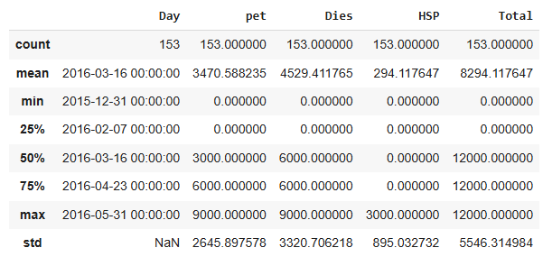
DESCRIPTIVE ANALYSIS OF THE ORDERS PLACED ON BPCL
Observations:
Diesel exhibits the highest mean and variability, likely due to demand or production fluctuations.
HSP has minimal contributions and variability, indicating a more stable pattern.
Most of the dataset's values are concentrated in the upper range for Petroleum and Diesel.

Slide 19
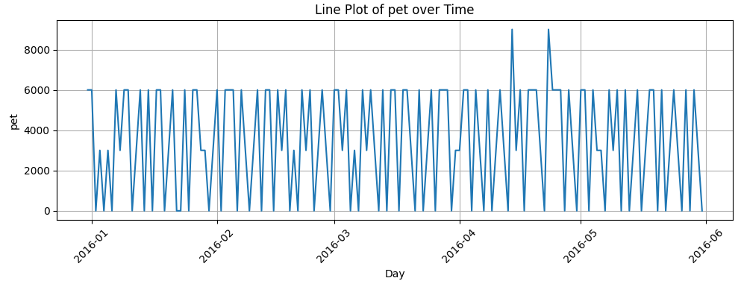
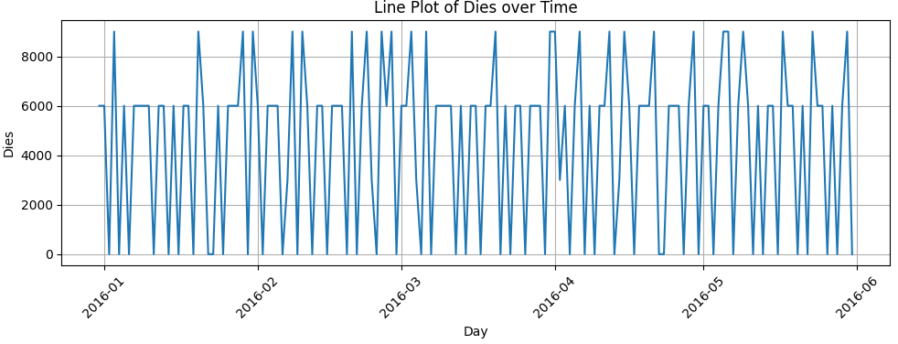
Trend of The Order Placed on BPCL

Slide 20
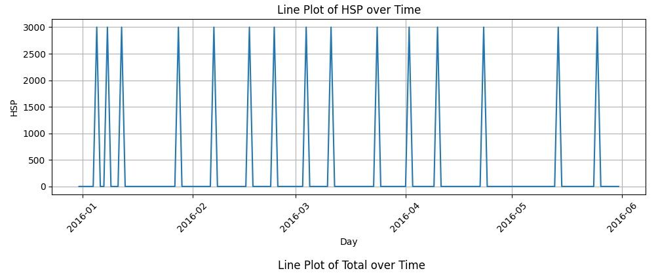
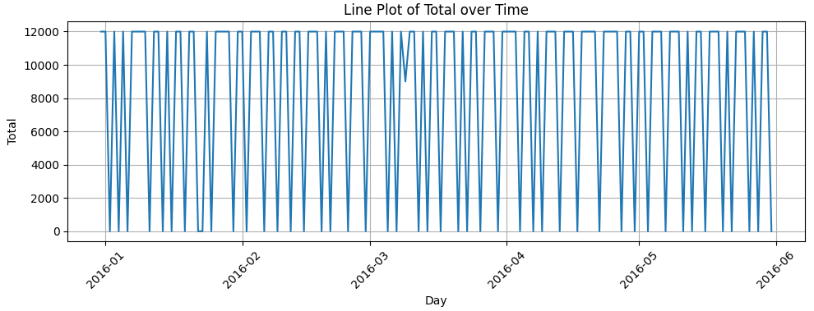

Slide 21
PREDICTIVE STATISTICS
Forecasting Techniques used
Moving Average (window length)
Weighted Moving Average (window length, weights)
Exponential Smoothing (alpha)
Double Exponential Smoothing (alpha, beta)
Triple Exponential Smoothing (season length, alpha , beta, gamma)
Calculated errors ME, MAD, MAPE, RMSE for all the techniques
Technique with minimum MAPE selected
Analysis done on MS-EXCEL and Python
Prescriptive Analytics used to arrive at optimized value of various parameters

Slide 22
MOVING AVERAGE - PETROL
PETROL | MFE | MAD | MAPE | RMSE
1 MA | 1 | 464 | 13.22% | 652
2 MA | 0 | 454 | 12.82% | 605
3 MA | -1 | 437 | 12.31% | 588
4 MA | -2 | 424 | 11.92% | 569
5 MA | -2 | 424 | 11.92% | 565
6 MA | -1 | 421 | 11.88% | 559
7 MA | -3 | 411 | 11.58% | 547
8 MA | -1 | 405 | 11.39% | 542
9 MA | -3 | 406 | 11.43% | 542
10 MA | -4 | 410 | 11.55% | 545

Slide 23
WEIGHTED MOVING AVERAGE - PETROL
PETROL | MFE | MAD | MAPE | RMSE
3 WMA | -0.94 | 425.56 | 12.05% | 579.87
4 WMA | -1.71 | 409.89 | 11.61% | 558.07
5 WMA | -1.19 | 405.13 | 11.50% | 557.58
6 WMA | -0.59 | 403.67 | 11.49% | 548.43
7 WMA | -1.89 | 393.85 | 11.18% | 536.24
8 WMA | -0.21 | 390.30 | 11.06% | 532.36
9 WMA | -3.07 | 384.00 | 10.93% | 528.92
10WMA | -2.07 | 386.08 | 10.98% | 529.74
11WMA | -2.05 | 387.46 | 11.01% | 528.43
3 WMA | 4 WMA | 5 WMA | 6 WMA | 7 WMA | 8 WMA | 9 WMA | 10 WMA | 11 WMA
0.30 | 0.31 | 0.09 | 0.14 | 0.13 | 0.15 | 0.002 | 0.00 | 0.04
0.16 | 0.14 | 0.26 | 0.00 | 0.09 | 0.09 | 0.065 | 0.00 | 0.00
0.54 | 0.13 | 0.13 | 0.21 | 0.01 | 0.09 | 0.235 | 0.08 | 0.00
 | 0.42 | 0.04 | 0.12 | 0.16 | 0.01 | 0.082 | 0.19 | 0.11
 |  | 0.48 | 0.08 | 0.15 | 0.17 | 0.013 | 0.06 | 0.17
 |  |  | 0.45 | 0.07 | 0.08 | 0.123 | 0.07 | 0.08
 |  |  |  | 0.40 | 0.07 | 0.026 | 0.09 | 0.02
 |  |  |  |  | 0.34 | 0.028 | 0.01 | 0.11
 |  |  |  |  |  | 0.427 | 0.08 | 0.04
 |  |  |  |  |  |  | 0.41 | 0.05
 |  |  |  |  |  |  |  | 0.38

Slide 24
COMPARISON OF ALL THE FORECASTING TECHNIQUES - PETROL
PETROL | Mean Error | MAD | MAPE | RMSE | Parameters | Forecasted Value
Moving Avg | -2.57 | 405 | 11.41 | 542 | 8 Days | 3240
Weighted Moving Avg | -3.07 | 384 | 10.93 | 528 | 9 Days | 3390
Exponential Smoothing | -1.83 | 402 | 11.35 | 536 | alpha = 0.23 | 3315
Double Exponential Smoothing | -1.83 | 397 | 11.28 | 532 | alpha = 0.18 beta = 0.99 | 3392
Triple Exponential Smoothing | 5.04 | 416 | 11.7 | 564 | alpha = 0.2 beta = 0.1 gamma = 0.1 season length = 4 | 3327
BEST TECHINIQUE WITH MINIMUM MAPE
9 DAYS WIGHTED MOVING AVERAGE

Slide 25
MOVING AVERAGE - DIESEL
DIESEL | MFE | MAD | MAPE | RMSE
1 MA | -1 | 1366 | 27.50% | 1833
2 MA | -8 | 1210 | 25.30% | 1648
3 MA | -7 | 1117 | 23.60% | 1541
4 MA | -7 | 1099 | 23.58% | 1525
5 MA | -5 | 1095 | 23.49% | 1554
6 MA | -8 | 1087 | 23.41% | 1572
7 MA | -7 | 1072 | 23.12% | 1563
8 MA | -9 | 1082 | 23.38% | 1586
9 MA | -15 | 1078 | 23.42% | 1604
10 MA | -13 | 1064 | 23.16% | 1598
11 MA | -21 | 1052 | 23.05% | 1584
12 MA | -24 | 1060 | 23.24% | 1597

Slide 26
WEIGHTED MOVING AVERAGE - DIESEL
Diesel | MFE | MAD | MAPE | RMSE
3 WMA | -7.17 | 1113.25 | 23.51% | 1537.29
4 WMA | -7.02 | 1094.94 | 23.35% | 1519.94
5 WMA | -3.05 | 1084.41 | 23.12% | 1528.79
6 WMA | -6.45 | 1072.48 | 22.98% | 1529.24
7 WMA | -6.24 | 1058.33 | 22.66% | 1510.82
8 WMA | -7.73 | 1059.16 | 22.68% | 1508.81
9 WMA | -11.45 | 1057.93 | 22.69% | 1511.34
3 WMA | 4 WMA | 5 WMA | 6 WMA | 7 WMA | 8 WMA | 9 WMA
0.41 | 0.13 | 0.12 | 0.13 | 0.15 | 0.00 | 0.02
0.26 | 0.35 | 0.08 | 0.09 | 0.07 | 0.13 | 0.00
0.33 | 0.24 | 0.33 | 0.09 | 0.07 | 0.06 | 0.12
 | 0.28 | 0.22 | 0.30 | 0.06 | 0.06 | 0.06
 |  | 0.25 | 0.13 | 0.28 | 0.05 | 0.07
 |  |  | 0.26 | 0.14 | 0.30 | 0.04
 |  |  |  | 0.23 | 0.15 | 0.30
 |  |  |  |  | 0.25 | 0.15
 |  |  |  |  |  | 0.24

Slide 27
COMPARISON OF ALL THE FORECASTING TECHNIQUES - DIESEL
DIESEL | Mean Error | MAD | MAPE | RMSE | Parameters | Forecasted Value
Moving Avg | -20.95 | 1052 | 23.05 | 1583 | 11 Days | 4560
Weighted Moving Avg | -6.24 | 1058 | 22.66 | 1510 | 7 Days | 4814
Exponential Smoothing | -5.87 | 1032 | 22.46 | 1508 | alpha = 0.15 | 4730
Double Exponential Smoothing | -5.28 | 1031 | 22.44 | 1509 | alpha = 0.14 beta = 0.05 | 4728
Triple Exponential Smoothing | 293 | 1144 | 23.27 | 1587 | alpha = 0.4 beta = 0.0 gamma = 0.2 season length =14 | 3934
BEST TECHINIQUE WITH MINIMUM MAPE
DOUBLE SMOOTHING

Slide 28
MOVING AVERAGE - HSP
HSP | MFE | MAD | MAPE | RMSE
1 MA | 0 | 121 | 41.97% | 176
2 MA | 0 | 120 | 43.43% | 163
3 MA | 0 | 120 | 44.42% | 161

Slide 29
MOVING AVERAGE - HSP
HSP | MFE | MAD | MAPE | RMSE
3 WMA | 0.13 | 114.18 | 40.65% | 164.54
4 WMA | 0.46 | 112.98 | 40.46% | 161.95
5 WMA | 0.55 | 113.14 | 40.44% | 162.30
6 WMA | 0.30 | 113.53 | 40.53% | 163.14
7 WMA | 0.18 | 113.91 | 40.64% | 163.07
3 WMA | 4 WMA | 5 WMA | 6 WMA | 7 WMA
0.18 | 0.16 | 0.05 | 0.00 | 0.01
0.04 | 0.04 | 0.08 | 0.07 | 0.00
0.78 | 0.05 | 0.09 | 0.12 | 0.03
 | 0.75 | 0.02 | 0.03 | 0.13
 |  | 0.76 | 0.01 | 0.01
 |  |  | 0.77 | 0.06
 |  |  |  | 0.77

Slide 30
COMPARISON OF ALL THE FORECASTING TECHNIQUES - HSP
HSP | Mean Error | MAD | MAPE | RMSE | Parameters | Forecasted Value
Moving Avg | -0.36 | 121 | 42.32 | 177 | 1 Day | 361
Weighted Moving Avg | 0.55 | 113 | 40.44 | 162 | 5 Days | 347
Exponential Smoothing | 0.43 | 114 | 40.82 | 161 | alpha = 0.73 | 388
Double Exponential Smoothing | 0.43 | 113 | 40.43 | 162 | alpha = 0.39 beta = 0.99 | 369
Triple Exponential Smoothing | 65.39 | 133 | 41.52 | 181 | alpha = 0.8 beta = 0.0 gamma = 0.2 season length = 8 | 331
BEST TECHINIQUE WITH MINIMUM MAPE
DOUBLE SMOOTHING

Slide 31
FORECASTED VALUE USING THE BEST TECHNIQUE
0.002
0.065
0.235
0.082
0.013
0.123
0.026
0.028
0.427
 | Petrol | Diesel | HSP
Forecasting Method | 9 Days WMA | Double Smoothing (0.14 , 0.05) | Double Smoothing (0.39 , 0.99)
Forecasted Value on 1/Jun/16 Wed | 3390 | 4728 | 369
EXCEL FILE
PYTHON

Slide 32
INVENTORY PLANNING
 | PETROL | DIESEL | HSP
Selling Price / Litre | ₹ 70.00 | ₹ 60.00 | ₹ 73.00
Margin / Litre | ₹ 2.33 | ₹ 1.50 | ₹ 2.50
Cost Price / Litre [Selling Price – Margin] | ₹ 67.67 | ₹ 58.50 | ₹ 70.50
Ordering Cost | ₹ 150.00 | ₹ 150.00 | ₹ 150.00
Holding Cost / Litre [10% of Cost Price] | ₹ 7.00000 | ₹ 6.00000 | ₹ 7.30000
Cost Price [ (Holding Cost * Inventory) + (Cost Price * Order Placed) + Ordering Cost ] | X | Y | Z
TOTAL COST PRICE | (X+Y+Z) (MINIMIZE)
CONSTRAINTS
Total Order Placed has to be 12000 litres
Order can be placed in multiples of 3000 litres
Storage Capacity for Petrol, Diesel, HSP is 15000, 20000 & 10000 respectively
For every 1000 litres purchased, 4 litres is lost in transit (0.4 %)

Slide 33
INVENTORY PLANNING
Minimize Total Cost :
TC₁ = (7 I_{p0} + 6 I_{d0}+ 7.3 I_{h0} ) + ( 67.67 Q_{p1} + 58.5 Q_{d1} + 70.5 Q_{h1}) + 150
(0 = on T0 ; 1 = on T1 )
Subject to
Q_{p1} + Q_{d1} + Q_{h1} = 12000 litres or 0 litres
Q_{p1} , Q_{d1} , Q_{h1} <= Storage Capacity Left (Rounded down to Multiple of 3000)
Q_{p1} , Q_{d1} , Q_{h1} >= Q_{rp1} , Q_{rd1} , Q_{rh1} (Rounded down to Multiple of 3000)
Q_{rp} = FV_{p1} – [ (I_{po}- FV_{po}) – R_{op} ] (RO = Reorder Point (Litres) ; FV = Forecast Value)
Q_{rd} = FV_{d1} – [ (I_{do}- FV_{do}) – R_{od} ] (I = Inventory )
Q_{rh} = FV_{h1} – [ (I_{ho}- FV_{ho}) – R_{oh} ]

Slide 34
INVENTORY PLANNING
PARAMETER | FORMULA
Average Daily Sales | From Descriptive Analysis
Lead Time (Days) | 2 Days
Re Order Point (Litres) | [ Average Daily Sales * Re Order Point ]
Inventory on T0 (Litres) | Initially Assumed
Forecast for T0 (Litres) | From Forecasting Technique
Inventory on T1 morning (Litres) | [ Inventory on T0 - Forecast for T0 ]
Forecast for T1 (Litres) | From Forecasting Technique
Quantity Required on T1 (Litres) | [Forecast on T1 - (Inventory on T1 – Re Order Point)]
Minimum Quantity Required on multiples of 3000 # | Calculated by rounding down the values (A)
Maximum Quantity Required on multiples of 3000 | Calculated by rounding up the values
Storage Capacity (Litres) | Given
Capacity Left on T1 morning | [Storage Capacity – Inventory on T1 morning]
Minimum in Capacity as multiple of 3000 * | Calculated by rounding down the values (B)
Upper Limit for Order * | B
Lower Limit for Order # | A
Optimized Quantity to be ordered on T0 for T1 (Litres) | Calculated using Solver (C)
Order to be refilled on T1 (Litres) | 96.6% of C

Slide 35
INVENTORY PLANNING
EXCEL FILE INVENTORY PLANNING

Slide 36
THANK YOU

