Slide 1
PROJECT PRESENTATION / JAVA WEB APPLICATION
Online Library
Management System
A role-based web application for managing books, members, borrowing, returns and library operations.
Project made by:
Anurag Kumar — Leader
Ayush Bharti — Member
Yuvraj Saini — Member
Galgotias University
01

Slide 2
Problem Statement
Why a library management system is needed
Manual library workflows can become difficult to track.
Project response
• Record management: book and member details may be scattered across registers.
• Availability tracking: staff need a reliable view of available copies.
• Borrowing and returns: transactions require consistent updates and history.
• Overdue handling: late returns need follow-up and fine/notification support.
01
Centralise
Books, members and transactions
02
Control access
Separate member and librarian actions
03
Improve accuracy
Database-backed issue/return workflows
04
Automate follow-up
Background notifications and reporting
ONLINE LIBRARY • JAVA WEB PROJECT
02

Slide 3
Objectives & Proposed Solution
A structured workflow from catalogue to transaction history
Manage the catalogue
Manage members
Track circulation
Add, update, search and organise book records.
Maintain member profiles and role-based access.
Record borrowing, returns, due dates and fines.
Protect data
Support staff
Reduce manual work
Validate requests and use controlled database operations.
Provide librarian dashboards and report views.
Use scheduled background processing for notifications.
Solution principle: keep presentation, business rules and database access in separate layers.
ONLINE LIBRARY • JAVA WEB PROJECT
03

Slide 4
Key Features
Functional scope represented in the source code
Book catalogue
Member management
Borrow / return
Borrowing history
Search books and manage book records
Maintain member details
Record transactions and update availability
Review transaction records
Authentication
Authorisation
Notifications
Reports
Login, logout and session handling
Restrict routes by user role
Notification views and preferences
Summarise library activity
ONLINE LIBRARY • JAVA WEB PROJECT
04

Slide 5
System Architecture
Layered Java web application
PRESENTATION LAYER
JSP / JSTL views • HTML / CSS
WEB / CONTROLLER LAYER
Jakarta Servlets • Filters • Request routing
BUSINESS LAYER
LibraryService • Validation • Access policies
DATA ACCESS LAYER
DAO interfaces and implementations • JDBC
DATABASE
MySQL tables for users, books, categories, transactions and related records
ONLINE LIBRARY • JAVA WEB PROJECT
05

Slide 6
User Roles & Main Workflows
Role-based access supports different responsibilities
MEMBER
LIBRARIAN
• Sign in and manage profile
• Search the book catalogue
• Borrow eligible books
• View borrowing history and notifications
• Manage book records
• Manage members
• Review and manage transactions
• Access reports and notification administration
Search
Issue
Return
Review
Find a book
Check eligibility
Update status
History / reports
ONLINE LIBRARY • JAVA WEB PROJECT
06

Slide 7
Database Design
Relational data model at a glance
CATEGORIES
BOOKS
USERS
id (PK)
name, description
id (PK)
category_id (FK), ISBN
copies / availability
id (PK)
member / librarian data
Design notes
• Primary and foreign keys link related records.
• Transaction updates should keep inventory and issue records consistent.
BOOK_ISSUES / TRANSACTIONS
FINES
book_id (FK)
user_id (FK), dates, status
issue reference
amount / status
Exact column names and relationships should be read from the submitted schema.sql.
ONLINE LIBRARY • JAVA WEB PROJECT
07

Slide 8
Core Java Concepts
Mapped to the Java GUI / web evaluation criteria
OOP & interfaces
Inheritance & exceptions
Model classes encapsulate data; DAO and service interfaces define contracts; implementations provide behaviour.
A base LibraryException and specialised exceptions represent domain errors.
Collections & generics
Multithreading
Typed collections support lists, maps and structured results across service and DAO layers.
ScheduledExecutorService runs background notification work using Runnable tasks.
Book-specific synchronisation helps protect concurrent issue / return operations.
ONLINE LIBRARY • JAVA WEB PROJECT
08

Slide 9
Database Integration with JDBC
How the application persists and retrieves data
• Connection: DBConnection centralises database connection setup.
• PreparedStatement: parameterised SQL is used for database operations.
• ResultSet: query results are mapped into Java model objects.
• DAO layer: data access code is separated from controllers and services.
• Transactions: commit / rollback protects multi-step operations.
TRANSACTION FLOW
connection.setAutoCommit(false);
// validate and update records
// issue / return operation
connection.commit();
// on failure: rollback
Goal: keep book availability and transaction records consistent.
ONLINE LIBRARY • JAVA WEB PROJECT
09

Slide 10
Servlets & Web Integration
Request handling, sessions and access control
Browser
Servlet
Service
DAO + JDBC
JSP
HTTP request
doGet / doPost
Business rules
Database
Response view
Authentication
Authorisation
Request protection
Session-based login and logout flow.
Filters restrict protected routes by role.
CSRF-related filter and validation utilities.
Runtime note: deployment and end-to-end behaviour should be verified in the target Tomcat / MySQL setup.
ONLINE LIBRARY • JAVA WEB PROJECT
10

Slide 11
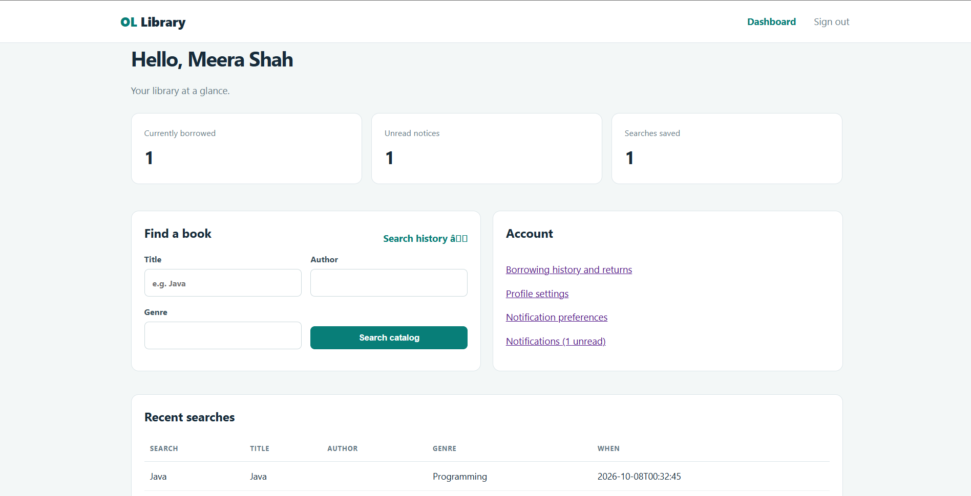
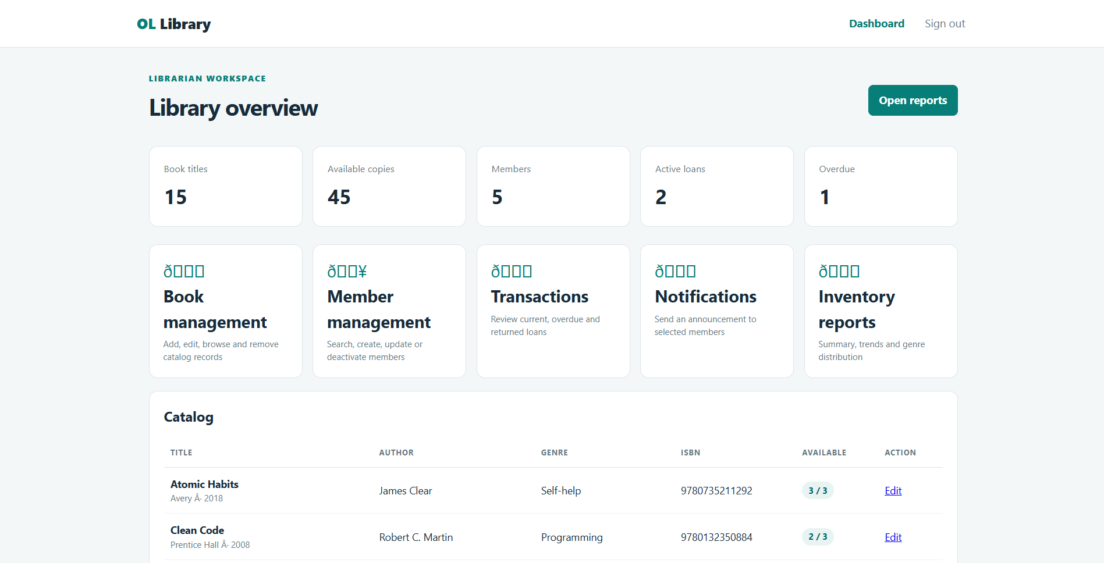
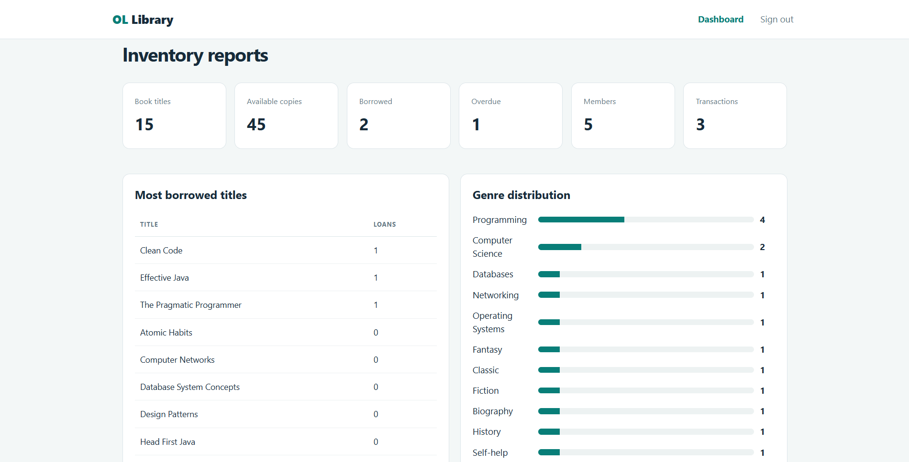
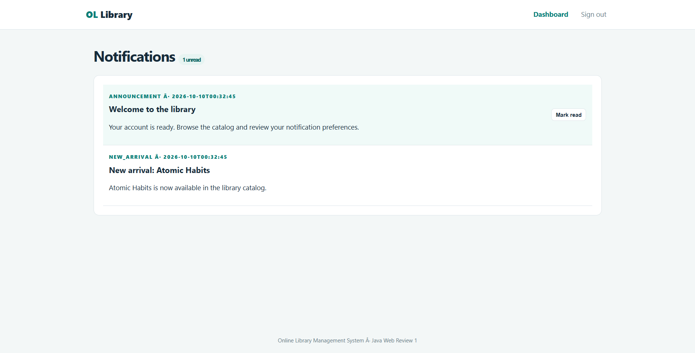
Application Walkthrough
Use this slide to show the actual running interface during the presentation
Member dashboard
Librarian workspace
Inventory reports
Notifications
ONLINE LIBRARY • JAVA WEB PROJECT
11

Slide 12
Conclusion & Future Scope
Summary of the project
One system. Clearer library operations.
FUTURE SCOPE
• Centralised workflows: books, members and circulation.
• Layered architecture: JSP, Servlets, services, DAO and JDBC.
• Reliability focus: validation, transaction handling and access control.
• Automation: scheduled notification processing.
• Deploy to a stable hosted environment
• Expand automated integration testing
• Improve analytics and usage reports
• Add barcode / QR-assisted circulation
Thank you • Questions?
12
12

