Slide 1

WEB SCRAPING AND CREATING DATASET
Presented by Anurag Mehta
Mentored by Dr Sharon Christa

Slide 2
Introduction
Web scraping is the process of extracting data from websites. This can be done manually, but it is usually faster and more efficient to automate the task. Web scraping software, also known as web scrapers, can be used to automatically load and extract data from websites based on user requirements.
Collecting data for research or analysis.
Building a database of product or pricing information
Tracking changes to websites over time
Automating tasks such as price monitoring

Slide 3
Methodology
Identify the Target Website: Determine the website from which you want to extract data. Understand its structure, HTML elements, and the specific data you wish to scrape.
Choose a Python Web Scraping Library: Select a suitable Python library for web scraping, such as BeautifulSoup or Req. These libraries provide convenient functions and methods to parse HTML, navigate through web pages, and extract desired data.
Set Up the Development Environment: Install the necessary Python packages and dependencies required for web scraping. Create a new Python project or virtual environment to keep your scraping code organized.
Inspect the Website Structure: Use web browser developer tools, such as the Chrome Developer Tools or Firefox Developer Tools, to inspect the website's HTML structure. Identify the relevant HTML tags and attributes containing the data you want to scrape.

Slide 4
Methodology (contd.)
Write the Scraping Code: Use the selected Python library to write code that navigates through the website's HTML structure and extracts the desired data. This involves using functions like finding HTML elements, accessing attributes, and extracting text or other data from those elements.
Handle Web Page Retrieval: Use Python's requests library to retrieve the web page content programmatically.
Implement Data Parsing and Extraction: Utilize the parsing capabilities of the chosen library to extract the desired data from the retrieved web page. This may involve traversing the HTML structure, using CSS selectors or XPath expressions, and applying filters or conditions to narrow down the data extraction.

Slide 5
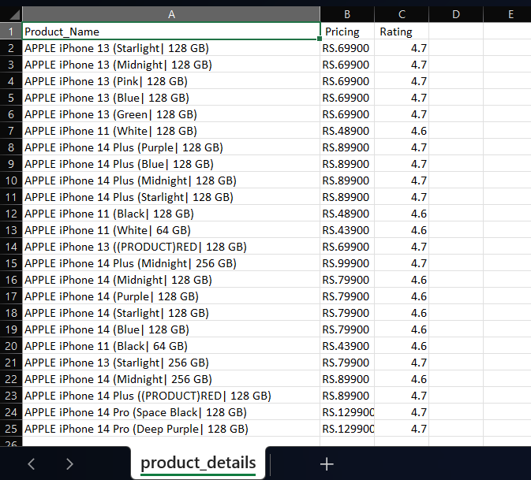
Results AND DISCUSSION

Slide 6
Conclusion and future work
The development of more sophisticated web scraping tools. As web scraping becomes more popular, there will be a demand for more sophisticated tools that can automate the process of extracting data from websites. These tools will need to be able to handle complex websites with dynamic content, and they will need to be able to avoid detection by anti-scraping measures.
The use of web scraping for more innovative applications. Web scraping is already being used for a variety of purposes, but there are many other potential applications that have yet to be explored. For example, web scraping could be used to track the spread of misinformation online, or to monitor the behavior of competitors.
Create more user-friendly web scraping tools. Currently, web scraping can be a difficult and time-consuming process. There is a need for more user-friendly web scraping tools that make it easier for people to collect data from websites.

Slide 7
THANK YOU

