Slide 1


Machine Learning Project
Image compression using PCA
Under the Guidance of
Prof . D.A Torse
Sl. No. | Name | SRN.
1 | Anurag Karehonna | 02FE21BEC009
2 | Basavesh Patil | 02FE21BEC018
3 | Diya Bandi | 02FE21BEC031
4 | Prerana Kolkar | 02FE21BEC060

Slide 2
Problem Statement
Image compression using principal component analysis were
Pixels will be reduced
Dept. of ECE

Slide 3
Introduction :
The escalating demand for efficient storage, rapid transmission, and seamless sharing of images necessitates advanced image compression techniques.
Among these techniques, Principal Component Analysis (PCA) has emerged as a promising method for achieving substantial data reduction while preserving essential image information. However, the optimal application of PCA for image compression poses challenges that demand a comprehensive investigation.

Slide 4
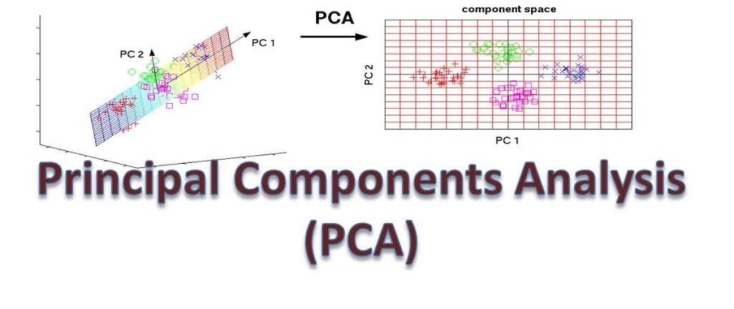
Principal component analysis
Principal Component Analysis (PCA) is a statistical procedure that uses an orthogonal transformation that converts a set of correlated variables to a set of uncorrelated variables.PCA is the most widely used tool in exploratory data analysis and in machine learning for predictive models. Moreover
It is also known as a general factor analysis where regression determines a line of best fit.It is a measure of how similar an object is to its own cluster (cohesion) compared to other clusters (separation).

Slide 5
Dataset Information :
The data used in this project are real time images from our drive
The dataset is uploaded to our jupyter notebook folder

Slide 6







Block Diagram :
Applying PCA for dimensionality reduction (N components)
Input images from our device to notebook
Reshaping images(2D), pixels,channels
Displaying results
Inverse transform to reconstruct compressed image

Slide 7
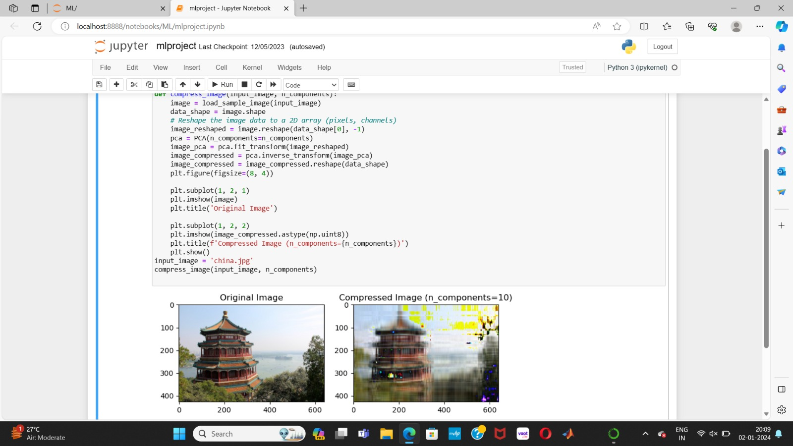

Slide 8
Thanking You all

