Slide 1

Cryptographic Algorithms for Data Security: AES & Blowfish Overview
Presented By :
Anurag Parashar
(CSS)

Slide 2
Introduction to Symmetric Key Cryptography
A cryptographic technique where the same key is used for both encryption and decryption.
Also known as Secret Key Cryptography.
Commonly used in applications requiring fast and efficient encryption (e.g., AES, Blowfish).

Slide 3
How It Works
A single key is shared between sender and receiver.
Both parties use this key to encrypt and decrypt data.
Example flow:
Plaintext + Key → 🔒 Encryption → Ciphertext
Ciphertext + Same Key → 🔓 Decryption → Plaintext

Slide 4
Blowfish Algorithm
Inventor: Bruce Schneier (1993) Purpose: Alternative to DES — faster, stronger, and not patented Type: Symmetric Block Cipher
blockSize: 64-bits
keySize: 32-bits to 448-bits variable size
Number of subkeys: 18 [P-array]
Number of rounds: 16
number of substitution boxes: 4 [each having 512 entries of 32 bits each]

Slide 5
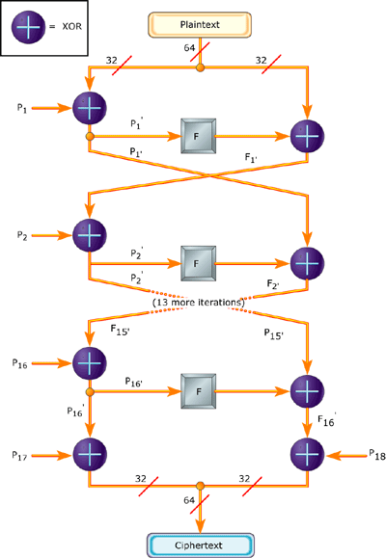
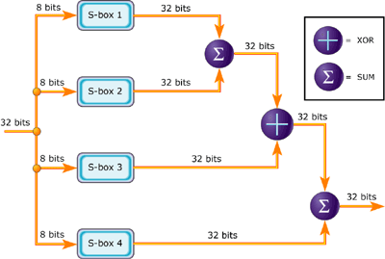
Schematic of Blowfish Algorithm

Slide 6
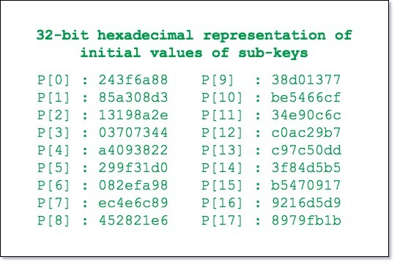
Step 1: Generation of subkeys
18 subkeys (P[0] to P[17]) are required.
Stored in a P-array, each of 32 bits.
These subkeys are used in both encryption and decryption (same for both directions).
Now each of the subkey is changed with respect to the input key as:
P[0] = P[0] xor 1st 32-bits of input key P[1] = P[1] xor 2nd 32-bits of input key. . . . P[i] = P[i] xor (i+1)th 32-bits of input key (roll over to 1st 32-bits depending on the key length). . . . P[17] = P[17] xor 18th 32-bits of input key (roll over to 1st 32-bits depending on key length)
The resultant P-array holds 18 subkeys
that is used during the entire encryption
process

Slide 7
⚙️ Step 2: Initialize Substitution Boxes (S-boxes)
S-boxes (Substitution boxes) are used in each encryption round to perform complex substitutions on the data.
Blowfish uses 4 S-boxes:
Blowfish uses 4 S-boxes:
S[0], S[1], S[2], S[3]
Each S-box contains 256 entries (0 to 255), and each entry is 32 bits wide.
Usage in Encryption & Decryption
These S-boxes are used in the F-function of Blowfish during each of the 16 rounds.
The same S-boxes are used for both encryption and decryption, ensuring reversibility.

Slide 8
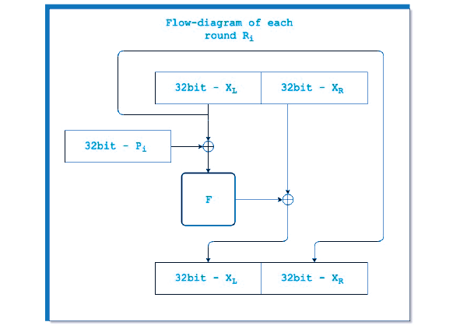
Step 3: Encryption
The encryption function consists of two parts:
a. Rounds: The encryption consists of 16 rounds with each round(Ri) taking inputs the plaintext(P.T.) from previous round and corresponding subkey(Pi). The description of each round is as follows
Here, the function "add" is addition modulo 2^32.
Decryption of Blowfish
In Blowfish, decryption is carried out by reversing the encryption process. Therefore, everything reverses until the ciphertext is converted back into plaintext.

Slide 9
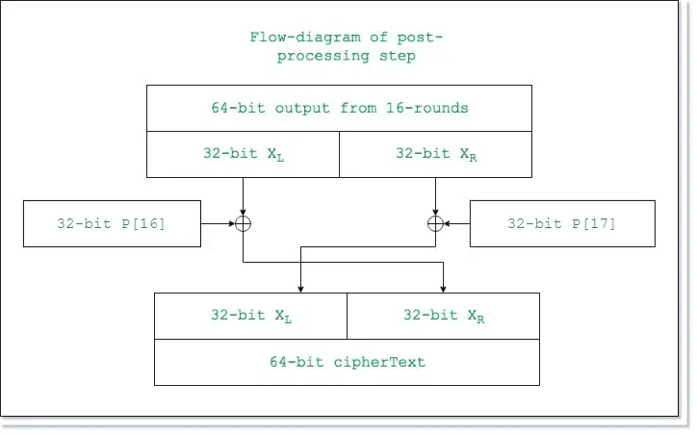
b. Post-processing: The output after the 16 rounds is processed as follows:
Swap L and R

Slide 10
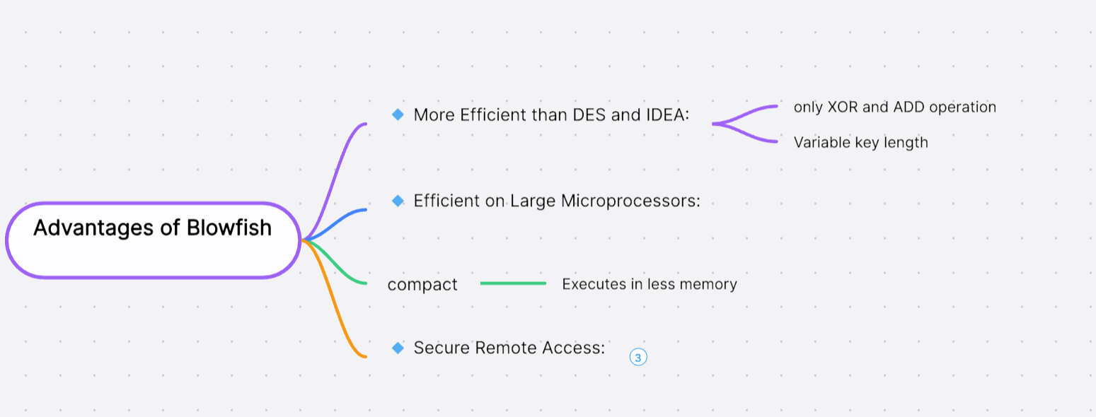

Slide 11
Overview
Developed by NIST in 2001.
Block cipher used to secure data by transforming it into an unreadable format.
Widely adopted due to its strength and reliability
Advanced Encryption Standard (AES)
Key Features
Key Sizes: 128, 192, or 256 bits.
Block Size: 128 bits (input and output).
Type: Substitution-Permutation Network (SPN).
Rounds:
10 rounds for 128-bit key
12 rounds for 192-bit key
14 rounds for 256-bit key
💡 Why AES?
Much stronger than DES & 3DES.
Efficient for both hardware and software.
Global standard for:
Internet security
File encryption
Securing sensitive data

Slide 12
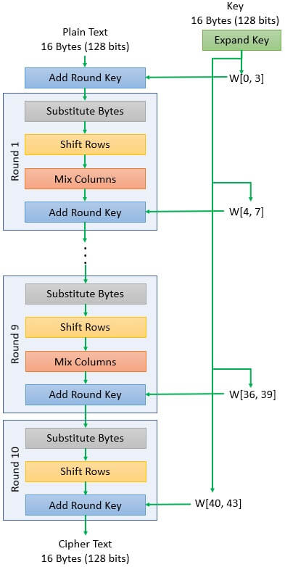
Schematic of AES structure
The AES algorithm can be broken into three phases: the initial round, the main rounds, and the final round.
Initial Round
AddRoundKey
SubBytes
ShiftRows
MixColumns
AddRoundKey
Final Round (Nr)
SubBytes
ShiftRows
AddRoundKey
Main Rounds (1 to Nr−1)

Slide 13
AES Key Schedule
Key Schedule generates a set of round keys from the initial secret key.
The number of round keys = Nr + 1:
11 keys for 128-bit
13 keys for 192-bit
15 keys for 256-bit
11 subkeys? But there are only 10 rounds !
That's because first key K0 is XOR'd with the plaintext before the first round.
Round keys are used in the AddRoundKey step of each round.

Slide 14
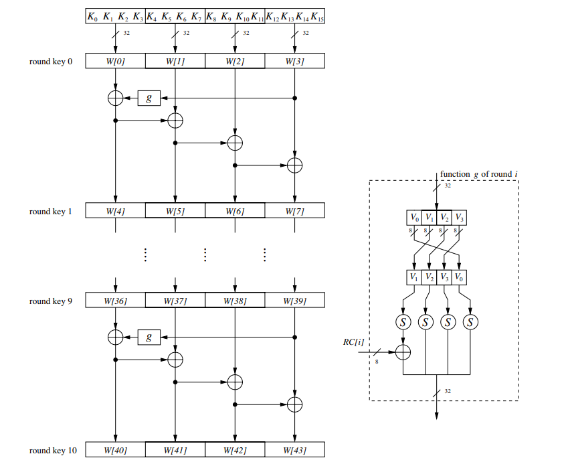


AES Key Schedule for 128 bits
K0=[w0​,w1​,w2​,w3​]
Then each new subkey depends on the
previous subkey. To compute
K1=[w4,w5,w6,w7]
the algorithm the following:
Here g() is a nonlinear function with a four-byte input and output. The remaining three words of a subkey are computed recursively as:
where i = 1,….,10 and j = 1,2,3. The function g() rotates its four input bytes

Slide 15
How g() function work
It consists of 3 steps:
RotWord:
Takes a 4-byte word and rotates it left by 1 byte.
Example: Input = [a0, a1, a2, a3]
Output = [a1, a2, a3, a0]
SubWord
Applies the AES S-box to each byte of the word.
Introduces non-linearity and confusion.
Rcon
XORs the result with a round constant (Rcon).
Ensures each round key is uniquely dependent on the round number.
Values of Rcon (for AES-128):
RC[1] = x⁰ = (00000001)₂
RC[2] = x¹ = (00000010)₂
RC[3] = x² = (00000100)₂
RC[4] = x³ = (00001000)₂
RC[5] = x⁴ = (00010000)₂
RC[6] = x⁵ = (00100000)₂
RC[7] = x⁶ = (01000000)₂
RC[8] = x⁷ = (10000000)₂
RC[9] = x⁸ = (00011011)₂
RC[10] = x⁹ = (00110110)₂

Slide 16
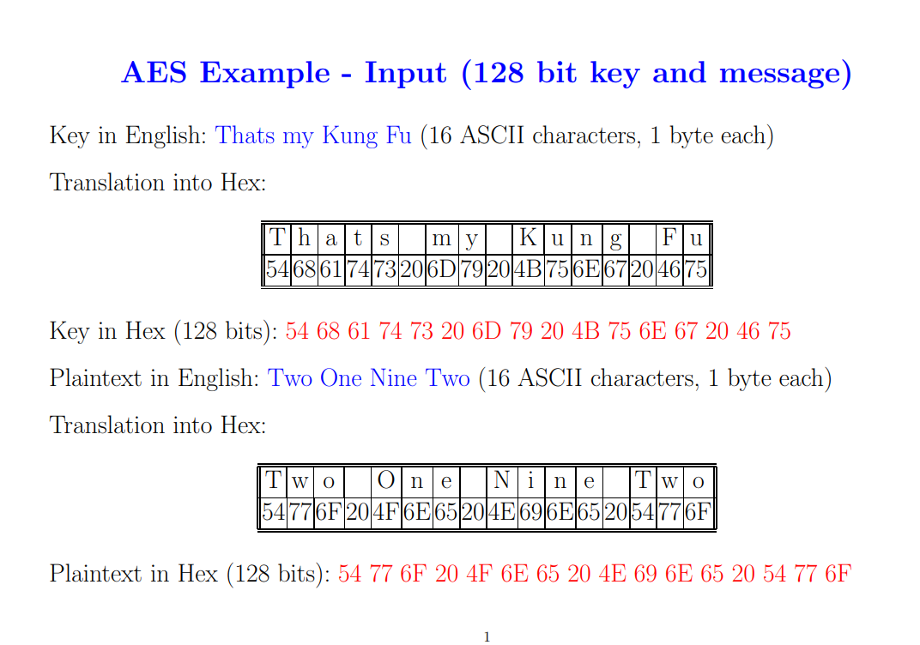

Slide 17
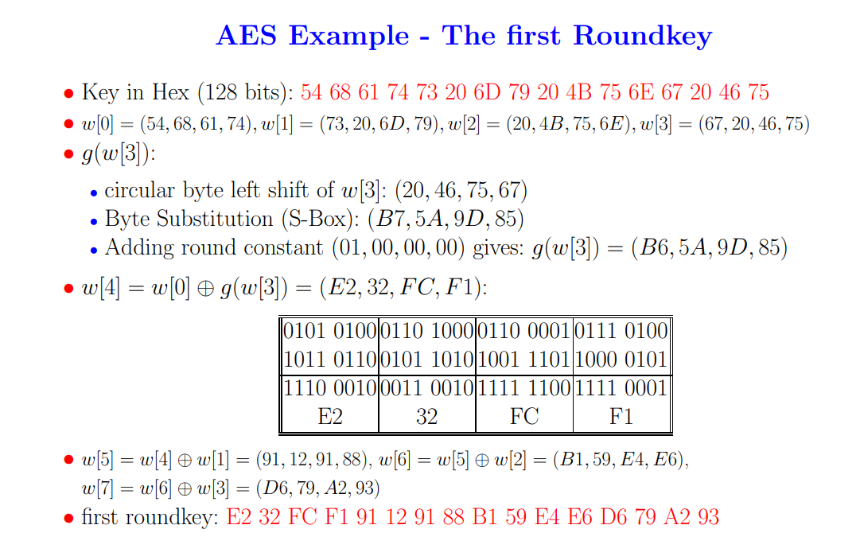

Slide 18
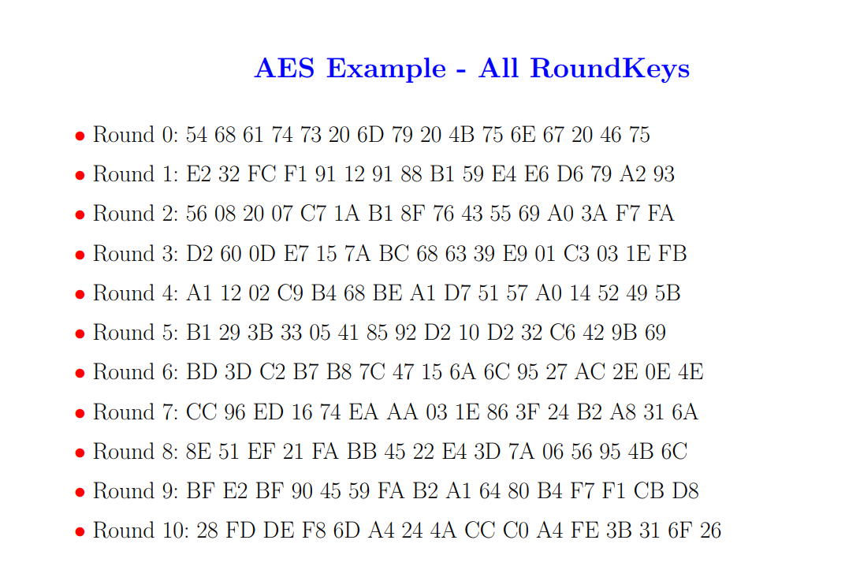

Slide 19
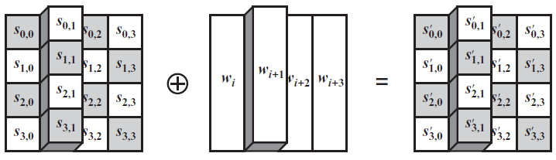
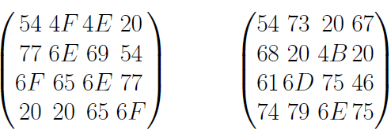
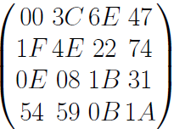
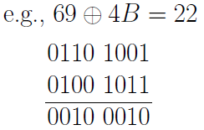

AddRoundKey
In this operation, the 128 bits of State are bitwise XORed with the 128 bits of the round key. Here is an example where the first matrix is State, and the second matrix is the round key.
$$$$
=

Slide 20
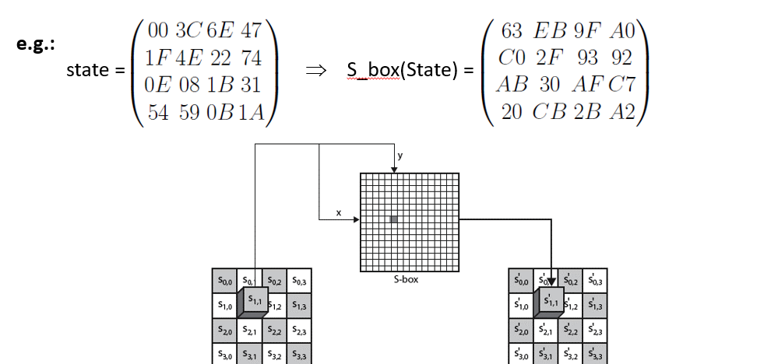
SubBytes
SubBytes is a nonlinear substitution step.
Each byte in the state matrix is replaced using the AES S-Box.
The byte (e.g., 6E) is split into:
Row = 6 (first 4 bits)
Column = E (last 4 bits)
The substitution value is taken from S-Box[6][E] = 9F.

Slide 21
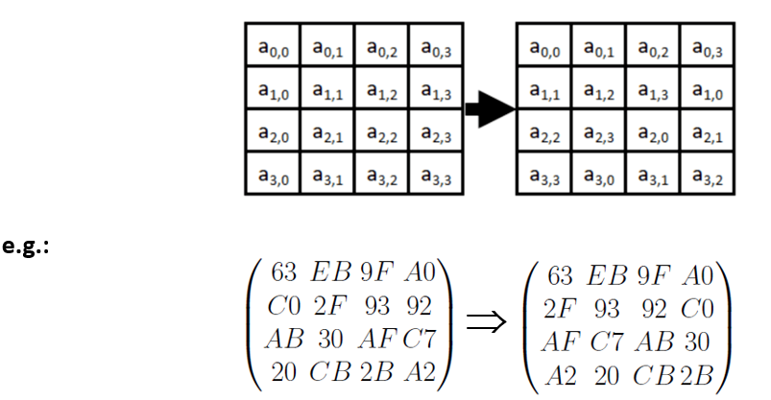
ShiftRows
no shift
one position left shift
one position left shift
one position left shift

Slide 22
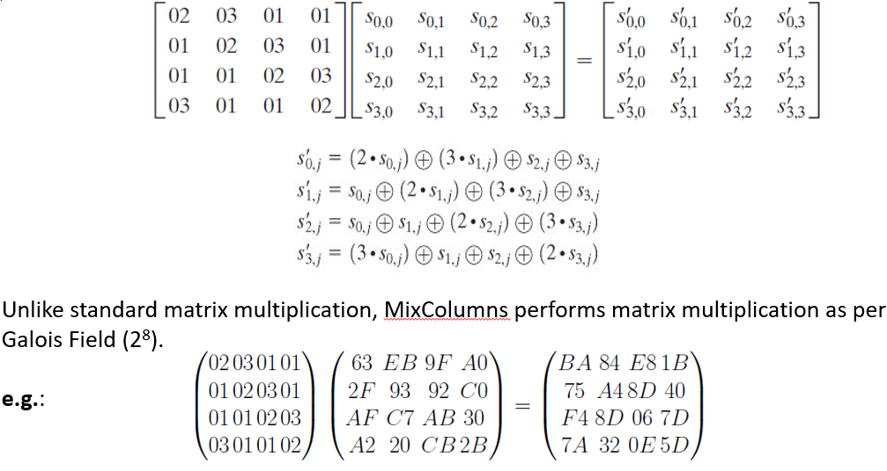
MixColumns
a linear mixing operation which multiplies fixed matrix against current State Matrix:

Slide 23
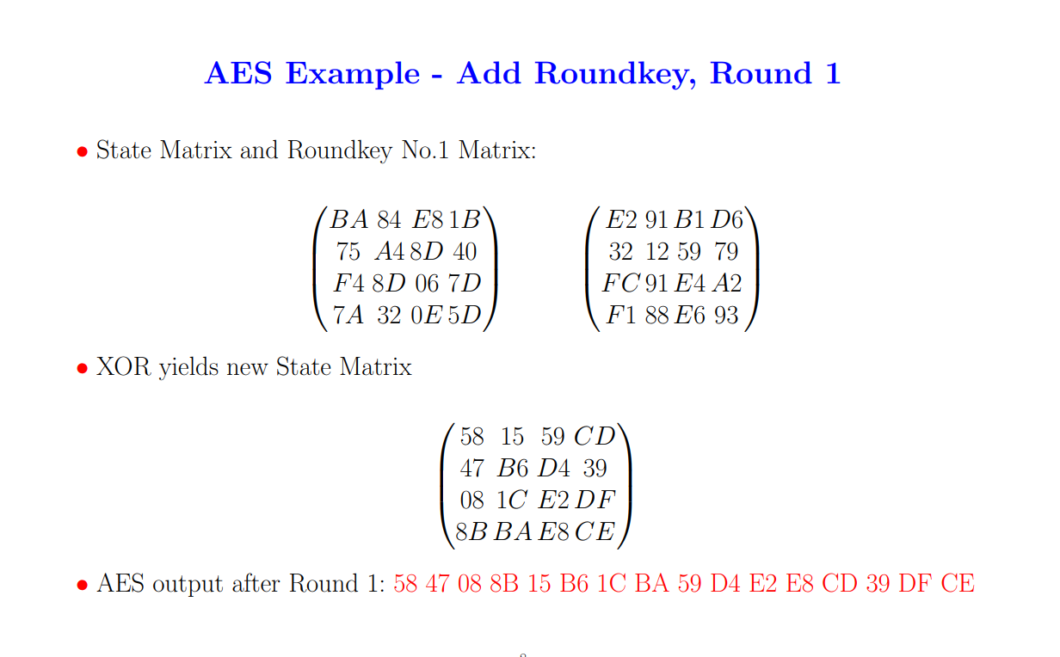

Slide 24
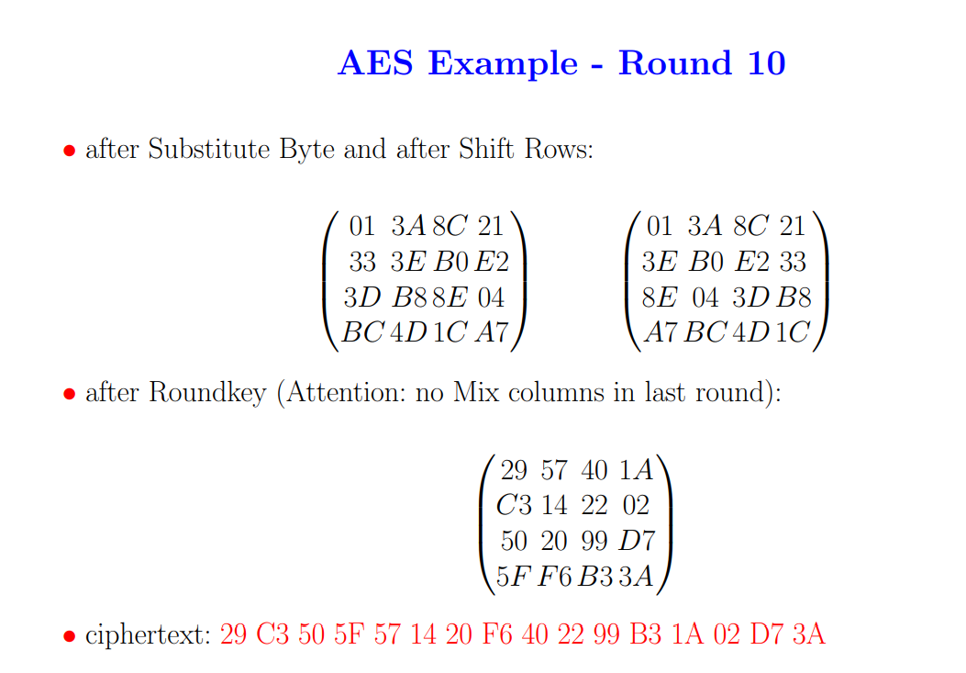

Slide 25
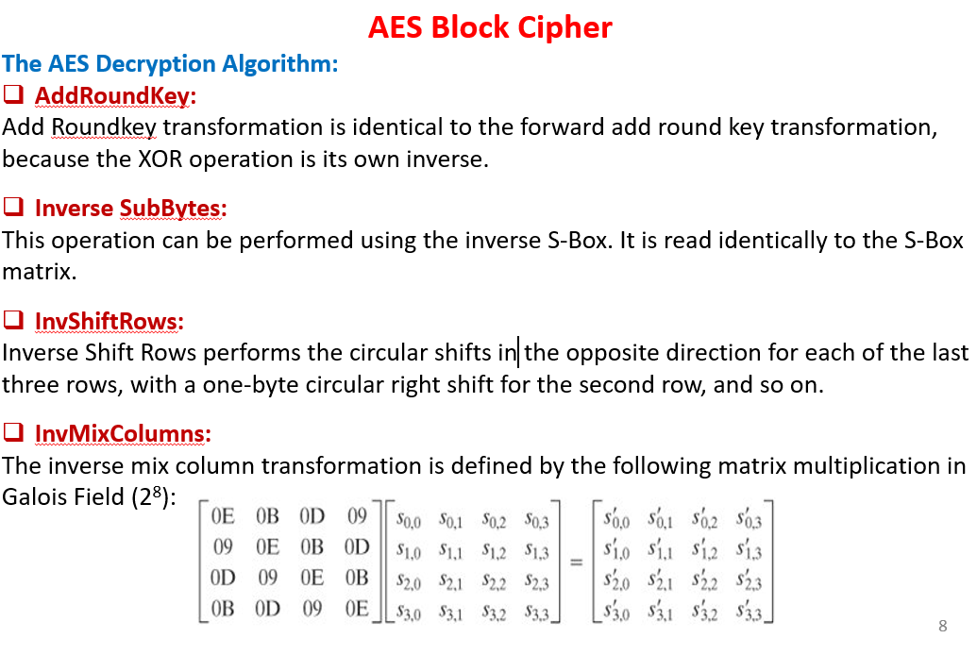

Slide 26
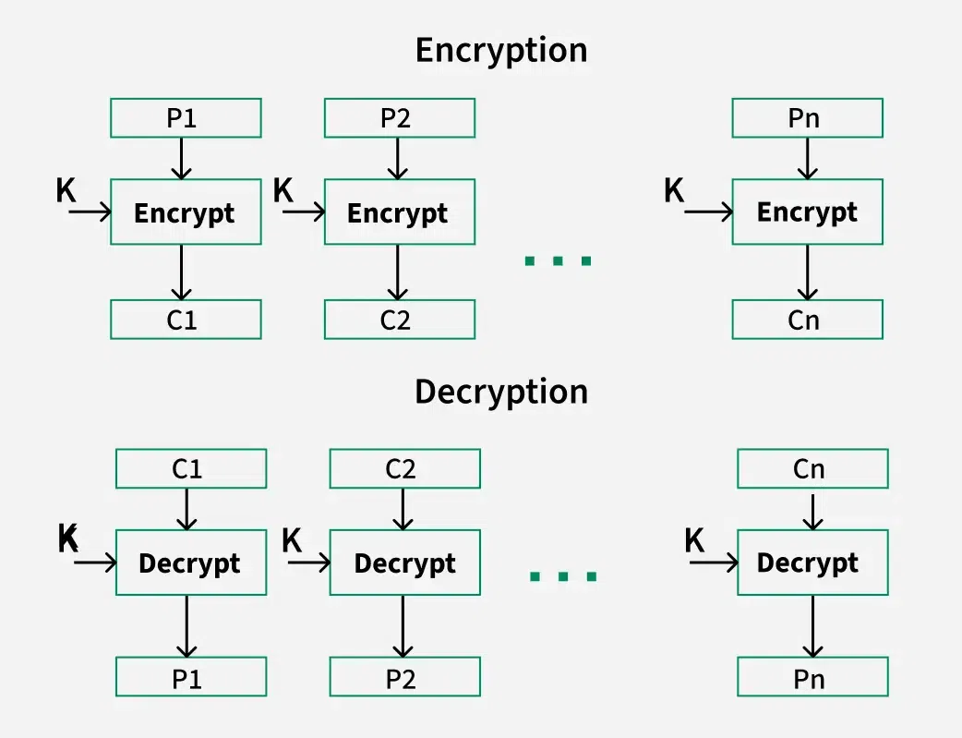
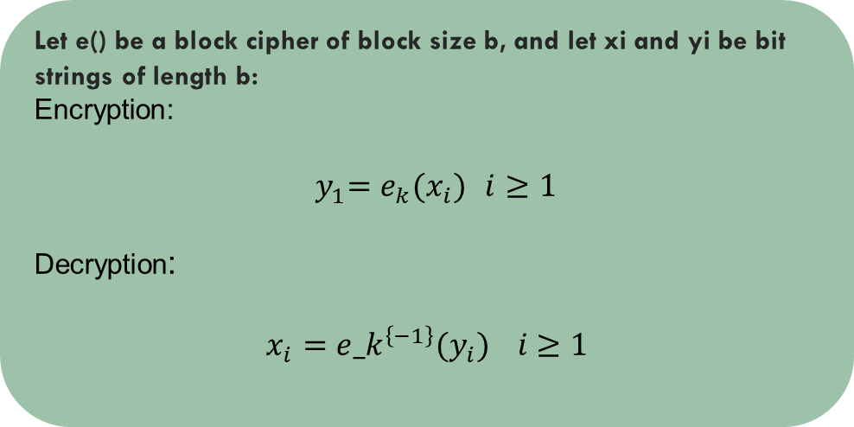
Electronic Code Book (ECB)
Simplest block cipher mode.
Each block encrypted independently
Let e() be a block cipher of block size b, and let xi and yi be bit strings of length b:
Encryption:
${ y}_{1}=e_{k}(x_{i})$ $i≥1$
Decryption:
$$x_{i}={e_k}^{\left\{−1\right\}}(y_{i}) i≥1$$

Slide 27
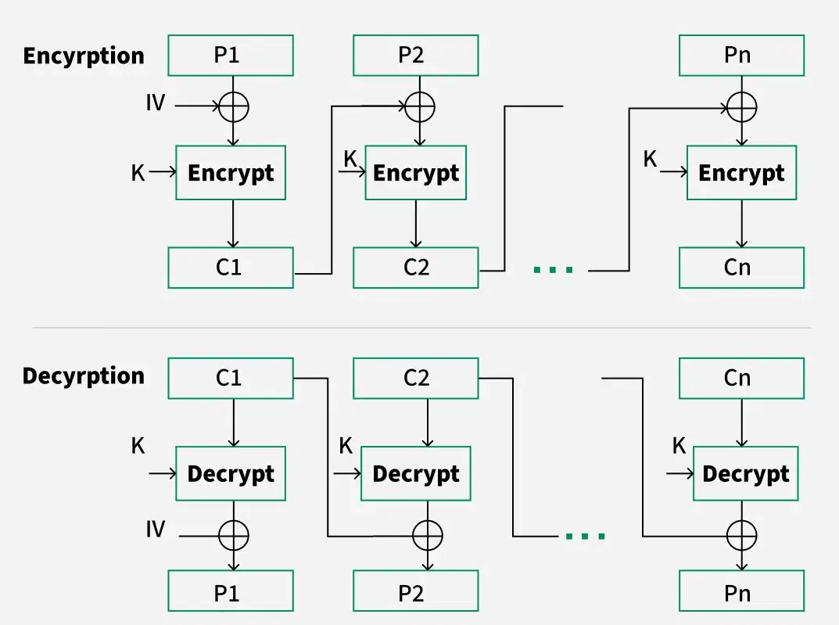
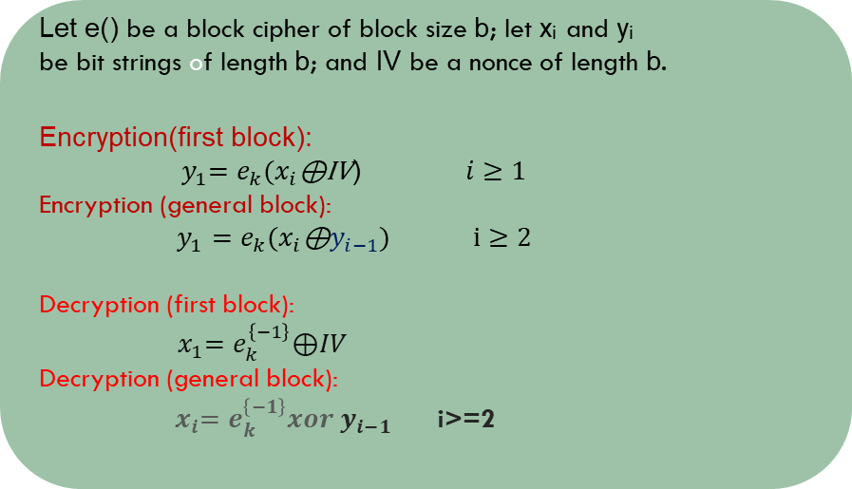
Cipher block chaining mode (CBC):
Converts block cipher into self-synchronizing stream cipher.
Encrypts IV, then XORs with plaintext
Let e() be a block cipher of block size b; let xᵢ and yᵢ
be bit strings of length b; and IV be a nonce of length b.
Encryption(first block):
${ y}_{1}=e_{k}(x_{i}\text{⊕}\text{IV}$) $i≥1$
Encryption (general block):
$y_{1}=e_{k}(x_{i}\text{⊕}y_{i−1}\text{) }$ $i≥2$
Decryption (first block):
${ x}_{1}=e_{k}^{\left\{−1\right\}}\text{⊕}IV$
Decryption (general block):
${ x}_{i}=e_{k}^{\left\{−1\right\}}xor y_{i−1}$ i>=2

Slide 28
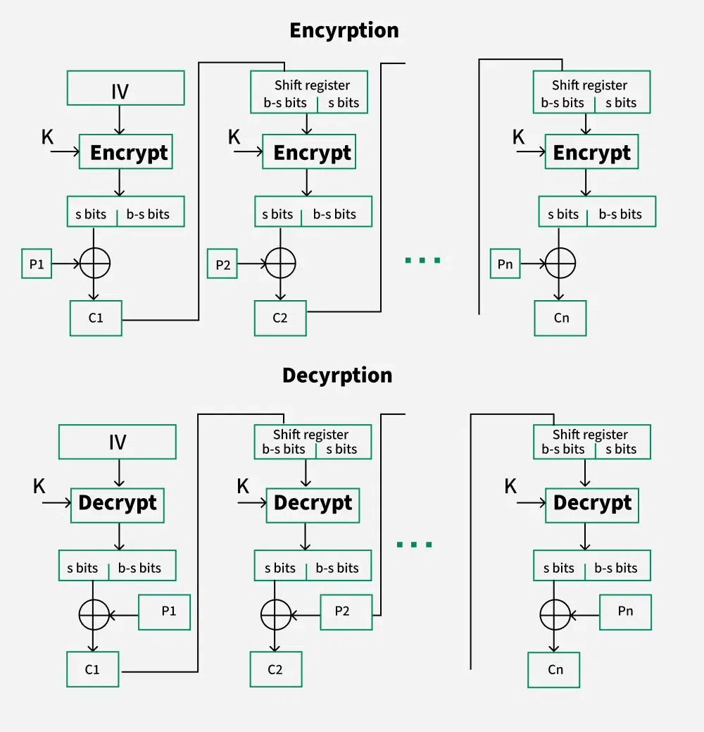
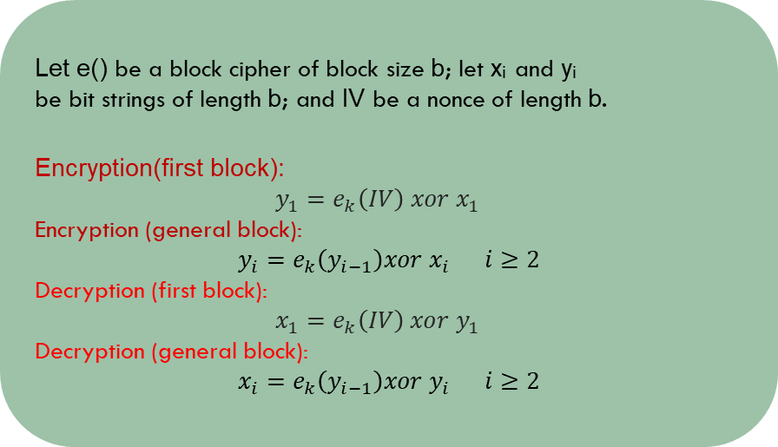
Cipher feedback mode (CFB):
Each plaintext block is XORed with the previous ciphertext block.
IV (Initialization Vector) is used for the first block.
Let e() be a block cipher of block size b; let xᵢ and yᵢ
be bit strings of length b; and IV be a nonce of length b.
Encryption(first block):
$$y_{1}=e_{k}\left(IV\right) xor x_{1}$$
Encryption (general block):
$$y_{i}=e_{k}\left(y_{i−1}\right)xor x_{i} i≥2$$
Decryption (first block):
$$x_{1}=e_{k}\left(IV\right) xor y_{1}$$
Decryption (general block):
$$x_{i}=e_{k}\left(y_{i−1}\right)xor y_{i} i≥2$$

Slide 29
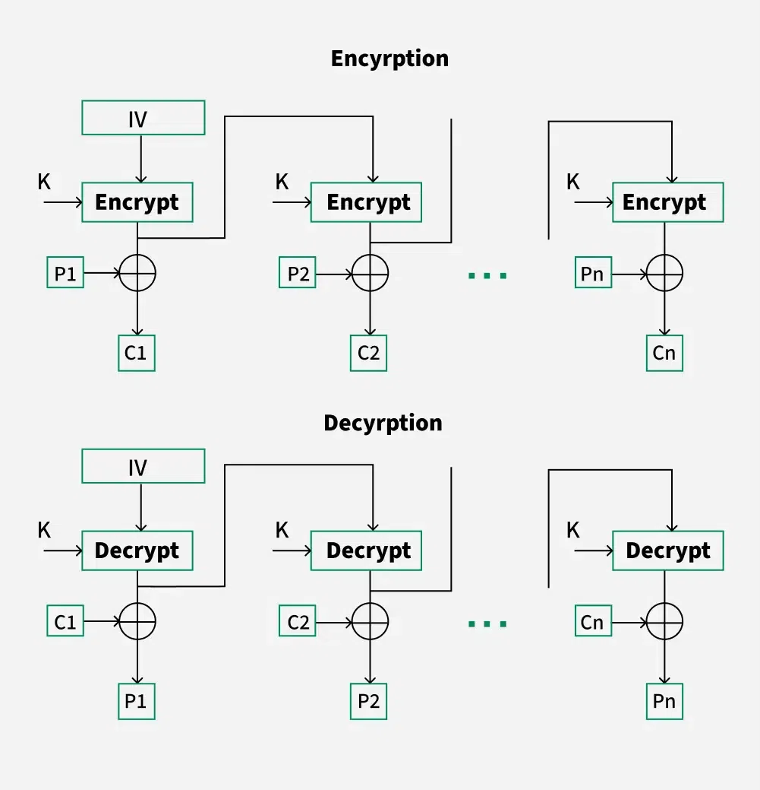
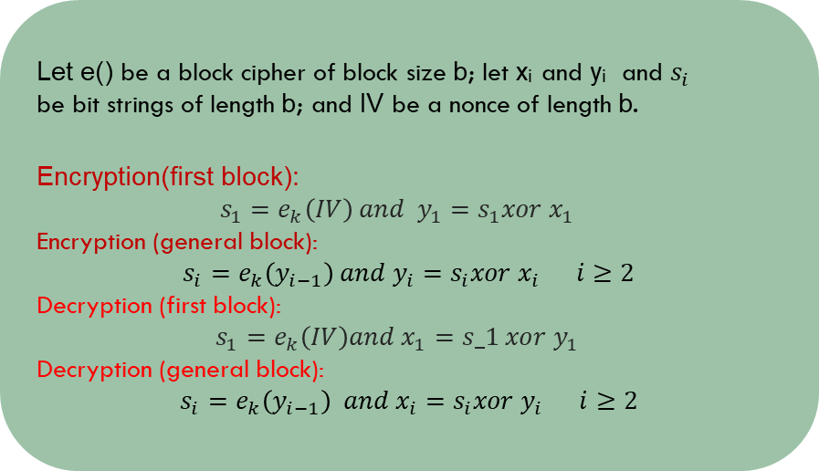
Output feedback mode (OFB):
Uses encrypted output as feedback instead of ciphertext.
Entire block output is used, making it a stream-like cipher.
Let e() be a block cipher of block size b; let xᵢ and yᵢ and $s_{i}$
be bit strings of length b; and IV be a nonce of length b.
Encryption(first block):
$$s_{1}=e_{k}\left(IV\right) and y_{1}=s_{1}xor x_{1}$$
Encryption (general block):
$$s_{i}=e_{k}\left(y_{i−1}\right) and y_{i}=s_{i}xor x_{i} i≥2$$
Decryption (first block):
$$s_{1}=e_{k}\left(IV\right)and x_{1}=s_1 xor y_{1}$$
Decryption (general block):
$$s_{i}=e_{k}\left(y_{i−1}\right) and x_{i}=s_{i}xor y_{i} i≥2$$

Slide 30
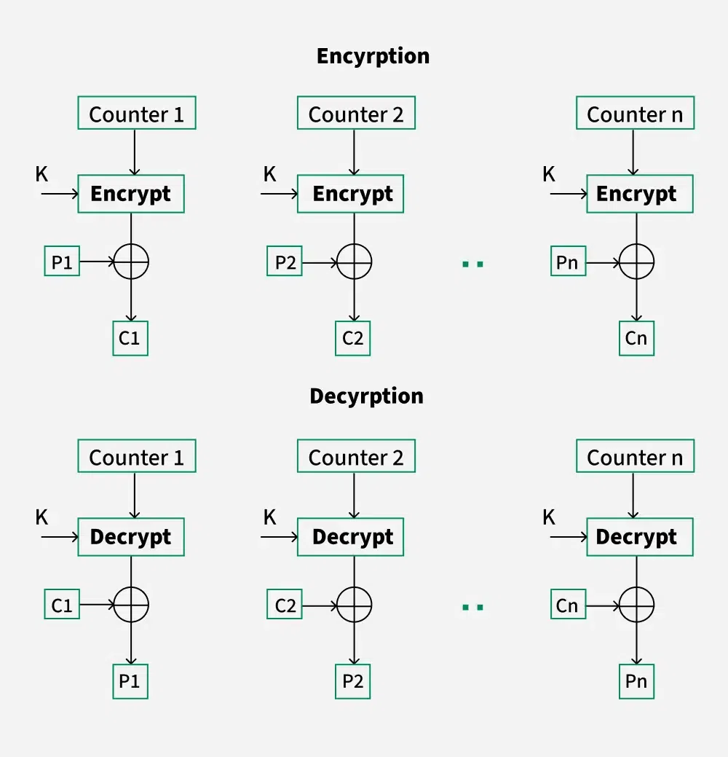
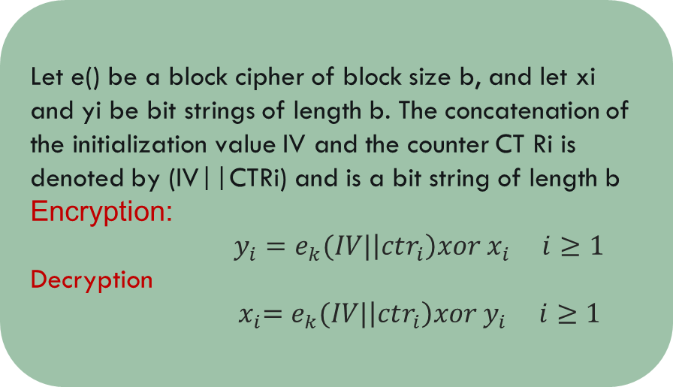
Counter mode (CTR):
Encrypts a counter for each block.
Counter is incremented for each block.
Let e() be a block cipher of block size b, and let xi and yi be bit strings of length b. The concatenation of the initialization value IV and the counter CT Ri is denoted by (IV||CTRi) and is a bit string of length b
Encryption:
$y_{i}=e_{k}(IV|\left|ctr_{i}\right)xor x_{i} i≥1$
Decryption
${ x}_{i}=e_{k}(IV|\left|ctr_{i}\right)xor y_{i} i≥1$

Slide 31
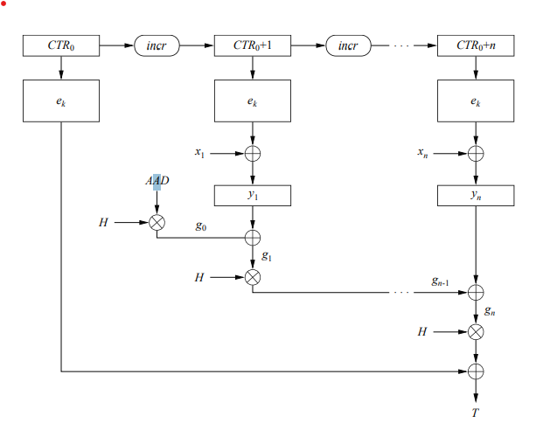
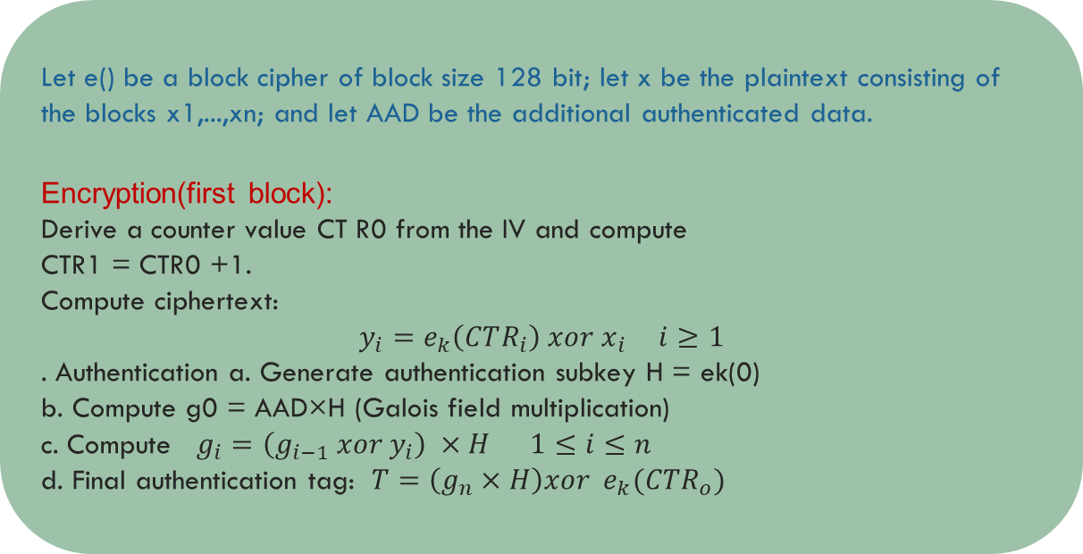
Galois Counter Mode (GCM)
Combines CTR mode + Authentication (via GHASH).
Provides confidentiality + integrity.
Used In: TLS, VPNs, IPsec.
Let e() be a block cipher of block size 128 bit; let x be the plaintext consisting of the blocks x1,...,xn; and let AAD be the additional authenticated data.
Encryption(first block):
Derive a counter value CT R0 from the IV and compute
CTR1 = CTR0 +1.
Compute ciphertext:
$$y_{i}=e_{k}\left(CTR_{i}\right) xor x_{i} i≥1$$
. Authentication a. Generate authentication subkey H = ek(0)
b. Compute g0 = AAD×H (Galois field multiplication)
c. Compute $g_{i}=\left(g_{i−1} xor y_{i}\right) ×H 1≤i≤n$
d. Final authentication tag: $T=\left(g_{n}×H\right)xor e_{k}(CTR_{o})$

Slide 32
References:
https://csrc.nist.gov/archive/aes/rijndael/Rijndael-ammended.pdf
Paar, C., & Pelzl, J. (2010). Understanding Cryptography: A Textbook for Students and Practitioners. Springer.
Schinta. (n.d.). Blowfish Encryption Algorithm [PDF]. CS Department, Indiana State University. Available at: https://cs.indstate.edu/~schinta/blowfish.pdf
Tita, F., Setiawan, A., & Susanto, B. Construction of Substitution Box (S-Box) Based on Irreducible Polynomials on GF(2⁸).

Slide 33


