Slide 1
IBM University Engagement Project Submission
“Exploring the Power of Agentic AI with IBM Granite and IBM Bob”

Slide 2
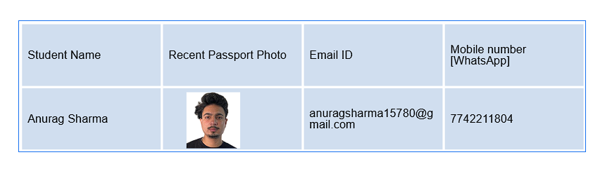
Project Tile – AI-Powered Health & Wellness Assistant
Domain of Project – Healthcare

Slide 3
Problem Statement -
Problem Statement : StudyMate AI
The Challenge
Students often struggle with time management, subject prioritization, revision planning, and maintaining consistent study schedules. Study resources are scattered across different platforms, making it difficult to organize learning effectively. Without personalized guidance, students may spend too much time on low-priority topics and struggle to prepare efficiently for exams.
The Objective
Build an AI-powered Study Assistant Agent that provides personalized study guidance and planning. The solution should:
• Subject Prioritization – Identify weak and high-priority subjects.
• Revision Planning – Generate structured revision schedules before exams.
• Learning Assistance – Explain difficult topics in simple language.
• Progress Tracking – Track completed tasks and study progress.
• AI Study Assistant – Provide interactive support for study-related questions.
• Daily & Weekly Goals – Set achievable learning targets and monitor progress.

Slide 4
Proposed Solution -
Proposed Solution: AI-Powered Study Assistant
The proposed solution is a multi-agent AI-powered Study Assistant built using IBM Bob, IBM watsonx.ai, and Granite Models to provide personalized, real-time study guidance. The system addresses challenges in study planning, subject prioritization, revision, and learning through an intelligent, modular architecture.
At its core, the solution uses AI-powered reasoning and personalization to understand student information such as subjects, available study time, weak areas, and exam goals, enabling the system to generate effective study plans.
The system consists of four key agents:
Study Planning Agent creates personalized study schedules based on student inputs such as subjects, available time, and learning goals.
Subject Analysis Agent identifies weak and high-priority subjects and recommends where the student should focus.
Revision Agent generates structured revision schedules and helps students prepare for upcoming examinations.
Learning Assistant Agent explains difficult topics in simple language and provides interactive support for study-related questions.
The solution includes a user-friendly dashboard that displays daily study schedules, completed tasks, upcoming exams, and overall study progress.
IBM Bob is used to orchestrate agent workflows, while watsonx.ai supports AI model integration and deployment. Granite models power reasoning, explanation, summarization, and personalization.
Overall, this solution delivers an end-to-end intelligent study assistant that helps students plan, learn, revise, and track their academic progress.

Slide 5
Technology Used
• IBM Bob platform – For designing and developing the Study Assistant Agent and orchestrating AI workflows.
• IBM Granite model – For natural language understanding, reasoning, explanations, and personalized study guidance.
• IBM Cloud – Provides the infrastructure to build, deploy, and scale the Study Assistant efficiently.
• AI Agent Architecture – Enables specialized agents to work together for study planning, subject analysis, revision, and learning assistance.
• IBM watsonx.ai – For AI model integration, deployment, and AI governance.
• Web Technologies (HTML/CSS/JavaScript) – For creating the responsive and interactive StudyMate user interface.

Slide 6
Required Files created using IBM bob -
1.index.html
2.README.md
3.env.example

Slide 7
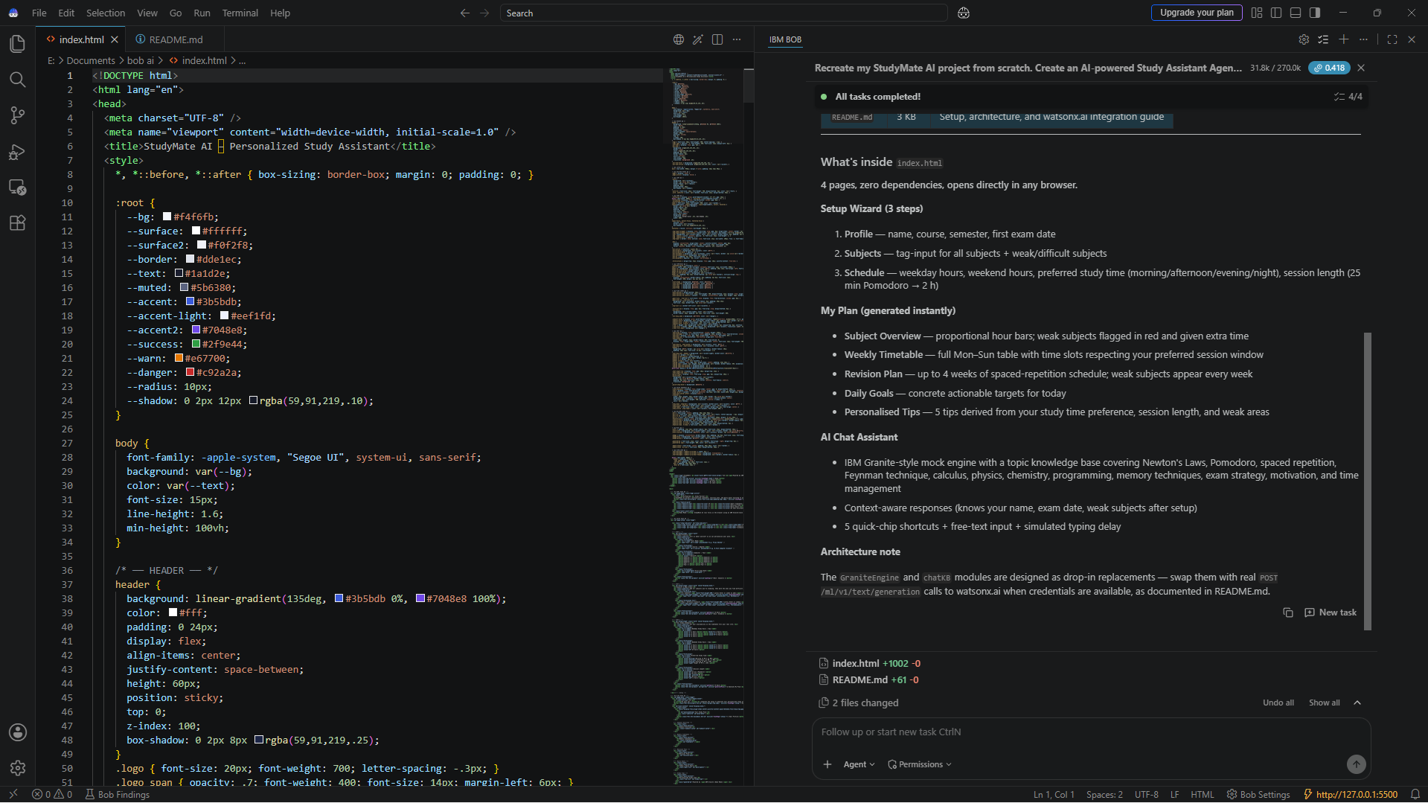
IBM Bob Screenshots:

Slide 8
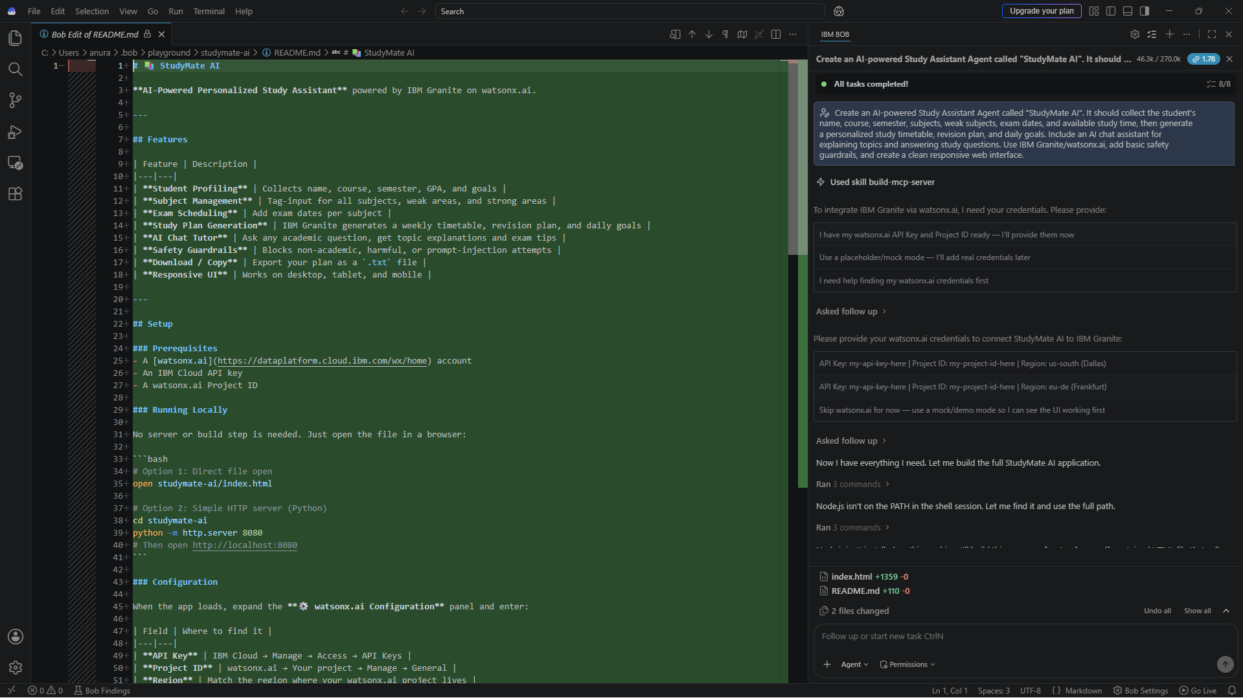

Slide 9
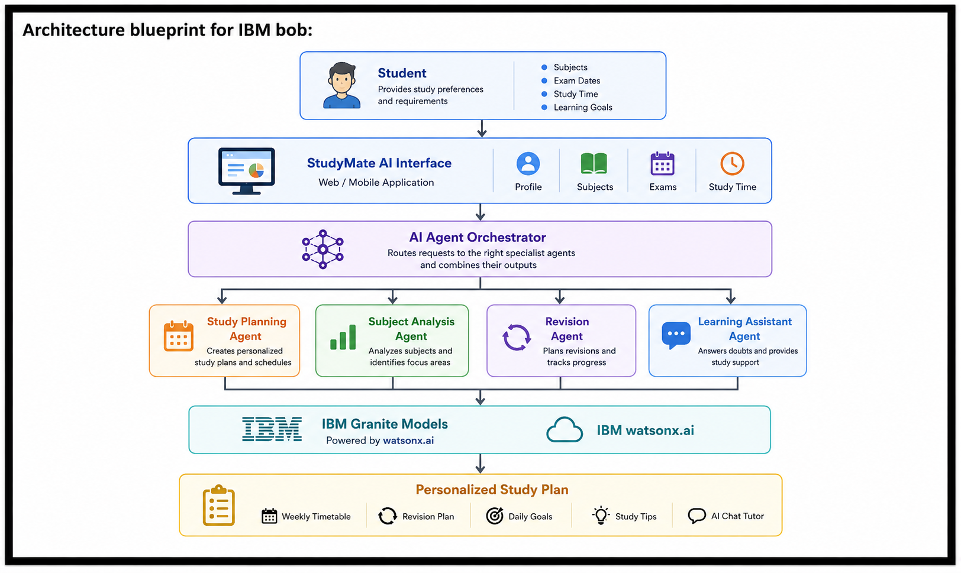

Slide 10

Role of Agentic AI in the solution
Role of Agentic AI in StudyMate AI
Agentic AI enables StudyMate AI to function as an intelligent, autonomous study assistant rather than a simple chatbot. Using IBM watsonx.ai and IBM Granite models, it coordinates multiple specialized agents to provide personalized study guidance.
Each agent performs a specific role—such as creating study plans, analyzing subjects, preparing revision schedules, and explaining topics—while working collaboratively. This multi-agent approach ensures efficient task execution and personalized learning support.
Agentic AI also provides context awareness, understanding student details such as subjects, weak areas, exam dates, available study time, and learning goals. It supports real-time adaptation, updating study recommendations based on the student's progress and requirements.
Additionally, agents work together to improve decision-making and provide better study recommendations. Overall, Agentic AI makes StudyMate AI proactive, personalized, and goal-driven, acting as a smart digital study assistant that helps students plan, learn, revise, and track their academic progress.

Slide 11
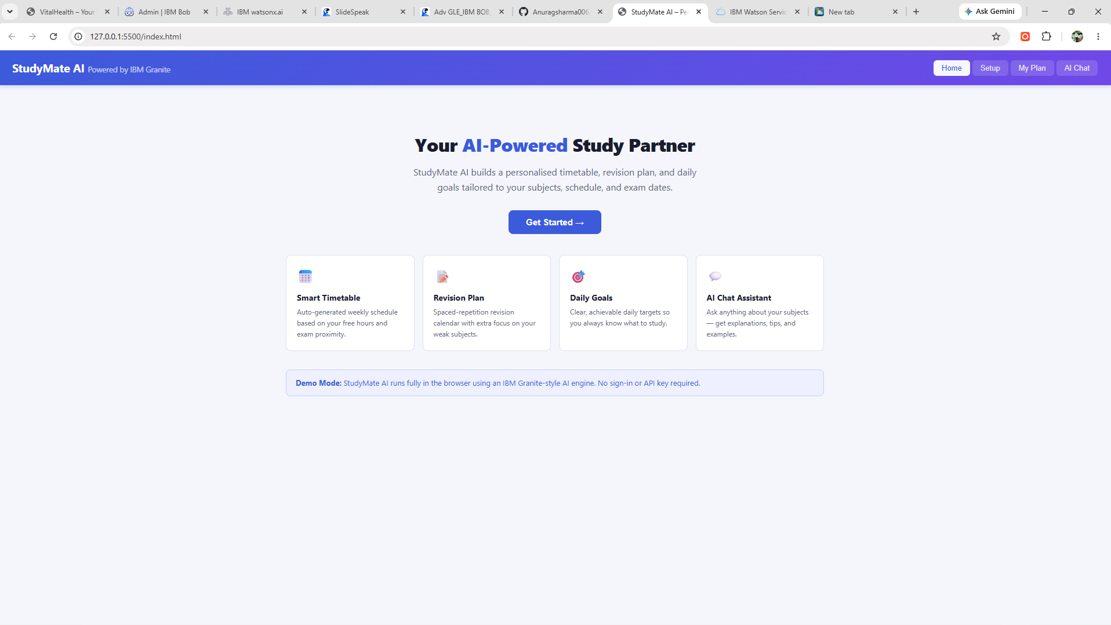
Project Output Screenshot:

Slide 12
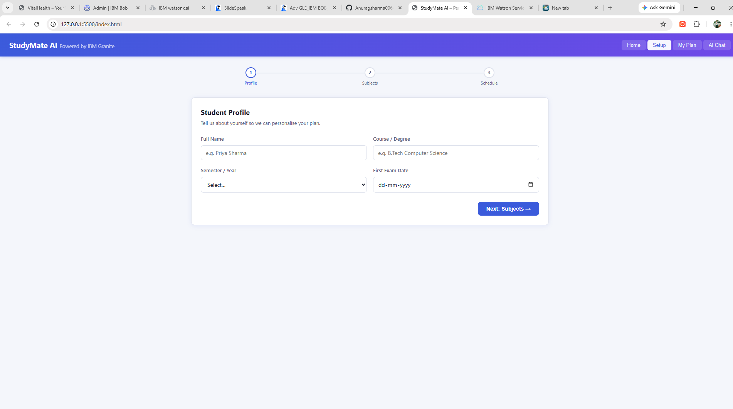
Project Output Screenshot

Slide 13
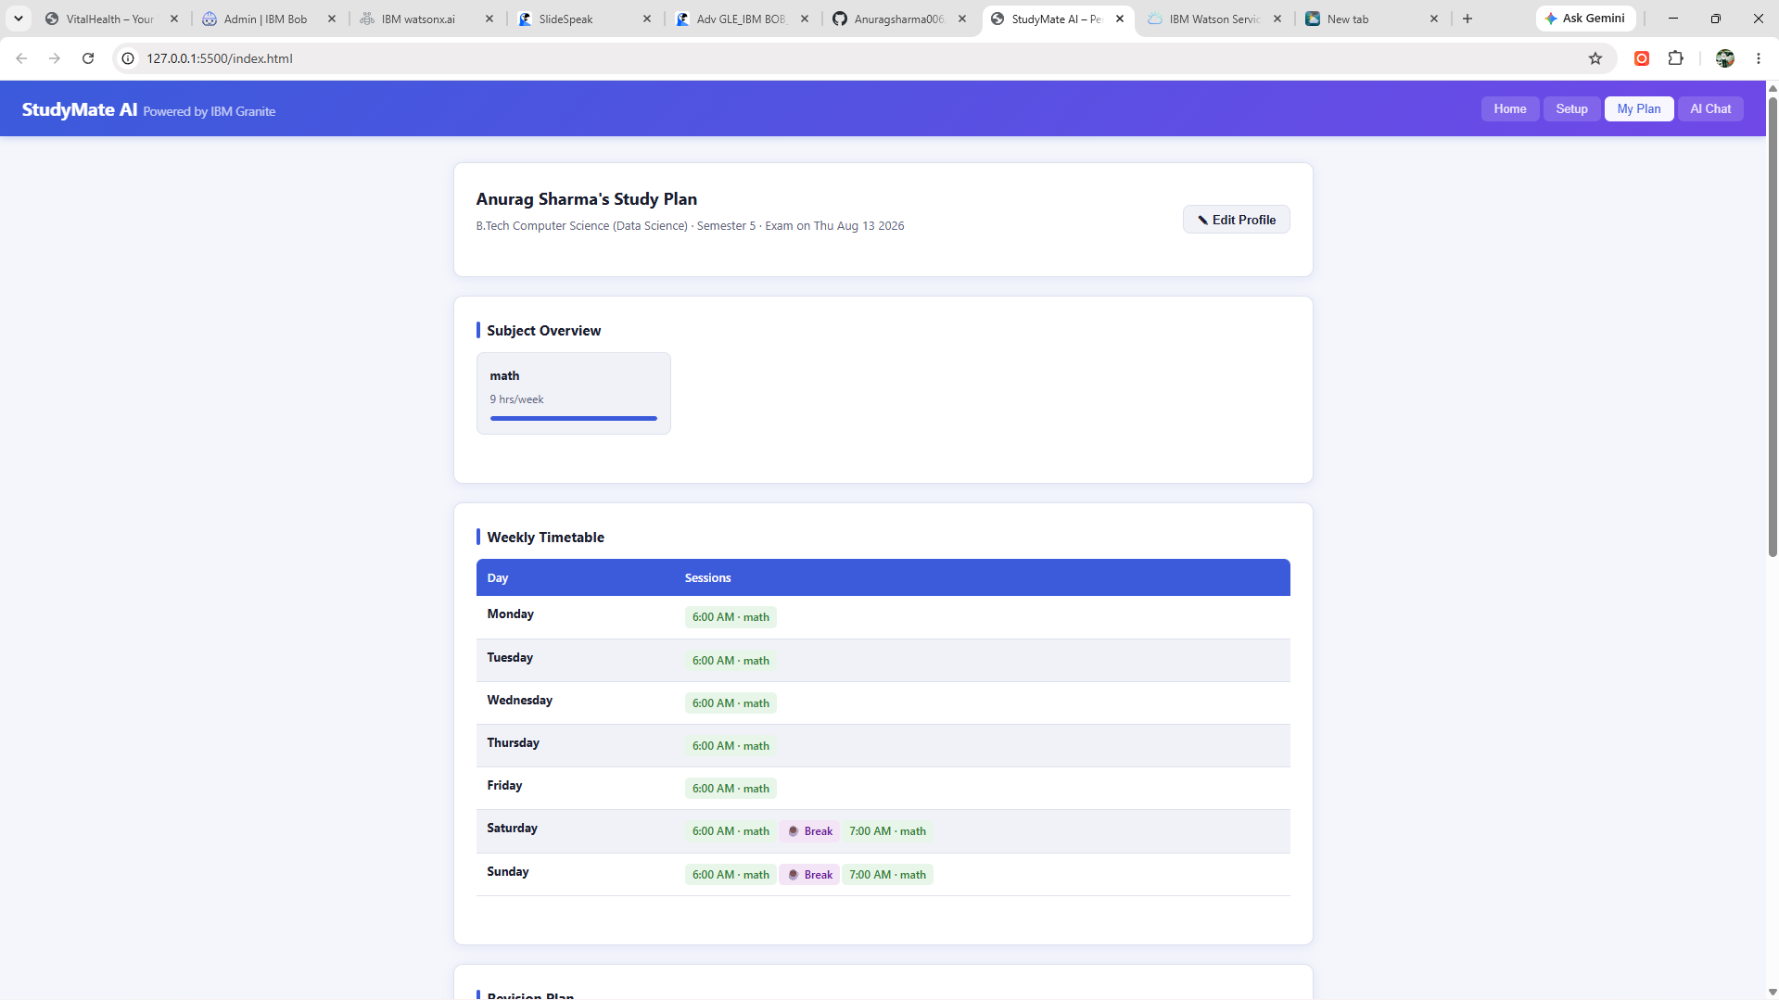
Project Output Screenshot

Slide 14
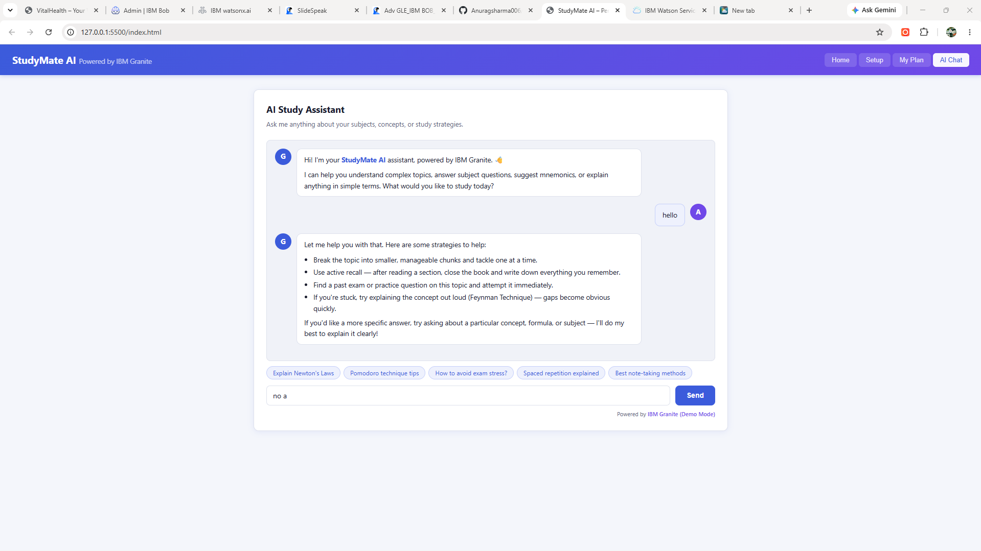
Project Output Screenshot

Slide 15
Novelty and Uniqueness
The proposed StudyMate AI stands out by combining Agentic AI, personalization, and intelligent study planning into a single study assistant.
Personalized Study Planning – Generates study timetables based on the student's subjects, weak areas, exam dates, and available study time.
Multi-Agent Intelligence – Uses specialized agents for study planning, subject analysis, revision, and learning assistance.
Adaptive Revision – Creates revision schedules based on exam deadlines, weak subjects, and learning priorities.
AI Learning Assistant – Explains difficult topics in simple language and answers study-related questions interactively.
Progress & Goal Tracking – Helps students set daily and weekly learning goals and track their study progress.
Context-Aware Assistance – Uses student information, subjects, exam dates, and study preferences to provide relevant guidance.
IBM GraIntegration nite – Uses IBM Granite models through watsonx.ai for intelligent study guidance and personalized responses.
Clean & Responsive Interface – Provides a simple, user-friendly interface that can be accessed across different screen sizes.
This makes the solution a smart, adaptive, and personalized digital study assistant, rather than just a basic timetable generator.

Slide 16
Git Hub Link
https://anuragsharma006.github.io/studymate-ai/

Slide 17
Future Scope
1. Integration with Learning Platforms –The system can be integrated with online learning platforms and course management systems to access study materials, assignments, and course schedules. This will enable StudyMate AI to provide more accurate and context-aware study recommendations.
2. AI-Powered Voice Assistant & Multilingual Support –Enhancing the system with a voice-enabled assistant and support for multiple languages will improve accessibility. Students can interact naturally in their preferred language, making the solution more inclusive and suitable for diverse learners.
3. Smart Performance Analytics –Future versions can analyze long-term study performance, identify learning patterns, and provide personalized recommendations to improve academic progress
4. Mobile Application –The StudyMate AI system can be extended into a mobile application, allowing students to access their study plans, revision schedules, daily goals, and AI learning assistant anywhere.

Slide 18
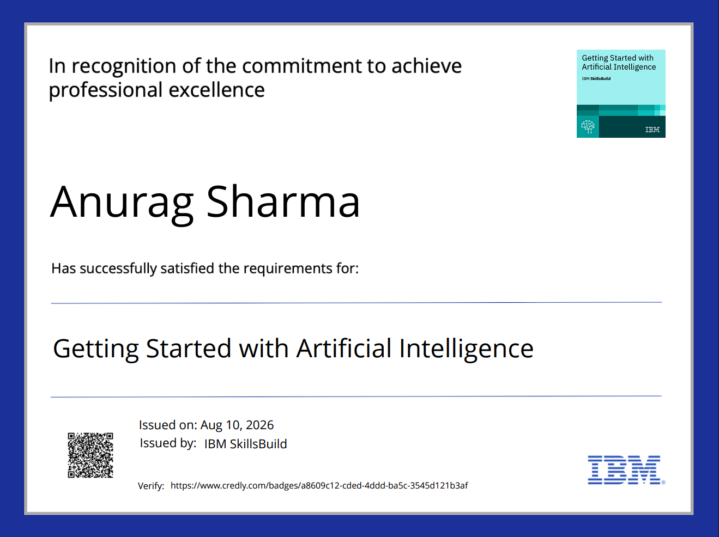
Certificates Earned:

Slide 19
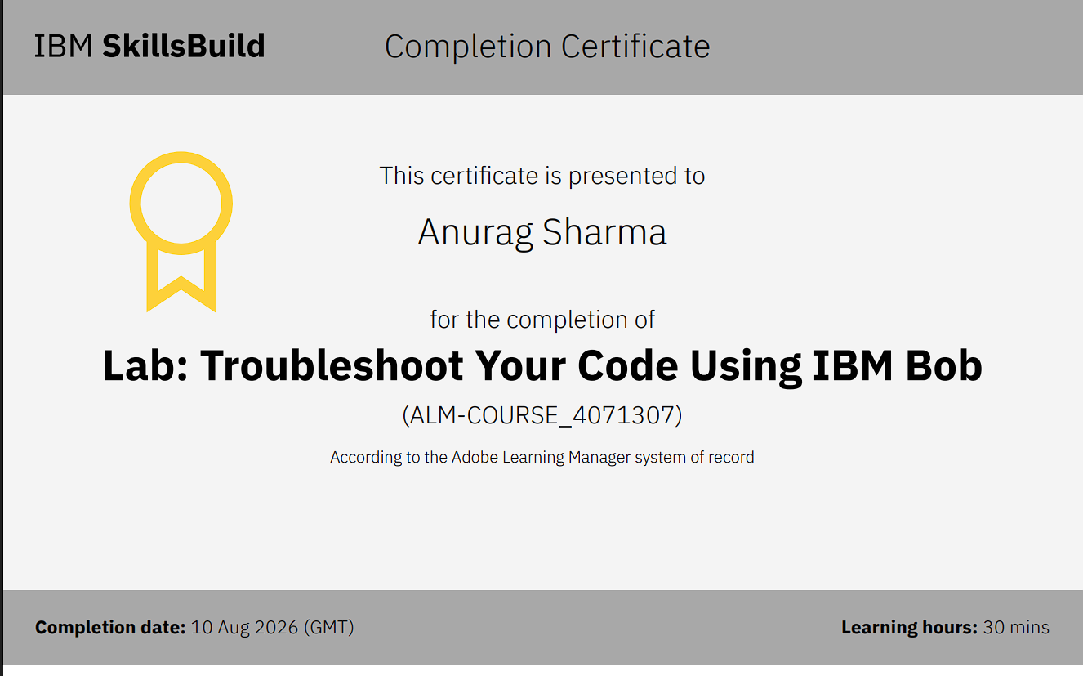
Certificates Earned:

Slide 20
THANK YOU!
Thank you for your time and interest

