Slide 1
Chapter 9
Uniprocessor Scheduling
Types of Processor Scheduling
Scheduling Algorithms

Slide 2
Scheduling
An OS must allocate resources amongst competing processes.
The resource is allocated by means of scheduling - determines which processes will wait and which will progress.
The resource provided by a processor is execution time.

Slide 3
Overall Aim of Scheduling
The aim of processor scheduling is to assign processes to be executed by the processor over time,
  in a way that meets system objectives, such as response time, throughput, and processor efficiency.

Slide 4
Scheduling Objectives
The scheduling function should
  Share time fairly among processes
  Prevent starvation of a process
  Use the processor efficiently
  Have low overhead
  Prioritise processes when necessary (e.g. real time deadlines)

Slide 5
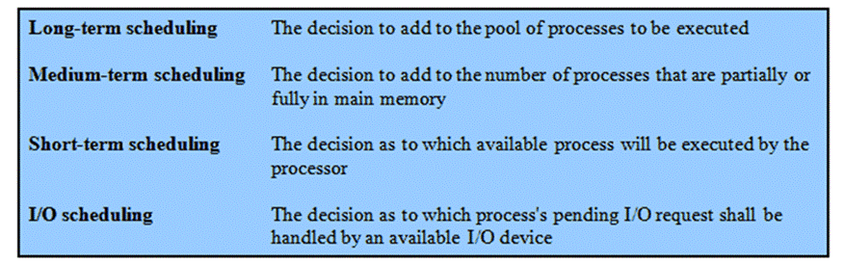
Types of Scheduling

Slide 6
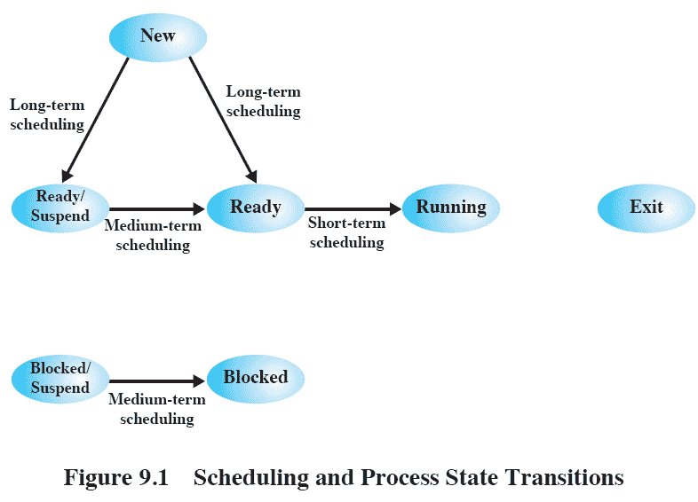
Scheduling and
Process State Transitions
Long-term scheduling is performed when a new process is created.
Medium-term scheduling is a part of the swapping function.
Short-term scheduling is the actual decision of which ready process to execute next.
Focus of this chapter

Slide 7
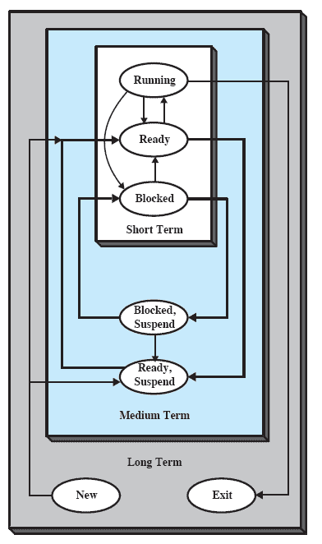
Nesting of
Scheduling Functions

Slide 8
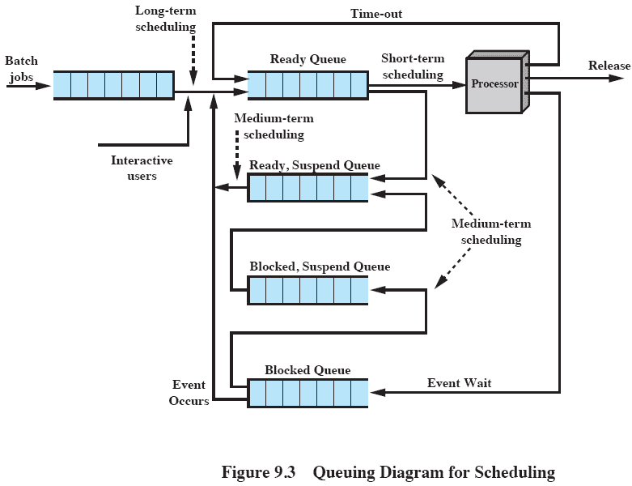
Queuing Diagram
Scheduling is a matter of managing queues to minimize queuing delay and to optimize performance.

Slide 9
Long-Term Scheduling
Determines which programs are admitted to the system for processing
  May be first-come-first-served
  According to criteria such as priority, I/O requirements or expected execution time
Controls the degree of multiprogramming
  More processes, smaller percentage of time each process is executed

Slide 10
Medium-Term
Scheduling
Part of the swapping function
Swapping-in decisions are based on
  the need to manage the degree of multiprogramming
  the memory requirements of the swapped-out processes

Slide 11
Short-Term Scheduling
Short-term scheduler is known as the dispatcher.
Executes most frequently to decide which process to execute next
Invoked when an event occurs
  Clock interrupts
  I/O interrupts
  Operating system calls

Slide 12
Roadmap
Types of Processor Scheduling
Scheduling Algorithms

Slide 13
Aim of Short
Term Scheduling
Main objective is to allocate processor time to optimize certain aspects of system behaviour.
A set of criteria is needed to evaluate the scheduling policy.

Slide 14
Short-Term Scheduling
Criteria: User vs. System
User-oriented
  Behavior of the system as perceived by individual user or process
  Example: response time (in an interactive system)
    Elapsed time between the submission of a request until there is output
System-oriented
  Effective and efficient utilization of the processor
  Example: throughput
    Process completion rate

Slide 15
Short-Term Scheduling
Criteria: Performance
Performance-related
  Quantitative
  Easily measured
  Example: response time and throughput
Non-performance related
  Qualitative
  Hard to measure
  Example: predictability

Slide 16
Interdependent
Scheduling Criteria
More scheduling criteria can be found in Table 9.2.
Impossible to optimize all criteria simultaneously.
  Example: response time vs. throughput
Design of a scheduling policy involves compromising among competing requirements.

Slide 17
Priorities
In many systems, each process is assigned a priority.
Scheduler will always choose a process of higher priority over one of lower priority.
Have multiple ready queues to represent each level of priority.

Slide 18
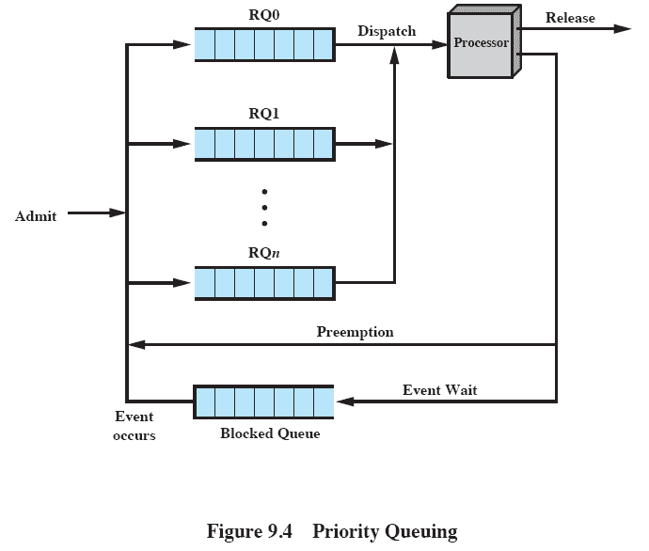
Priority Queuing
priority[RQi] > priority[RQj] for i<j; larger priority values represent lower priority processes.
The scheduler will start at the highest-priority ready queue.

Slide 19
Starvation
Problem
  Lower-priority processes may suffer starvation if there is a steady supply of high priority processes.
Solution
  Allow a process to change its priority based on its age or execution history.

Slide 20
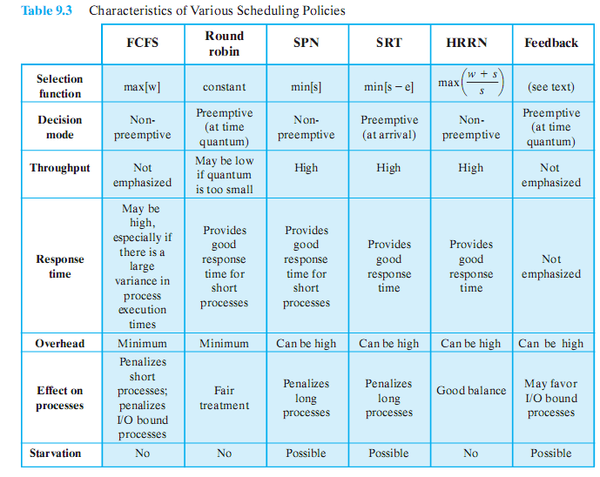
Alternative Scheduling
Policies

Slide 21
Selection Function
Determines which process is selected for execution.
If based on execution characteristics then important quantities are:
  w = time spent in system so far, waiting
  e = time spent in execution so far
  s = total service time required by the process, including e

Slide 22
Decision Mode
Specifies the instants in time at which the selection function is exercised.
Two categories:
  Non-preemptive
  Preemptive

Slide 23
Non-preemptive vs.
Preemptive
Non-preemptive
  Once a process is in the running state, it will continue until it terminates or blocks itself for I/O or OS service.
Preemptive
  Currently running process may be interrupted and moved to ready state by the OS.
  Preemption may occur when new process arrives, on an interrupt, or periodically.

Slide 24
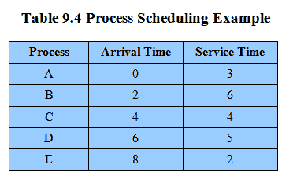
Process Scheduling
Example
Example set of processes, consider each a batch job
  Service time (T_{s}) represents total execution time

Slide 25
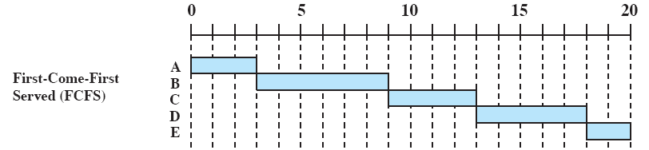
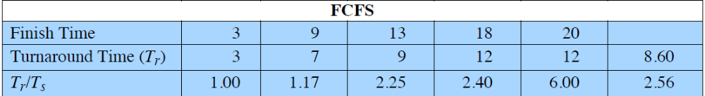
First-Come-
First-Served (FCFS)
Each ready process joins the ready queue.
When the current process ceases to execute, the process in the ready queue the longest is selected.

Slide 26
FCFS
 A short process may have to wait a very long time before it can execute.
 Favors CPU-bound processes (mostly use processor) over I/O-bound processes.
  I/O processes have to wait until CPU-bound process completes
  may result in inefficient use of both the processor and the I/O devices

Slide 27
Round Robin (RR)
 Reduce penalty that short jobs suffer with FCFS by using clock interrupts generated at periodic intervals.
When an interrupt occurs, the currently running process is placed in the ready queue and the next ready job is selected on a FCFS basis.
Also known as time slicing because each process is given a slice of time before being preempted.

Slide 28
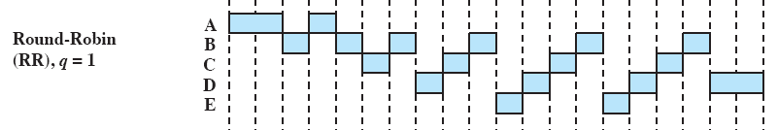
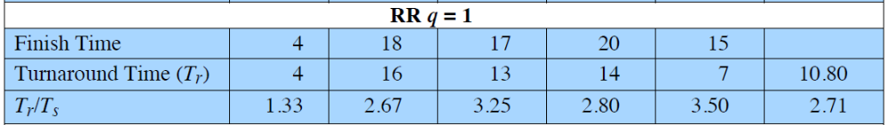
RR

Slide 29
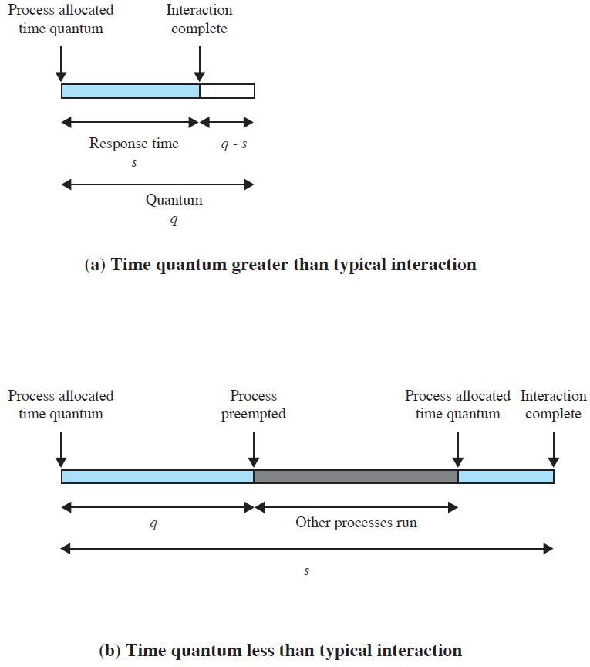
Effect of Size of
Preemption Time Quantum
 There is processing over-head involved in handling the clock interrupt and performing the scheduling and dispatching function.
The time quantum should be slightly greater than the time required for a typical interaction.

Slide 30
RR
 Generally, I/O-bound process has a shorter processor burst (amount of time spent executing between I/O operations) than a CPU-bound process
  results in poor performance, inefficient use of I/O devices, and an increase in the variance of response time.

Slide 31
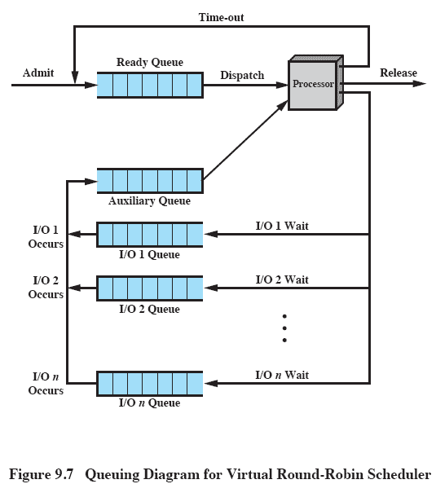
Virtual Round Robin
A fair approach: similar to RR except processes in the auxiliary queue get preference over those in the main ready queue.

Slide 32
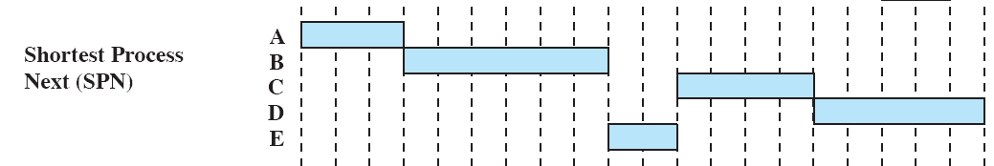
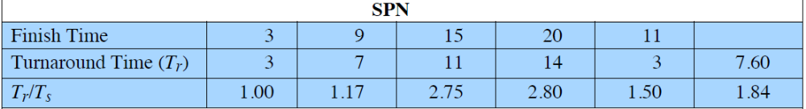
Shortest Process Next (SPN)
Non-preemptive policy
Process with shortest expected processing time is selected next.
 Reduce the bias in favor of long processes in FCFS by allowing short processes jump ahead of longer processes.

Slide 33
SPN
 Predictability of longer processes is reduced.
 Need to know or estimate the required processing time for each process.
  Programmers may be required to supply an estimate for batch jobs.
  Statistics may be gathered for repeating jobs.
  If estimated processing time is not correct, OS may abort it.

Slide 34
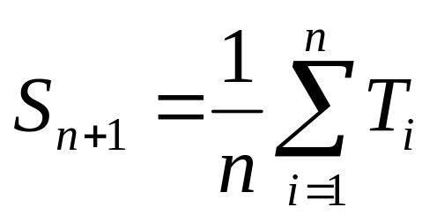
Calculating
‘Burst’ for interactive processes
A running average of each “burst” for each process
  T_{i} = processor execution time for the ith instance of this process
  S_{i} = predicted value for the ith instance
  S₁ = predicted value for first instance; not calculated

Slide 35
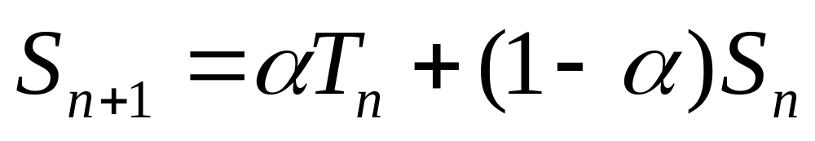
Exponential Averaging
Recent bursts more likely reflect future behavior.
A common technique for predicting a future value on the basis of a time series of past values is exponential averaging.
where 0 < α < 1

Slide 36
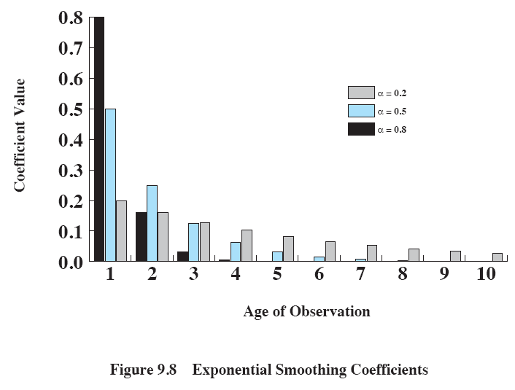
Exponential Smoothing Coefficients
The larger the value of α, the greater the weight given to the more recent observations.

Slide 37
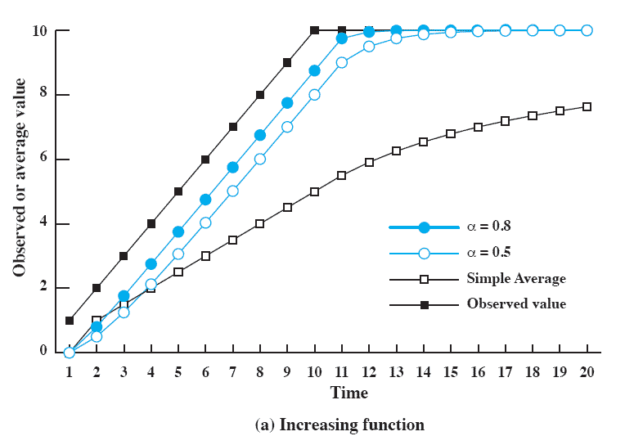
Use Of
Exponential Averaging
Exponential averaging tracks changes faster than simple averaging.
The larger value of α results in a more rapid reaction to the change.

Slide 38
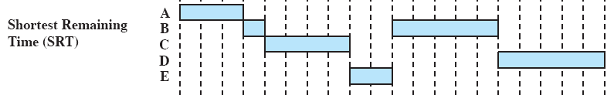
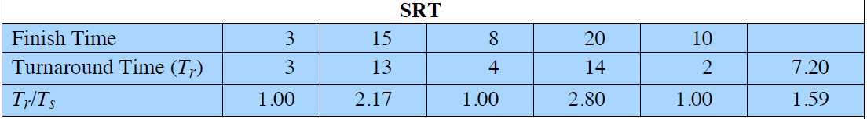
Shortest Remaining
Time (SRT)
Preemptive version of SPN: chooses the process with the shortest expected remaining processing time.

Slide 39
SRT
 SRT does not have the bias in favor of long processes found in FCFS.
 Unlike round robin, no additional interrupts are generated, reducing overhead.
 SRT should give superior turnaround time performance to SPN, because a short job is given immediate preference to a running longer job.
 Must estimate processing time and record elapsed service time.
 A risk of starvation of longer processes.

Slide 40

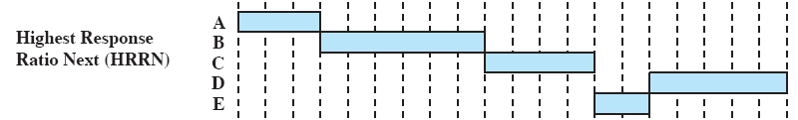
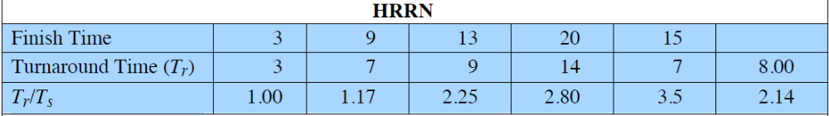
Highest Response
Ratio Next (HRRN)
Choose next process with the greatest response ratio, trying to minimize the normalized turnaround time.

Slide 41
HRRN
 Shorter jobs are favored (a smaller denominator yields a larger ratio).
 Longer processes will eventually get past competing shorter jobs (aging without service also increases the ratio).
 As with SRT and SPN, the expected service time must be estimated.

Slide 42
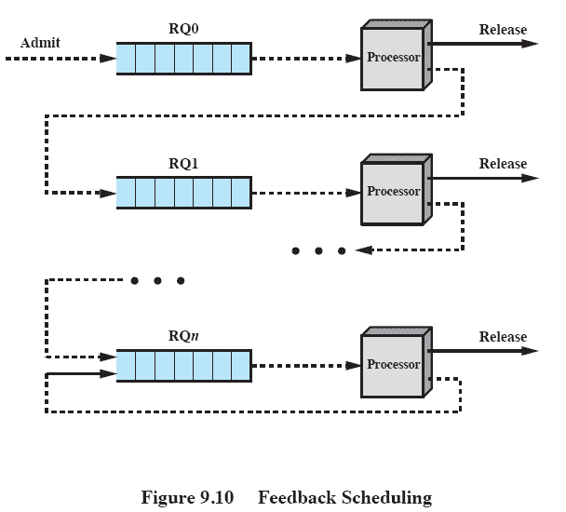
Feedback Scheduling (FB)
Penalize jobs that have been running longer by demoting to the next lower-priority queue.
Scheduling with preemptive and dynamic priority mechanism.

Slide 43
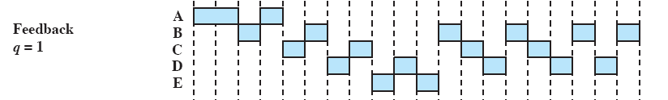
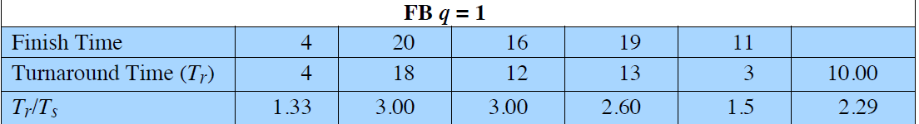
FB Performance
Variations exist, simple version preempts periodically, similar to round robin
  longer processes may suffer starvation if new jobs are entering the system frequently

Slide 44
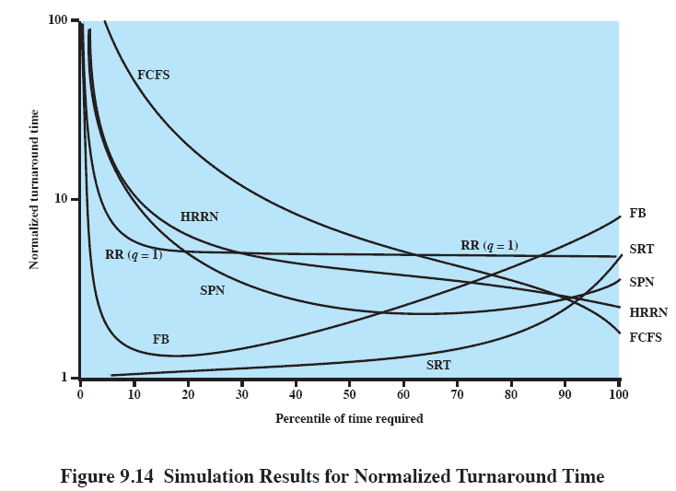
Normalized
Turnaround Time
It is impossible to make definitive comparisons because relative performance will depend on a variety of factors.
short processes
long processes

Slide 45
Fair-Share Scheduling
User’s application runs as a collection of processes (threads).
User is concerned about the performance of the application.
Fair-share scheduling: Make scheduling decisions based on process sets.
The concept can be extended to groups of users.

Slide 46
Fair-Share Scheduling
Each user is assigned a weighting that defines that user’s share of system resources.
Objective: To give fewer resources to users who have had more than their fair share and more to those who have had less than their fair share.

Slide 47
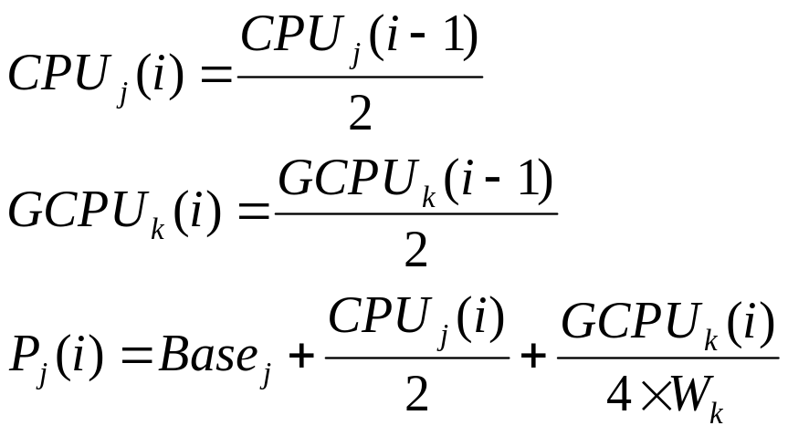
Fair-Share Scheduler
The user community is divided into a set of fair-share groups and a fraction of the processor resource is allocated to each group.
For process j in group k, we have
CPU_{j}(i)=measure of CPU utilization by process j through interval i
GCPU_{k}(i)=measure of CPU utilization of group k through interval i
P_{j}(i)=priority of process j at beginning of interval i; lower values equal higher priorities
Base_{j}=base priority of process j
W_{k}=weighting assigned to group k (share of resources)

Slide 48
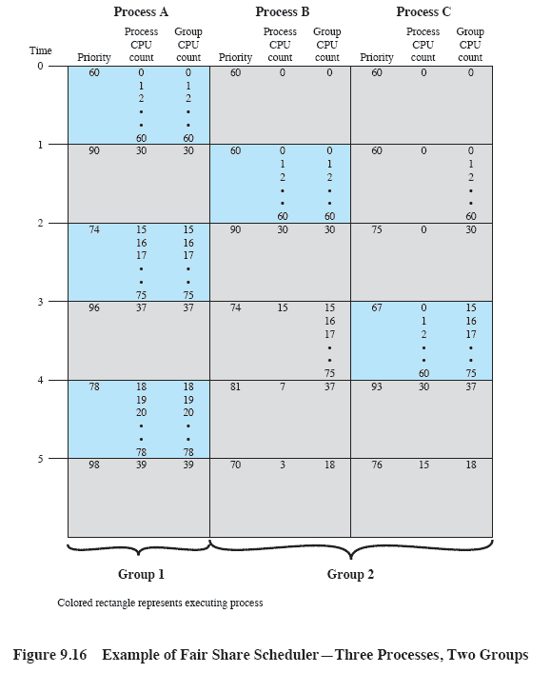
Fair-Share Scheduler
Given:
  W₁=W₂=0.5
  Base₁=Base₂=Base₃=60
  The CPU count is incremented 60 times per second
  Priorities are recalculated once per second

