Slide 1
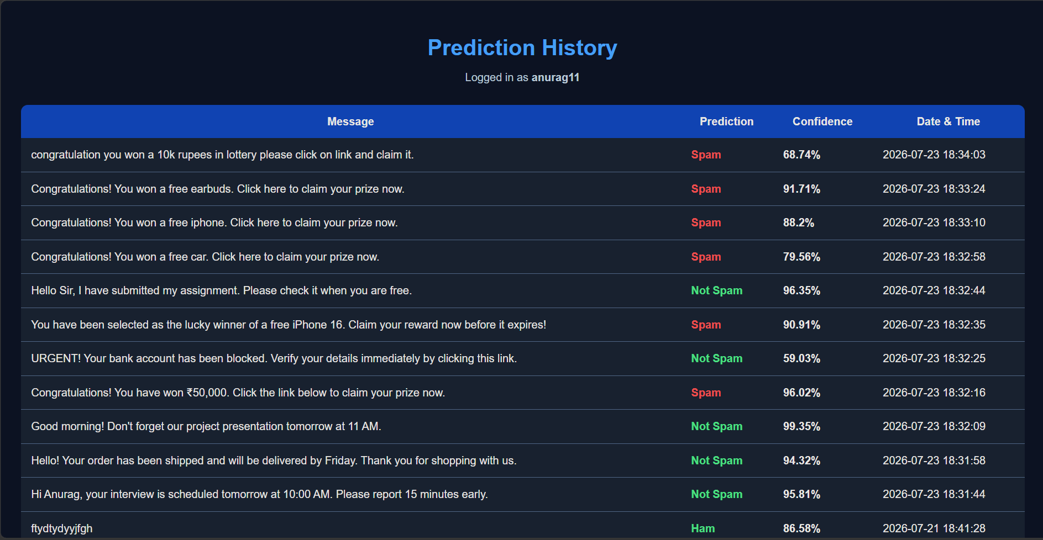
Spam Detection System
Machine Learning Based Email/SMS Spam Classifier
• Final Year Mini Project
• Secure Authentication
• Real-time Spam Detection
• Prediction History

Slide 2
Agenda
• Problem Statement
• Objectives
• System Architecture
• Technology Stack
• Workflow
• Application Screens
• Model Performance
• Future Scope
• Conclusion

Slide 3
Problem Statement & Objectives
• Spam messages waste time and may cause fraud.
• Automatically classify Email/SMS.
• Provide confidence score.
• Maintain prediction history.
• Easy-to-use interface.

Slide 4
System Architecture
User
Frontend
HTML/CSS/JS
Flask API
ML Model
(NLP+Classifier)
SQLite DB
→
→
→
→

Slide 5
Technology Stack
• Frontend: HTML5, CSS3, JavaScript
• Backend: Python + Flask
• Machine Learning: Scikit-learn, NLP
• Database: SQLite
• Version Control: Git & GitHub

Slide 6
Working Flow
• Login/Register
• Enter Email or SMS
• Text Preprocessing
• Feature Extraction
• Prediction
• Display Confidence
• Save History

Slide 7
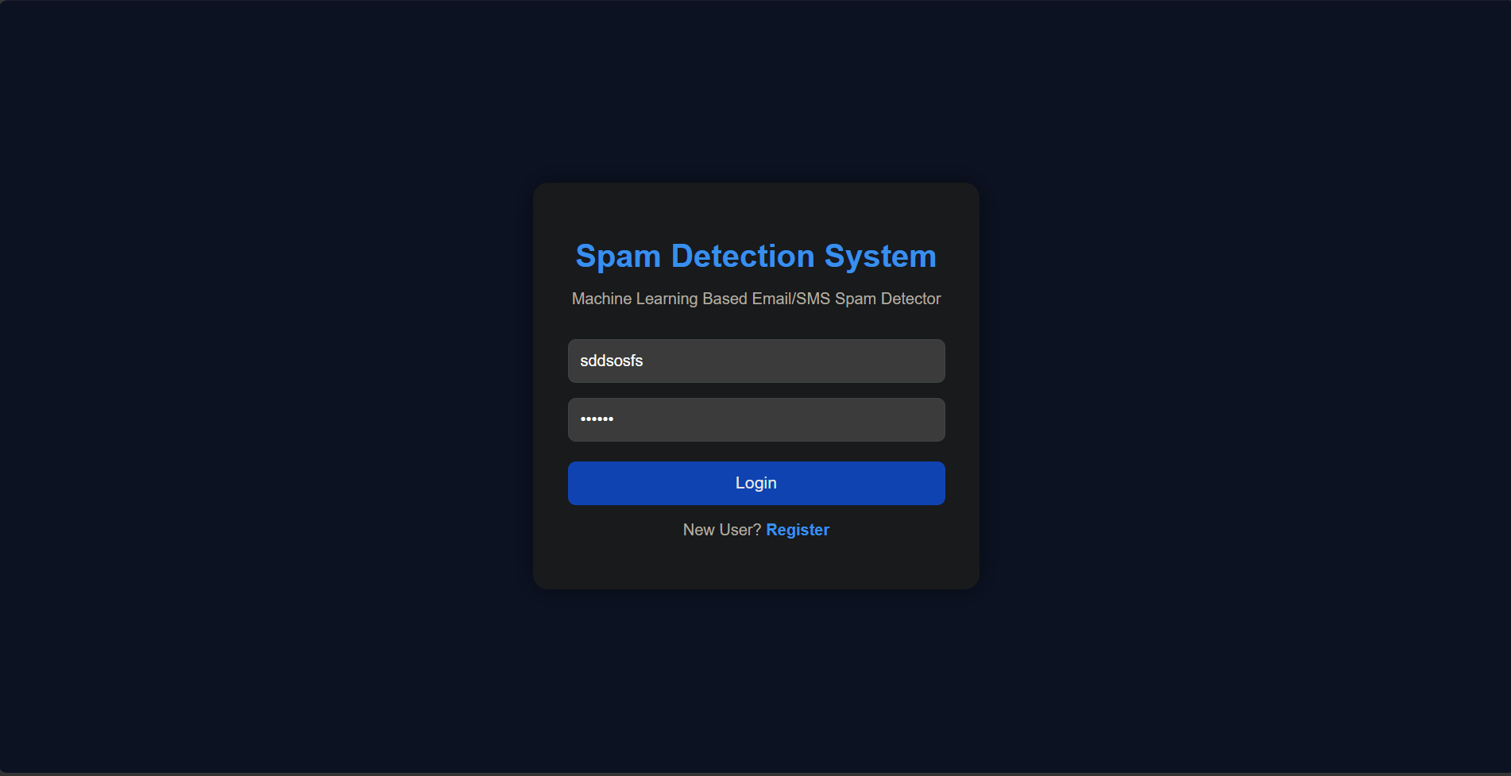
Login Screen

Slide 8
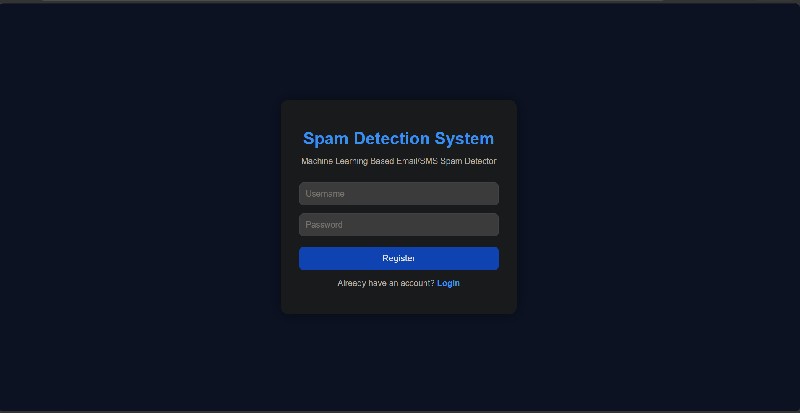
Register Screen

Slide 9
Prediction Screen

Slide 10
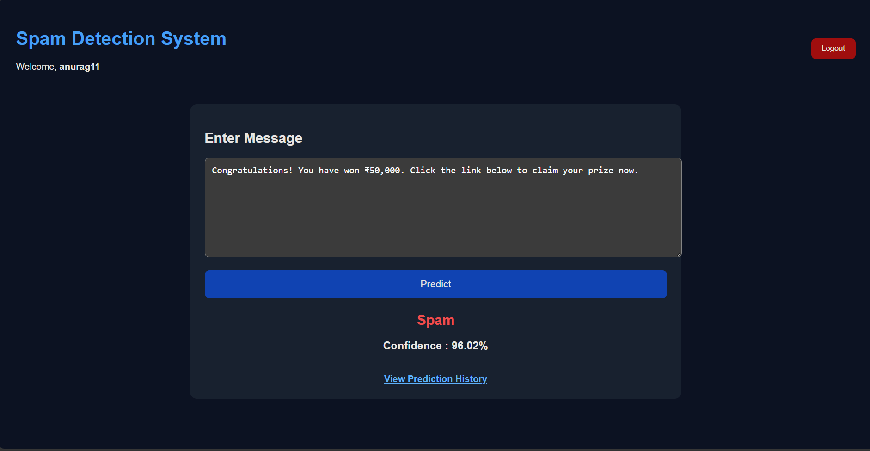
History Screen

Slide 11
Machine Learning Model
• Dataset: Labeled Spam/Ham messages
• Preprocessing: Lowercase, Tokenization, Stop-word Removal
• Vectorization: TF-IDF
• Classifier: Naive Bayes / ML Classifier
• Output: Spam / Not Spam + Confidence

Slide 12
Performance
• Fast prediction
• Confidence score for every message
• User-wise prediction history
• Scalable Flask backend

Slide 13
Future Scope
• Deep Learning integration
• Multi-language support
• Email API integration
• Live phishing detection
• Cloud deployment

Slide 14
GitHub & Project Structure
• Frontend
• Backend
• Model
• Database
• README & Documentation
• Version Control

Slide 15
Thank You
Questions?

