Slide 1


NEXT GEN EMPLOYABILITY PROGRAM
CREATING A FUTURE-READY WORKFORCE

Slide 2
Student Name : Anuraj Anil Chavan
Student ID : STU648028521dcd41686120530
College Name : Vasantdada Patil Pratishthan’s College of Engineering & Visual Arts

Slide 3
CAPSTONE PROJECT SHOWCASE
Project Title : Real time business monthly data analysis
Abstract | Problem Statement | Project Overview | Proposed Solution | Technology Used | Modelling & Results | Conclusion | Q&A

Slide 4
Abstract
The dataset comprises order information, including details such as order ID, dates, shipping mode, customer data, product specifics, and financials. This data spans multiple months and is suitable for monthly analysis. Key aspects include temporal distribution, sales performance, product category insights, customer segmentation, profitability assessment, discount impact, geographical variations, and shipping mode efficiency. Monthly analysis facilitates the identification of sales trends, customer behaviors, and product success, enabling businesses to make informed decisions for inventory management, marketing strategies, and overall operational optimization.
Click here
Reference link

Slide 5
Problem Statement
The organization, based on the provided dataset, faces challenges in understanding and optimizing its business operations. Several key issues need to be addressed through a comprehensive analysis of the monthly data:
Sales Trends and Seasonality, Product Performance, Customer Behavior and Segmentation, Profitability Challenges, Discount Impact, Geographical and Regional Variations, Shipping Mode Efficiency.
Addressing these challenges through a systematic monthly data analysis will provide the organization with actionable insights to enhance operational efficiency, boost sales, and improve overall business performance.
Click here
Reference link

Slide 6
Project Overview
Exploratory Data Analysis (EDA):
Visualize and identify monthly trends.
Product and Customer Analysis:
Evaluate product and customer segmentation.
Profitability and Discount Analysis:
Assess monthly profitability and discount impact.
Geographical and Shipping Analysis:
Explore regional variations and shipping efficiency.
Deliverables:
Detailed analysis report with visualizations.
Recommendations for business optimization.
Benefits:
Improved understanding of monthly sales dynamics.
Enhanced segmentation and profitability strategies.
Informed decision-making for discounts and operations.
Click here
Reference link

Slide 7
Proposed Solution
Dynamic Inventory Management:
Adjust inventory with product insights.
Prioritize resources based on monthly sales trends.
Targeted Marketing Campaigns:
Tailor strategies to customer segments.
Promote based on preferences and behaviors.
Profitability Enhancement:
Tackle low-profit factors, adjust pricing or operations.
Optimize discounts for high-impact products and months.
Geographically Tailored Approach:
Customize strategies for regional nuances.
Enhance customer experience with personalized approaches.
Click here
Reference link

Slide 8
Technology Used
Power BI
Power Query
Click here
Reference link

Slide 9
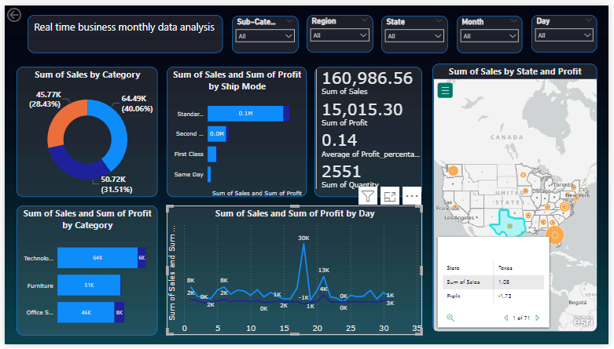
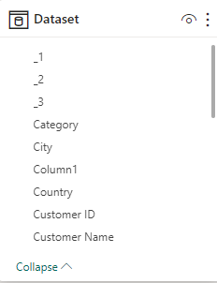

Modelling & Results
Graphs and Slicers
Folders type data
Real time monthly data analysis
Click here
Reference link

Slide 10
Conclusion
Expected Outcomes:
Increased Revenue:
Power BI insights drive targeted marketing and dynamic inventory management.
Profit Margins Improvement:
Identify and address low-profit factors with Power BI analytics.
Enhanced Customer Satisfaction:
Utilize Power BI for geographical and shipping optimizations, resulting in improved customer satisfaction.
With Power BI, we're not just managing data; we're transforming it into actionable intelligence for a brighter business future! 💡📊
Click here
Reference link

Slide 11
Thank You!
Notes:
Thank You !!

