Slide 1
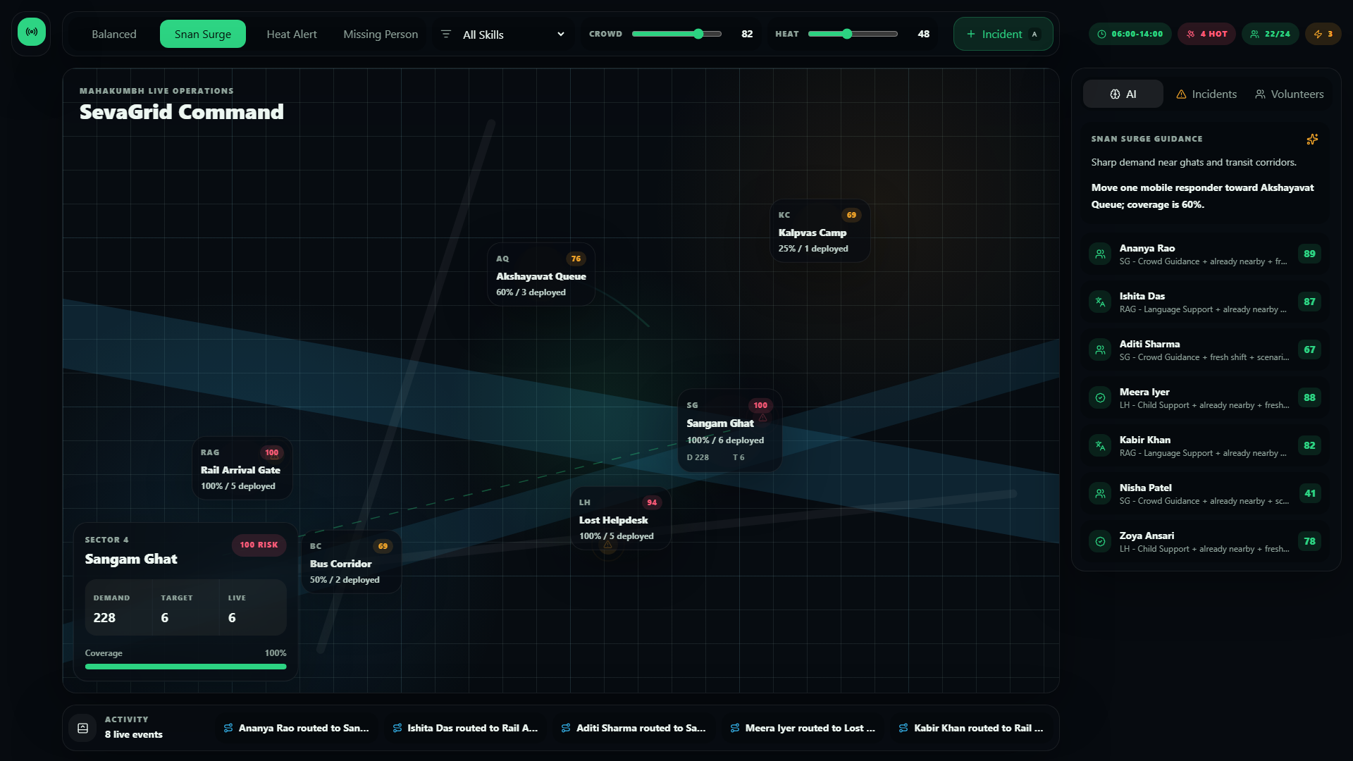
ROUND 2 PRODUCT BUILD
A live command center for Mahakumbh volunteer deployment.
SevaGrid Command helps operations teams recruit-style model, allocate, monitor, and optimize thousands of volunteers by skills, location, workload, and live incidents.
65-70%
0
200 OK
map-first surface
backend secrets
live deployment
Live: sevagrid-command.vercel.app
Repo: github.com/AnuranjanJain/Round2-Experthire
SevaGrid Command | Smart Volunteer Deployment & Workforce Optimization
01

Slide 2
OPERATING PROBLEM
At Mahakumbh scale, volunteer deployment is a live spatial problem.
Skills
Who can solve this incident?
Thousands of volunteers may support crowd guidance, medical aid, lost-child response, language queues, water relief, and logistics across fast-changing sectors.
Location
Who is close enough to move now?
Workload
Who is available without fatigue risk?
Roster spreadsheets separate people from places.
Demand
Which sectors are under-covered?
Dashboards show totals but not dispatch decisions.
Operators need explainable recommendations under pressure.
Incidents
What changed in the last minute?
SevaGrid Command | Smart Volunteer Deployment & Workforce Optimization
02

Slide 3
PRODUCT VISION
Every staffing decision should be anchored to the live map.
Priority 1: Map
The center canvas owns attention. Route lines, nodes, selected sector detail, and incident risk all live in one spatial field.
Priority 2: AI Dispatch
The right panel explains who should move, why they fit, and which risk gap they close.
Priority 3: Incidents
Incidents modify zone risk and assignment urgency instead of floating as admin data.
SevaGrid Command | Smart Volunteer Deployment & Workforce Optimization
03

Slide 4
OPERATOR WORKFLOW
From scenario pressure to dispatch recommendation in seconds.
1
2
3
4
Select pressure mode
Inspect map sector
Review AI dispatch
Send response
Snan Surge, Heat Alert, Missing Person, or Balanced.
Coverage, risk, deployed volunteers, and demand appear in-place.
Recommendations rank by skill fit, proximity, fatigue, and scenario match.
Ticket moves into activity stream and updates operational state.
Keyboard-first shortcuts support field operators: 1-6 select zones, brackets cycle scenarios, A adds an incident, T toggles timeline.
SevaGrid Command | Smart Volunteer Deployment & Workforce Optimization
04

Slide 5
THEME FIT
The product maps directly to the hackathon workforce optimization brief.
Recruit
Volunteer profiles include skills, languages, fatigue, availability, mobility, and current zone.
Manage
Roster state separates active, bench, protected, training, and resting volunteers.
Allocate
Optimizer assigns people to under-covered zones based on fit and urgency.
Monitor
Live map, incident queue, coverage percent, and activity stream show changing operations.
Optimize
Demand/risk scoring balances coverage, skill gaps, proximity, and fatigue fairness.
SevaGrid Command | Smart Volunteer Deployment & Workforce Optimization
05

Slide 6
OPTIMIZER LOGIC
SevaGrid ranks deployments with explainable operational signals.
Demand
crowd, weather, scenario pressure
assignment scores
Deterministic scoring engine
Risk
priority, incident severity, under-coverage
human-readable reasons
No black-box API is needed for the demo. Judges can inspect `src/optimizer.ts` and trace why every recommendation appears.
coverage targets
Fit
skills, language, incident match
missing skills
Movement
same-zone, adjacent-zone, mobile preference
bench and protected lists
Fairness
fatigue and shifts worked
SevaGrid Command | Smart Volunteer Deployment & Workforce Optimization
06

Slide 7
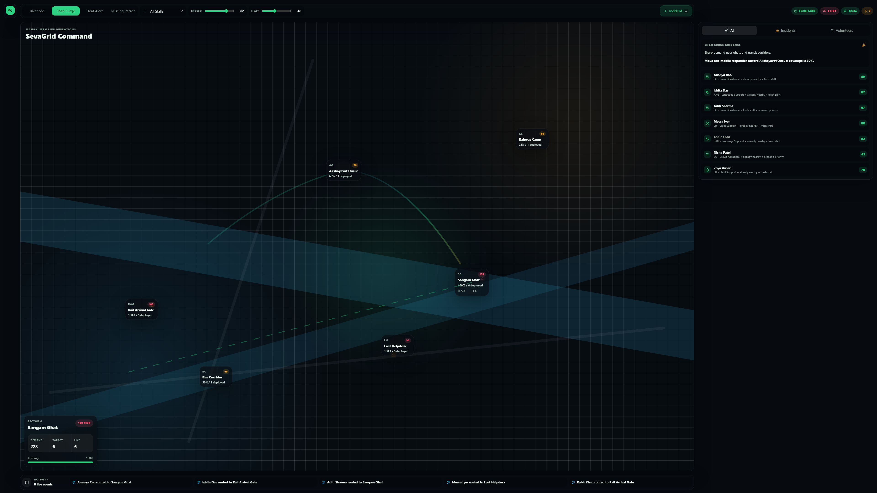
COMMAND EXPERIENCE
The interface avoids a dashboard and behaves like race-control software.
Map owns attention
65-70% viewport target on large screens.
Panels attach to work
AI, incident, and volunteer state explain map actions.
Minimal chrome
Collapsed rail and compact command bar preserve focus.
Operational motion
Subtle pulses and route lines show live deployment state.
SevaGrid Command | Smart Volunteer Deployment & Workforce Optimization
07

Slide 8
ARCHITECTURE + SECURITY
A inspectable static app with typed models and production security headers.
Live Command UI
src/app/page.tsx
Security checks documented
Typed Operations Data
src/data.ts
No backend secrets
Synthetic demo data
Deployment Optimizer
src/optimizer.ts
0 audit vulnerabilities
CSP + XFO + XCTO headers
Design Tokens
src/app/globals.css
HTTPS on Vercel
Next/Vercel Runtime
next.config.ts + HTTPS
SevaGrid Command | Smart Volunteer Deployment & Workforce Optimization
08

Slide 9
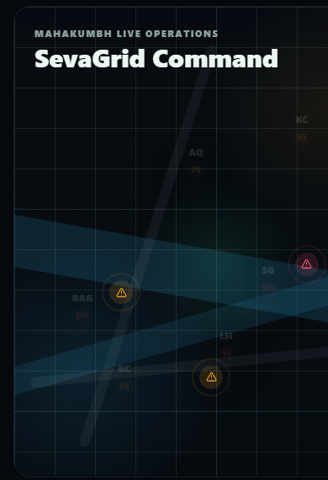
VALIDATION
The submission is deployed, checked, and honest about remaining test gaps.
PASS
PASS
0
ESLint
prod build
audit vulns
Mobile-first responsiveness verified visually with compact command controls and map continuity.
200
5
health check
sec headers
Current gap: automated unit, E2E, and axe accessibility tests are documented as future work rather than claimed prematurely.
SevaGrid Command | Smart Volunteer Deployment & Workforce Optimization
09

Slide 10
ROADMAP
From hackathon demo to operational deployment platform.
Now
Next
Pilot
Scale
Map-first command UI, deterministic optimizer, deployed demo, security headers.
Optimizer unit tests, Playwright E2E, axe accessibility automation, CSV volunteer import.
GIS routing, supervisor acknowledgements, WhatsApp/SMS dispatch, role-based auth.
Real-time check-ins, incident forecasting, privacy review, audit logs, historical analytics.
Live deployment: https://sevagrid-command.vercel.app
GitHub repository: https://github.com/AnuranjanJain/Round2-Experthire
SevaGrid Command | Smart Volunteer Deployment & Workforce Optimization
10

