Slide 1
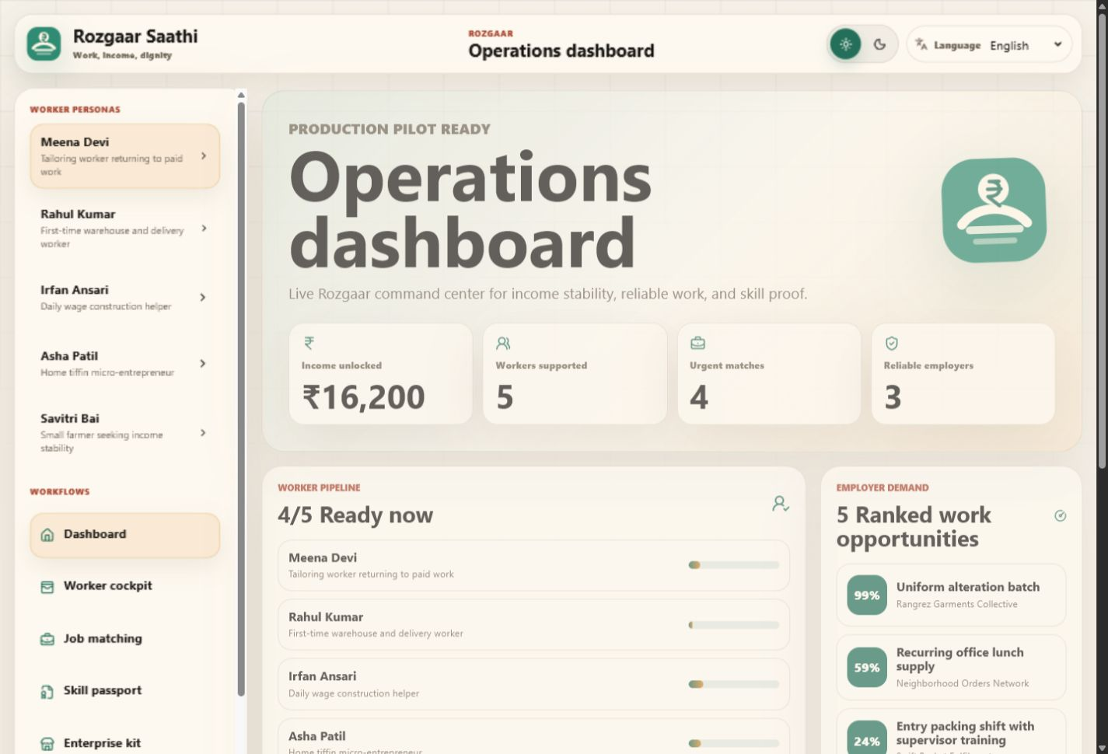
Rozgaar Saathi
ROZGAAR | income dignity
Income dignity ops for informal workers
A dashboard-first Rozgaar platform for planning earnings, matching trusted work, building Skill Passports, and stabilizing micro-enterprise and farm income.
Built for Good | SamaSocial
Theme: ROZGAAR
Rozgaar Saathi / 01

Slide 2
WHY
Skill is visible. Work access is not.
Informal workers face unclear pay, weak trust, missing proof, unsafe timings, and seasonal income gaps.
450M
5
8
The gap
informal workers in India (problem brief)
Rozgaar needs handled in one operating dashboard
regional UI languages for practical access
Workers may have tailoring, packing, dairy, or masonry skills but still lack proof, trust signals, and a stable weekly plan.
Unclear payment terms
No portable work record
Women’s timing and safety constraints
Farm and gig income volatility
Rozgaar Saathi / 02

Slide 3
WHO
Designed around the full ROZGAAR breadth, without mixing themes.
Each workflow is still about work, income, and economic dignity.
Daily wage workers
First-time workers
Women returning to work
Track weekly target, pending earnings, completed shifts, and next best paid work.
See entry jobs with training, matched skills, missing requirements, and trust signals.
Prefer nearby hours, women-friendly employers, childcare constraints, and clear payment.
Micro-entrepreneurs
Small farmers
Package local services, price ranges, repeat customers, and incoming requests.
Link harvest demand, buyer windows, and off-season income suggestions.
Rozgaar Saathi / 03

Slide 4
PRODUCT
The first screen is the operations dashboard, not a landing page.
A field team or NGO operator can immediately see where income is stuck and which workers need action today.
1,240
Rs 18.6L
workers supported
weekly income unlocked
830
214
Skill Passports
reliable employers
Operator questions answered
Who needs work? Which jobs are safe? What income gap remains?
Rozgaar Saathi / 04

Slide 5
WORKFLOWS
Five practical tools, one income dignity loop.
The product is not a job board alone. It connects planning, matching, proof, enterprise leads, and farm stability.
Income Planner
→
Job Matching
→
Skill Passport
→
Enterprise Kit
→
Farm Stability
Daily use
Trust loop
Start from the income target, then choose a shift, document task, passport share, service quote, or buyer window.
Every match explains skills, gaps, pay clarity, employer reliability, and segment fit so decisions are visible instead of black-box.
Rozgaar Saathi / 05

Slide 6
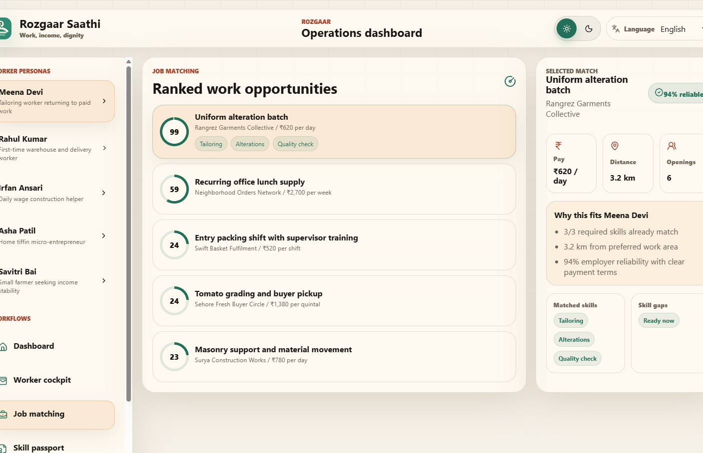
MATCHING
Explainable match scores turn opportunity into a safer decision.
Workers and operators can see why a job fits, what is missing, and whether the employer is reliable.
Inputs
Trust signals
Skills, verified skills, segment, distance preference, availability, documents, and women’s work mode.
Employer reliability, payment clarity, women-friendly indicator, and past hiring evidence.
Output
A ranked match with reasons, missing requirements, pay clarity, and recommended next action.
Rozgaar Saathi / 06

Slide 7
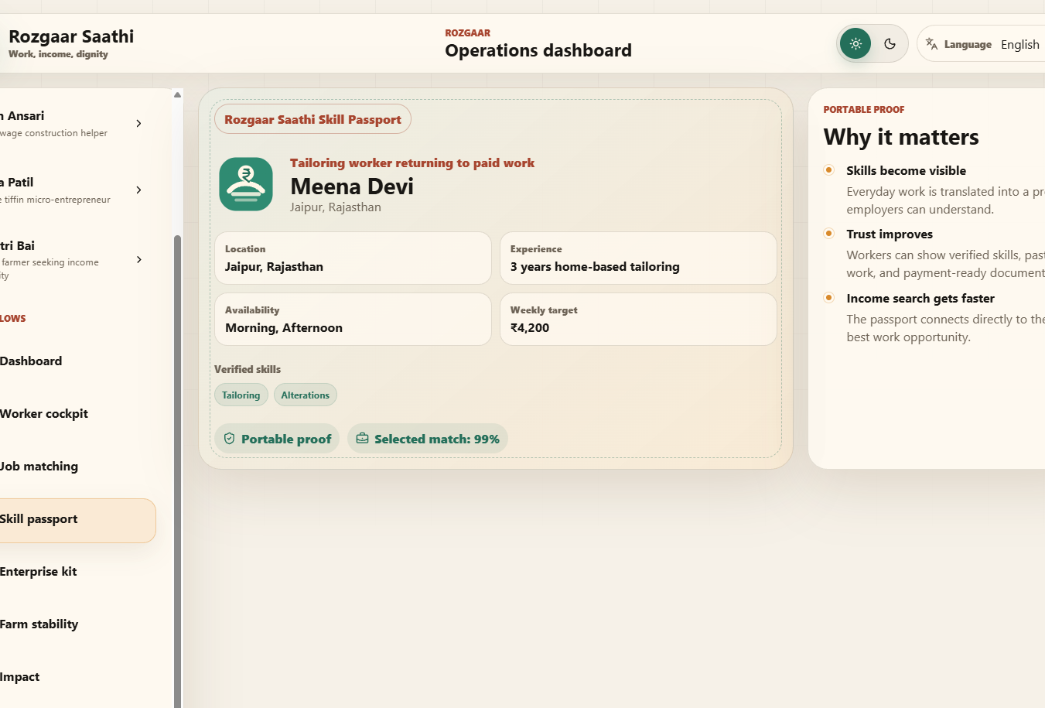
SKILL PASSPORT
A shareable proof-of-work card for people without formal resumes.
Verified skills, availability, documents, work history, and the best current match in one trusted view.
Verified skills and real work history
Weekly income target and availability
Document readiness checklist
Best current job match
Portable profile for employers or field staff
Rozgaar Saathi / 07

Slide 8
ENTERPRISE + FARM
Rozgaar also means stabilizing self-employment and seasonal income.
The app supports micro-entrepreneurs and small farmers as workers with demand, pricing, buyer windows, and off-season options.
Micro-enterprise support
Farmer income stability
Example income actions
Service card generation, price range, customer requests, repeat orders, and monthly earning goals for home-based services like tailoring and tiffin.
Buyer opportunities, price bands, harvest windows, and off-season work such as dairy care or seed sorting.
• Quote 12 uniform repairs
• Renew monthly tiffin order
• Lock tomato buyer pickup
• Take off-season dairy shift
Rozgaar Saathi / 08

Slide 9
ARCHITECTURE
A lightweight frontend pilot built to grow into a partner-ready platform.
Today it runs as a Vite static app with typed local data and deterministic logic. Tomorrow, each local module can attach to APIs without redesigning the UX.
Typed data
Product logic
React views
Static deploy
→
→
→
Workers, employers, jobs, services, farm opportunities
Income gaps, match scores, readiness, next action
Dashboard, cockpit, matching, passport, enterprise, farm, FAQ
Vercel-hosted production build; backend-ready later
Future backend path: Auth + database + job APIs + WhatsApp/SMS sharing + partner reporting. The current app already separates models, data, translations, brand, and views for that migration.
Rozgaar Saathi / 09

Slide 10
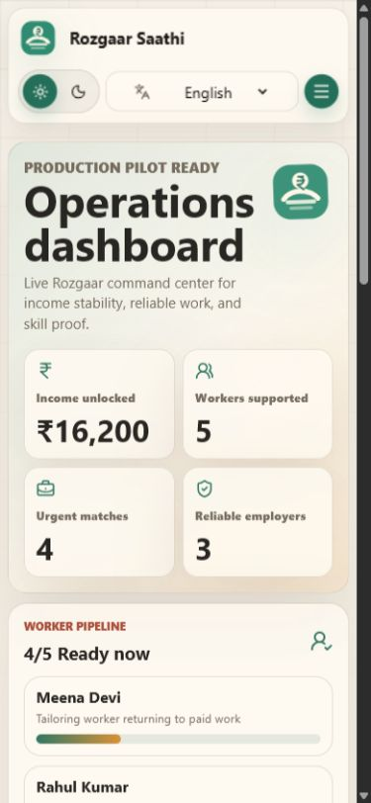
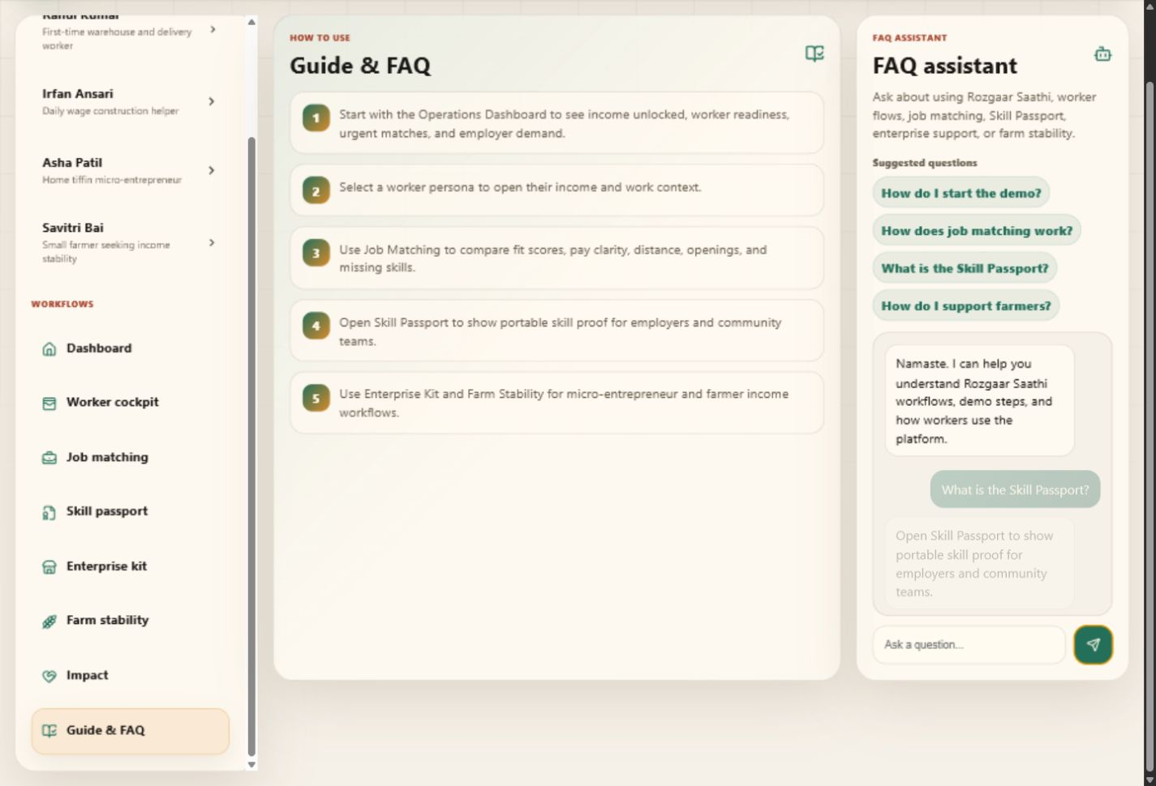
ACCESS
Trustworthy UX for low-friction field use.
Built for mobile, regional language, and FAQ-led field training.
8 languages
English, Hindi, Tamil, Telugu, Bengali, Marathi, Kannada, and Malayalam for interface labels and critical product copy.
FAQ chatbot
A privacy-safe local assistant answers how to use matching, passports, personas, themes, and workflows.
Designed for a field worker showing the product on a phone, not only a judge watching a desktop demo.
Rozgaar Saathi / 10

Slide 11
IMPACT
How Rozgaar Saathi helps: more paid work, less uncertainty, stronger worker dignity.
Impact is modeled around practical changes a field team can measure in the first pilot.
Worker-level
Employer-level
Partner-level
A weekly income target becomes visible; the next action becomes clear; missing documents and skills stop being hidden blockers.
Reliable employers receive better-fit workers, while poor payment clarity becomes visible before acceptance.
NGOs and community operators can track pipeline health, language coverage, urgent matches, and unlocked income.
Chart uses current product demo metrics; Rs 18.6L is shown as 1,860 units of Rs 1,000.
Rozgaar Saathi / 11

Slide 12
Rozgaar Saathi
ROZGAAR | income dignity
Ready for idea submission. Ready for pilot conversation.
Rozgaar Saathi is intentionally useful today as a guided product, and intentionally structured for tomorrow as a real deployment with live jobs, worker-owned passports, and partner reporting.
Submission
Next build
Title: Rozgaar Saathi
Theme: ROZGAAR
Demo: rozgaar-saathi-sigma.vercel.app
Repo: AnuranjanJain/samasocial_buildforgood
Backend profiles, WhatsApp Skill Passport sharing, field verification, live employer onboarding, and pilot analytics for NGOs.
Build for Good | भारत के लिए बनाओ। असल समस्याओं के लिए बनाओ।

