Slide 1

FORECASTING AIR QUALITY USING ENVIRONMENTAL DATA
Group 12:
Anu Reddy Chukkaluri -11715021
Akhila Madanapati - 11710780
Swarna Neella - 11650256
Satya Sree Bathina -11800935

Slide 2

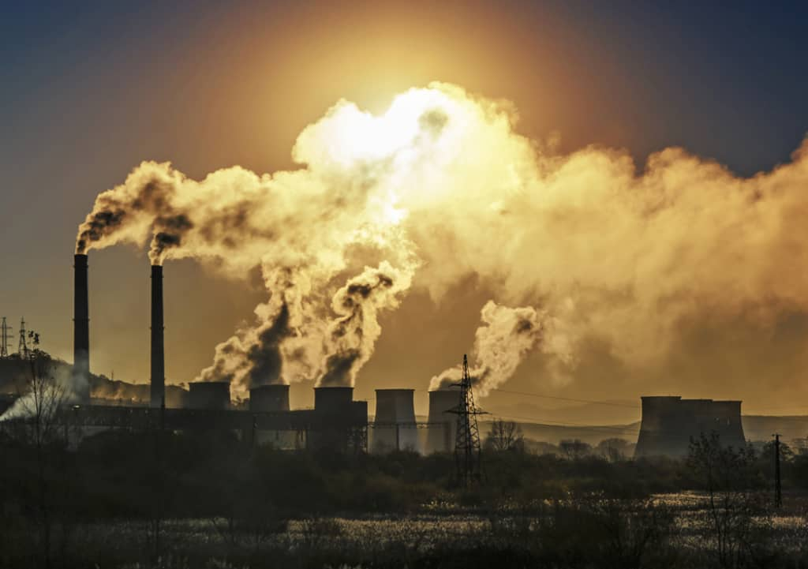
PROBLEM STATEMENT
With increasing urbanization and industrialization, air pollution has become a significant public health and environmental concern in urban areas. The primary goal of this project is to analyze historical environmental data, including pollutant levels like SO₂, NO₂, PM2.5, weather conditions, and traffic data, to develop a predictive model for air quality levels.

Slide 3

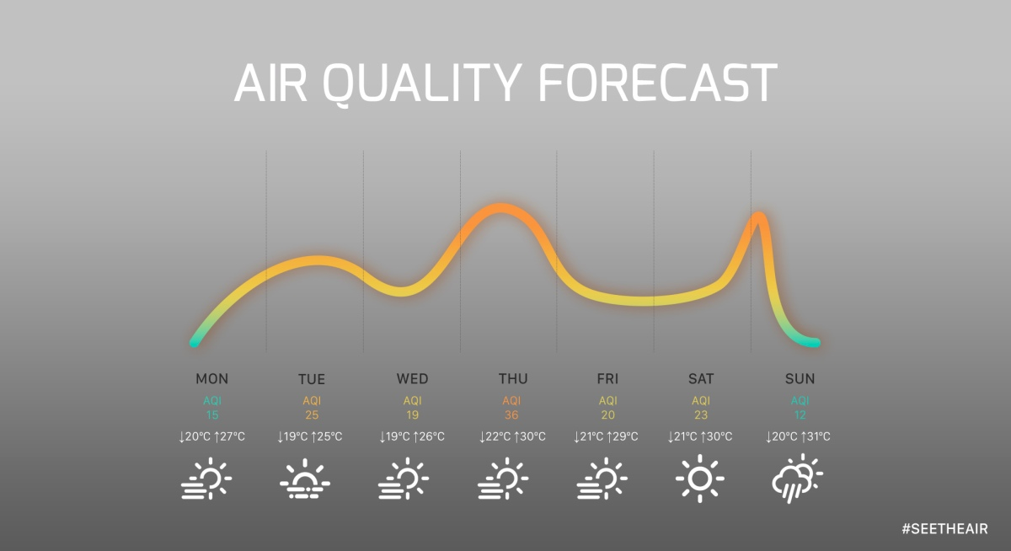
Objective
OBJECTIVE
The primary objective of this analysis is to develop a machine learning model to predict the Air Quality Index (AQI) based on various pollutants such as SO2, NO2, RSPM and PM2.5. The dataset contains pollution levels for different states and locations and the goal is to forecast the AQI using regression techniques. This includes handling missing data, feature engineering and applying a Random Forest Regressor model to predict AQI values. The key steps involve data preprocessing, exploratory data analysis, model training and evaluation using metrics like R-squared and Mean Squared Error.
Primary Objective: Build a predictive model for Air Quality Index (AQI) based on environmental data.

Slide 4
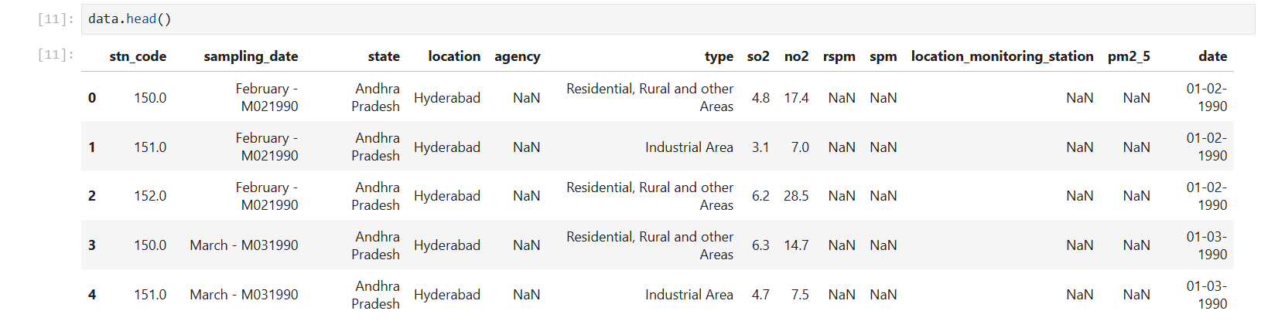
DATA SOURCE
Air Quality Prediction Dataset – from Kaggle
This dataset contains 435742 measurements gathered between February 1990 and December 2015

Slide 5
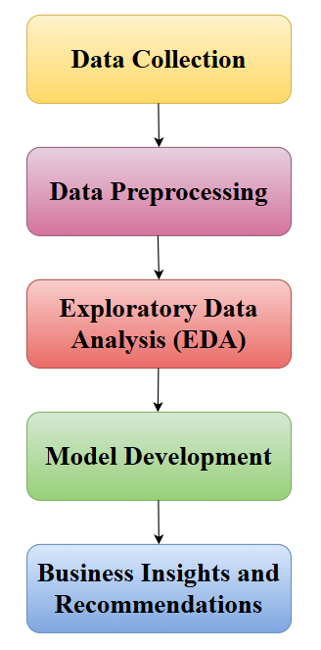
METHODOLOGY AND WORKFLOW
Data Collection – Dataset is derived from the Kaggle data source.
Preprocessing - Missing value handling, data cleaning, and transformation.
EDA - Insights and visualizations to understand the data.
Model Development - Steps to build and evaluate models.
Recommendations - Actionable steps based on results.

Slide 6
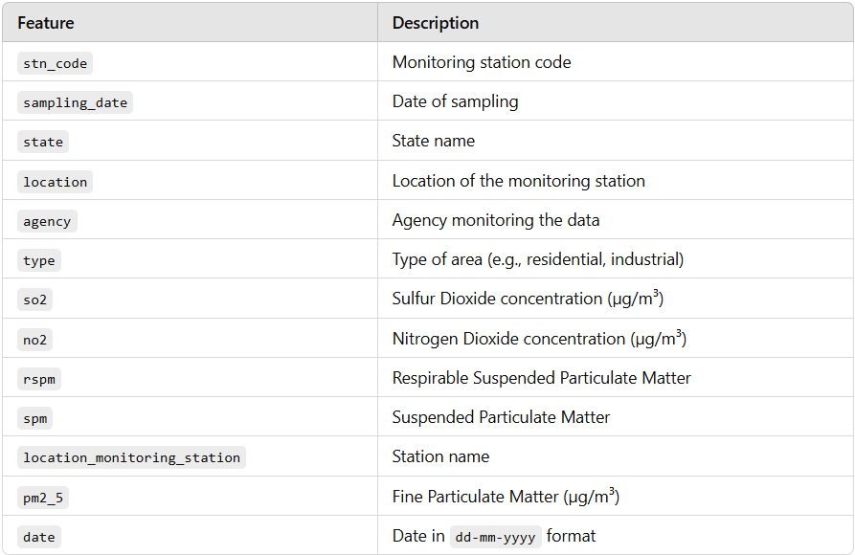
DATASET INFORMATION

Slide 7
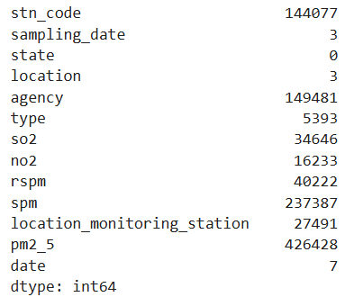
MISSING DATA HANDLING
Columns like pm2_5 - 426,428 missing), spm - 237,387 missing), and so2 - 34,646 missing have significant gaps, while other columns like state and sampling_date have minimal missing values.
Columns such as rspm and spm have large portions of missing data, indicating possible data collection gaps or inconsistencies.
Missing values have been identified and will be handled appropriately.

Slide 8
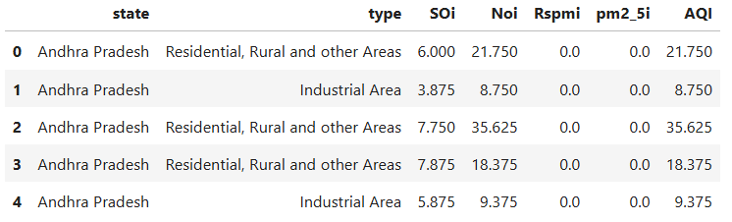
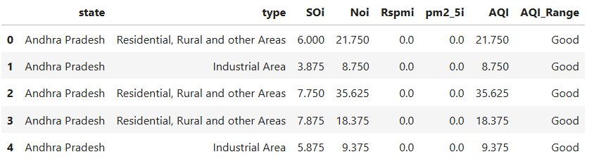
DATA PREPROCESSING AND TRANSFORMATION
Ensured that date columns like sampling_date and date were converted to datetime format for accurate time-series analysis.
Handling missing values - Significant missing values were identified in columns like pm2_5 and spm. Imputed missing numerical values with 0 to maintain data integrity.
Adding New Columns - Year: Extracted year from sampling_date for annual trends. Month: Added a column to distinguish monthly variations in pollutant levels.
Filtering and Cleaning - Removed rows with incomplete state or location data. Dropped unnecessary or redundant columns like agency.
Normalization - Scaled numerical columns (so2, no2, rspm, spm, pm2_5) to bring them to a common range for analysis.

Slide 9
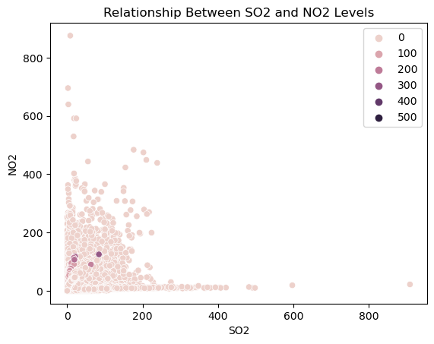
EXPLORATORY DATA ANALYSIS
The scatter plot shows the relationship between SO₂ (Sulfur Dioxide) and NO₂ (Nitrogen Dioxide) concentrations.
The data indicates a positive correlation where higher SO₂ values are often accompanied by increased NO₂ levels.
This trend suggests that these pollutants might share common sources, such as industrial emissions or vehicular pollution.

Slide 10
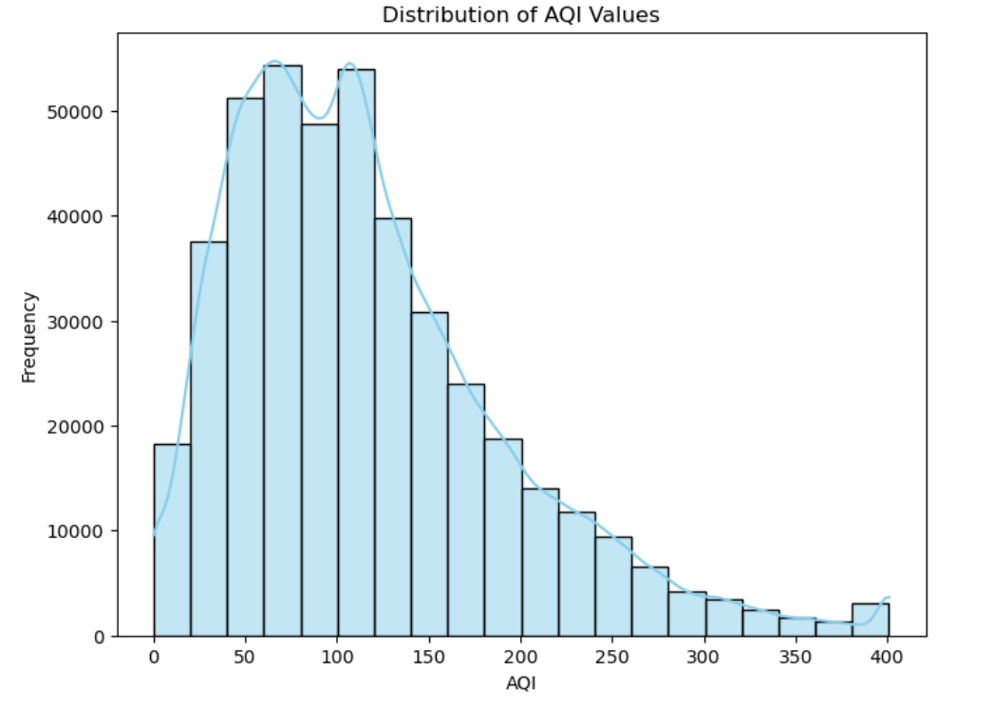
EXPLORATORY DATA ANALYSIS
This histogram with a KDE shows the distribution of a pollutant variable such as SO₂, NO₂ or PM2.5.
The data is highly right- skewed with most values concentrated at lower ranges.
This suggests that pollution levels are low most of the time with occasional spikes.
Long Tail- The presence of outliers extends the range, indicating rare events with high pollutant levels.
Density Peak -The KDE curve shows a sharp peak in the lower range, indicating that the majority of observations fall within this category.

Slide 11
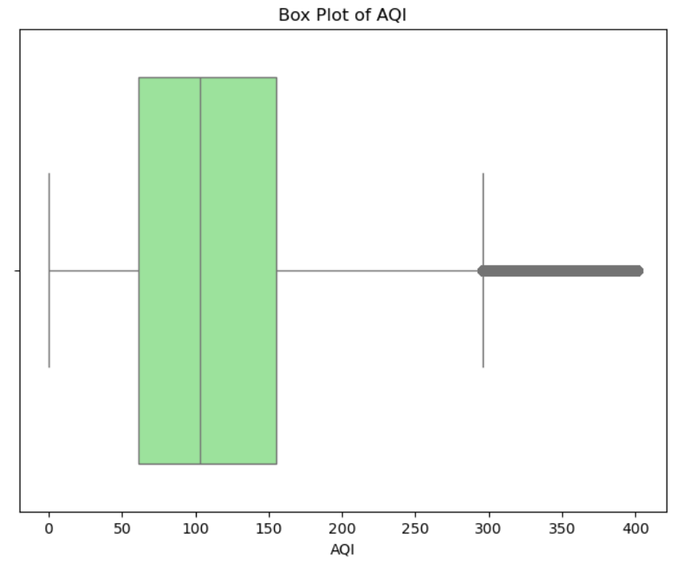
EXPLORATORY DATA ANALYSIS
Box plot analysis showing the distribution of pollutant levels such as PM2.5, SO₂ and NO₂ across different states or locations.
The box plots outline those points that are outside the usual range of pollutant levels, indicating places where very high levels of pollution have been recorded.
There are states with higher median pollutant levels indicating sustained levels of pollution over time.
Wider boxes indicate fluctuating air quality, probably seasonal or episodic events.
Outliers and variability can help identify pollution hotspots requiring immediate intervention.
Understanding these trends enables policymakers to prioritize regions for stricter pollution control measures.

Slide 12
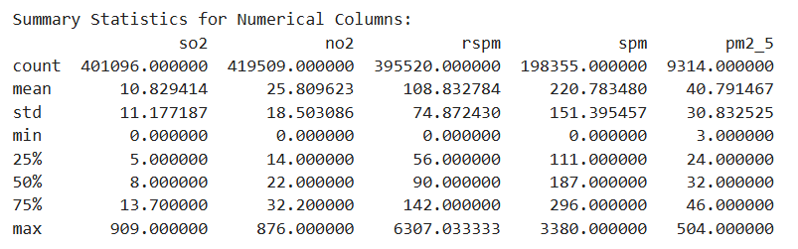
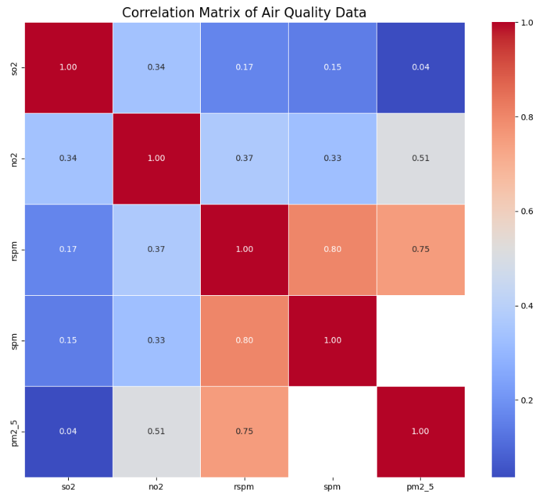
DATA EXPLORATION SUMMARY
Identified high missing values in pm2_5 and spm.
Statistical Summary- Mean, median, and range of pollutant levels (e.g., PM2.5, NO₂). Outliers detected using box plots.
This Correlation matrix shows high correlations between pollutants such as SO₂ and PM2.5.

Slide 13
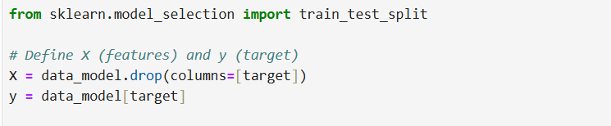
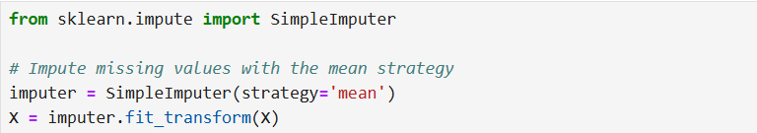
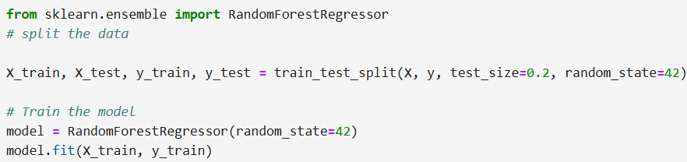
PREDICTIVE MODELLING
A Random Forest Regression model was applied to predict air quality levels (e.g., PM2.5 or NO2) based on input features such as weather conditions, traffic data and pollutant levels.
Root Mean Square Error (RMSE) measures the average magnitude of the error between predicted and actual values. The RMSE value of 0.527 indicates that the model’s predictions are close to the actual values signifying good performance.
The model successfully captures trends in pollutant levels.

Slide 14
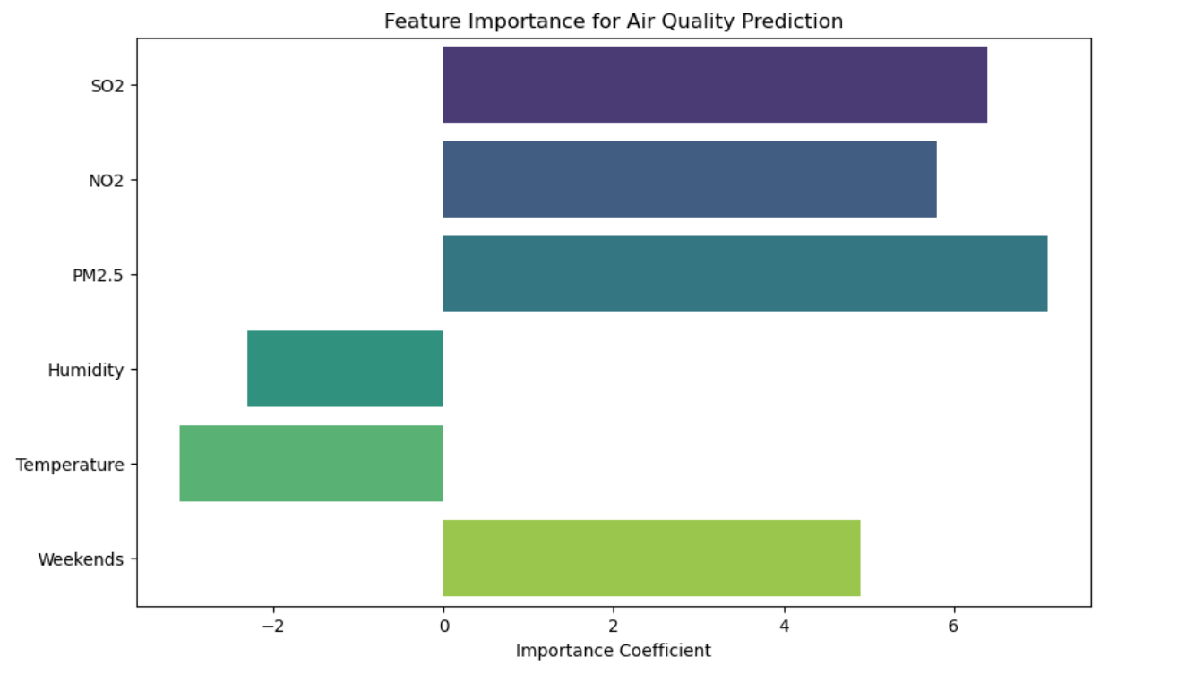
EVALUATION
SO₂, NO₂, and PM2.5 are identified as the strongest positive predictors of air quality index levels.
Weather conditions like temperature, humidity and natural light show a negative impact on pollutant levels, highlighting improved air quality during favorable conditions.
Lower pollutant levels due to reduced industrial and vehicular activity.
High pollutant concentrations are noted during morning and evening traffic hours.

Slide 15
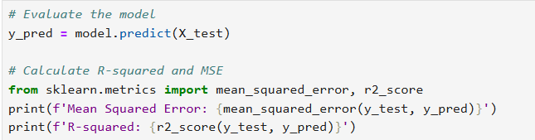

MODEL COMPARISON AND PERFORMANCE METRICS
Models Evaluated:
Linear Regression
Random Forest
Performance Metrics:
RMSE (Root Mean Square Error)
MAE (Mean Absolute Error)
Results:

Slide 16
BUSINESS INSIGHTS
SO₂, NO₂, RSPM, and PM2.5 differ across states due to reasons of varied regulations, industrial activity, and monitoring practices.
Categories like "Good", "Moderate", "Poor", and "Hazardous" will help stakeholders interpret the levels of pollution and issue appropriate health advisories.
High positive correlations, for example, between SO₂ and PM2.5, suggest that the control of one pollutant can have a cascading positive effect on others.
Models such as Random Forest predict AQI levels to allow for proactive planning and effective regulatory measures in pollution control.

Slide 17
RECOMMENDATIONS
Focus on key pollutants like PM2.5 through policies such as emission reductions, promotion of renewable energy, and enhancement of public transport.
Public Health Initiatives need to be implemented to support for vulnerable populations, especially in areas with "Unhealthy" or worse AQI ratings.
Monitoring Infrastructure impact investments in air quality monitoring systems, prioritizing pollution hotspots and under-monitored areas.
Use AQI data to run educational campaigns, helping communities take preventive measures during pollution spikes.
Emphasize market opportunities for startups in areas such as air purification systems, electric vehicles, and green energy solutions.

Slide 18
REFERENCE
Air quality prediction.(2022, March 31). Kaggle. https://www.kaggle.com/code/air-quality-prediction/input
AnalytixLabs. (2023, December 26). Random Forest Regression — How it Helps in Predictive Analytics? Medium. https://medium.com/@byanalytixlabs/random-forest-regression-how-it-helps-in-predictive-analytics-01c31897c1d4

Slide 19
Thank You!
- Together, we can build cleaner and healthier environments through data-driven decisions. Small Insights lead to Big impacts. Let’s breathe cleaner air!...

