Slide 1


Islamic Family Project

Slide 2

TEAM MEMBERS
KHUSHI
ANUREET KAUR
VANSHNOOR SINGH
KAWALDEEP KAUR

Slide 3

Problem Statement
Driving a predictive solution for the Islamic Community to improve food hamper distribution by forecasting demand to optimize inventory and resources, adapting plans for special events and peak times, and efficiently allocating resources to meet client needs effectively.​

Slide 4

Overview of the project
Key Goals:
Datasets used
Examine past data to schedule appointments.
Utilize data to improve operational efficiency and predictive modelling.
To better serve client needs, incorporate data specific to the community.
Food hamper Distribution dataset
Client Information Dataset
Islamic Calendar Dataset

Slide 5
Exploratory Data Analysis (EDA)
Converted data type for date columns.
Filled "sex" using "sex_new" for demographic accuracy.
Removed columns with high missing values.
Filled "age" using "birthdate" info.
Merged datasets with "unique_client" and "unique_id."
Power Bi
GOOGLE COLAB
​
Descriptive Stats: Mean, median, mode of age, pickups.
Missing Value %: Check missing data in each column.
Correlation: Analyze age vs. pickups.

Slide 6
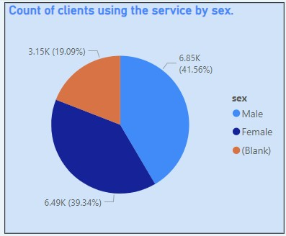
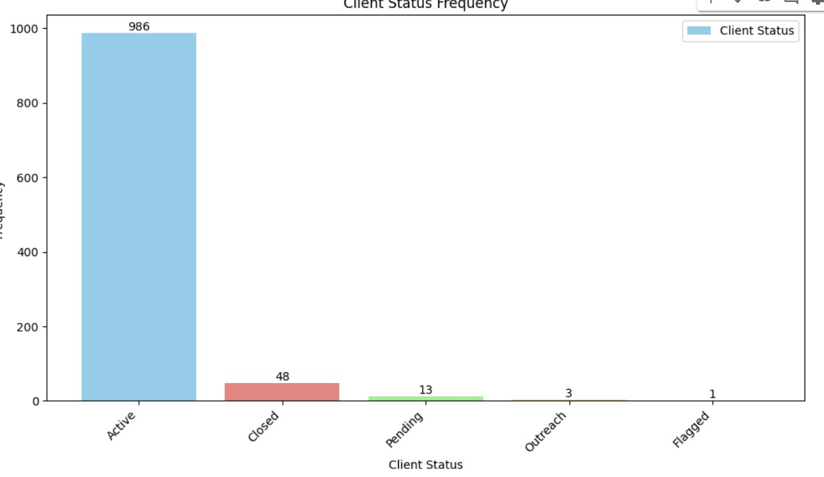
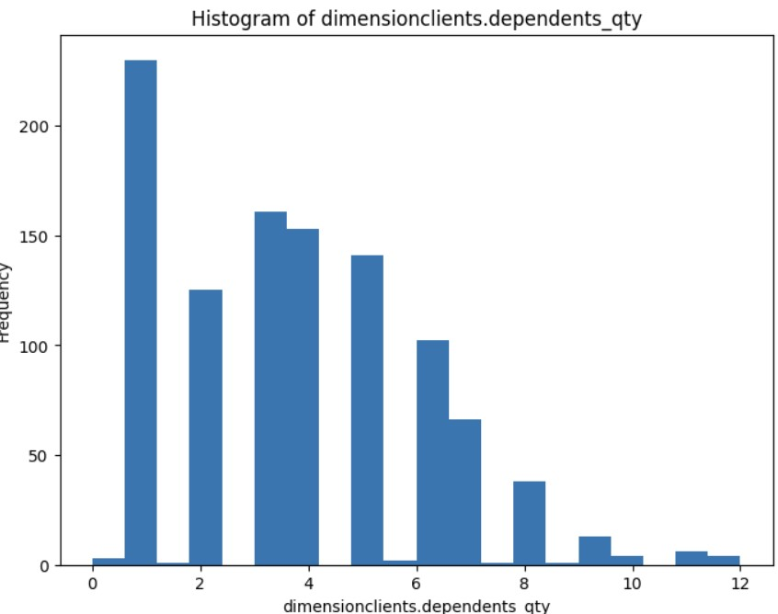
Key Insights
Unique Clients: 26 K
Active Clients: 986
Workers Count: 19
Sex Distribution: 41.56% Male, 39.34% Female
Average Dependents: 1 per client

Slide 7
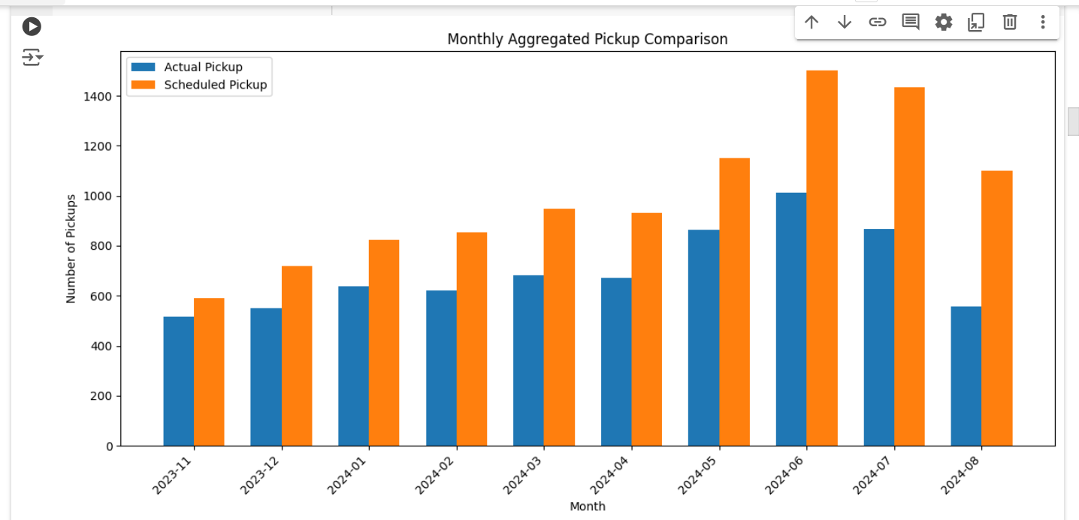
Hamper Distribution

Slide 8



LOOKER VISUALIZATION
https://lookerstudio.google.com/reporting/b91808fe-0100-4e7f-94d4-957c4fea0c20/page/AtrGE

Slide 9


Data Quality and cleaning
Data merging
MERGED 3 DATASETS​
MISSING VALUES
INTERPOLATE - NUMERICAL TO CATEGORICAL
OUTLIER DETECTION
IQR METHOD
DATA TRANSFORMATION
BOX – COX TRANSFORMATION

Slide 10
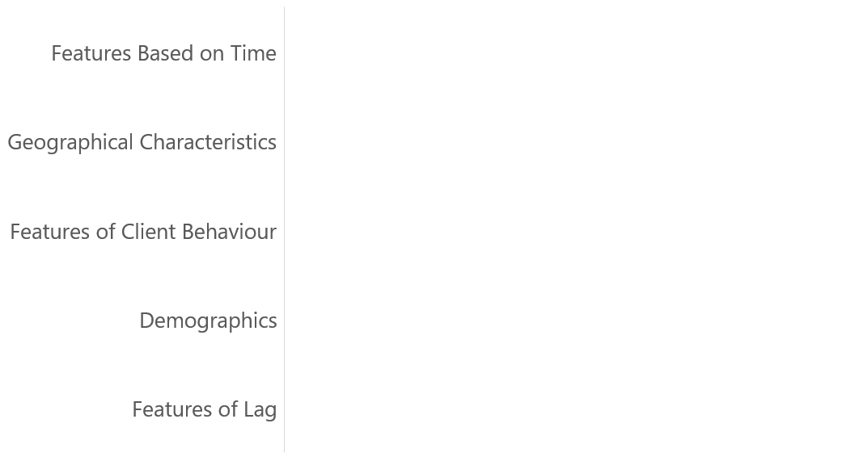
FEATURE ENGINEERING
Dates of Pickup: From "collect_scheduled_date" field.
Seasonal Indicators: Based on the Islamic calendar (e.g., Ramadan).
Uses address data to enhance targeting and delivery routes.
Derived from previous appointments to measure usage frequency.
Characteristics: Age, sex, and other
7-day and 14-day lags to track trends and seasonality.
​

Slide 11
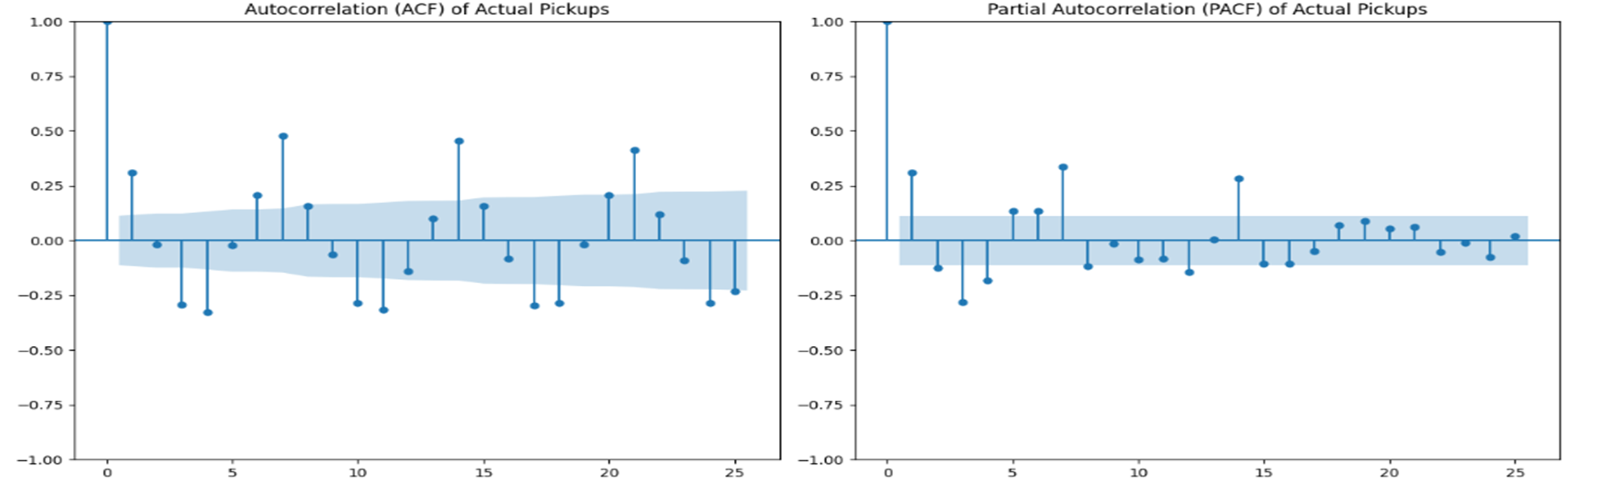
ACF & PACF METHODS
$3B
$2B
$1B
Opportunity to build​
Addressable market​
Freedom to invent​
Serviceable market​
Few competitors
Obtainable market​​

Slide 12
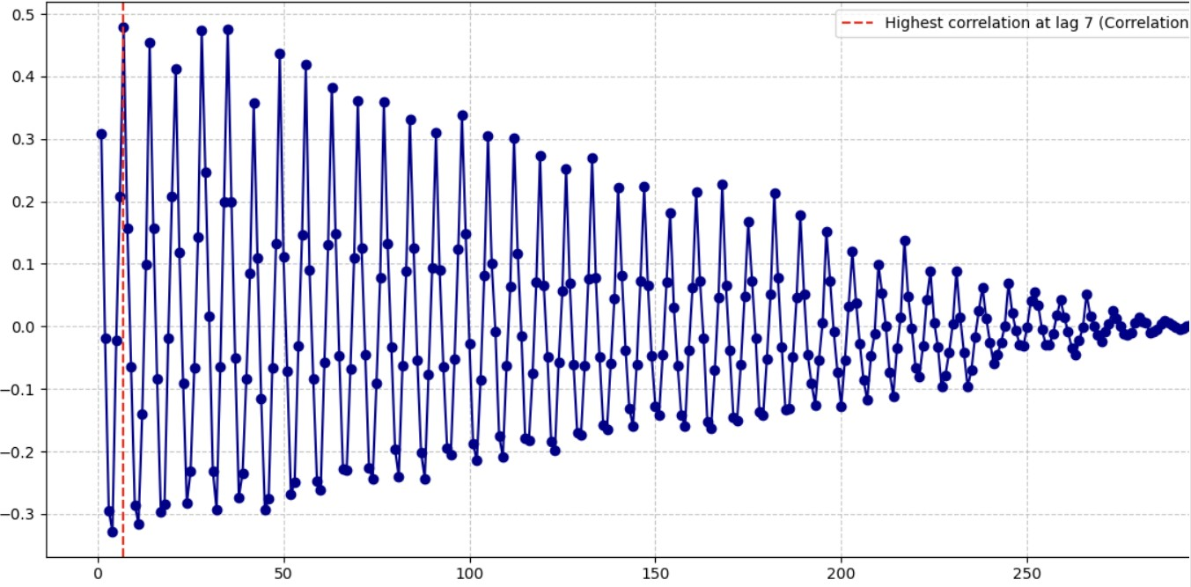
Transforming data
Non-stationary to Stationary.
Differencing.
p-value: 0.0002
if p value> 0.05
3. Box-cox transformation.

Slide 13
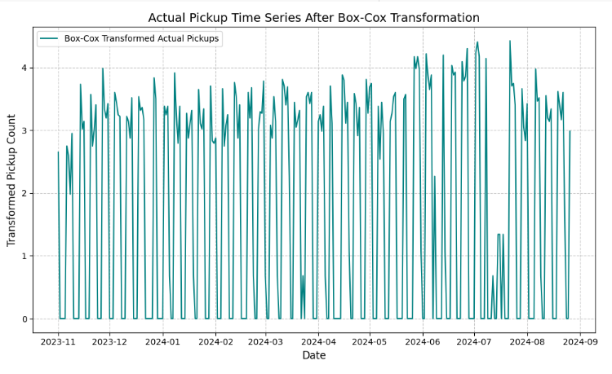
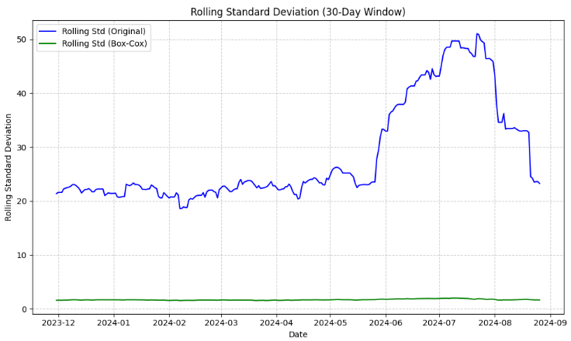
Results of box-cox transformation

Slide 14
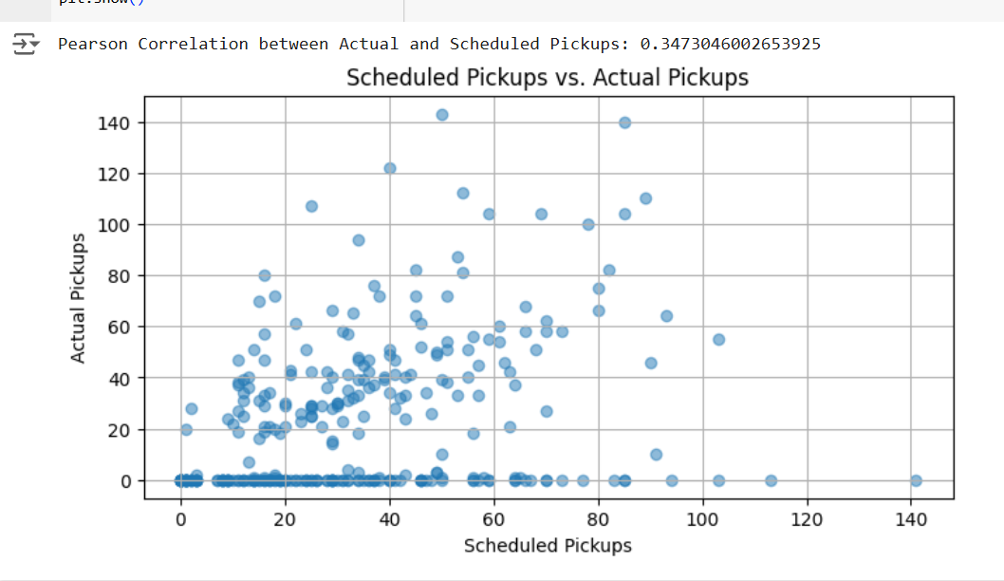
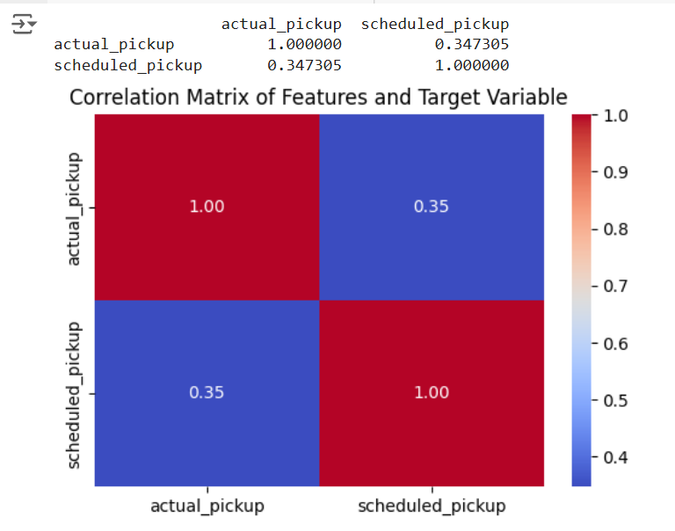
Correlation analysis & visualizations
Feb 20xx
Oct 20xx
Roll out product to hospitals in the region to help establish the product​
Gather feedback from the medical staff and the healthcare community to expand availability of the product​

Slide 15

Ml & Model development
The aim is to identify the model with high accuracy and minimal error.
MODELS USED
SARIMA MODEL
RANDOM FOREST
XGBoost REGRESSOR

Slide 16
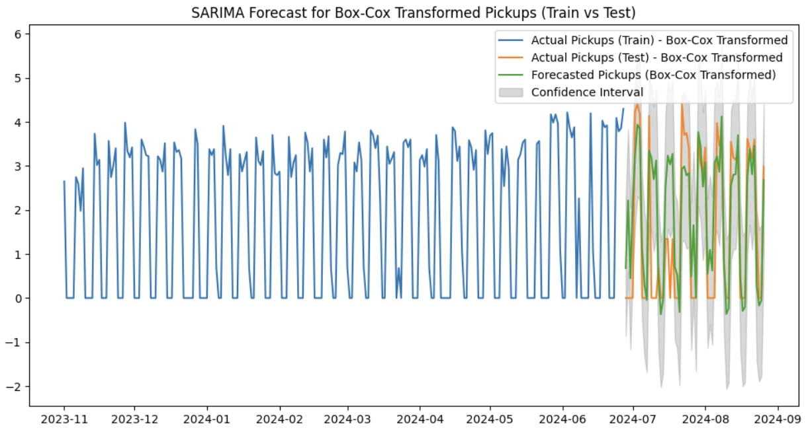
Traditional model- SARIMA MODEL
SARIMA (Seasonal AutoRegressive Integrated Moving Average) is a time-series forecasting model that captures seasonality, trend, and noise in data by combining autoregressive, differencing, and moving average components.
Model Setup
sarima_model_boxcox = sm.tsa.SARIMAX(
train_df['actual_pickup_boxcox'], # Target variable (Box-Cox transformed)
exog=exog_train, # Use external regressors (exogenous variables) like scheduled pickup data and its lags
order=(4, 1, 4), # Specifies the ARIMA parameters: (p=4, d=1, q=4)
seasonal_order=(1, 1, 1, 7)
Performance Metrics
R-squared (R²): 0.525

Slide 17

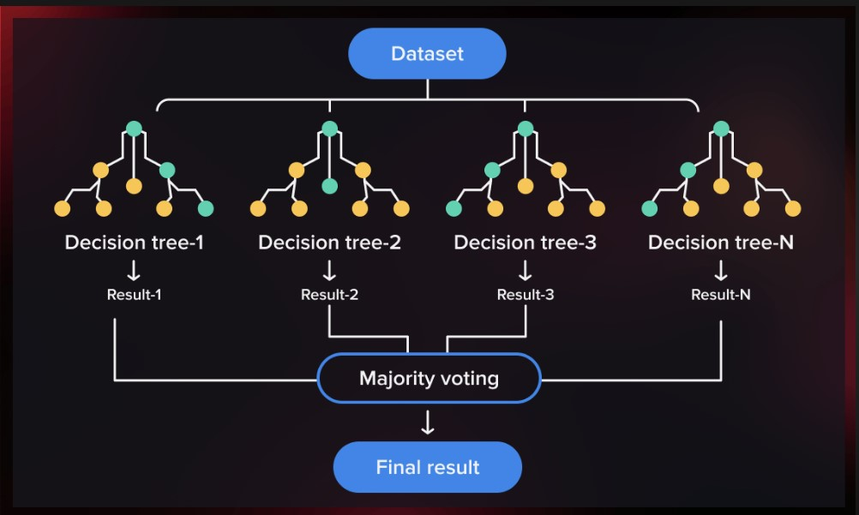
RANDOM FOREST
Random Forest is a model that uses multiple decision trees to make accurate and stable predictions. It’s good at handling complex data and avoids overfitting.

Slide 18
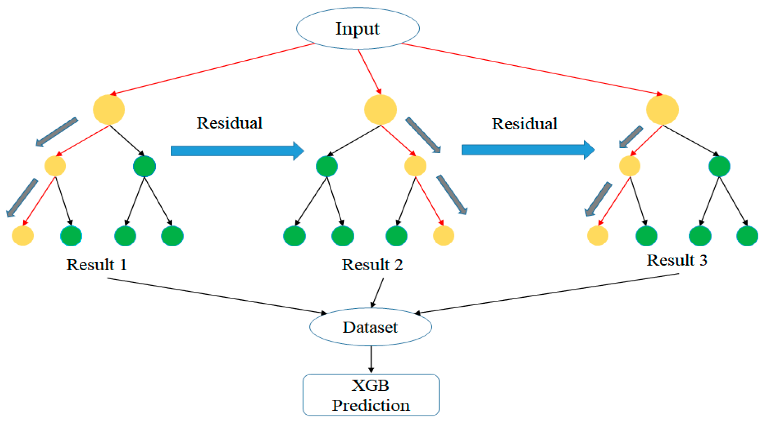

XGBOOST REGRESSOR
XGBoost is a fast and efficient model that builds trees one after another, each learning from the mistakes of the previous one. It’s great for large datasets and highly accurate.

Slide 19
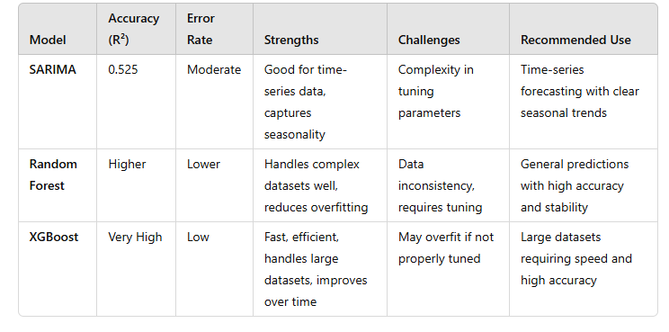
Evaluation Matrix
Because Random Forest is more accurate and has a lower error rate than SARIMA, it is the best model according to the evaluation matrix. It is appropriate for forecasting demand in the distribution of food hampers for the Islamic community since it manages the dataset's complexity well and is less likely to overfit.

Slide 20

CHALLENGES FACED
Model Deployment Challenges:
Faced difficulties due to inconsistent data
Required extensive feature tuning to optimize model performance
Feature Engineering Modifications:
Identified the need for additional improvements to enhance model accuracy and reliability.
Techniques for Overcoming Obstacles:
Engaged in group discussions to collaboratively resolve data issues
Incorporated feedback and suggestions from team members.
Sought guidance from instructors to address specific challenges
$14,000
$32,000
$82,000
$12,000
Insurance​
Angel investments​
Cash​
Shares​
Revenue obtained from medical insurance payments​
Amount obtained through other investors​
Liquid cash we have on hand​
Number of shares converted into USD​

Slide 21
NEXT STEPS
Short-Term Objectives: 1. Complete the deployment of the model and run tests to validate it in real-world scenarios. 2. Make a thorough presentation that highlights essential discoveries.
Long-Term Strategies: 1. Incorporate suggestions made during this demonstration into the final model improvements. 2. To improve the robustness of the model, investigate other features and data sources.

Slide 22

The project successfully used Random Forest and XGBoost to predict demand, with Random Forest emerging as the preferred model due to its higher accuracy and lower error. Key challenges included inconsistent data and the need for feature tuning, which were addressed through group discussions and instructor support. The importance of data consistency, practical feature engineering, and collaboration was highlighted, reinforcing these as essential steps for accurate and reliable model outcomes.

Slide 23

Thank you
Mirjam Nilsson​​
206-555-0146​
mirjam@contoso.com​
www.contoso.com​

