Slide 1



Ontario Rental Market Data Analysis Using Machine Learning MODELLING and deployment
Ontario
.

Slide 2

Problem Statement
"Developing an accurate housing price prediction model tailored for Canadian small communities through regression and classification techniques. The project focuses on implementing cross-validation and hyperparameter tuning to optimize model performance. The resulting application provides real-time price estimates and actionable insights, empowering community members to make informed decisions and address local housing needs effectively."
2

Slide 3
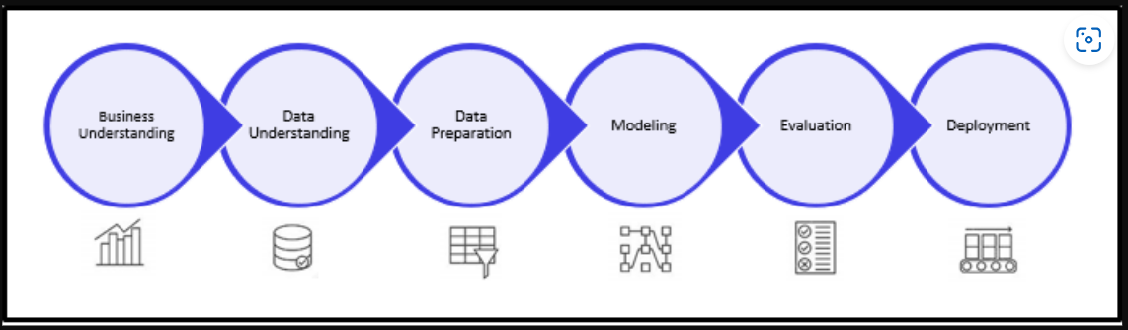

Steps Involved:
3

Slide 4
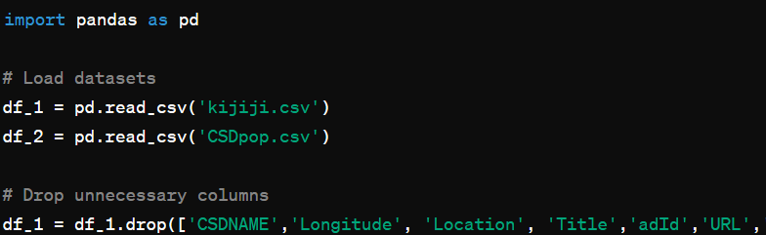
DATA preparation
In the process of preparing the dataset for accurate modeling in our project, we began by loading two crucial datasets: "kijiji.csv," which contains housing listings, and "CSDpop.csv," which provides population data. Subsequently, we filtered out unnecessary columns from the housing listings dataset and performed essential data type conversions to ensure compatibility with our analysis tools. This initial step sets the foundation for a streamlined and efficient data preparation process, laying the groundwork for subsequent modeling efforts.
4

Slide 5
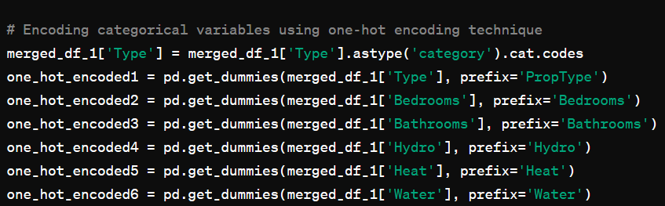
DATA preparation
20,585 samples (rows)
37 features (columns),
Handled missing values by replacing outliers and filling NaN values.
Formatted price data by removing special characters and converting to numeric format.
Merged datasets based on a common identifier and encoded categorical variables using a one-hot encoding technique.
Ensured the dataset was cleaned, formatted, and ready for machine learning model training.
5

Slide 6

ML MODELING
List of Models Used:
RandomForestRegressor
GradientBoostingRegressor
Linear Regression
DecisionTreeRegressor
KNeighborsRegressor.

Slide 7


Cross validation? Why we need this?
Ensures Model Generalization: Cross-validation helps ensure that the model performs well not just on the training data, but on new, unseen data as well, reducing the risk of overfitting.
Model Tuning: It allows for the tuning of hyperparameters to find the combination that yields the best model performance across different data splits.
Data Efficiency: Utilizes the data more efficiently by allowing each observation to be used for both training and validation.
Error Estimation: Provides a better estimate of the model's prediction error on an independent dataset.
Robust Model Assessment: By using multiple subsets of the data, cross-validation provides a more robust assessment of the model's performance compared to a single train-test split.

Slide 8
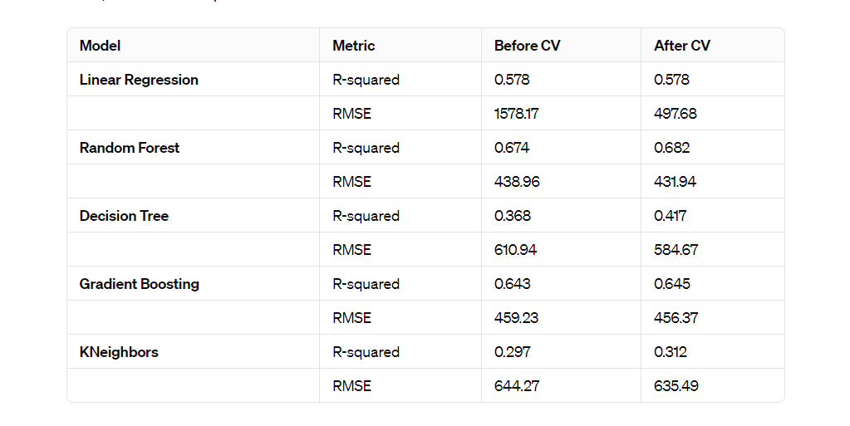
Model’s Report:
R-squared (Coefficient of Determination): This metric indicates the proportion of variance in the dependent variable that is predictable from the independent variables. Values range from 0 to 1, where higher values suggest a better fit of the model to the data. However, very high values may indicate overfitting.
Root Mean Square Error (RMSE): RMSE measures the average magnitude of the errors between predicted and observed values, providing a sense of model accuracy. It is expressed in the same units as the dependent variable. Lower RMSE values represent a more accurate model, making it crucial for models where prediction accuracy is the goal.
CV : Cross-Validation
8

Slide 9
Among the models evaluated in the analysis, the Random Forest model emerged as the most effective for predicting rental prices in the Ontario market
Random Forest model achieved the lowest RMSE and highest R-squared value post cross-validation.
It consistently provided accurate predictions and explained a significant portion of rental price variance.
The model offered valuable insights into feature importances, aiding in understanding key factors influencing rental prices.
Known for its robustness, it effectively handled complex data relationships.
Overall, the Random Forest model emerged as the top performer for predicting rental prices in the Ontario market.

Slide 10
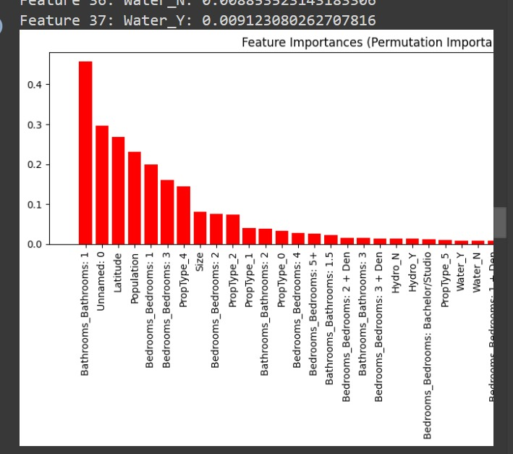
FEATURE ENGINEERING
The

Slide 11
Model Deployment
Model Deploy:
https://go.screenpal.com/watch/cZfqocVMVNZ
Random Forest stood out as the top model for both predicting rental prices and classifying rental properties, even after parameter tuning, underscore its effectiveness in predicting rental prices and classifying properties. Its performance highlights its suitability for practical applications in the Ontario rental market.
https://lookerstudio.google.com/reporting/9758bc61-0c8d-4759-8632-5facb0db2cf5
Dashboard view

Slide 12
What we learned?
Despite facing various obstacles, such as managing missing data and dealing with a limited dataset size, we successfully conducted machine learning analysis on the small community dataset.
This course has proven to be an invaluable resource, offering us essential insights that have deepened our understanding of machine learning principles.
Overcoming these challenges has not only been gratifying but has also strengthened our skills and knowledge in the field.
Looking ahead, we are eager to apply the lessons learned from this experience to future projects.
Our journey in machine learning continues, and we are committed to ongoing growth and exploration in this dynamic domain.

Slide 13
UPDATED TIMELINE
25–26 Jan. 2024
PREPARATION PHASE
28 Jan. – 3 Feb. 2024
EXPLORATORY ANALYSIS
6 Feb. – 15 Mar. 2024
FEATURE ENGINEERING
29 Mar. – 18 Apr. 2024
MODEL DEPLOY

Slide 14

Thank You
Khushi
Anureet Kaur
Kawaldeep Kaur

