Slide 1
Domain - Customer Analytics
Assessing Small Business Loan Health: A Data-Driven Approach
Group 2 – PGPDSE-FT Online Feb24
By - Group 2 Richu Mathew
Anuron Sharma
Shivam Mahendra
Dadi Prashanth
Kabir Kullar
Kalbe Hassan

Slide 2
Problem Definition
Problem Statement:
Banks face delays and high costs in processing loan applications, impacting efficiency.
Poor risk assessment leads to defaults and delayed business funding.
Objective:
Use past loan data to identify patterns and predict repayment likelihood.
Impact:
Inefficient loan processes.
Economic and job growth stagnation. Speed up approvals, reduce costs, and improve risk management

Slide 3
Problem Identification : Define challenges faced by banks.
Workflow
Objective Setting : Focus on repayment prediction.
Data Preparation : Clean, preprocess, and explore data.
Model Development : Train Logistic Regression, Random Forest, and Gradient Boosting.
Evaluation and Insights : Assess models, highlight key findings.

Slide 4
Data Overview
IMPORTANT FEATURES
State : Borrower state
BankState : Bank state
ApprovalFY : Fiscal year of commitment
ApprovalDate : Date SBA commitment issued
Term : Loan term in months
NoEmp : Number of business employees
NewExist : Number of Businesses, 1 = Existing business, 2 = New business
CreateJob : Number of jobs created
Retained Job : Number of jobs retained
UrbanRural : Locality, 1 Urban, 2 Rural, 0= undefined
RevLineCr : Revolving line of credit: Y = Yes, N = No
BalanceGross : Gross amount outstanding
ChgOffPrinGr : Charged-off amount
GrAppv : Gross amount of loan approved by bank
MIS_Status : Target column, Loan status charged off = CHGOFF, Paid in full =PIF
No. of Rows - 147916
No. of Columns - 27
Categorical Data - 16
Numerical Data - 11

Slide 5
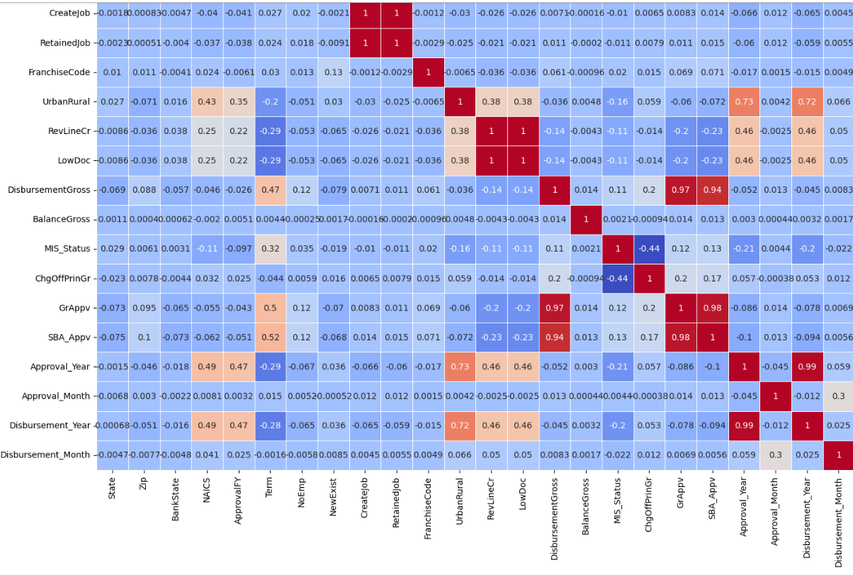
Exploratory Data Analysis (EDA)

Slide 6
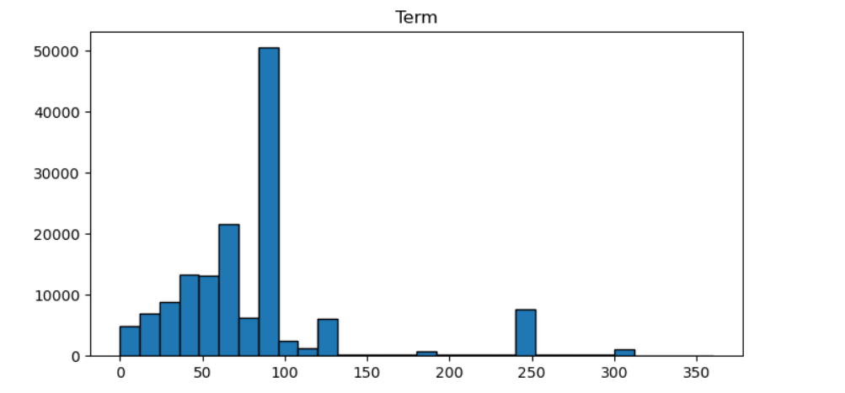
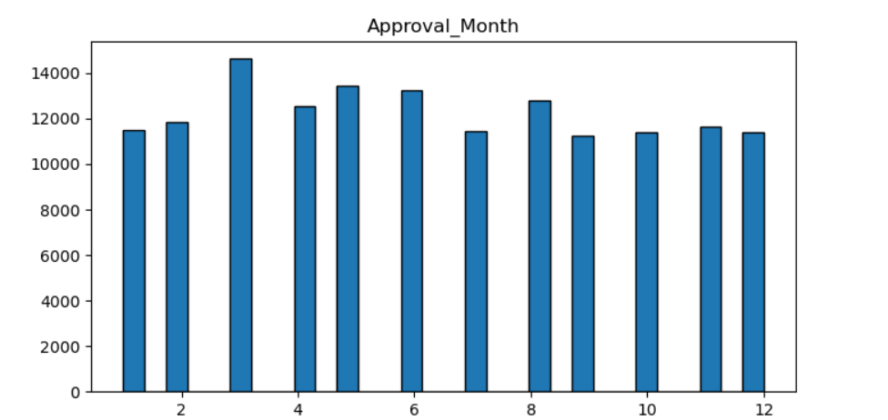
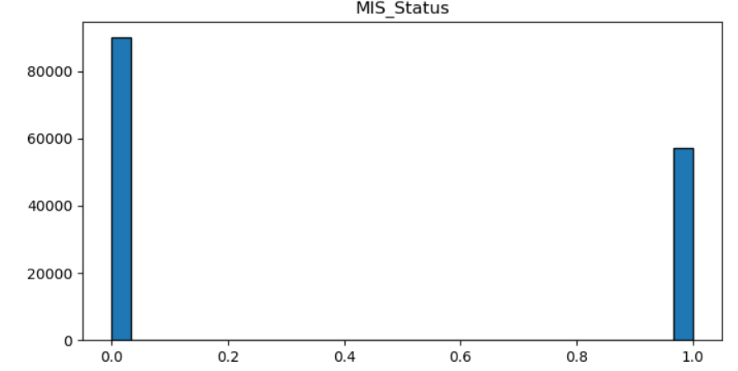
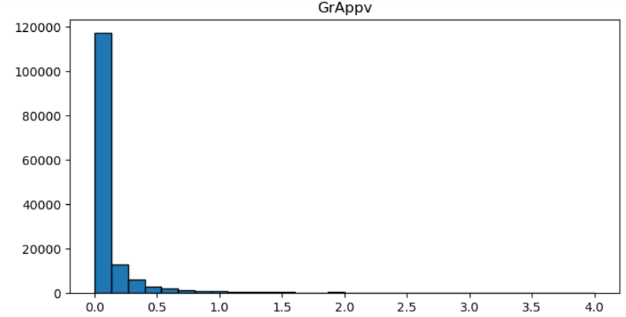

Slide 7
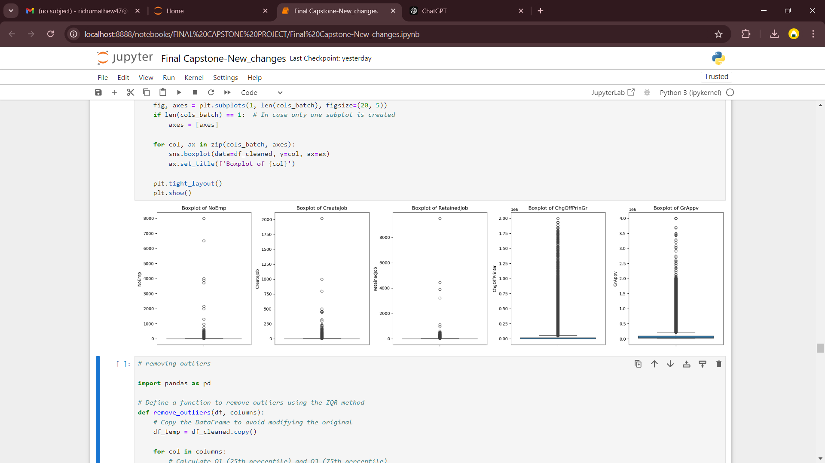
Outlier Detection

Slide 8
Data Preprocessing
Handling missing values : Missing values were minimal, so we chose to remove the rows.
Outlier Detection : We analyzed outliers using the IQR method but found that removing them would result in a loss of nearly 50% of the data. Since our models were tree-based models like Random Forest and XGBoost are inherently robust to outliers, we decided to retain them to preserve data diversity.
Encoding : Use We performed Target encoding on our columns with high cardinality using target column.
Scaling: We performed Standard scaling to achieve a mean of 0 and standard deviation of 1 for features.

Slide 9
Model Selection and Training [Supervised Learning (SL)]
Evaluation Metrics : Accuracy, Precision, Recall, F1- Score
Logistic Regression :
Accuracy : 97.81, Precision : 97.81, Recall : 97.81, F1-score : 97.81
Achieved an accuracy of 98%with an F1-score of 0.98 for both classes.
Random Forest :
Accuracy : 98.91, Precision : 98.94, Recall : 98.91, F1-score : 98.92
Improved accuracy to 99%, with F1-scores of 0.99 for Class 0 and 0.98 for Class 1.
XGBoost :
Accuracy : 98.85, Precision : 98.87, Recall : 98.85, F1-score : 98.85
Matched Random Forest with an accuracy of 99% and F1-scores of 0.99 for both classes.

Slide 10
Results and Overview - Supervised Learning (SL)
Logistic Regression:
While strong overall, it slightly underperformed compared to the tree-based models, especially in capturing nuanced patterns in the data.
Random Forest :
Demonstrated better balance between precision and recall, especially for identifying defaulters.
XGBoost :
Outperformed other models slightly in robustness and interpretability due to better handling of feature interactions and hyperparameter optimization.
Overall Observations:
Tree-based models outperformed Logistic Regression. This could be due to their ability to handle non-linear relationships and interactions.
XGBoost is our chosen model due to its scalability, efficiency, and superior performance in real-world deployment scenarios.

Slide 11
Modeling and Performance - Unsupervised Learning (USL)
K-Means Clustering:
Why Choose K-Means:
Simplicity: Easy to implement and computationally efficient for large datasets.
Interpretability: Clear, well-defined clusters with centroids representing the cluster centres.
Scalability: Performs well with a reasonable number of clusters and features.
Cluster 1: Businesses with Higher Approved Loans:
Created more jobs. Had a higher number of employees. Enjoyed a longer loan term duration. Exhibited greater urban-rural exposure. Had fewer revolving lines of credit.
Cluster 2: Businesses Differentiated by Revolving Credit Lines:
Businesses in this cluster were primarily defined by the number of revolving lines of credit they had.
Cluster 3: Businesses with Distinct Urban-Rural Exposure:
Highlighted by specific patterns in urban-rural exposure, making this cluster unique.
Key Observation:
The clustering distinctly grouped businesses based on job creation, loan characteristics, and exposure metrics, indicating three unique business profiles in the dataset.

Slide 12
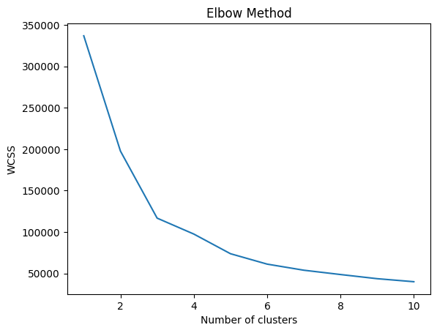
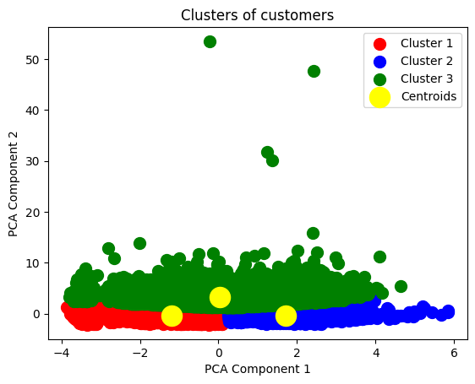
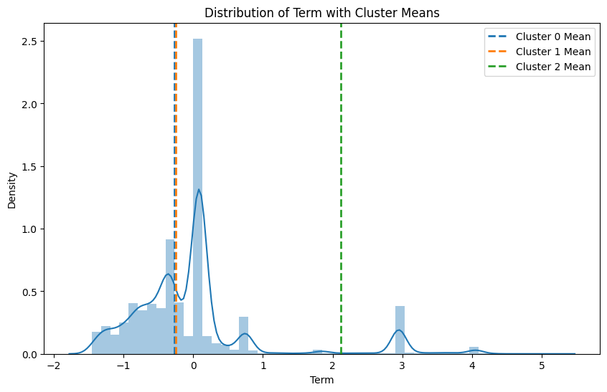
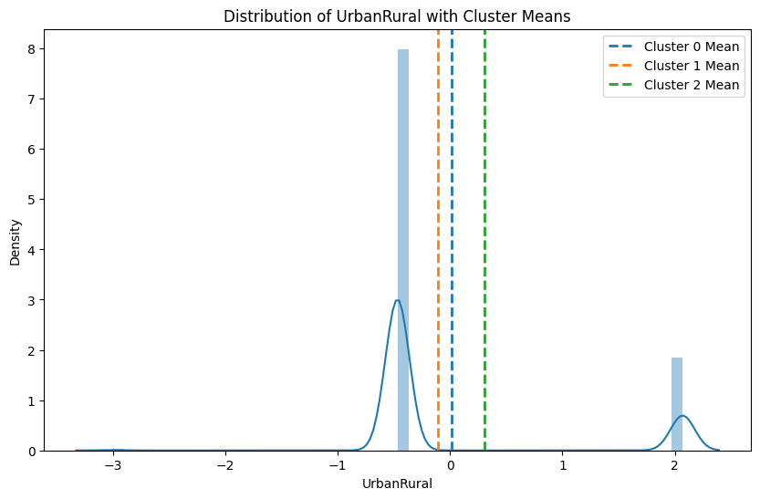

Slide 13
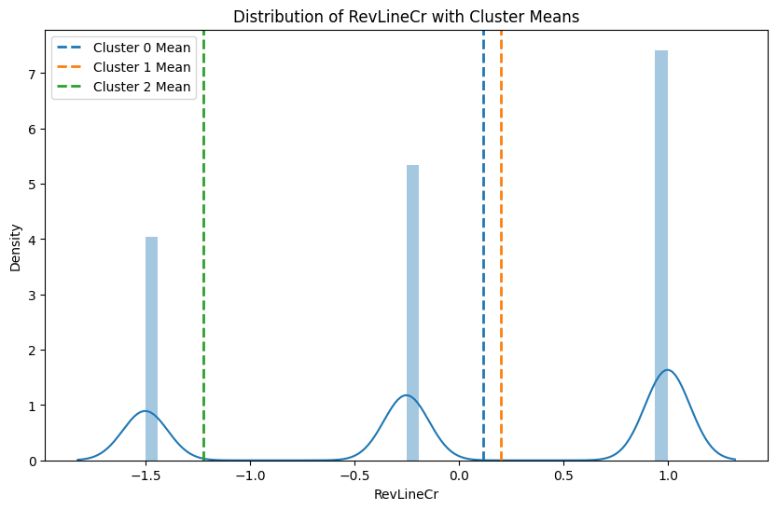
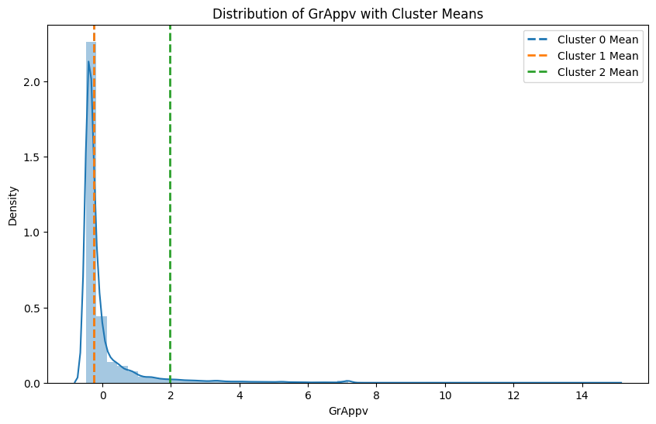
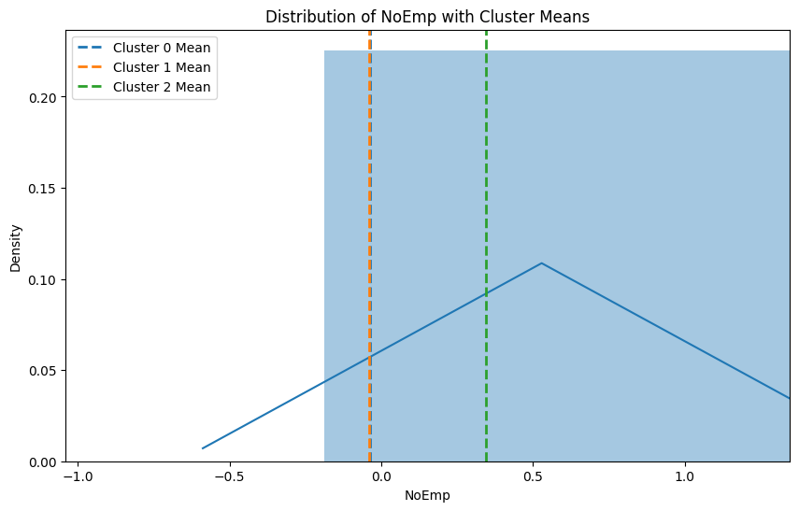
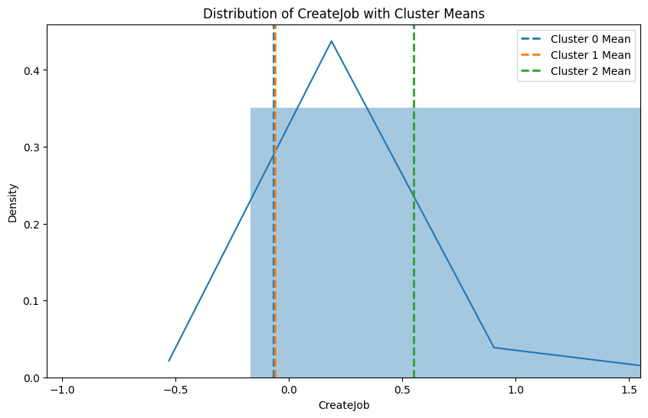

Slide 14
Challenges and Limitations
Class imbalance and outliers can impact model performance on new data.
Clustering assumptions like linear separability might not apply to complex data.
Limited features may limit insights. Adding external data could improve the model.
High training accuracy may indicate overfitting, affecting generalization in real world scenarios. This was addressed using XGBoost model.

Slide 15
Closing Reflections
Combining predictive and unsupervised learning techniques provides deeper insights.
Feature engineering and data visualization are crucial for creating effective solutions.
Clustering offers an important exploratory aspect to predictive modeling.
Prioritizing exploratory data analysis helps reveal hidden patterns.
Future Scope
Explore advanced clustering techniques such as DBSCAN for more detailed segmentation.
Use temporal analysis to identify evolving trends in loan approvals.

Slide 16
Conclusion
In conclusion, our loan default prediction model is an effective tool for identifying Small Businesses at high risk of defaulting on loans. By analyzing factors such as employee count, number of existing businesses, presence of revolving lines of credit, retained jobs, loan amount, and more, the model helps banks make more informed decisions and reduces the risk of defaults.
This approach not only lowers financial risks for banks but also facilitates a more personalized, data-driven lending process, which could be automated in the future with the right pipelines.
Looking ahead, refining the features or exploring advanced techniques can further improve the model’s accuracy and scalability, ultimately benefiting both lenders and borrowers by enabling faster and more efficient lending practices.

Slide 17
Thankyou!

