Slide 1
RentalHouse
Premium House Rental MERN Platform Summer Internship Project Presentation
Student: Anurudh Gujja (24EG105B65) Mentor: Dr R Jyothikumar Anurag University

Slide 2
Introduction
• RentalHouse is a verified peer-to-peer property renting portal built on the MERN Stack.
• Digitizes the leasing lifecycle, removing middleman agents and high brokerage fees.
• Integrates interactive coordinates maps (Leaflet) and comparison matrices client-side.

Slide 3
Problem Statement
• Fake & Duplicate Listings: Unverified posting entries scam tenants out of advance deposit bookings.
• Steep Broker Commissions: offline real estate brokers block direct access and inflate costs.
• Manual Comparison: Renter leads cannot evaluate features of multiple properties side-by-side.
• Unintuitive Directories: Lack of visual coordinates-based properties discovery on maps.

Slide 4
Project Objectives
1. Direct Verification: Implement admin listing auditing to keep entries hidden until validated.
2. Widescreen Compare matrix: Enable tenants to compare up to 3 listings side-by-side.
3. Leaflet Geolocations: Render listing markers on OpenStreetMap grids in real-time.
4. Direct Messaging: Establish visitor inquiries logging in owner dashboard boxes.
5. Decoupled Architecture: Setup high-speed React front-end communicating with stateless REST APIs.

Slide 5
System Architecture
• Decoupled MVC Architecture:
- UI Layer: React SPA client on port 3000.
- Controller Layer: Express backend server on port 5000.
- Data Layer: MongoDB Atlas Cloud database.
• Fallback Image Streamer:
- Uses Local uploads/ file folder fallback if Cloudinary API variables are empty in env.
• Email SMTP Fallback:
- Logs mailers output to terminal if SMTP server variables are blank.

Slide 6
Technology Stack
• Frontend Core: React 18, Vite compiler
• Styling & Grid UI: Vanilla CSS, Bootstrap 5
• Map Widget Engine: Leaflet, React-Leaflet
• Analytics Viz: Recharts (Data Visualizations)
• Backend Logic: Node.js, Express.js REST API
• Security Hashing: Bcrypt.js (Password protection)
• DB Layer: MongoDB Atlas & Mongoose ODM
• File Parsing: Multer (Multiform file upload)

Slide 7
Key Functional Modules
• Authentication Gatekeeper: Secure onboarding. Signs secure JWT token for Tenant/Owner/Admin role access.
• Property Explorer Catalog: Fast city/rent/amenity query listings filter with local comparison matrices.
• Landlord Dashboard: Owner listing upload editor + direct booking visit inquiries table inbox.
• Admin Control Panel: Moderates pending listings (Approving/Deleting) and user accounts block toggles.

Slide 8
Data Flow Diagram (Level 1)
• Context Level Data Flows:
- Tenant inputs Search query, receives listings JSON.
- Tenant submits Booking Inquiry message, stored in D4 DB.
- Owner posts Listing properties details, writes to D2 Property DB.
- Admin sends Moderation triggers (delete listings, block users).
• Process Nodes:
- 1.0 JWT User Authentication
- 2.0 Catalog Filtering & search
- 3.0 Booking / Inquiry routing
- 4.0 listings Administration moderation

Slide 9
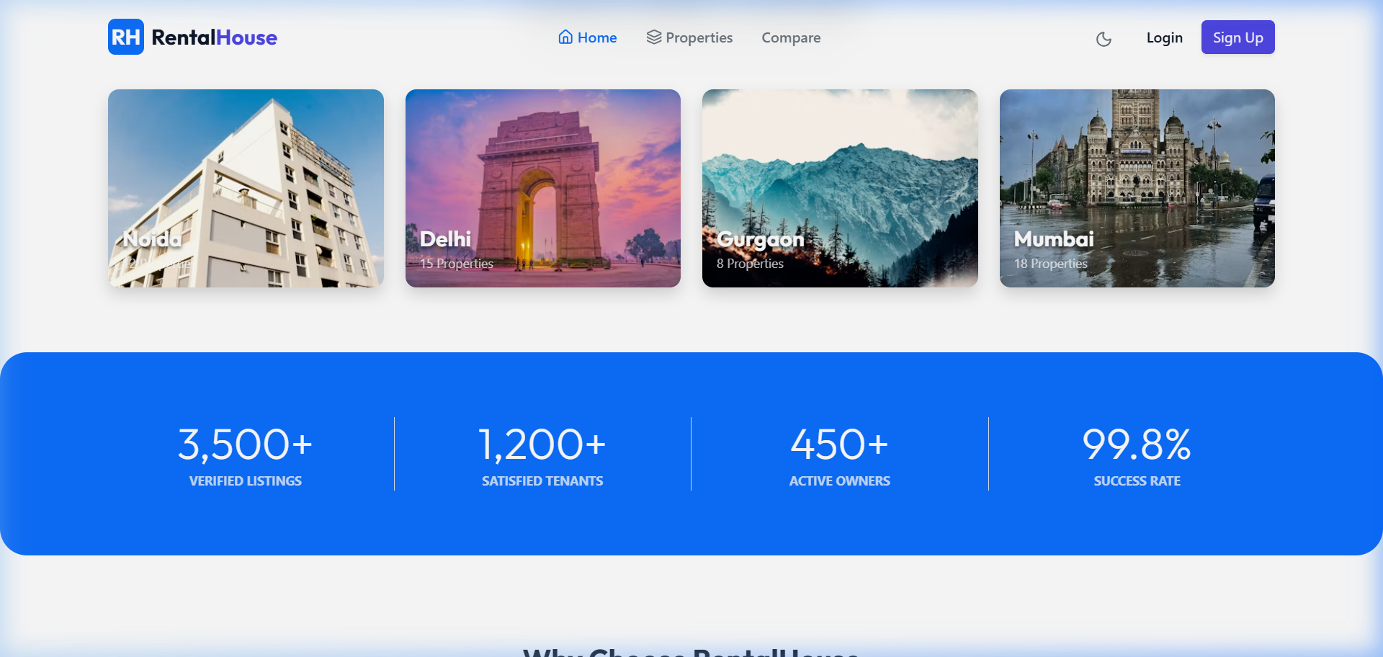
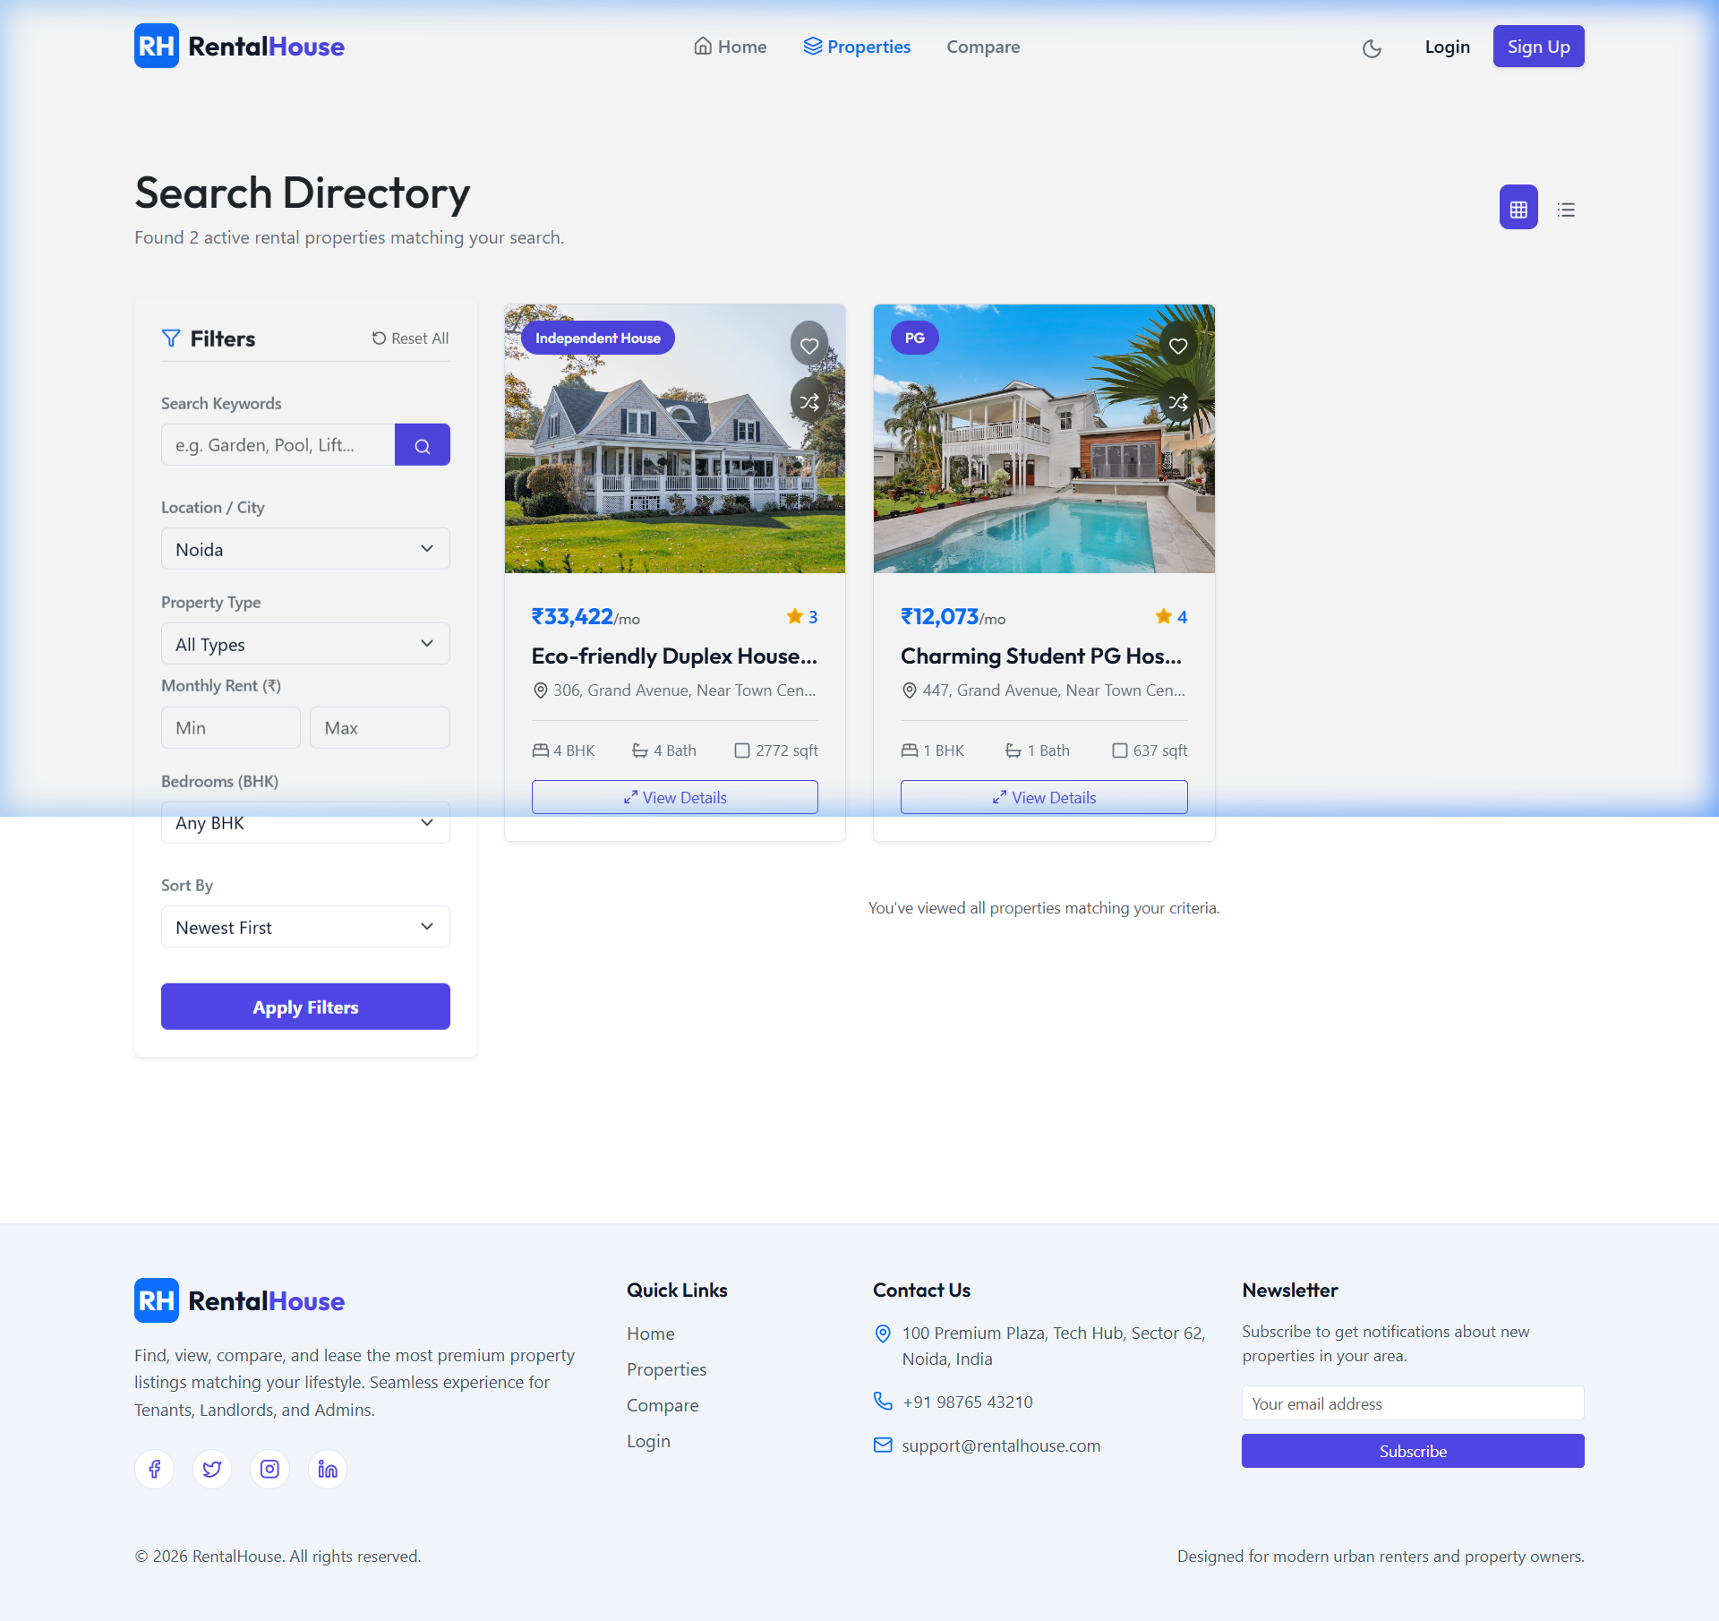
User Interface (Homepage & Search)
Homepage City Filter (Noida fixed image) & Properties Directory Search:

Slide 10
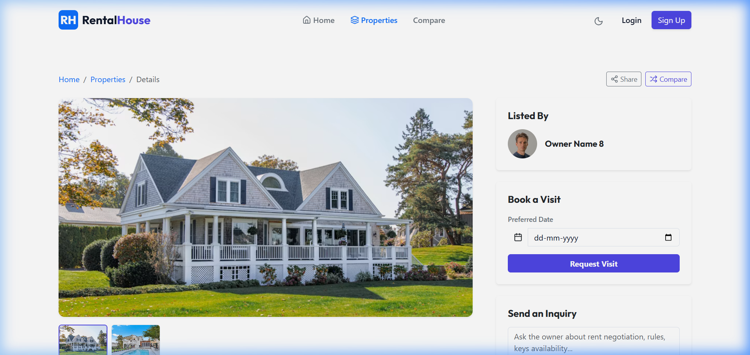
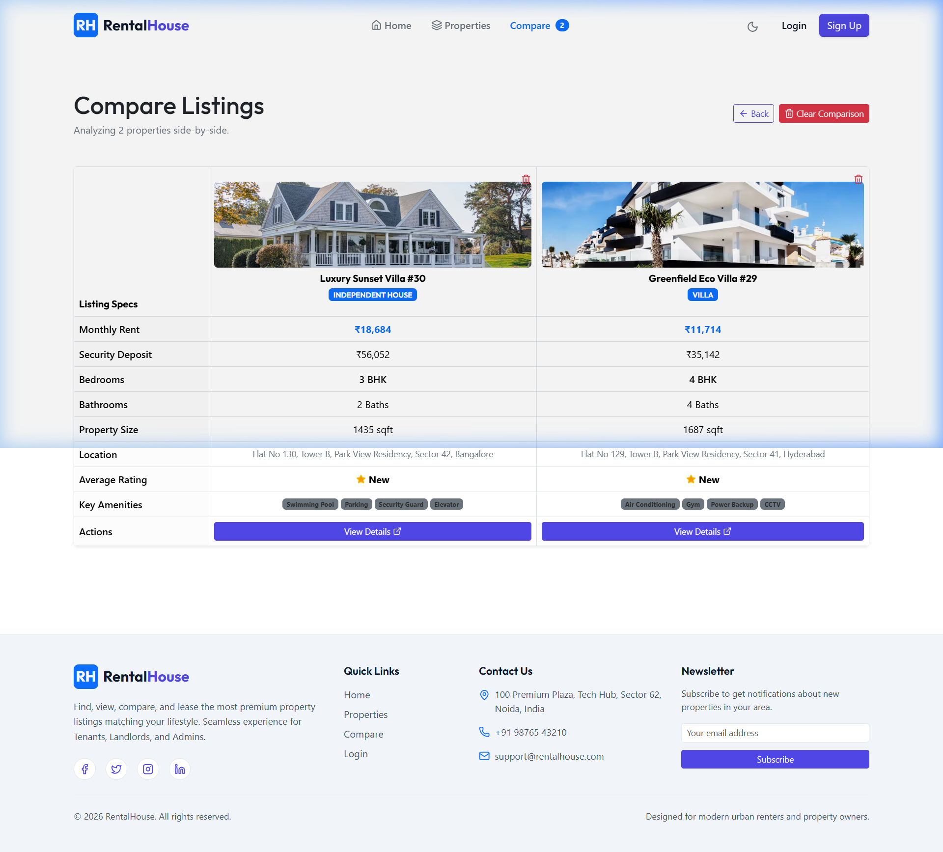
User Interface (Details & Compare)
Interactive OSM Map Details View & Widescreen Property Compare matrix:

Slide 11
Quality Assurance & Testing
• Functional UAT: Validated credentials login flow and dashboard guard redirects.
• API Testing: postman endpoint evaluations on routes (GET /properties, POST /inquiries) returning correct status codes.
• Integrations Validation: Verified database average ratings triggers calculations upon review inserts.
• Local Fallbacks Checked: Verified property creation and uploads directory uploads stream without Cloudinary API configurations.
• Performance checks: Vite bundling load validations show paginated query retrievals render in under 350ms.

Slide 12
Conclusion & Future Scope
• Conclusion:
- RentalHouse provides a secure MERN portal that removes real estate brokers and verified fake listings.
- Decentralized portals lower landlord operations overhead and give tenants visual comparative searching matrices.
• Future Enhancements:
- Video Consultations: WebRTC streaming in dashboard grids for virtual listings inspections.
- Payment integrations: Stripe booking deposit hold charges checkout.
- Notification services: Twilio SMS text alerts for booking updates.

