Slide 1
European Airbnb Prices
By:Anusaanth

Slide 2
TABLE OF CONTENTS
01
02
03
Demonstration
Data Collection and Analysis
Training and Models

Slide 3
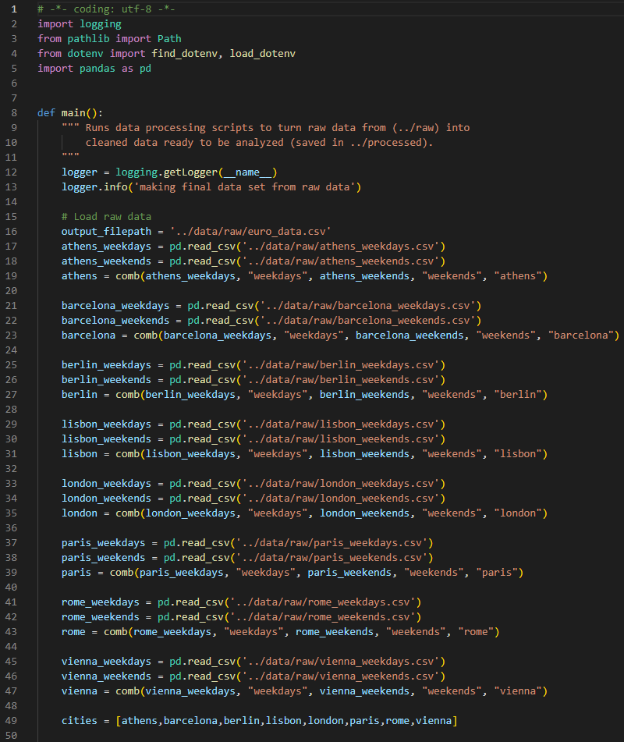
Data Collection
Dataset contains information from various European countries
Including features such as location, property type, and guest reviews.
Combined all datasets
Obtained from Kaggle

Slide 4
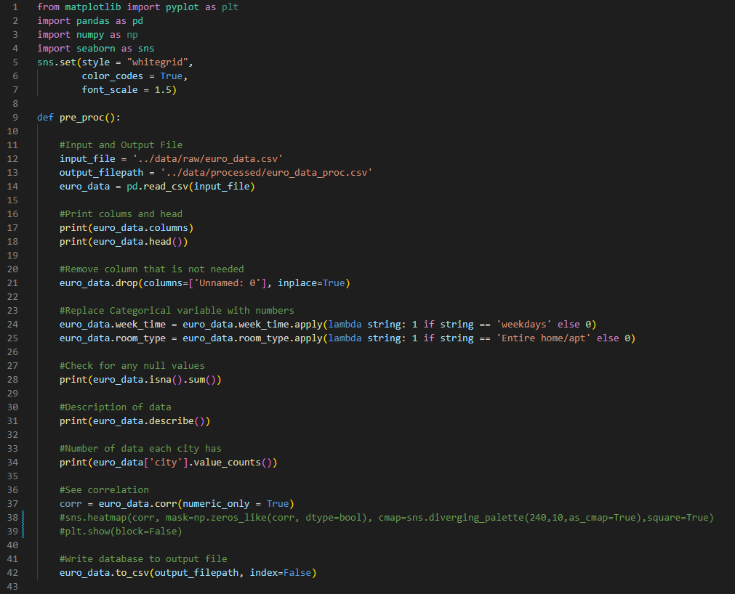
Exploratory Data Analysis
Used function such as colums, and head
Removed unnessary columns
No Null values
Converted categorical variaboles

Slide 5
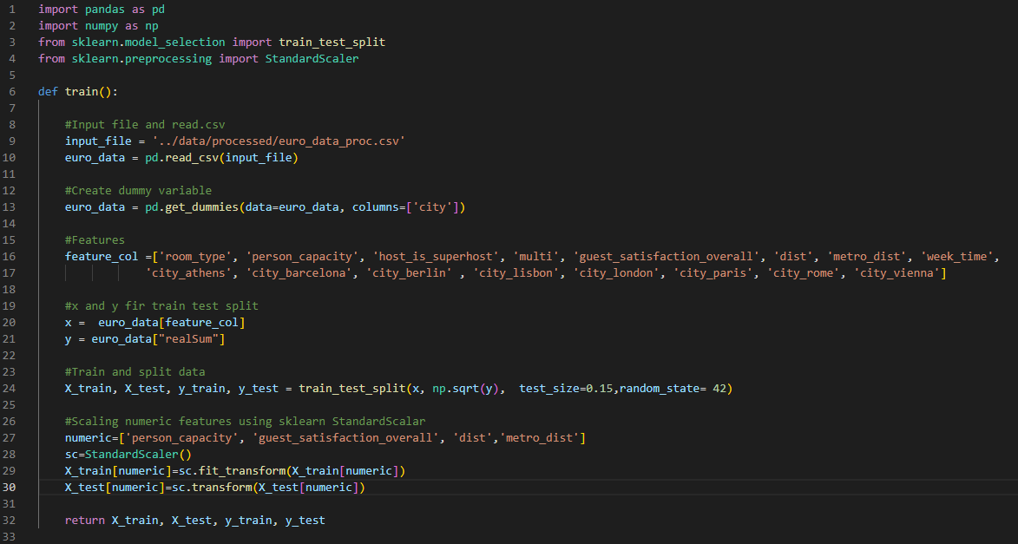
Training
Created dummy variable
Used heatmap to see correlation between variables
Scaled numeric features

Slide 6
Methodology
Linear
Ridge
Lasso
Decision Tree
Statistical Technique
Regularization Technique
Regularization Technique
Tree Structure

Slide 7
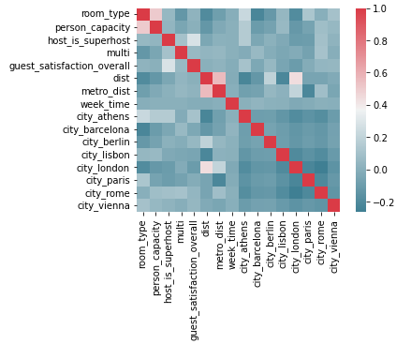
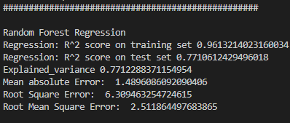
Random Forest Regression
Highest accuracy among all models

Slide 8
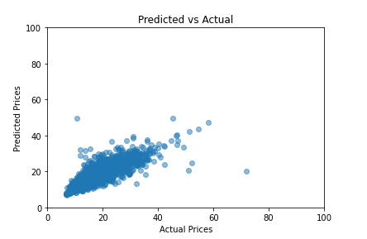
Random Forest Regression

Slide 9
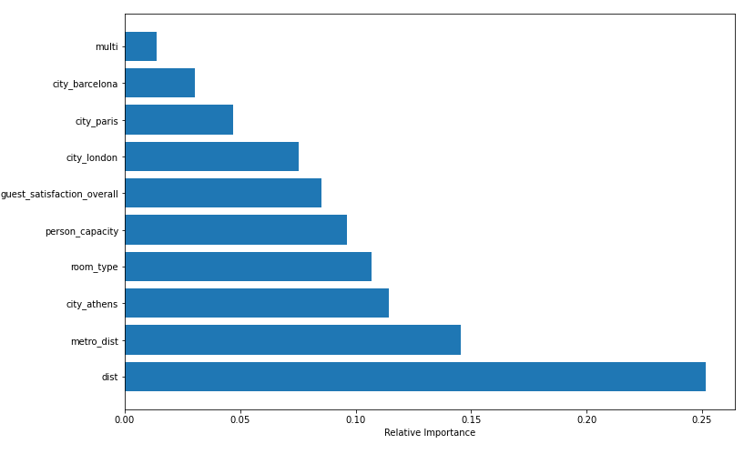
Random Forest Regression

Slide 10
Demonstration

Slide 11
THANK YOU

