Slide 1
LEADS SCORING
CASE STUDY
BY:
Anush Goel
Rohit Sahu
Udit Birthare

Slide 2
PROBLEM
STATEMENT
X Education offers online education for professionals in the sector.
Despite receiving a high volume of leads, X Education's conversion rate is low. For example, if they generate 100 leads each day, only roughly 30 of them get converted.
To improve efficiency, the organization aims to find 'high potential', or hot leads.
If they are successful in identifying this group of leads, the lead rate of conversion should increase since the sales staff will be focused more on connecting with prospective prospects instead of making calls to all people.

Slide 3
BUSINESS
OBJECTIVE
X education aims to identify the most likely leads.
The goal is to develop a model that can identify hot leads.
Deploying the model for future usage.

Slide 4
Solution Methodology
Data cleaning and Data manipulation
Check and handle NA or missing values.
Drop columns that contain a substantial number of values that are absent and are useless for the analysis.
Whenever required, the values will be imputed.
Check and supervise outliers in data.
Check and eliminate duplicate data.
EDA
Univariate data analysis: Plot of value count of variable .
Bivariate data analysis: Analyze the relationship coefficient and patterns between parameters etc.
Dummy Variables, Feature Scaling & Data Encoding.
Classification technique: Logistic Regression used for the Model Building and Prediction.
Validation of the model: Confusion Matrix, Accuracy, Recall and Precisions
Model presentation.
Conclusions and recommendations.

Slide 5
DATA MANIPULATION
Total count of rows : 37; Total count of columns : 9240.
Single-value features include "Magazine," "Receive More Updates About Our Courses," and "Update My Supply“
The words "chain content," "get updates on DM content," and "I agree to pay the amount through check" have been removed.
Removed unnecessary fields "ProspectID" and "Lead Number" from the data analysis.
The following features have been dropped due to high variance: "Do Not Call, "Search," "Newspaper, Article,“ "XEducation Forums," "Newspaper," & "DigitalAdvertisement.“
Removed columns with over 35% missing values, including 'How did you learn about X Education' and 'Lead Profile'.

Slide 6
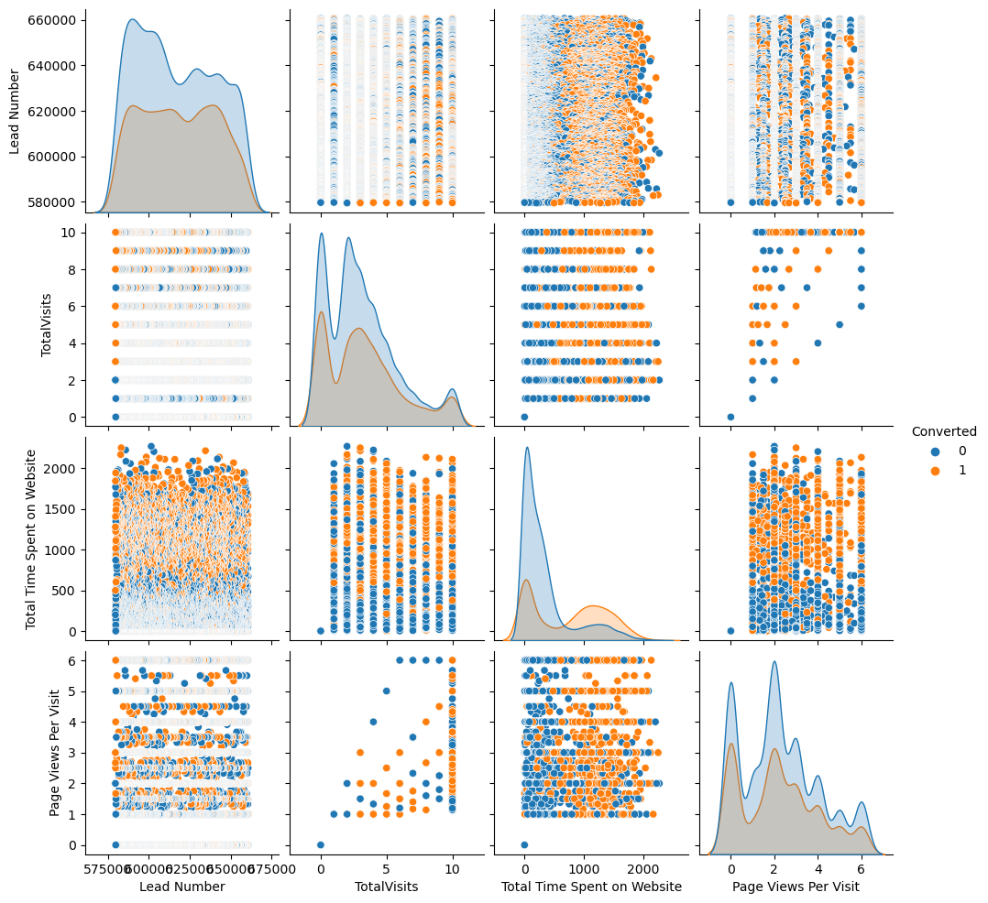
EDA
(EXPLORATORY DATA ANALYSIS)

Slide 7
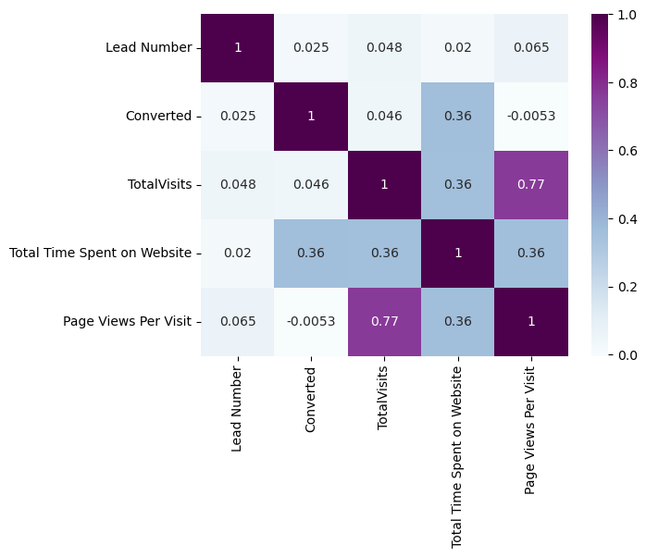
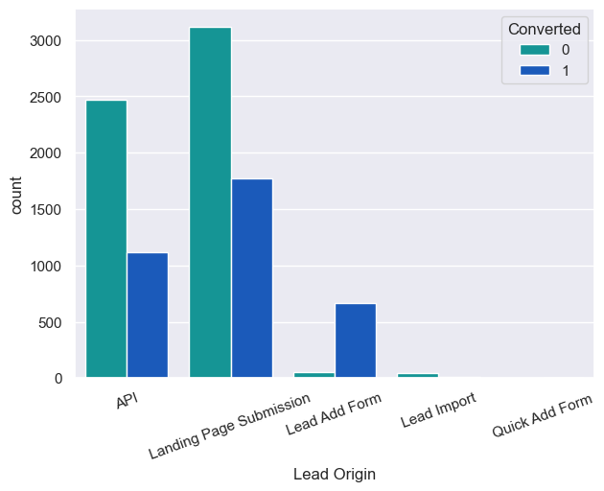
Heat Map & Bar Plot

Slide 8
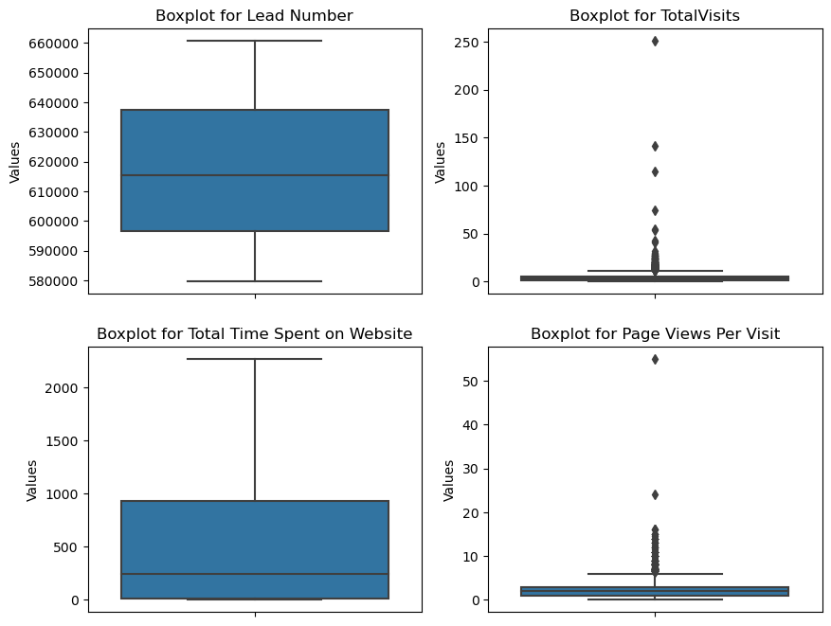
BOXPLOT

Slide 9

DATA CONVERSION
Numerical Variables are Normalised
Dummy Variables are created for Categorical variables
Total Rows for Analysis: 9420
Total Columns for Analysis: 57

Slide 10
MODEL BUILDING
Basic Splitting into X and Y
Splitting the Data into Train-Test Split, in the ratio of 70:30
Use RFE for Feature Selection
20 variables were chosen through RFE
Building a model by eliminating variables with p-values larger than 0.05 and VIF values over five
Predictions on test data set
Overall accuracy 80 %

Slide 11
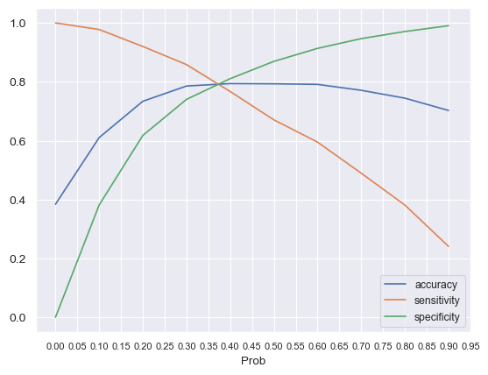
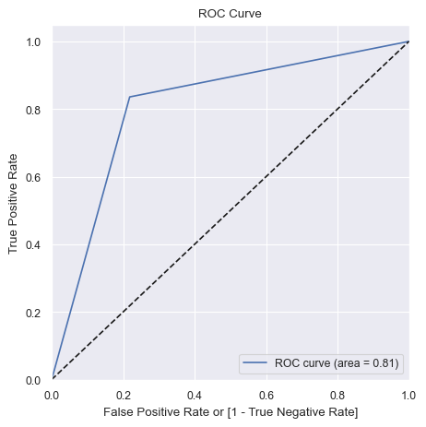
ROC Curve
Finding the Optimal Cut-off Point
The optimal cut-off probability is
Probability provides balanced sensitivity and specificity.
The subsequent graph shows that the ideal cut off is 0.37.

Slide 12
CONCLUSION
It turned out that the criteria that contributed the most for possible customers were:
The total time spend on the Website.
Total number of visits.
Last Activity: SMS Sent & Olark Chat
Current Occupation: Working Professional
With these factors in consideration, X Education has a great possibility of convincing customers to invest in the course they offer.

