Slide 1
Comprehensive Digital Marketing
Project Work-Apollo Hospitals

Slide 2

Part 1: Brand study, Competitor Analysis & Buyer’s/Audience’s Persona
Research Brand Identity: Study the brand's mission, values, vision, and unique selling propositions (USPs).
Brand colour : Blue and White
Logo:
Mission : Apollo Hospitals is one of the leading hospital chains in India with a focus on providing high-quality medical services to patients.
Apollo Hospitals' primary mission is to deliver excellent patient care, making use of advanced medical technologies and highly qualified healthcare professionals.

Slide 3
Part 1: Brand study, Competitor Analysis & Buyer’s/Audience’s Persona Company/topic for project : LAKME
Values: Apollo Hospitals, one of the largest healthcare providers in India, is guided by several core values that shape their culture, operations, and interactions with patients and stakeholders..
Putting patients at the center of everything they do, focusing on their well-being, safety, and providing compassionate care.
USP: Apollo Hospitals has several unique selling propositions (USPs) that differentiate it from other healthcare providers in India.
Apollo Hospitals has been at the forefront of healthcare innovation in India, introducing advanced medical technologies, procedures, and treatments. They have a track record of being the first to introduce many medical advancements to the country.
Apollo Hospitals has been at the forefront of healthcare innovation in India, introducing advanced medical technologies, procedures, and treatments. They have a track record of being the first to introduce many medical advancements to the country.

Slide 4
Part 1: Brand study, Competitor Analysis & Buyer’s/Audience’s Persona
Analyze Brand Messaging:
Quality and Excellence: Apollo Hospitals consistently emphasizes its commitment to providing high-quality healthcare services. The brand messaging highlights the organization's focus on medical excellence, advanced technology, and well-trained healthcare professionals to deliver the best possible outcomes for patients.
Patient-Centric Approach: The brand messaging portrays Apollo Hospitals as patient-centric, placing the well-being and comfort of patients at the core of its operations. It strives to provide compassionate care and ensure that patients feel supported and cared for throughout their healthcare journey.
Examine the brand's tagline: "Touching Lives“
The tagline "Touching Lives" reflects Apollo Hospitals' strong focus on patient care and the impact their services have on people's lives. It conveys the organization's commitment to making a positive difference in the lives of patients and their families.

Slide 5
Part 1: Brand study, Competitor Analysis & Buyer’s/Audience’s Persona
Competitor Analysis: Select three competitors operating in the same industry or niche as the chosen brand, examine their USPs and online communication.
Competitor 1: https://www.fortishealthcare.com/
Fortis Healthcare:Fortis Healthcare has a significant presence not only in India but also in several other countries, making it a prominent player in the international healthcare market.
Competitor 2: https://www.maxhealthcare.in/
Max Healthcare :Max Healthcare offers a comprehensive range of integrated healthcare services, including primary care, diagnostics, and advanced medical treatments, providing patients with continuity of care.
Competitor 3: https://www.narayanahealth.org/
Narayana Health : Narayana Health is known for its focus on providing affordable and accessible healthcare services, particularly in complex medical procedures.

Slide 6
Part 1: Brand study, Competitor Analysis & Buyer’s/Audience’s Persona
Buyer's/Audience's Persona: Clearly define the target audience for the chosen brand. Consider demographics, psychographics, behaviors, and interests.
Demographics:
Age: The audience of Apollo Hospitals is diverse in terms of age, as healthcare services cater to people of all age groups, from infants to seniors.
Gender: Both men and women seek healthcare services from Apollo Hospitals, making it a gender-inclusive audience.
Location: Apollo Hospitals caters to patients from urban as well as rural areas across India and also attracts a significant number of medical tourists from abroad.
Psychographics:
Health Consciousness: The audience of Apollo Hospitals is health-conscious and proactive about seeking medical advice and treatments to maintain their well-being.
Concern for Quality Healthcare: Patients who choose Apollo Hospitals are often discerning and prioritize high-quality medical care and treatment.

Slide 7
Part 1: Brand study, Competitor Analysis & Buyer’s/Audience’s Persona Behaviors: Seeking Medical Treatment: The primary behavior of the audience is seeking medical treatment for various health concerns, ranging from routine check-ups to complex medical procedures. Medical Tourism: Apollo Hospitals attracts international patients who travel to India specifically to seek advanced medical treatments at more affordable costs. Referrals and Word-of-Mouth: Positive experiences with Apollo Hospitals lead to word-of-mouth referrals, where satisfied patients recommend the hospital to their friends and family. Interests: Wellness and Preventive Care: The audience has an interest in wellness and preventive healthcare to maintain a healthy lifestyle and prevent illnesses. Medical Advancements: Patients seeking treatment at Apollo Hospitals may show interest in the latest medical advancements and technologies used in treatments.

Slide 8
Part 2: SEO & Keyword Research
SEO Audit: Do an SEO audit of the brands website
Keyword Analysis:
Identify the target keywords related to Apollo Hospitals' services, such as "best hospitals in [location]," "specialty treatments," and "top doctors in [specialty]."
Check keyword rankings to see how well the website is performing for its target keywords.
Explore potential new keywords based on search volume and relevance.
On-Page Optimization:
Review title tags, meta descriptions, and header tags to ensure they are relevant, unique, and contain target keywords.
Check for keyword usage in the website's content, ensuring it is natural and not overused (avoid keyword stuffing).
Content Quality:
Assess the quality and relevance of the website's content. Content should be informative, accurate, and engaging for users.
Look for opportunities to create new content that addresses patients' frequently asked questions or provides valuable healthcare information.

Slide 9
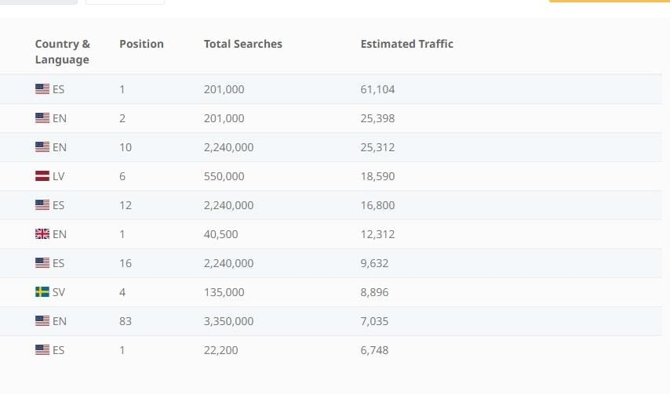
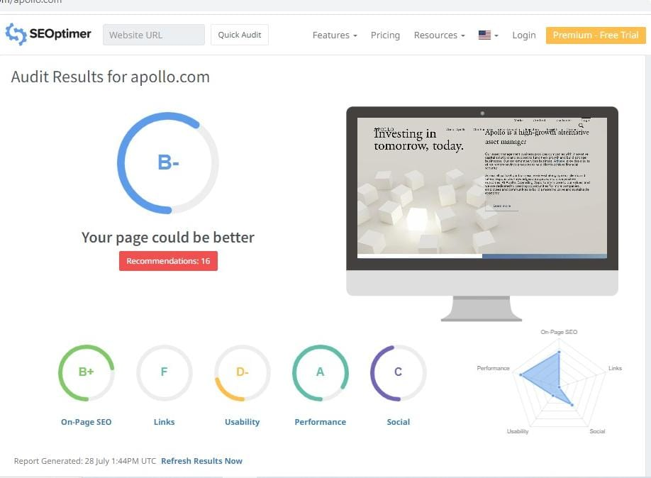

Slide 10
Part 2: SEO & Keyword Research Keyword Research: Define Research Objectives, Brainstorm Seed Keywords, Utilize Keyword Research Tools (SEMrush or Moz Keyword Explorer),Analyze Competitor Keywords, Long-tail Keyword Exploration (specific, longer phrases) that align with the research objectives and have lower competition but higher conversion potential. Keyword research is a crucial part of search engine optimization (SEO) to understand what terms and phrases potential visitors are using to search for information related to Apollo Hospitals. Below are some key keyword research ideas for Apollo Hospitals: "Apollo Hospitals": The brand name itself is an essential keyword, as people often search for specific hospitals by their names. "Best Hospitals in [City/Region]": Many people search for the best hospitals in their city or region, so targeting location-specific keywords can help attract local patients. "Medical Services at Apollo Hospitals": Highlighting the various medical services and specialties offered by Apollo Hospitals can attract users looking for specific treatments. "Top Doctors at Apollo Hospitals": People often search for renowned doctors at specific hospitals, so showcasing the expertise of Apollo Hospitals' doctors is valuable.

Slide 11
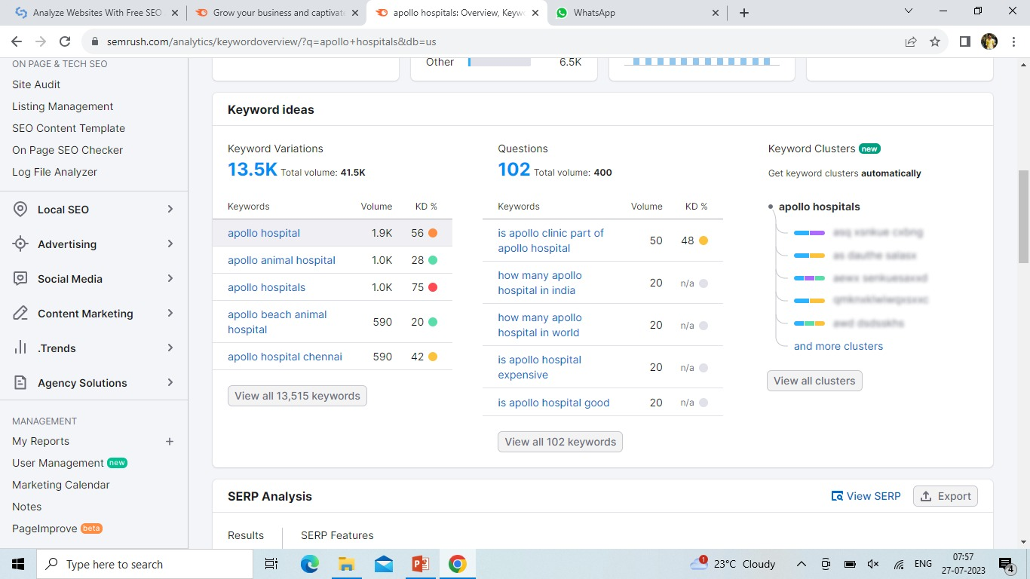
Keyword Research

Slide 12
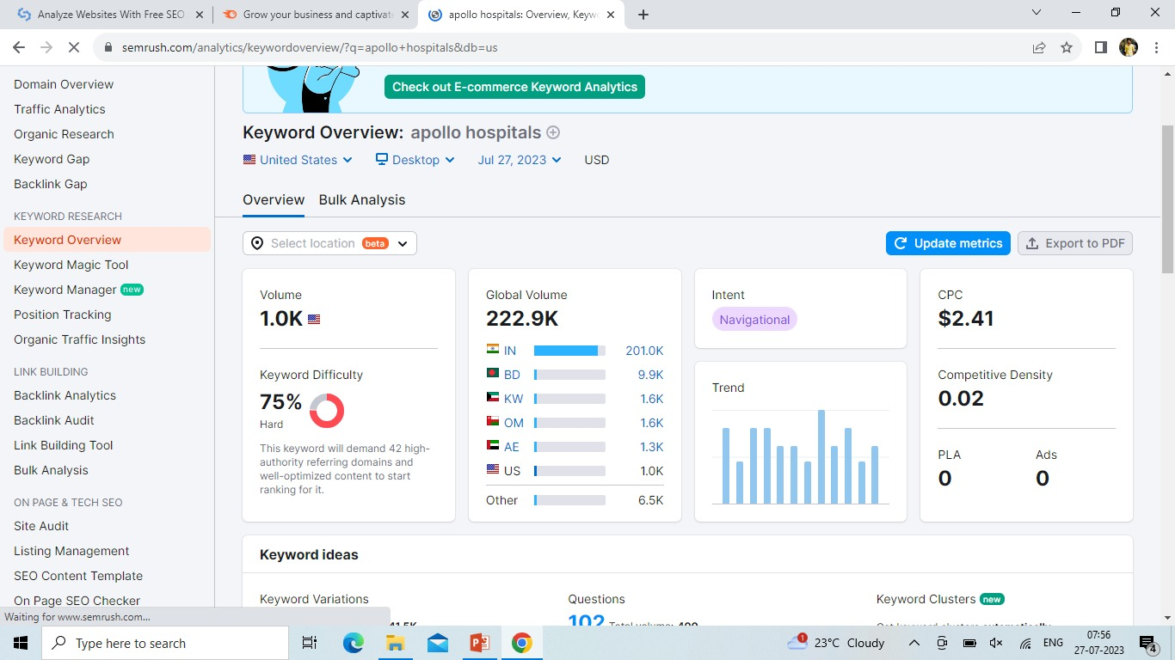

Slide 13
On page Optimization: Meta Tag optimization & content optimization Reflect on the process of conducting keyword research and the SEO recommendations provided. Document the challenges faced during the research and analysis phase, as well as the key insights gained from the keyword research process. Keyword Research and Implementation: Conduct thorough keyword research to identify relevant and high-traffic keywords related to Apollo Hospitals' services and medical specialties. Incorporate these keywords naturally into page titles, headings, meta descriptions, and content throughout the website. Optimize Page Titles and Meta Descriptions: Craft unique and descriptive page titles and meta descriptions for each page, including relevant keywords. These elements appear in search engine results and influence click-through rates. Security and SSL: Secure the website with an SSL certificate to protect user data and gain a slight SEO advantage

Slide 14
Part 3: Content Ideas and Marketing Strategies
Content Idea Generation & Strategy: Create a content calendar for the remaining month of July by brainstorming content themes, exploring various formats like blog posts, videos, infographics, podcasts, and interactive quizzes, and scheduling publication dates mainly on Facebook & Instagram. And include the strategy, aim and the idea behind these posts and story
Content Calendar Example (Try creating a table for the month of July)

Slide 15


Slide 16
Part 3: Content Ideas and Marketing Strategies
Reflect on the content ideas and marketing strategies process, discussing the challenges encountered and lessons learned.
Challenges Encountered:
Regulatory Restrictions: The healthcare industry is subject to stringent regulations, which can limit certain marketing strategies and content promotion.
Sensitive Content: Creating content on healthcare topics requires careful handling of sensitive information and maintaining patient privacy.
Balancing Promotional Content: Finding the right balance between promotional content and informative content to avoid appearing too sales-oriented.
Measuring ROI: Measuring the effectiveness and ROI of marketing efforts in the healthcare sector can be challenging due to longer patient decision-making processes.

Slide 17
Lessons Learned: Patient-Centric Approach: Putting the needs and concerns of patients first in content creation and marketing strategies leads to better engagement and trust. Compliance and Ethical Considerations: Adhering to healthcare regulations and ethical considerations in all content and marketing activities is essential for maintaining the hospital's reputation. Data-Driven Insights: Using data analytics to understand audience behavior and preferences helps in tailoring content and marketing efforts for maximum impact. Transparency and Authenticity: Being transparent and authentic in communications fosters a stronger connection with the audience and builds trust. Adaptability to Trends: Being agile and adapting marketing strategies to current trends and events helps in staying relevant and resonating with the audience. Engagement and Interaction: Encouraging audience engagement and interaction through comments, feedback, and inquiries strengthens the hospital's relationship with its community.

Slide 18
Part 4: Content Creation and Curation (Post creations, Designs/Video Editing, Ad Campaigns over Social Media and Email Ideation and Creation)
Post Creation:
Format 1:Blog Article
Aim : Boost SEO & Provide information about Apollo hospitals..
Date : 24th July 2023
Topic: we created a article on Apollo hospitals
https://www.blogger.com/blog/posts/5018551733821299762

Slide 19
Part 4: Content Creation and Curation (Post creations, Designs/Video Editing, Ad Campaigns over Social Media and Email Ideation and Creation) Format 2: Video Date : 20th July 2023 Topic: Brand advertisement Drive Link: https://youtu.be/TbWCbQWCvpI

Slide 20

Part 4: Content Creation and Curation (Post creations, Designs/Video Editing, Ad Campaigns over Social Media and Email Ideation and Creation) Format 3: Creative Meme Date:20th July 2023 Topic: Apollo hospitals Meme: To create a meme on Apollo hospitals.

Slide 21
Part 4: Content Creation and Curation (Post creations, Designs/Video Editing, Ad Campaigns over Social Media and Email Ideation and Creation)
Instagram Story
Utilize the Stories feature on Instagram for three consecutive days. Share behind-the-scenes glimpses, polls, quizzes, or sneak peeks etc to encourage audience participation. Once uploaded use the story highlight feature on Instagram and save the 3 story with an appropriate name for each. Note: Once done monitor the performance of the posts and Stories using the insight tool and analyze the engagement metrics (likes, comments, shares, impressions, etc.). Based on the analysis, mention the strategies and areas for improvement.

Slide 22
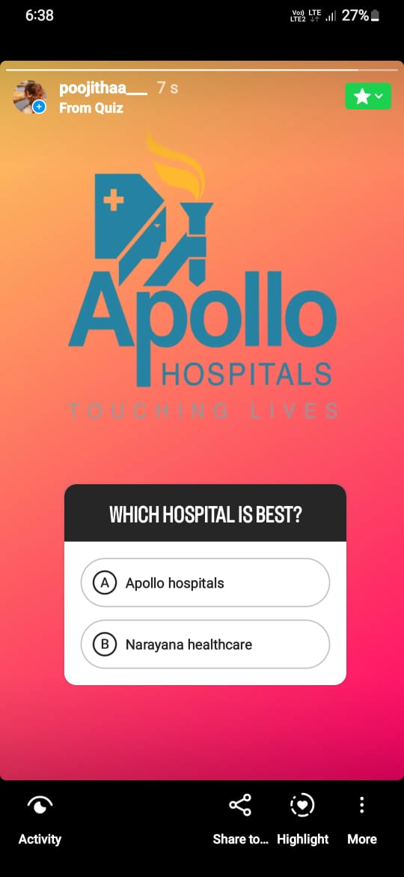
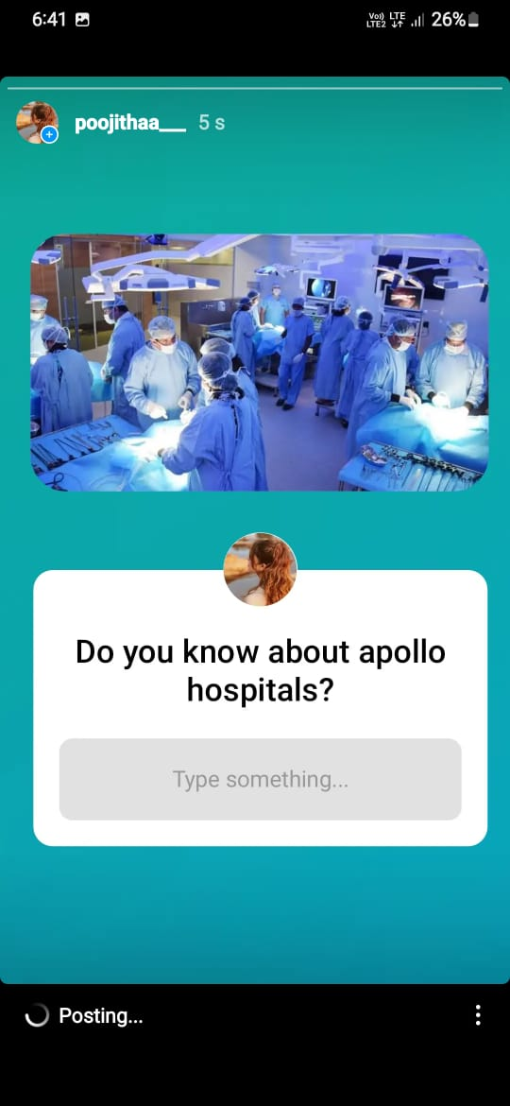
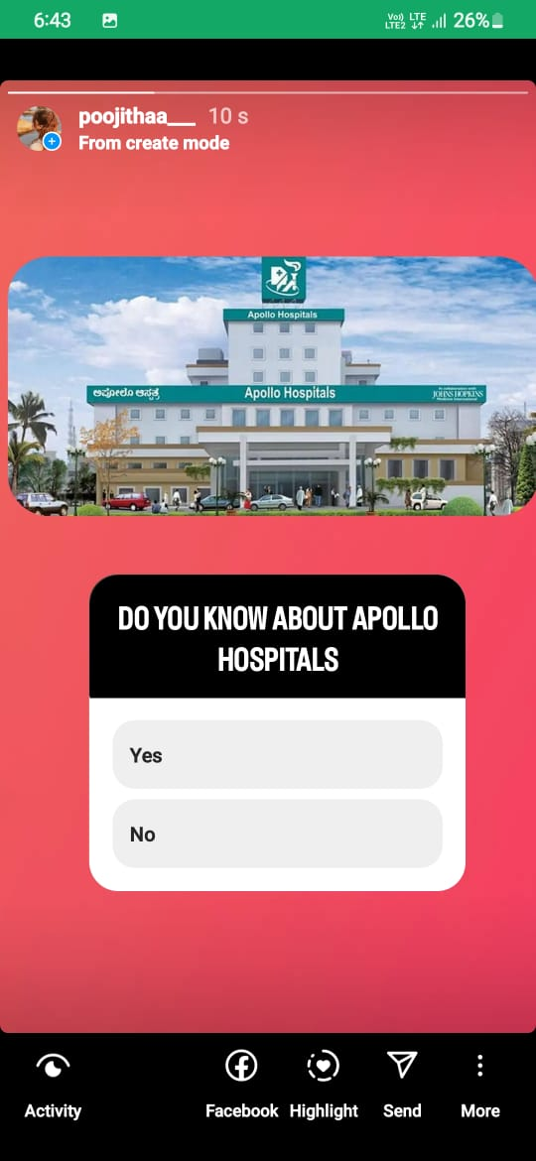
Instagram Story

Slide 23
Part 4: Content Creation and Curation (Post creations, Designs/Video Editing, Ad Campaigns over Social Media and Email Ideation and Creation)
Designs/Video Editing
Design Tools Familiarization (use Canva for creating visually appealing graphics)
Video Creation: Utilize VN or any video editor of your choice to create videos related to the chosen topic.
Video Creation: Advertisement video on Apollo hospitals
https://youtu.be/OJlsOZWUbtQ

Slide 24
Part 4: Content Creation and Curation (Post creations, Designs/Video Editing, Ad Campaigns over Social Media and Email Ideation and Creation)
Social Media Ad Campaigns
Ad Campaigns over Social Media:
Come up with 3 ad campaigns each covering one of the mentioned goals: brand awareness, driving website traffic, or generating leads
Clearly outline the goals of the ad campaign. These could be increasing brand awareness, promoting specific services, driving website traffic, or increasing appointment bookings.
Identify your target audience. Apollo Hospitals likely caters to people of different age groups and medical needs. Understand their preferences, pain points, and what appeals to them.

Slide 25
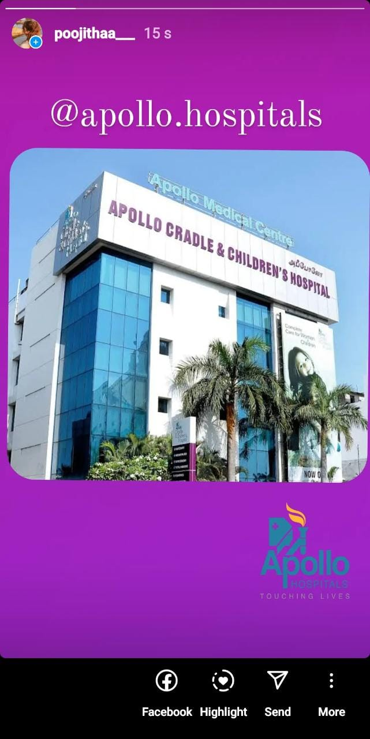

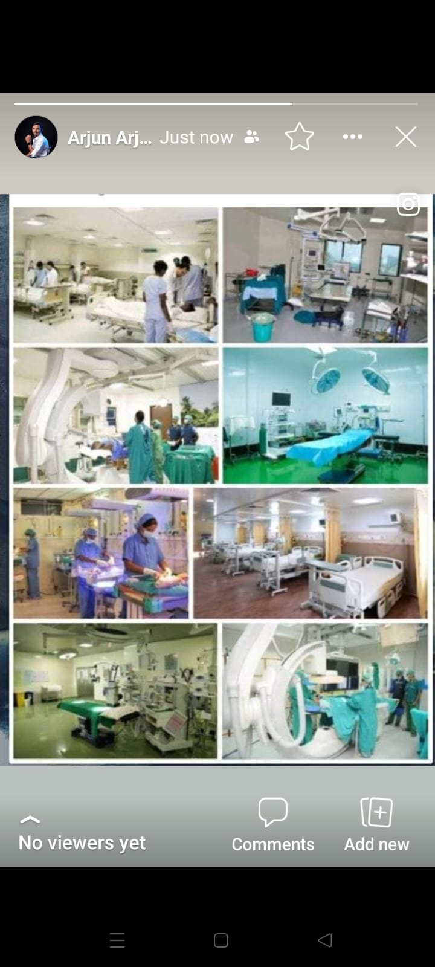
Social Media Ad Campaigns

Slide 26
Part 4: Content Creation and Curation (Post creations, Designs/Video Editing, Ad Campaigns over Social Media and Email Ideation and Creation)
Email Ad Campaigns
Ad Campaigns for email marketing:
Come up with 2 email ad campaigns with the mentioned goals: brand awareness & generating leads
Brand Awerness :
Brand awareness is crucial for any organization, including Apollo Hospitals, to maintain a strong presence in the market and to attract new customers
Invest in a comprehensive digital marketing strategy that includes search engine optimization (SEO), social media marketing, pay-per-click (PPC) advertising, and content marketing. Ensure that the hospital's website is user-friendly, informative, and mobile-responsive.
Leverage the power of social media platforms to connect with the target audience. Share valuable healthcare content, patient testimonials, success stories, and engage with followers regularly.

Slide 27
Generating leads: Online Appointment Booking: Ensure that Apollo Hospitals' website has a user-friendly and secure online appointment booking system. Make it easy for potential patients to schedule appointments with doctors or healthcare specialists. Content Marketing: Create informative and engaging content related to healthcare, medical treatments, wellness, and healthy living. Utilize blogs, videos, infographics, and ebooks to establish Apollo Hospitals as a trusted source of information. Search Engine Optimization (SEO): Optimize the hospital's website for relevant keywords and phrases related to their medical specialties and services. This will help improve the website's ranking in search engine results and attract organic traffic. Testimonials and Reviews: Showcase positive patient testimonials and reviews on the website and social media platforms to build trust and credibility.

Slide 28
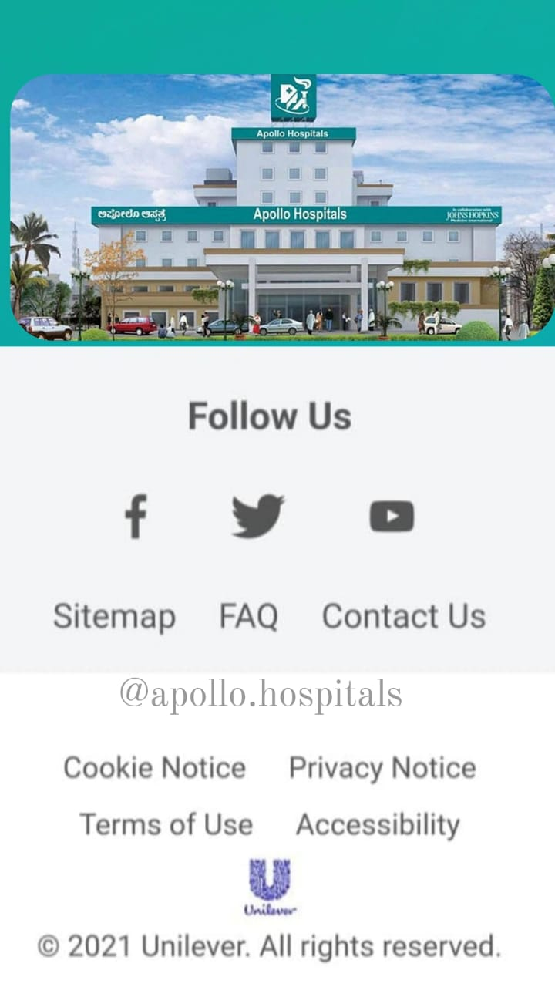
Email Ad Campaign 1 - Brand Awareness
(insert emailer image)

Slide 29

Email Ad Campaign 2 - Lead Generation
(insert emailer image)

Slide 30
Part 4: Content Creation and Curation (Post creations, Designs/Video
Editing, Ad Campaigns over Social Media and Email Ideation and Creation)
Reflect on the content creation and curation process, discussing the challenges faced and lessons learned.
Challenges Faced:
Handling Complex Cases: Apollo Hospitals deals with a broad range of complex medical cases, which can be challenging to diagnose and treat. They face the pressure of delivering successful outcomes in critical situations.
Healthcare Infrastructure: Providing advanced medical care requires state-of-the-art infrastructure and equipment. Keeping up with technological advancements and maintaining infrastructure can be a continuous challenge.
Managing Patient Inflow: Apollo Hospitals caters to a vast number of patients, which can strain resources and lead to longer waiting times for appointments and treatments.
Healthcare Costs: Balancing the delivery of high-quality healthcare while keeping it affordable for patients is an ongoing challenge, especially with the increasing costs of medical technology and services.

Slide 31
Lessons Learned: Focus on Patient-Centric Care: One of the critical lessons Apollo Hospitals has learned is the importance of a patient-centric approach. Prioritizing patient needs and preferences leads to better overall outcomes and patient satisfaction. Continuous Learning and Training: To stay at the forefront of medical advancements, Apollo Hospitals emphasizes continuous learning and training for its medical staff. Regular skill enhancement is crucial for delivering top-notch medical care. Investment in Technology: Apollo Hospitals recognizes the significance of investing in advanced medical technology. Keeping up with technological innovations enhances diagnostic accuracy and treatment outcomes. Collaboration and Networking: The hospital has learned the value of collaboration with other healthcare institutions, medical researchers, is crucial for delivering top-notch andorganizations. Networking allows for knowledge-sharing and access to specialized resources. Community Engagement: Apollo Hospitals has learned the importance of community engagement and conducting health awareness campaigns. Educating the public about preventive healthcare can lead to early detection and better disease management.

