Slide 1
ARM: CH1
By Khushal

Slide 2
Introduction
The ARM processor core is use in many successful 32-bit embedded systems.
It widely used in mobile phones, handheld organizers, and everyday portable consumerdevices.
The ARM core uses a RISC architecture.
RISC provide simple but powerful instructions that execute within a single cycle at a high clock speed.

Slide 3
RISC and CISC processors
Sr. No. | RISC | CISC
01 | Instructions are of same size | Instructions are of variable size
02 | Take one cycle | Take one or more cycle
03 | Use pipeline for get more throughput | No pipeline
04 | More number of regesters | Less Number of regesters
05 | Load and store arch. (Load data from memory to reg first then perform operation on it.) | Direcctly perform operation on data in memory.
06 | Processor is simplex hence use less clock frequency. | Processor is complex hence use more clock frequency.

Slide 4
ARM Design Philosophy
It has been specifically designed to be small to reduce power consumption and extend battery operation.
High code density. Since embedded systems have limited memory due to cost and physical size restrictions.
It have incorporated hardware debug technology within the processor

Slide 5
Instruction set
Most of instruction is set of 32 bit.
Thumb 16-bit instruction set.
Enhanced instructions: set to support fast 16×16-bit multiplier operations and saturation.

Slide 6
ARM bus technology
Peripheral Component Interconnect (PCI) bus, connects such devices as video cards and hard disk controllers to the x86 processor bus.
The Advanced Microcontroller Bus Architecture (AMBA) in on-chip bus architecture used for ARM processors.
Using AMBA, peripheral designers can reuse the same design on multiple projects.
Because there are a large number of peripherals developed with an AMBA interface,

Slide 7
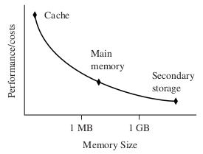
Memory
Width:
The memory width is the number of bits the memory returns on each access—typically 8, 16, 32, or 64 bits.
The memory width has a direct effect on the overall performance and cost ratio.

Slide 8
Peripherals
Memory Controllers:
Memory controllers connect different types of memory to the processor bus.
On power-up a memory controller is configured in hardware to allow certain memory devices to be active.
Interrupt Controllers:
An interrupt controller provides a programmable governing policy that allows software to determine which peripheral or device can interrupt the processor

Slide 9
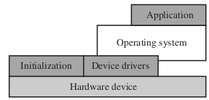
Embedded System Software
It contain four software layer.

Slide 10
Thanks...

