Slide 1
ARM Processor Fundamentals

Slide 2
r0
r1
r2
r3
r4
r5
r6
r7
r8
r9
r10
r11
r12
r13 sp
r14 lr
r15 pc
Registers
General-purpose registers hold either data or an address.
They are identiﬁed with the letter r preﬁxed to the register number.
For example, register 4 is given the label r4.
All the registers shown are 32 bits in size.
There are up to 18 active registers: 16 data registers and 2 processor status registers. The data registers are visible to the programmer as r0 to r15.
or special function: r13, r14, and r15.
Register r13 is traditionally used as the stack pointer (sp) and stores the head of the stack in the current processor mode.
Register r14 is called the link register (lr) and is where the core puts the return address whenever it calls a subroutine.
Register r15 is the program counter (pc) and contains the address of the next instruction to be fetched by the processor.
cpsr and spsr (the current and saved program status registers, respectively).

Slide 3
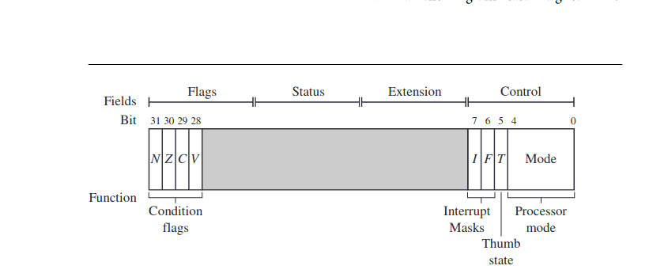
Current Program Status Register
cpsr to monitor and control internal operations.
The cpsr is a dedicated 32-bit register and resides in the register ﬁle.
The cpsr is divided into four ﬁelds, each 8 bits wide: ﬂags, status, extension, and control.
The control ﬁeld contains the processor mode, state, and interrupt mask bits.
The ﬂags ﬁeld contains the condition ﬂags
.

Slide 4
Processor Modes
Each processor mode is either privileged or nonprivileged:
A privileged mode allows full read-write access to the cpsr.
a nonprivileged mode only allows read access to the control ﬁeld in the cpsr
six privileged modes (abort, fast interrupt request, interrupt request, supervisor, system, and undeﬁned)
one nonprivileged mode(user).
The processor enters abort mode when there is a failed attempt to access memory.
Fast interrupt request and interrupt request modes correspond to the two interrupt levels available on the ARM processor.
Supervisor mode is the mode that the processor is in after reset and is generally the mode that an operating system kernel operates in.
System mode is a special version of user mode that allows full read-write access to the cpsr.
Undefined mode is used when the processor encounters an instruction that is undefined or not supported by the implementation.
User mode is used for programs and application

Slide 5
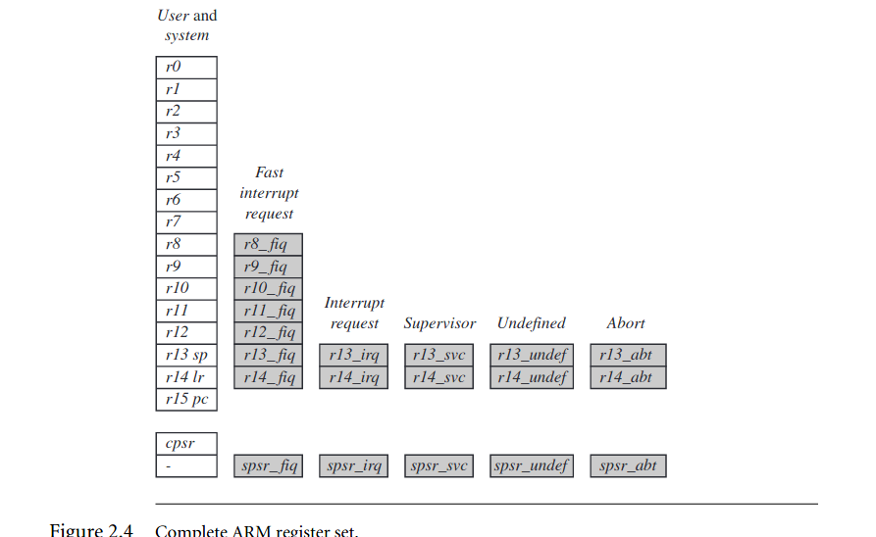
Banked Registes
all 37 registers in the register ﬁle. Of those, 20 registers are hidden from a program at different times.
These registers are called banked registers and are identiﬁed by the shading in the diagram
abort mode has banked registers r13_abt, r14_abt and spsr_abt.

Slide 6
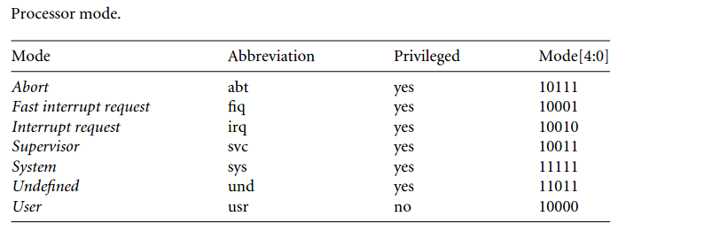
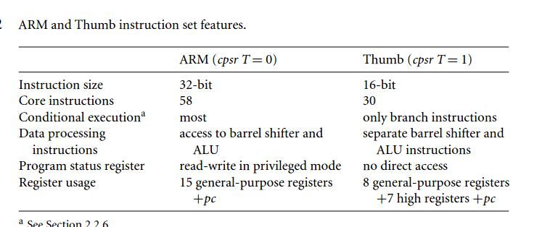

Slide 7
Pipeline
Using a pipeline speeds up execution by fetching the next instruction while other instructions are being decoded and executed.
Fetch loads an instruction from memory.
Decode identiﬁes the instruction to be executed.
Execute processes the instruction and writes the result back to a register.
As the pipeline length increases, the amount of work done at each stage is reduced,
This in turn increases the performance.
The ARM9 core increases the pipeline length to ﬁve stages,
The ARM10 increases the pipeline length still further by adding a sixth stage,
Fetch
Decode
Execute

Slide 8
ARM exceptions and interrupts and vector table
Exception in ARM
*Exceptions in ARM can occur from various situations.
*through execution of instruction
*side-effect of instruction –data fetch failure – other sources like RESET,FIQ,IRQ interrupts

Slide 9
Interrupt Vector table
When an exception or interrupt occurs, the processor set the pc to a specific memory address.
The address is within a special address range called the vector table.
The entries in the vector table are instructions that branch to specific routines designed to handle a particular exception or interrupt.
When an exception or interrupt occurs, the processor suspends normal execution and starts loading instructions from the exception vector table.

Slide 10
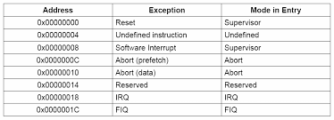

Slide 11
Reset vector is the location of the ﬁrst instruction executed by the processor when power is applied. This instruction branches to the initialization code.
Undeﬁned instruction vector is used when the processor cannot decode an instruction.
Software interrupt vector is called when you execute a SWI instruction. The SWI instruction is frequently used as the mechanism to invoke an operating system routine.
Prefetch abort vector occurs when the processor attempts to fetch an instruction from an address without the correct access permissions. The actual abort occurs in the decode stage.
Data abort vector is similar to a prefetch abort but is raised when an instruction attempts to access data memory without the correct access permissions.
Interrupt request vector is used by external hardware to interrupt the normal execution ﬂow of the processor. It can only be raised if IRQs are not masked in the cpsr.
Fast interrupt request vector is similar to the interrupt request but is reserved for hardware requiring faster response times. It can only be raised if FIQs are not masked in the cpsr.

Slide 12
Interrupt /Exception Execution
When interrupt or exception occurs,
Processor switch to privileged mode.
Current value pc+4 saved in the link register.
Current cpsr copied into spsr( Saved Program Status Register) of the privileged mode.
Program counter loaded with exception vector address from interrupt vector table.
Each vector table entry contains a form of branch instruction pointing to the start of a specific routine.
Execution of exception / interrupt start.

Slide 13
Core Extensions
standard components placed next to the ARM core.
They improve performance, manage resources, and provide extra functionality and are designed to provide ﬂexibility in handling particular applications.
Each ARM family has different extensions available
There are three hardware extensions ARM wraps around the core:
cache and tightly coupled memory.
memory management.
coprocessor interface.

Slide 14
Cache and Tightly Coupled Memory
The cache is a block of fast memory placed between main memory and the core.
With a cache the processor core can run for the majority of the time without having to wait for data from slow external memory.
ARM has two forms of cache
The ﬁrst is found attached to the Von Neumann–style cores. It combines both data and instruction into a single uniﬁed cache.
the second form, attached to the Harvard-style cores, has separate caches for data and instruction.

Slide 15
Memory Management
method to help organize these devices and protect the system from applications trying to make inappropriate accesses to hardware.
ARM cores have three different types of memory management hardware
no extensions providing no protection.
Non protected memory is ﬁxed and provides very little ﬂexibility. It is normally used for small, simple embedded systems
memory protection unit (MPU) providing limited protection.
MPUs employ a simple system that uses a limited number of memory regions. These regions are controlled with a set of special coprocessor registers
memory management unit (MMU) providing full protection.
MMUs are the most comprehensive memory management hardware available on the ARM

Slide 16
Coprocessors
Coprocessors can be attached to the ARM processor.
A coprocessor extends the processing features of a core by extending the instruction set or by providing conﬁguration registers.
More than one coprocessor can be added to the ARM core via the coprocessor interface.
The coprocessor can be accessed through a group of dedicated ARM instructions that provide a load-store type interface

Slide 17
Nomenclature
The nomenclature identiﬁes individual processors and provides basic information about the feature set.
The letters and numbers after the word “ARM” indicate the features a processor
ARM{x}{y}{z}{T}{D}{M}{I}{E}{J}{F}{-S}
x—family
y—memory management/protection unit
z—cache
T—Thumb 16-bit decoder
D—JTAG debug
M—fast multiplier
I—EmbeddedICE macrocell
E—enhanced instructions (assumes TDMI)
J—Jazelle
F—vector ﬂoating-point unit
S—synthesizible version

Slide 18
In the future the number and letter combinations may change as more features are added
All ARM cores after the ARM7TDMI include the TDMI features even though they may not include those letters after the “ARM” label.
The processor family is a group of processor implementations that share the same hardware characteristics. For example, the ARM7TDMI, ARM740T, and ARM720T all share the same family characteristics and belong to the ARM7 family.
JTAG It is a serial protocol used by ARM to send and receive debug information between the processor core and test equipment.
EmbeddedICE macrocell is the debug hardware built into the processor that allows breakpoints and watchpoints to be set.

Slide 19
ARM Processor Families
ARM has designed a number of processors that are grouped into different families according to the core they use.
The families are based on the ARM7, ARM9, ARM10, and ARM11 cores.
The postﬁx numbers 7, 9, 10, and 11 indicate different core designs.
The ascending number equates to an increase in performance.

Slide 20
Table 2.7 | Revision history.
Revision | Example core implementation | ISA enhancement
ARMv1 | ARM1 | First ARM processor
 |  | 26-bit addressing
ARMv2 | ARM2 | 32-bit multiplier
 |  | 32-bit coprocessor support
ARMv2a | ARM3 | On-chip cache
 |  | Atomic swap instruction
 |  | Coprocessor 15 for cache management
ARMv3 | ARM6 and ARM7DI | 32-bit addressing
 |  | Separate cpsr and spsr
 |  | New modes—undeﬁned instruction and abort
 |  | MMU support—virtual memory
ARMv3M | ARM7M | Signed and unsigned long multiply instructions
ARMv4 | StrongARM | Load-store instructions for signed and unsigned halfwords/bytes, New mode—system Reserve SWI space for architecturally deﬁned operations
 |  | 26-bit addressing mode no longer supported
ARMv4T | ARM7TDMI and ARM9T | Thumb
ARMv5TE | ARM9E and ARM10E | Superset of the ARMv4T
 |  | Extra instructions added for changing state between
 |  | ARM and Thumb
 |  | Enhanced multiply instructions
 |  | Extra DSP-type instructions
 |  | Faster multiply accumulate
ARMv5TEJ | ARM7EJ and ARM926EJ | Java acceleration
ARMv6 | ARM11 | Improved multiprocessor instructions
 |  | Unaligned and mixed endian data handling
 |  | New multimedia instructions

Slide 22


