Slide 1
I2c

Slide 2
I2c Introduction
I2C is a serial protocol for a two-wire interface to connect low-speed devices like microcontrollers, EEPROMs, A/D and D/A converters, I/O interfaces, and other similar peripherals in embedded systems
I2C uses only two wires:
SCL (serial clock)
SDA (serial data)
Master is the device that generates clock, starts communication, sends I2C commands, and stops communication
Slave is the device that listens to the bus and is addressed by the master
bus speed
100KHz/ 400KHz/ 1MHz/ 3.4MHz/ 5MHz

Slide 3
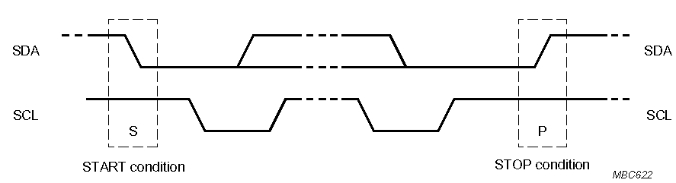
Start and Stop Condition
A transition of the data line while the clock line is high is defined as either a start or a stop condition.
Both start and stop conditions are generated by the bus master
The bus is considered busy after a start condition, until a stop condition occurs
SDA
SDA
SCL
SCL
Start Condition
Stop Condition

Slide 4
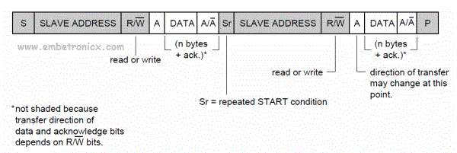
Repeated Start (R) Condition
A Start signal generated without first generating a Stop condition to terminate the communication
Used by the master to communicate with another slave or change data transfer direction without releasing the bus-
Also referred to as Restart condition

Slide 5
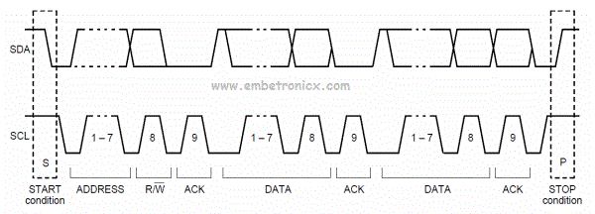
Data Transfer
Represents the transfer of eight bits of information
Data on the SDA line is considered valid only when the SCL signal is high.
When the SCL signal is low, data is allowed to change.
The eight-bit data may be a control code, an address, or data.

Slide 6
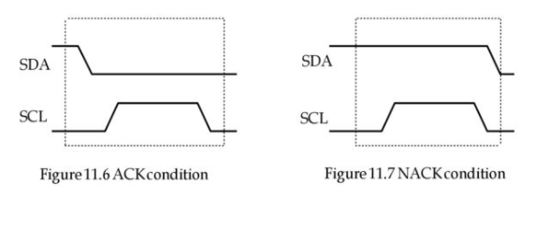
Acknowledge (ACK) Condition
Data transfer needs to be acknowledged either positively (A) or negatively (NACK).
A device acknowledges a byte it received positively by bringing the SDA line low during the ninth clock pulse of SCL.
If the device allows the SDA line to float high, it is transmitting a negative acknowledge (NACK).

Slide 7
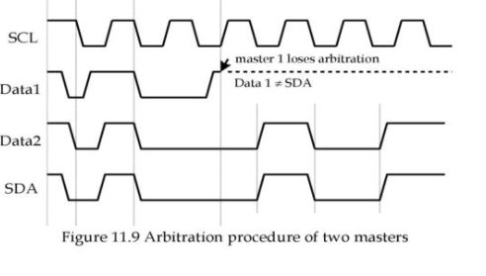
Arbitration
In the event two or more master devices attempt to begin a transfer at the same time ,an arbitration scheme is employed to force one or more masters to give up the bus.
The master devices continue to transmit data until one master attempt to send a high while the other transmits a low.
Since the SDA bus has open drain, the master device that attempts to send a high will detect a low.
At this point, it will stop driving the bus.The arbitration process does not slow down the winning master’s transfer and no data gets lost.

Slide 8
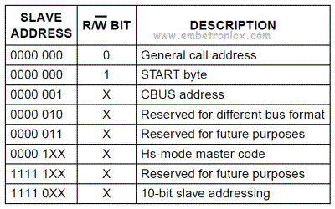
I²C Addressing
I2C protocol allows master devices to use either the 7-bit and 10-bit address to specify the slave device for data communication.
Each slave device on the bus should have a unique 7-bit address.
7 bits for I2C addresses allow only 127 different addresses where only 112 can actually be used
10-bit addressing supports up to 1024 I2C addresses

Slide 9
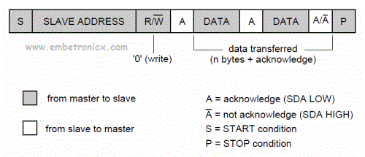

7 bit addressing:
10 bit addressing:

Slide 10
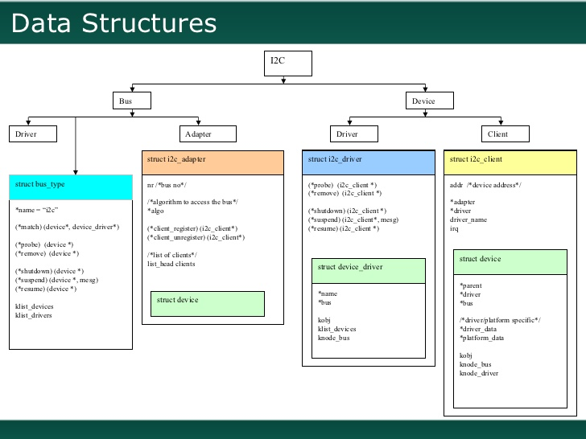
I2c Linux Subsystem

Slide 11
Data structure to implement i2c client driver
struct i2c_driver------------------------->linux/i2c.h
struct device_driver--------------------->linux/device.h
struct i2c_device_id--------------------->linux/mod-devicetable.h
struct of_device_id---------------------->linux/mod-devicetable.h
struct i2c_client-------------------------->linux/i2c.h
struct i2c_adapter------------------------>linux/i2c.h
struct i2c_algorithm -------------------->linux/i2c.h
.

Slide 12
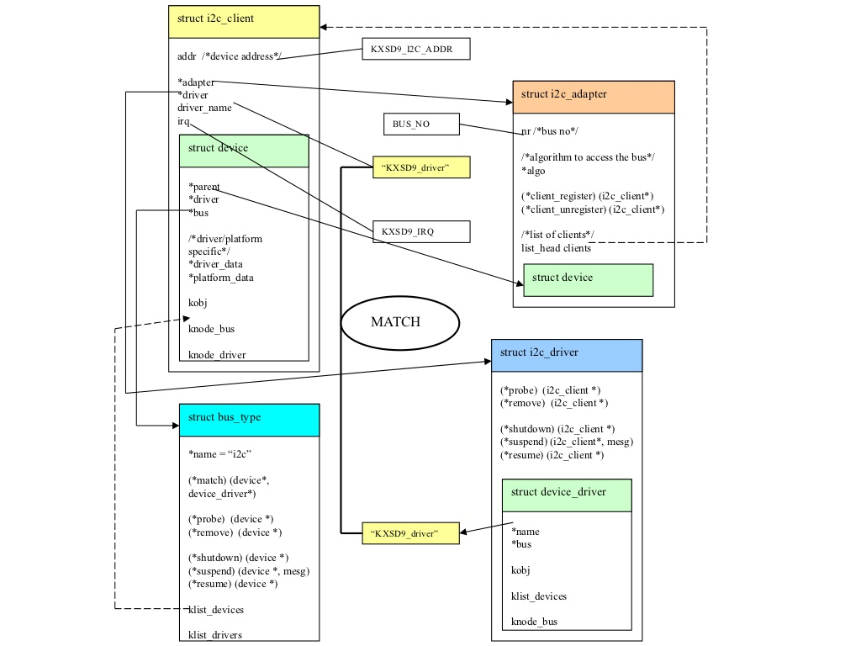
Structure call flow in I2c

Slide 13
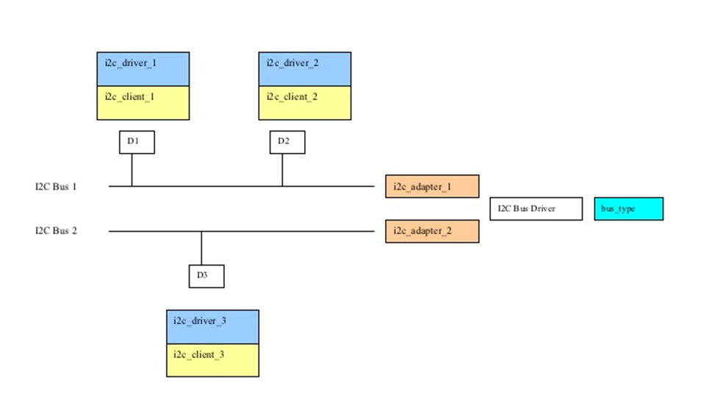
How they are internally connected?

Slide 14
How to write the I2C device driver in the Linux kernel
Get the adapter that is available using i2c_get_adapter()
Add the device using i2c_new_device()
Add the driver to the subsystem using i2c_add_driver()
Once you have done these steps, then just transfer the data using any transfer API.
Finally, unregister the device using i2c_unregister_device() and delete the driver from the subsystem using i2c_del_driver().

Slide 15
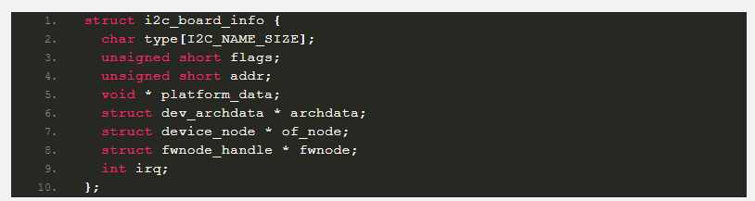
APIs used for writing a I2c driver
struct i2c_adapter *i2c_get_adapter(int nr):
-nr – I2C bus number. In our case (Raspberry Pi 4), it should be 1.
It returns the struct i2c_adapter.
Create Board info:
struct i2c_client * i2c_new_device ( struct i2c_adapter * adap, struct i2c_board_info const * info):
-adap – Adapter structure that we got from i2c_get_adapter()
-info – Board info structure that we have created
This will return the i2c_client structure. We can use this client for our future transfers.
i2c_add_driver(struct i2c_driver *i2c_drive):
-i2c_drive :The i2c_driver structure that we have created.
i2c_del_driver(struct i2c_driver *i2c_drive):Remove the driver

Slide 16
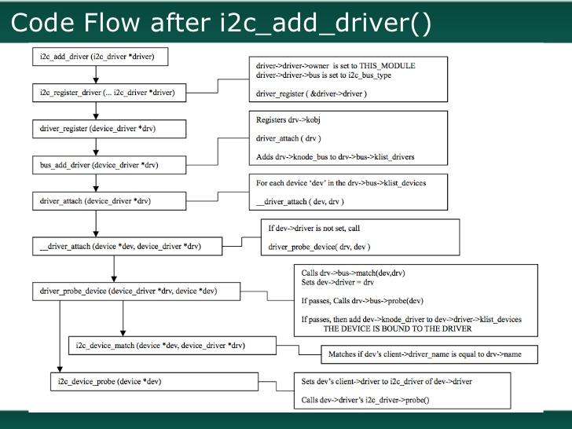

Slide 17
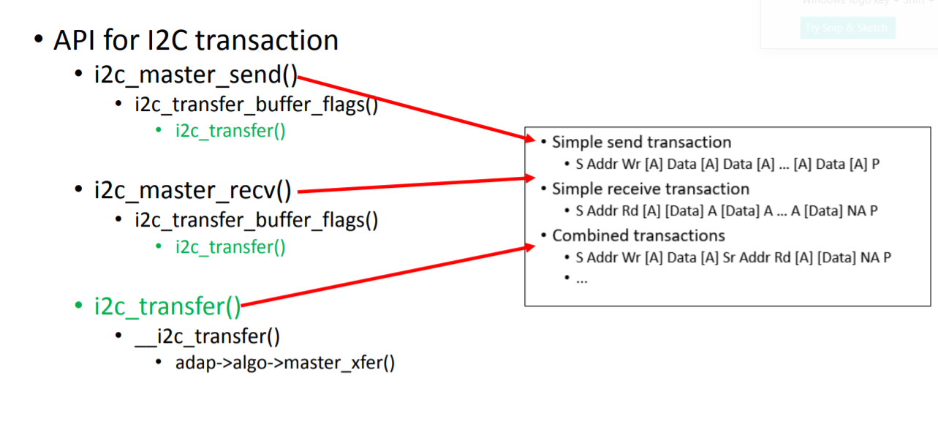
write & read calls
The most basic API to communicate with the I2C device provides functions to either send or receive data:

Slide 18
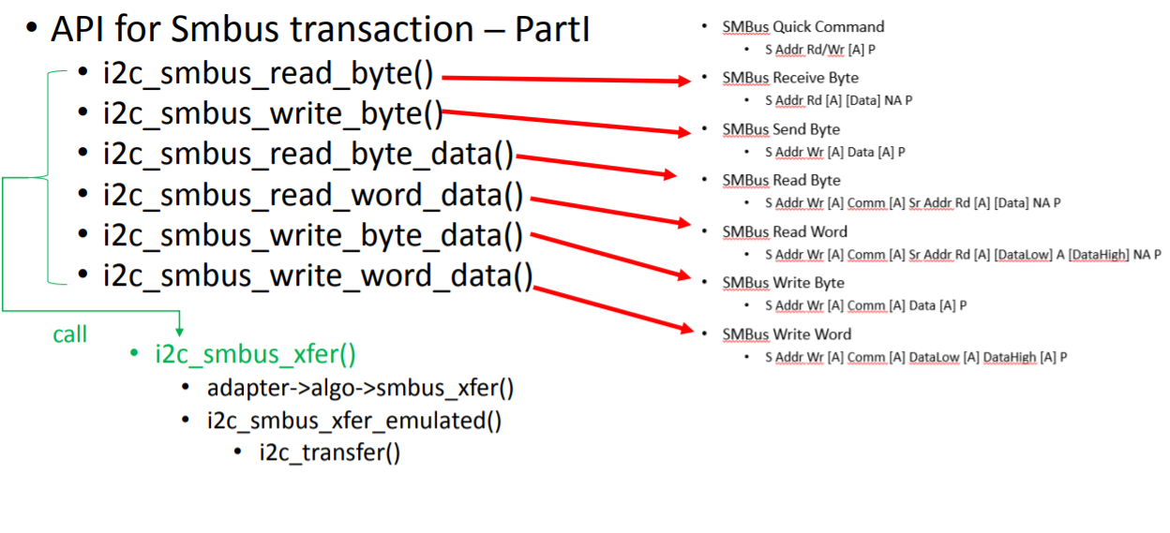
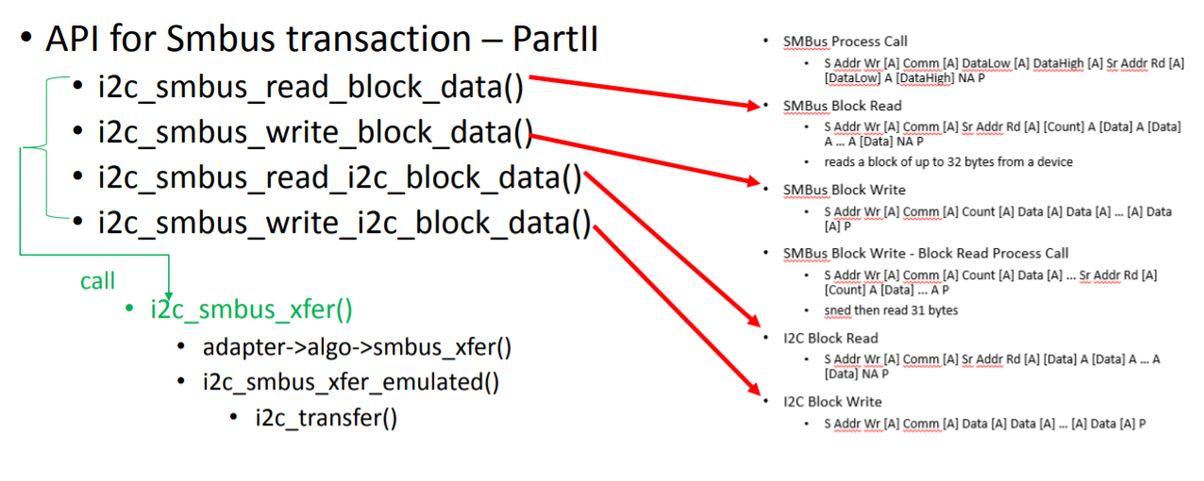

Slide 19
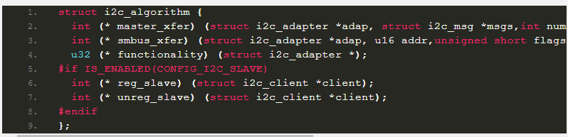
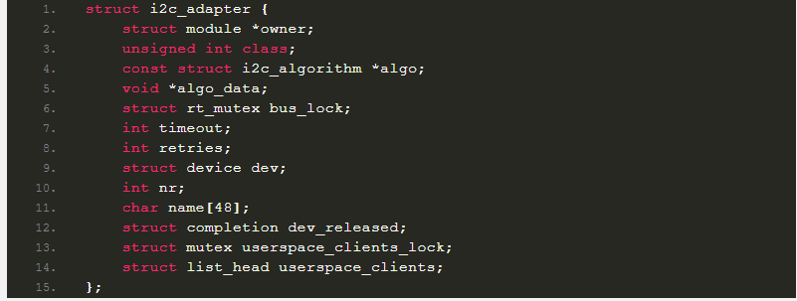
APIs and structure used for the I2C bus driver
There are two structures that you need to use in order to write the i2c bus driver in
the Linux kernel:
Algorithm Structure:
Adapter Structure:

Slide 20
Add the adapter to the subsystem:
int i2c_add_adapter (struct i2c_adapter * adapter): -adapter – the adapter to add It returns zero when a new bus number was allocated and stored in adap->nr, and the specified adapter became available for clients. Otherwise, a negative errno value is returned.
int i2c_add_numbered_adapter ( struct i2c_adapter * adap): This API is used to register the adapter to the subsystem. But it assigns the number that we asked for if only it is available. adap – the adapter to register (with adap->nr initialized)
This returns zero when the specified adapter is available for clients using the bus number provided in adap->nr. Otherwise, a negative err no value is returned.
Delete the adapter from the subsystem
void i2c_del_adapter ( struct i2c_adapter * adap):This API is used to unregister the adapter from the subsystem.
-adap – the adapter being unregistered

Slide 21
Thank you!!!!!!!

