Slide 1
Raspberry pi
GPIO, short for General Purpose Input Output
It allows these devices to control external components like motors & infrared transmitters (output), as well as to receive data from sensor modules and switches (input).
If you’re using the Raspberry Pi B+, 2 , 3, Zero or the latest Raspberry Pi 4 Model B, you’ll find a total of 40 GPIO pins on your RPi’s GPIO header. Older iterations of the RPI, such as the Raspberry Pi Model B, will only contain a total of 26pins.

Slide 2
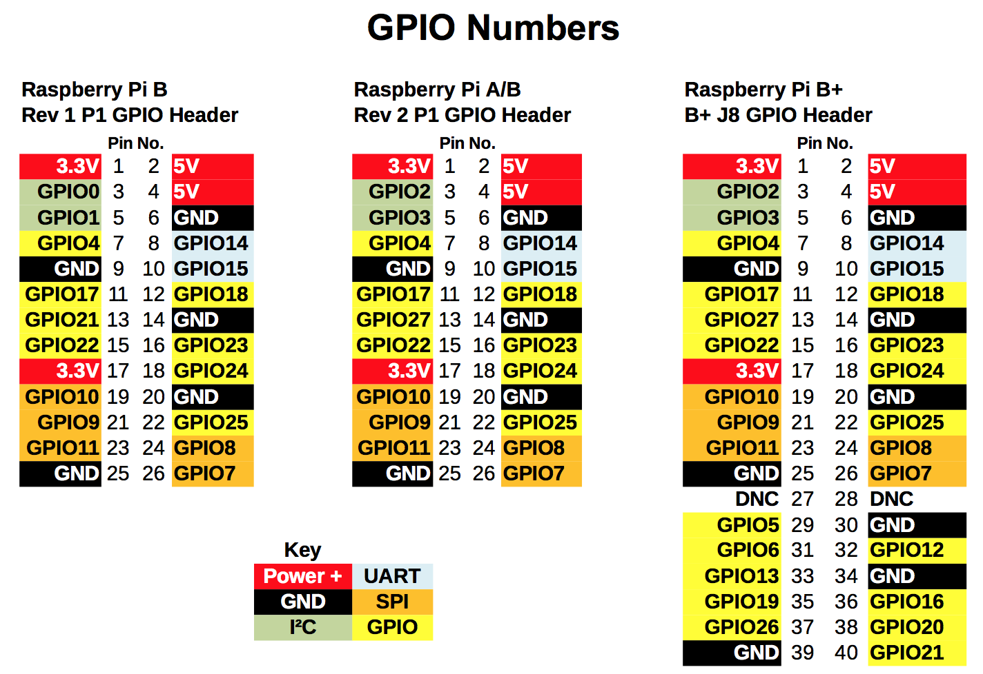

Slide 3
Each of the pins on the 40 Pin header have a designated purpose.
The different types are described in the table below.
GPIO Pin Type | Pin Functionality and Explanation
GPIO | GPIO pins are standard general-purpose pins that can be used for turning external devices, such as an LED, on or off.
Power | 5V and 3V3 pins are used to supply 5V and 3.3V power to external components.
I2C | I2C pins are used for connecting and hardware communication purposes with I2C compatible external modules.
SPI | SPI (Serial Peripheral Interface Bus) pins are also used for hardware communication, but with a different protocol.
UART | UART (Universal Asynchronous Receiver / Transmitter) pins are used for serial communication.
DNC | Use of DNC (Do Not Connect) pins should be avoided.
GND | GND (Ground) pins refer to pins that provide electrical grounding in your circuits.

Slide 4
How to Configure Raspberry Pi GPIO, I2C, and SPI Pins
Now that we know more about the Raspberry Pi’s GPIO, it’s time to get started with physical computing! Similar to other electrical components, we first have to configure the GPIO pins before using them. The configuration guide below will be run on Raspberry Pi OS
.
Configuring GPIO
If you’re running the latest version of Raspberry Pi OS, you can skip these steps and get straight into programming with GPIO!
Otherwise, you’ll have to run the following commands in the serial terminal to update your RPI:
sudo apt-get update
sudo apt-get upgrade
If for any reason you don’t have the GPIO package installed, you can run the following command for installation:
sudo apt-get install rpi.gpio

Slide 5
Configuring Raspberry Pi I2C / SPI Pins
To enable I2C or SPI for hardware communication, we’ll use the Raspi-Config tool by entering the following command:
sudo raspi-config
In the menu that shows up, navigate to Advanced Options > I2C and select yes. For SPI, navigate to Advanced Options > SPI instead.
Once complete, reboot your RPi and your I2C pins will be enabled. To ensure that I2C communication is working properly with your RPi,
connect your modules and enter the command below:
lsmod | grep i2c_
For SPI, run the following command instead:
lsmod | grep spi_
In each case, the command line should then return a list indicating the modules that you’re running through the I2C / SPI pins.

Slide 6
RPi.GPIO
Raspberry-gpio-python ^{[2]} or RPi.GPIO, is a Python module to control the GPIO interface on the Raspberry Pi. It was developed by Ben Croston and released under an MIT free software license.
The project Wiki ^{[3]} has documentation including example programs. I'll cover some of the basics here.
The RPi.GPIO module is installed by default on recent versions of Raspbian Linux. To use the module from Python programs, first import it using:
import RPi.GPIO as GPIO
This way you can refer to all functions in the module using the shorter name "GPIO".
RPi.GPIO supports referring to GPIO pins using either the physical pin numbers on the GPIO connector or using the BCM channel names from the Broadcom SOC that the pins are connected to. For example, pin 24 is BCM channel GPIO8. To use physical board pin numbers, call:
GPIO.setmode(GPIO.BOARD)
and to use the BCM channel numbers, use:
GPIO.setmode(GPIO.BCM)
Either method will work. The BOARD number scheme has the advantage that the library is aware of the Raspberry Pi model it is running on and will work correctly even if the Broadcom SOC channel names change in the future.
To set up a channel as an input or an output, call either:
GPIO.setup(channel, GPIO.IN)
or
GPIO.setup(channel, GPIO.OUT)
Where channel is the channel number based on the numbering system you specified when you called setmode.
To read the value of an input channel, call:

Slide 7
GPIO.input(channel)
where channel is the channel number as used in setup. It will return a value of 0, GPIO.LOW, or False (all are equivalent) if it is low and 1, GPIO.HIGH, or True if it was at a high level.
To set the output state of a GPIO pin, call:
GPIO.output(channel, state)
where channel is the channel number and state is the desired output level: either 0, GPIO.LOW, or False for a low value or 1, GPIO.HIGH, or True for a high level.
When you are done with the library, it is good practice to free up any resources used and return all channels back to the safe default of being inputs. This is done by calling:
GPIO.cleanup()
Here is a very simple standalone example that toggles an output pin on and off for 200 milliseconds, ten times. It also reports the level on input pin 31. If you put the commands in a file and make it executable, you can directly run it as a program.
#!/usr/bin/python3
import RPi.GPIO as GPIO import time
led = 18 switch = 31
GPIO.setmode(GPIO.BOARD) GPIO.setup(led, GPIO.OUT) GPIO.setup(switch, GPIO.IN)
for i in range(10): GPIO.output(led, GPIO.HIGH) time.sleep(0.2) GPIO.output(led, GPIO.LOW) time.sleep(0.2) print('Switch status = ', GPIO.input(switch))
GPIO.cleanup()
If pin 18 is connected to an LED and pin 31 to a switch, as it is on my little GPIO learning board, we can see the LED flashing and the program will report the status of the switch.

Slide 8
http://wiringpi.com/reference/priority-interrupts-and-threads/

