Slide 1
ARM Instruction Set
By Khushal

Slide 2
Introduction
Different ARM architecture support different instructions.
Code write fro architecture ARMv4T should execute on an ARMv5TE processor but not vice versa possible.

Slide 3
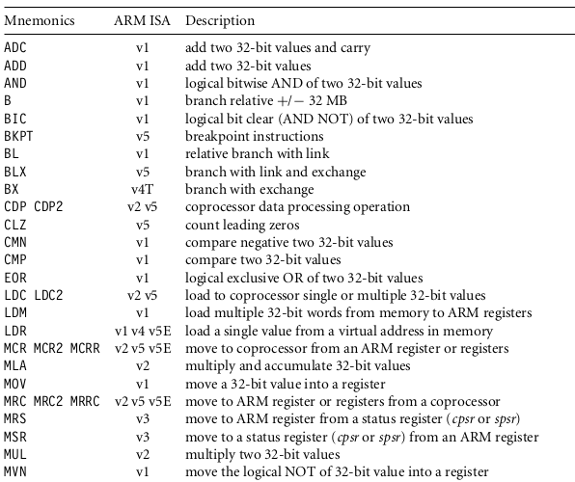
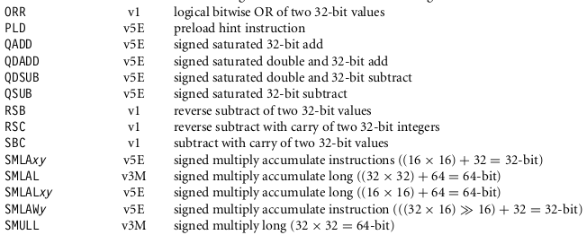
Instructions Set

Slide 4
Instructions Set

Slide 5
Addition
As ARM based on RISC arch, all arithmatic operations done through registers.
Load and store pattern use
Instruction Syntax | Destination Register | Source Register 1 | Source Register 2
ADD r3, r1, r2 | r3 | r1 | r2

Slide 6
Data Processing Instructions
Its manipulate data within registers.
There are move, arithmetic, logical, comparison and multiply instructions.
Instructions can process one of their operands using the barrel shifter.

Slide 7
Move Instructions
It copies N into a destination register Rd, where N is a register or immediate value.
Syntax: <instruction>{<cond>}{S} Rd, N
MOV | Move a 32-bit value into a register | Rd = N
MVN | Move the NOT of the 32-bit value into a register | Rd = ~ N

Slide 8
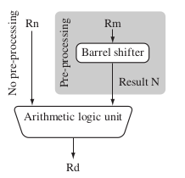
Barrel Shifter
ARM processor shift the 32-bit binary pattern in one of the source registers left or right by a specific number of positions before it enters the ALU.
This shift increases the power and flexibility of many data processing operations.

Slide 9
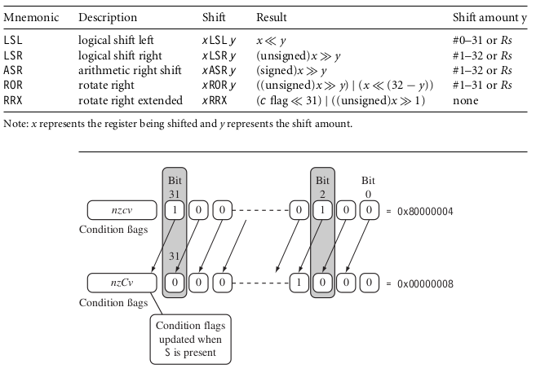
Barrel Shifter

Slide 10
Arithmetic Instructions
ADC | add two 32-bit values and carry | Rd = Rn + N + carry
ADD | add two 32-bit values | Rd = Rn + N
RSB | reverse subtract of two 32-bit values | Rd = N − Rn
RSC | reverse subtract with carry of two 32-bit values | Rd = N − Rn − !(carry flag)
SBC | subtract with carry of two 32-bit | values Rd = Rn − N − !(carry flag)
SUB | subtract two 32-bit values | Rd = Rn − N

Slide 11
Logical Instructions
AND | logical bitwise AND of two 32-bit values | Rd = Rn & N
ORR | logical bitwise OR of two 32-bit values | Rd = Rn | N
EOR | logical exclusive OR of two 32-bit values | Rd = Rn ∧ N
BIC | logical bit clear (AND NOT) | Rd = Rn & ∼N

Slide 12
Comparison Instructions
CMN | compare negated | flags set as a result of Rn + N
CMP | compare | flags set as a result of Rn − N
TEQ | test for equality of two 32-bit values | flags set as a result of Rn ∧ N
TST | test bits of a 32-bit value | flags set as a result of Rn & N

Slide 13
Branch Instructions
B | branch | pc = label
BL | branch with link | pc = label lr = address of the next instruction after the BL
BX | branch exchange | pc = Rm & 0xfffffffe, T = Rm & 1
BLX | branch exchange with link | pc = label, T = 1 pc = Rm & 0xfffffffe, T = Rm & 1 lr = address of the next instruction after the BLX
The address label is stored in the instruction as a signed pc-relative offset and
must be within approximately 32 MB of the branch instruction. T refers to the
Thumb bit in the cpsr.

Slide 14
Load-Store Instructions
Load-store instructions transfer data between memory
and processor registers.There are three types of
load-store instructions:
1. single-register transfer,
2. multiple-register transfer,
3. swap.

Slide 15
Single-register Transfer
LDR | load word into a register | Rd <- mem32[address]
STR | save byte or word from a register | Rd -> mem32[address]
LDRB | load byte into a register | Rd <- mem8[address]
STRB | save byte from a register | Rd -> mem8[address]

Slide 16
Program Status Register Instructions
The ARM instruction set provides two instructions to directly control a program status register (psr).
The MRS instruction transfers the contents of either the cpsr or spsr into a register.
The MSR instruction transfers the contents of a register into the cpsr or spsr.

Slide 17
Coprocessor Instructions
Coprocessor instructions are used to extend the instruction set.
A coprocessor can either provide additional computation capability or be used to control the memory subsystem including caches and memory management.

Slide 18

Loading Constants
There is no ARM instruction to move a 32-bit constant into a register.
ARM instructions are 32 bits in size, they obviously cannot specify a general 32-bit constant.

Slide 19
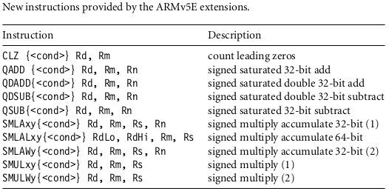
ARMv5E Extensions

Slide 20
Thanks...

