Slide 1
Efficient C Programming
By Khushal

Slide 2
Introduction
Write C code in a style that will compile efficiently on the ARM architecture.
C Compilers and Optimization:
Optimizing code takes time and reduces source code readability.
C compilers have to translate C function literally into assembler so that it works for all possible inputs.

Slide 3
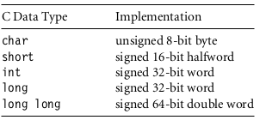
Basic C Data Types
Write C code in a style that will compile efficiently on the ARM architecture.
Most ARM data processing operations are 32-bit only. Hence should use a 32-bit datatype, int or long, for local variables wherever possible.

Slide 4
Function Argument Types
Can be use char or short to type int increases performance and reduces code size.
short add_v1(short a, short b)
{
return a + (b >> 1);
}

Slide 5
C Looping Structures
While and for loop can be use in ARM.
int checksum_v6(int *data){
unsigned int i;
int sum=0;
for (i=64; i!=0; i--)
sum += *(data++);
return sum;
}

Slide 6
Register Allocation
The compiler attempts to allocate a processor register to each local variable use in a C function.
It will try to use the same register for different local variables if the use of the variables do not overlap.

Slide 7
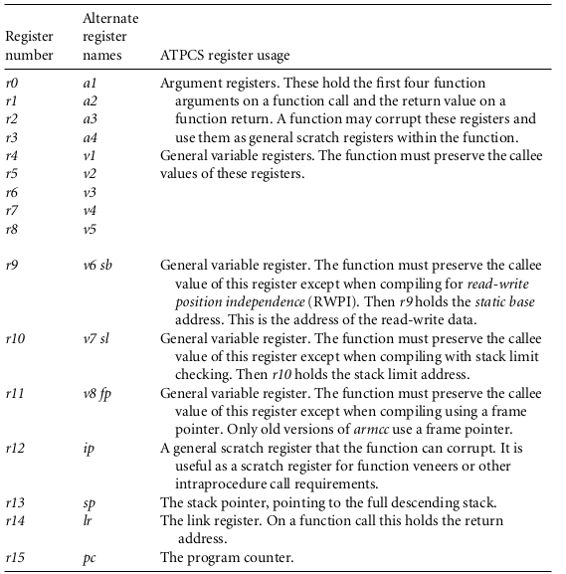

Slide 8
Pointer Aliasing
Two pointers are said to alias when they point to the same address.
If write to one pointer, it will affect the value you read from the other pointer.
void timers_v1(int *timer1, int *timer2, int *step)
{
*timer1 += *step;
*timer2 += *step;
}

Slide 9
Bit-fields
The compiler can choose how bits are allocated within the bit-field container.
typedef struct{
unsigned int stageA : 1;
unsigned int stageB : 1;
unsigned int stageC : 1;
} Stages_v1;

Slide 10
Floating Point
The majority of ARM processor do not support floating-point, which saves on power and area when using ARM in a price-sensitive, embedded application.
If you need fast execution and fractional values, you should use fixed-point or block-floating algorithms.
Fractional values are most often used when processing digital signals such as audio and video.

Slide 11
Inline Functions
It can remove the function call overhead completely by inlining functions.
Additionally many compilers allow you to include inline assembly in your C source code.
__inline int add(int a, int b)
{
return (a+b);
}

Slide 12
Portability Issues
The char type. On the ARM, char is unsigned rather than signed as for many other processors.
A common problem concerns loops that use a char loop counter i and the continuation condition i ≥ 0, they become infinite loops.
Use of bit-fields. The layout of bits within a bit-field is implementation and endian dependent. If C code assumes that bits are laid out in a certain order, then the code is not portable.

Slide 13
Portability Issues
Inline assembly. Using inline assembly in C code reduces portability between architectures.
The gcc compiler will always allocate four bytes to an enum type. The armcc compiler will only allocate one byte if the enum takes only eight-bit values.

Slide 14
Thanks

