Slide 1
I2c
Inter Integrated Circuit

Slide 2
Half duplex, Serial communication Protocol.
Two wire communication protocol.
Multi-master Multi slave.
Widely used for short-distance, intra-board communication.

Slide 3
I2c Introduction
I2C is a serial protocol for a two-wire interface to connect low-speed devices like microcontrollers, EEPROMs, A/D and D/A converters, I/O interfaces, and other similar peripherals in embedded systems
I2C uses only two wires:
SCL (serial clock)
SDA (serial data)
Master is the device that generates clock, starts communication, sends I2C commands, and stops communication
Slave is the device that listens to the bus and is addressed by the master
bus speed
100KHz/ 400KHz/ 1MHz/ 3.4MHz/ 5MHz

Slide 4
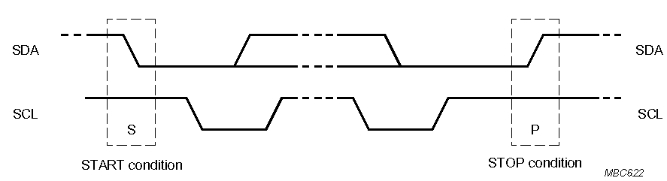
Start and Stop Condition
A transition of the data line while the clock line is high is defined as either a start or a stop condition.
Both start and stop conditions are generated by the bus master
The bus is considered busy after a start condition, until a stop condition occurs
SDA
SDA
SCL
SCL
Start Condition
Stop Condition

Slide 5
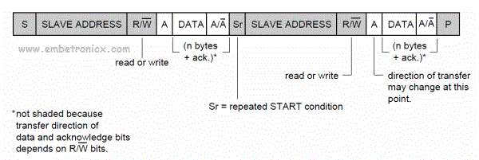
Repeated Start (R) Condition
A Start signal generated without first generating a Stop condition to terminate the communication
Used by the master to communicate with another slave or change data transfer direction without releasing the bus-
Also referred to as Restart condition

Slide 6
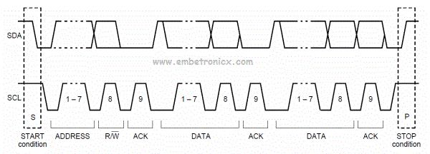
Data Transfer
Represents the transfer of eight bits of information
Data on the SDA line is considered valid only when the SCL signal is high.
When the SCL signal is low, data is allowed to change.
The eight-bit data may be a control code, an address, or data.

Slide 7
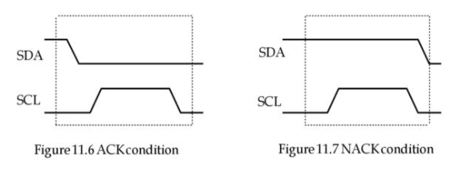
Acknowledge (ACK) Condition
Data transfer needs to be acknowledged either positively (A) or negatively (NACK).
A device acknowledges a byte it received positively by bringing the SDA line low during the ninth clock pulse of SCL.
If the device allows the SDA line to float high, it is transmitting a negative acknowledge (NACK).

Slide 8
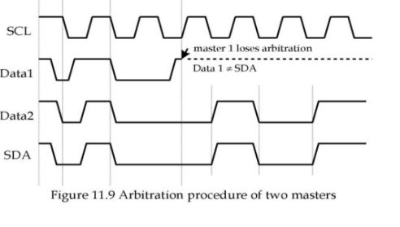
Arbitration
In the event two or more master devices attempt to begin a transfer at the same time ,an arbitration scheme is employed to force one or more masters to give up the bus.
The master devices continue to transmit data until one master attempt to send a high while the other transmits a low.
Since the SDA bus has open drain, the master device that attempts to send a high will detect a low.
At this point, it will stop driving the bus.The arbitration process does not slow down the winning master’s transfer and no data gets lost.

Slide 9
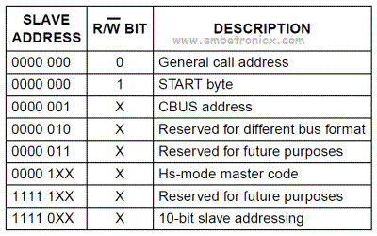
I²C Addressing
I2C protocol allows master devices to use either the 7-bit and 10-bit address to specify the slave device for data communication.
Each slave device on the bus should have a unique 7-bit address.
7 bits for I2C addresses allow only 128 different addresses where only 112 can actually be used
10-bit addressing supports up to 1024 I2C addresses

Slide 10
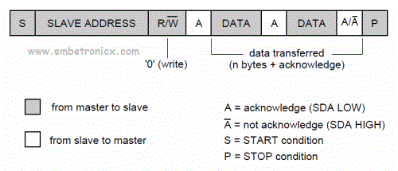

7 bit addressing:
10 bit addressing:

Slide 11
Thank you!!!!!!!

