Slide 1
Interrupt Handling Schemes

Slide 2
Types of schemes
Nonnested interrupt handler
Nested interrupt handler
Prioritized simple interrupt handler
Reentrant interrupt handler
Prioritized standard interrupt handler
Prioritized direct interrupt handler
Prioritized grouped interrupt

Slide 3
FIQ
IRQ1
IRQ2
IRQ
IRQ3
Interrupt
Controller
Processor
IRQ4

Slide 4
Nonnested interrupt handler
The interrupts are disabled until control is returned back to the interrupted task or process.
Handles and service individual interrupts sequentially.
Interrupts get re-enable only on returning from the handler.
Not use for complex embedded system.

Slide 5
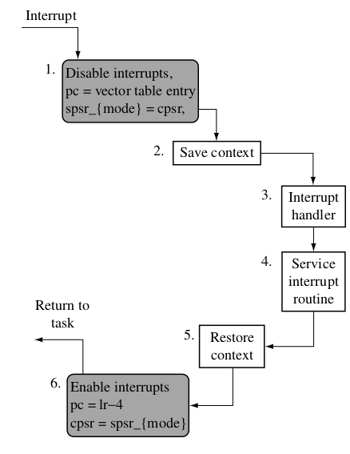
Nonnested interrupt handler
Interrupt working flow:

Slide 6
Nonnested Interrupt Handler
Summary:
Handles and services individual interrupts sequentially.
High interrupt latency; Cannot handle further interrupts occurring while an interrupt is being serviced.
Advantages: Relatively easy to implement and debug.
Disadvantage: Cannot be used to handle complex embedded systems with multiple priority interrupts.

Slide 7
Nested Interrupt Handler
It allows more than one interrupt to occur within currently called handler.
Latancy is improved.
More complex system with improved performance.
No prioritization of interrupts.
Normal interrupts can block more critical interrupts.
Need careful implementation to avoid system failure.

Slide 8
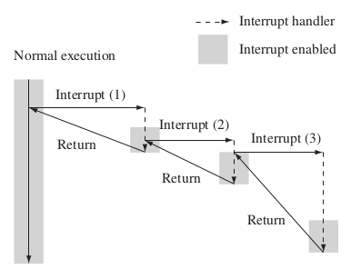
Nested Interrupt Handler

Slide 9
Nested Interrupt Handler
Interrupts will get enable

Slide 10
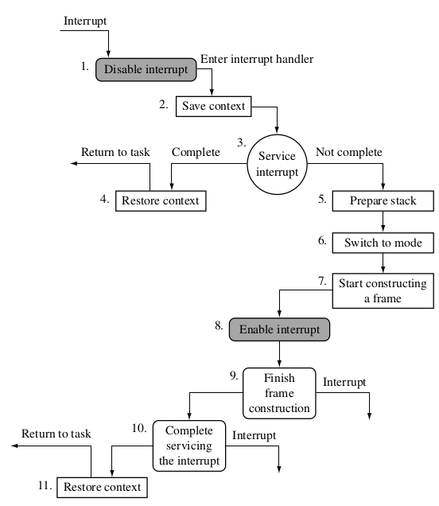

Slide 11
Nested Interrupt Handler
Summery:
Handles multiple interrupts without a priority assignment.
Medium to high interrupt latency.
Advantage- Can enable interrupts before the servicing of an individual interrupt is complete reducing interrupt latency.
Disadvantage- Does not handle prioritization of interrupts, so lower priority interrupts can block higher priority interrupts.

Slide 12
Prioritized simple interrupt handler
Interrupts from various sources are prioritized based on their criticality by the system designer.
The priority level is used to dicate the order that the interrupt will be serviced.
Thus a higher priority interrupts will take precedence over a lower priority interrupt.
Prioritization can be done either by hardware or by software.
It need more installation code at bootup.
Interrupt latancy is highly deterministic.

Slide 13
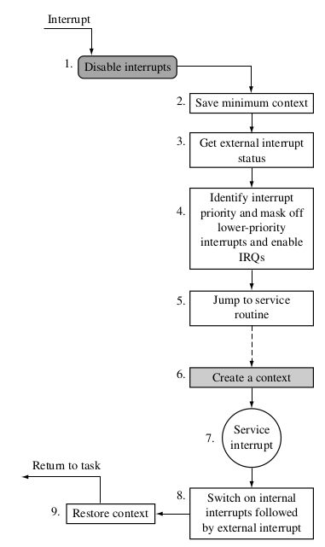

Slide 14
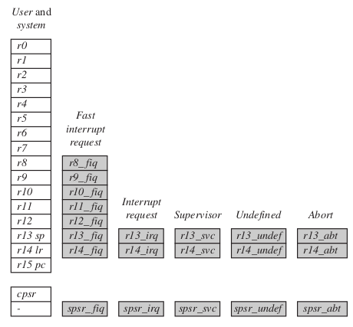
Fig. ARM register set

Slide 15
Prioritized simple interrupt handler
Summary:
Handles prioritized interrupts.
Advantage: Deterministic interrupt latency since the priority level is identified first and then the service is called after the lower-priority interrupts are masked.
Disadvantage: the time taken to get to a low-priority service routine is the same as for a high-priority routine.

Slide 16
Reentrant Interrupt Handler
Handling multiple interrupts where interrupts
are filtered by priority.
Interrupts with higher priority have a lower latency.
The interrupts are reenabled early, leads to reduce interrupt latancy.
Interrupts can’t reenabled in an interrupt mode.
Interrupt source is not disabled, an interrupt will be immediately regenerated, leading to an infinite interrupt sequence.

Slide 17
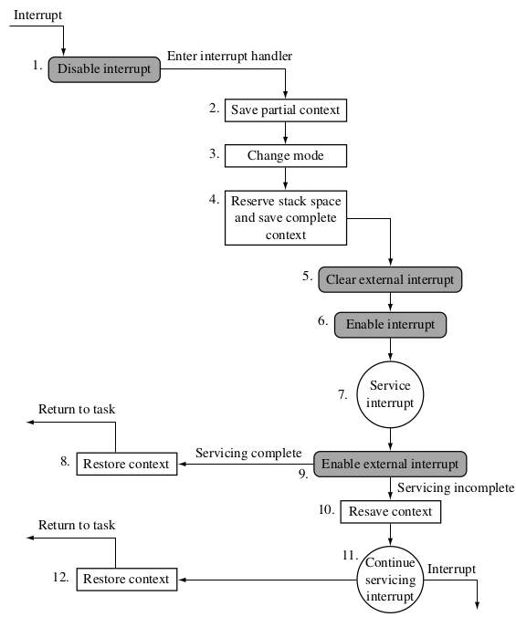

Slide 18
Reentrant Interrupt Handler
Summary:
Handling multiple interrupts where interrupts
are filtered by priority
Low interrupt latency.
Advantage: Handles interrupts with differing priorities.
Disadvantage: Tends to be more complex.

Slide 19
Prioritized Standard Interrupt Handler
Low interrput latency.
It basicaly uses software Interrput handler.
Handler tested all the interrupts to establish the highest priority.
Alternative approch: Jump early when highest priority interrupt has been identified to a routine thats also handles masking of low priority interrupts.
Handles high priority interrupt in shorter time compare to low priority interrupt.

Slide 20
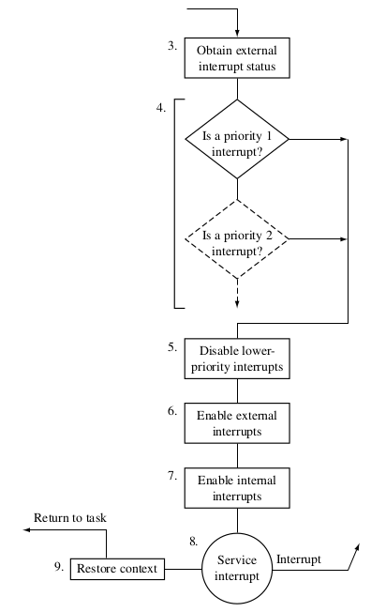
Dissable Interrupt and Save Context
1. 2.

Slide 21
Prioritized Standard Interrupt Handler
Summary:
Handles higher-priority interrupts in a shorter time than lower-priority interrupts.
Low interrupt latency.
Advantage: Higher-priority interrupts treated with greater urgency with no duplicatio of code to set external interrupt masks.
Disadvantage: There is a time penalty since this handler requires two jumps, resulting in the pipeline being flushed each time a jump occurs.

Slide 22
Prioritized Direct Interrupt Handler
Its mostly similar to Prioritized Standard Interrupt Handler.
Two difference as compare to Prioritized Standard Interrupt Handler.
Each ISR have same starting code i.e. duplication.
Working faster for high priority interrupt.
It use only one jump sequence.

Slide 23
Prioritized Direct Interrupt Handler
Summary:
Handles higher-priority interrupts in a shorter time. Goes directly to the specific ISR.
Low interrupt latency.
Advantage: Uses a single jump and saves valuable cycles to go to the ISR.
Disadvantage: Each ISR has a mechanism to set the external interrupt mask to stop lower-priority interrupts from halting the current ISR, which adds extra code to each ISR.

Slide 24
Prioritized Grouped Interrupt Handler
Its mostly similar to Prioritized Interrupt Handler.
One difference as compare to Prioritized Interrupt Handler.
Grouping of devices interrupt is proceed here.
Reduce complexity.
Grouping interrupts and give subset to it must be done carefully.

Slide 25
Prioritized Grouped Interrupt Handler
Summary:
Mechanism for handling interrupts that are grouped into different priority levels.
Low interrupt latency.
Advantage: Useful when the embedded system has to handle a large number of interrupts, and also reduces the response time since the determining of the priority level is shorter.
Disadvantage: Determining how the interrupts are grouped together.

Slide 26
Thanks

