Slide 1
Kernel timers
Time(jiffies&hz)
Delaying functions

Slide 2
During driver developement you might have a need to schedule an action to happen later,without blocking the current process
Kernel timers are run as the result of a software interrupt
Inorder to use the kernel timer ,you have to define a variable of struct timer_list type.
In the struct time_list the driver has to initialize three memberes expires,function and data

Slide 3
Header file :
#include <linux/timer.h>
#include <linux/jiffies.h>
Structure:
struct timer_list {
unsigned long expires;
void (*function)(unsigned long);
unsigned long data;
};

Slide 4
Kernel keep track of time via timer interrupts.
Generated by the timing hardware
Programmed at boot time according to HZ (default value is 1024)
At time the timer interrupt was configure as 1024 interrupts per second.
We have provision to modify HZ value
Every time a timer interrupt occur, kernel counter called jiffies will increment .
Init to zero at boot time .
This timer interrupts are generated at regular timer intervals by using system’s timing hardware.
Every time a timer interrupt occurs, the value of an internal kernel counter is incremented.
The counter is initialized to 0 at system boot, so it represents the number of clock ticks since last boot.
jiffies ==> On kernel boot-up, jiffies is initialized to a special initial value, and it is incremented by one for each timer interrupt.
Scheduler will use jiffies time to schedule process and cpu time .
jiffies = no. of ticks
seconds to unit jiffies: seconds * HZ
jiffies to seconds:jiffies / HZ
unsigned long now_tick = jiffies ; // now
unsigned long next_tick = jiffies + 1 ; // one tick from now
unsigned long timer_later = jiffies + (10*HZ) ; // 10s from now
unsigned long time_fraction = jiffies + (HZ/10) ; // 0.1s from now

Slide 5
You can use the following macros for comparing the jiffies values
#include<linux/jiffies.h>
int time_after(unsigned long a,unsigned long b);
  int time_before(unsigned long a, unsigned long b);
  int time_after_eq(unsigned long a,unsigned long b);
  int time_before_eq(unsigned long a, unsigned long b);
  unsigned int jiffies_to_msecs(cosnt unsigned long j);
  unsigned int msecs_to_jiffies(const unsigned long j);

Slide 6
Uses of kernel timers
1.Polling a device by checking its state at regular intervals when the hardware can’t fire interrupts.
2.The user wants to send some messages to another device at regular intervals.
3.Send error when some action didn’t happen in a particular time period.

Slide 7
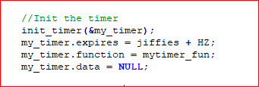
init_timer
To initialize the timer, then you need to set the callback function and data of the timer_list structure manually.
void fastcall init_timer ( struct timer_list * timer);

Slide 8
OR
setup_timer
Instead of initializing timer manually by calling init_timer, you can use this function to set data and function of timer_list structure and initialize the timer
void timer_setup (timer, function, data);
Example:
/* setup your timer to call my_timer_callback */
timer_setup (&my_timer, mytimer_fun, 0);
//Timer Callback function. This will be called when timer expires
void mytimer_fun (unsigned long data){
}
OR
DEFINE_TIMER
DEFINE_TIMER(_name, _function, _expires, _data)
If we are using this method, then no need to create the timer_list structure on our side. The kernel will create the structure in the name of _name and initialize it.
_name – name of the timer_list structure to be created
_function – Callback function to be called when the timer expires
_expires – the expiration time of the timer (in jiffies)
_data – data has to be given to the callback function

Slide 9
Start a Kernel Timer
add_timer
This will start a timer.
void add_timer(struct timer_list *timer);
Modifying Kernel Timer’s timeout
mod_timer
int mod_timer (struct timer_list * timer, unsigned long expires);
This function is used to modify a timer’s timeout. This is a more efficient way to update the expire field of an active timer (if the timer is inactive it will be activated).
mod_timer(timer, expires) is equivalent to:
del_timer(timer); timer->expires = expires; add_timer(timer);

Slide 10
Stop a Kernel Timer
del_timer
int del_timer (struct timer_list * timer);
This will deactivate a timer. This works on both active and inactive timers.
Argument:
timer – the timer needs to be deactivated
Return:
The function returns whether it has deactivated a pending timer or not.
0 – del_timer of an inactive timer
1 – del_timer of an active timer

Slide 11
Delay Execution:
Long (multi-jiffy) delay(mill sec to sec )
Busy waiting (cpu_relax()
yielding the processor (schedule_timeout)
Timeout-(wait-events)
Busy waiting : Busy-waiting approach just involves executing a while loop which wastes CPU cycles since it is not a productive work.
If the critical section code is of few lines, then its better to do busy-waiting since CPU spends very less waiting
But if the critical section code consists of thousands of lines, its better to use sleep-and-wake approach.

Slide 12
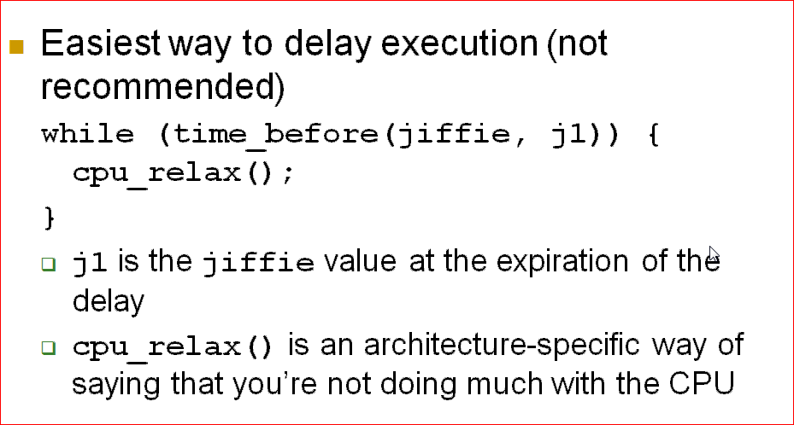

Slide 13
Yielding the Processor:
Explicitly release the cpu when not in using it
While(time_before(jiffIe,j1)){
Schedule();
}
Behaviour similar to busy waiting under a preemptive kernel
Still consumes cpu cycles and battery power
No guarantee that the process will get the cpu back soon .

Slide 14
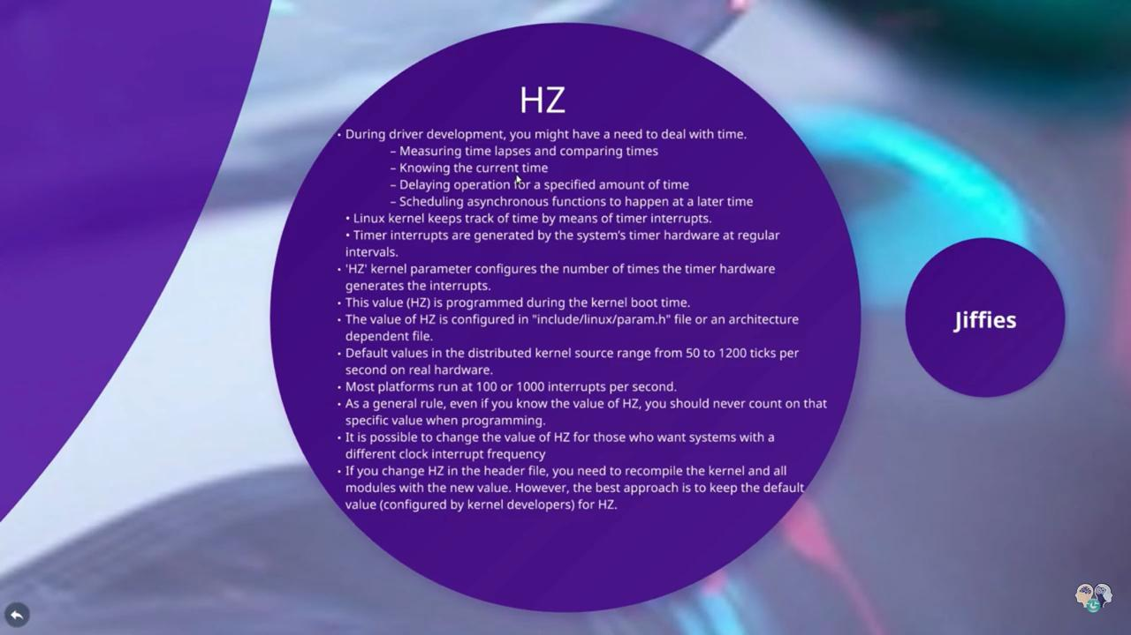

Slide 15
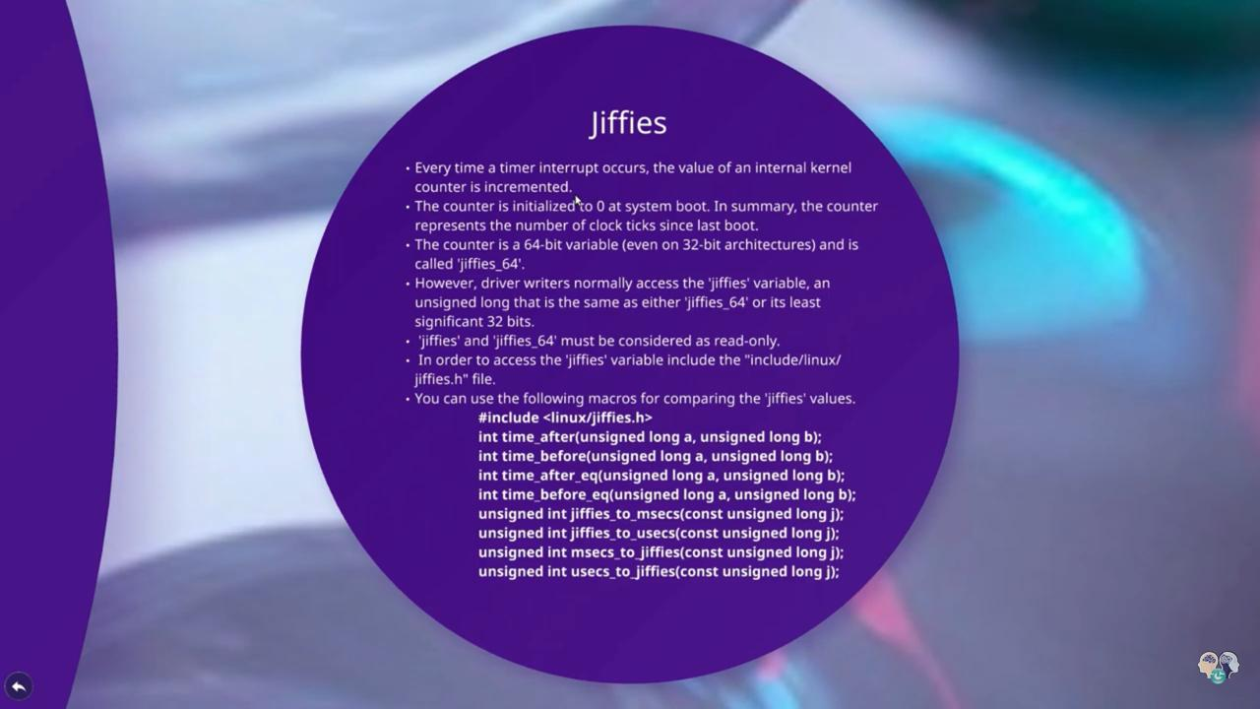

Slide 16
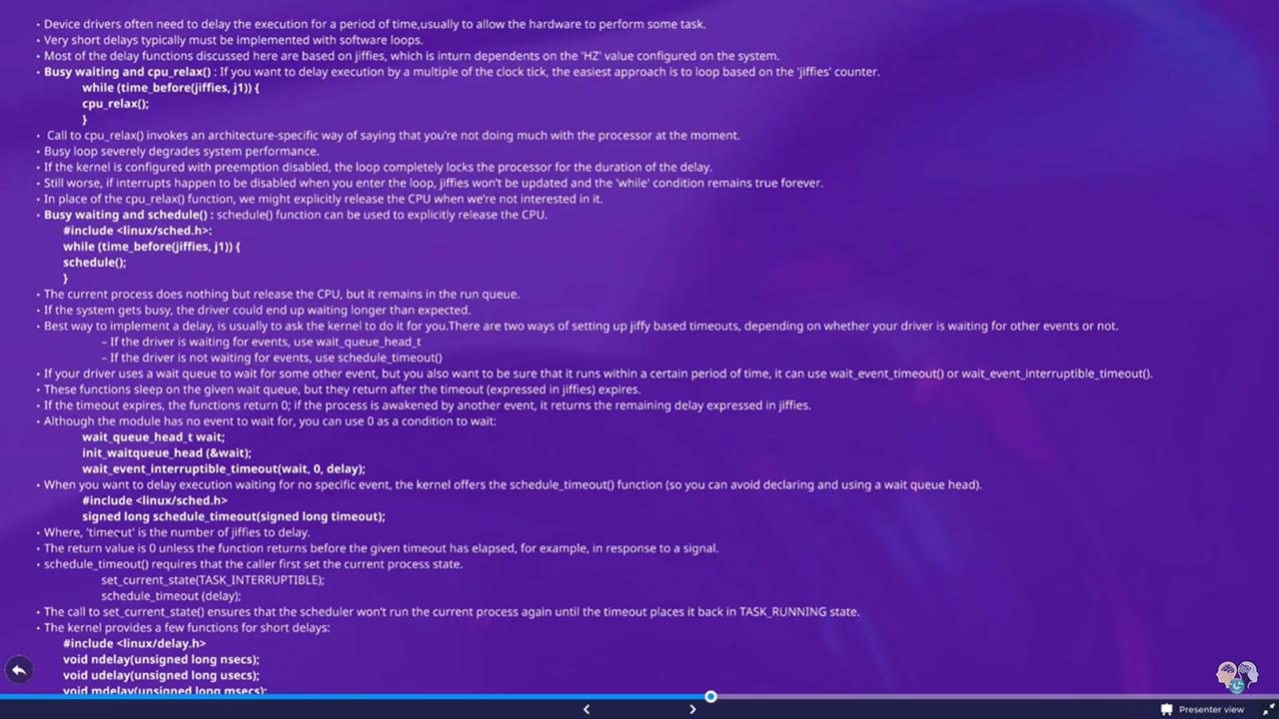

Slide 17
Thank you

